Slide 1
CHAT-APP
A MINIPROJECT FOR JAVA
By – Nitish Raj

Slide 2
ABOUT
THIS MINI PROJECT IS A PART OF APPLICATION DEVELOPMENT USING JAVA (18CS45) SUBMITTED TO THE DEPARTMENT OF COMPUTER SCIENCE.
AS THE NAME SUGGESTS MY APPLICATION FACILITATE A USER TO COMMUNICATE WITH ANOTHER USER VIA A NETWORK
ONE JUST NEEDS A PROFILE ON THIS CHAT APPLICATION TO CONVERSATE WITH OTHERS.

Slide 3
CONCEPTS USED
I HAVE USED THE CONCEPTS OF PROGRAMMING IN JAVA.
I HAVE ALSO USED SQL FOR THE DATABASE CREATION.
I HAVE USED BASIC PHP AND HTML AS WELL.

Slide 4
SOFTWARES USED AND PRE-REQUISITES
NETBEANS IDE
XAMPP
JAVA

Slide 5
GUI DESIGNS
MAIN WINDOW
SIGNUP WINDOW
CHAT WINDOW
WARNING DIALOGUE BOXES

Slide 6
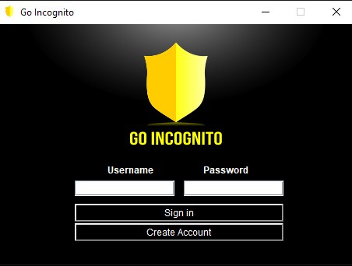
MAIN WINDOW
CONSISTS OF TEXTFIELD TO ENTER USERNAME AND PASSWORD.
CONTAINS BUTTONS FOR SIGN IN AND CREATING ACCOUNT.

Slide 7
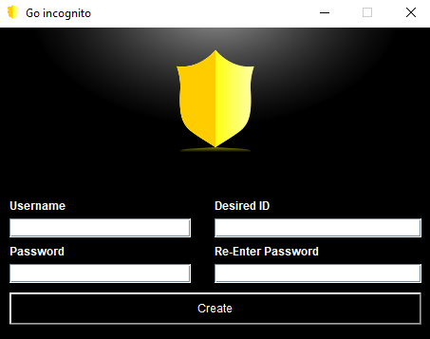
SIGNUP WINDOW
CONTAINS TEXTFIELDS TO ENTER NECESSARNY INFORMATION.
CONTAINS A BUTTON TO CREATE THE ACCOUNT.

Slide 8
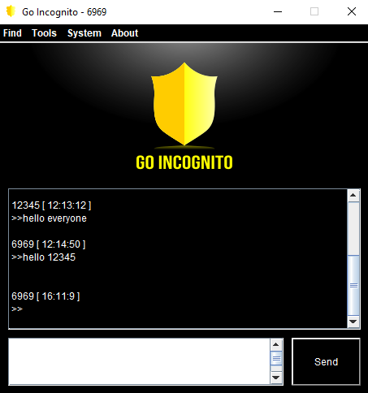
CHAT WINDOW
CONTAINS 4 DROP DOWN MENUS.
CONTAINS A TEXT FIELD TO DISPLAY THE MESSAGES.
CONTAINS ANOTHER TEXT FIELD TO WRITE THE INPUT MESSAGE.
CONTAINS A SEND BUTTON.

Slide 9
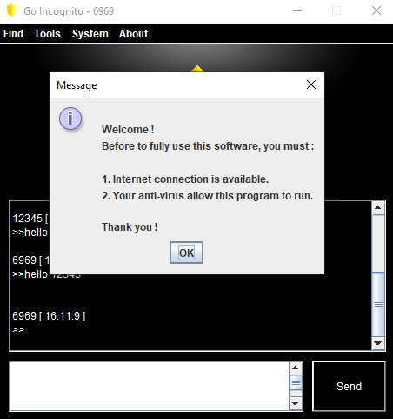
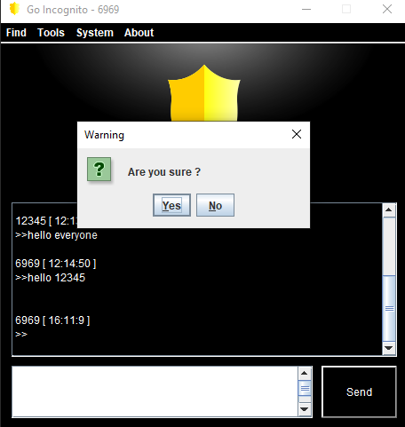
WARNING DIALOGUE BOXES
ALL THE WARNING BOXES CONTAINS A PRE WRITTEN MESSAGE OR A WARNING
ALSO CONTAIN ONE OR MORE BUTTONS ALLOWING THE USER TO PROCEED FURTHER.

Slide 10
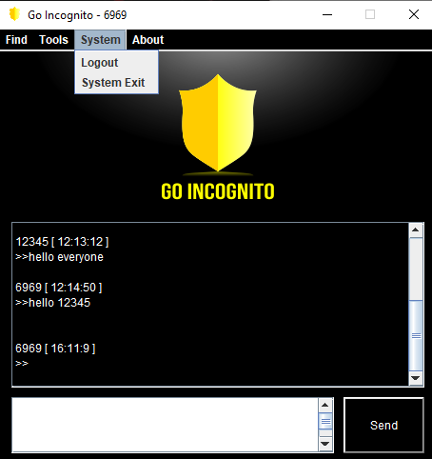
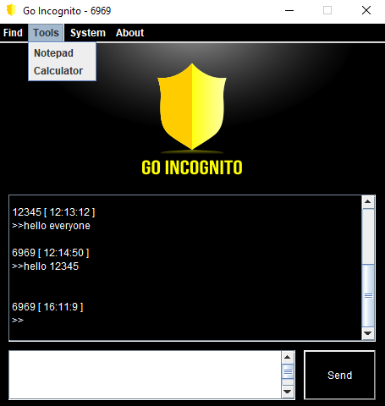
FUNCTIONALITY
SIGN-IN / SIGN-UP
CHAT SYSTEM
EXTRA TOOLS – NOTEPAD AND CALCULATOR
LOGOUT
EXIT WINDOW
ABOUT

Slide 11
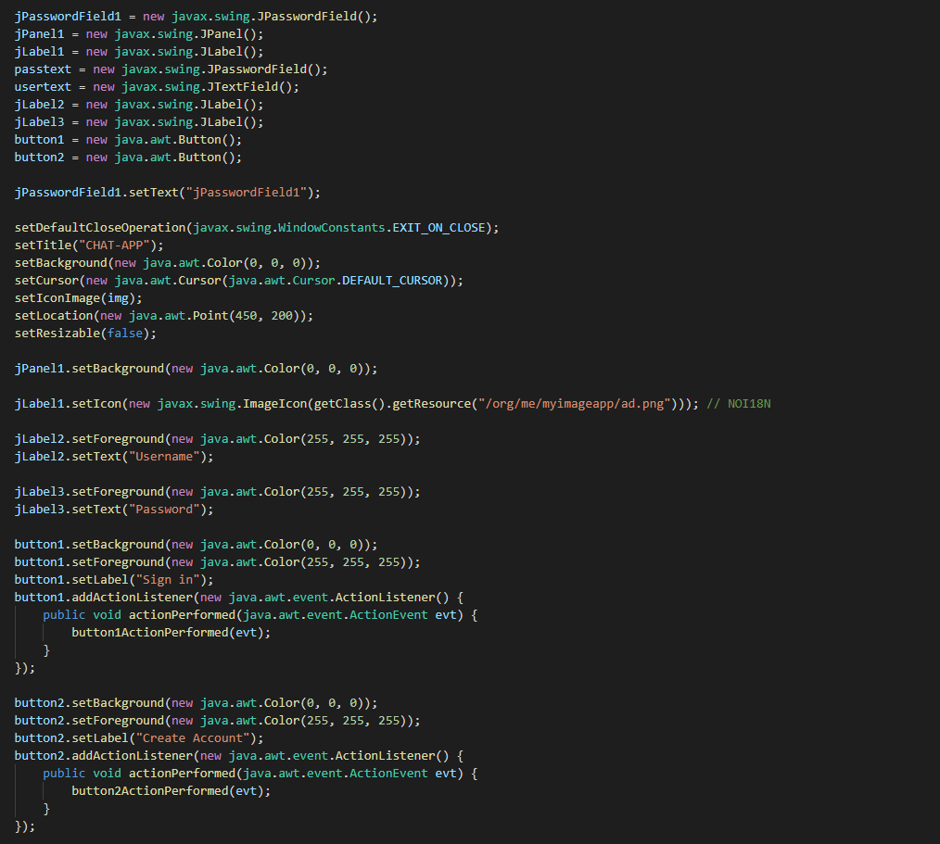
MAIN WINDOW CODE

Slide 12
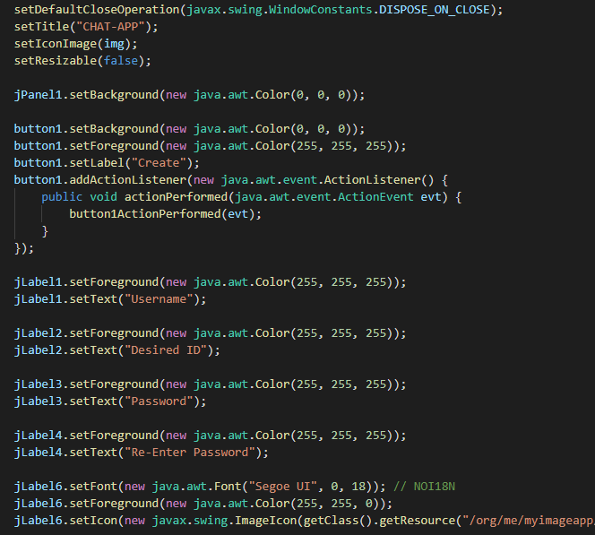
SIGNUP WINDOW CODE

Slide 13
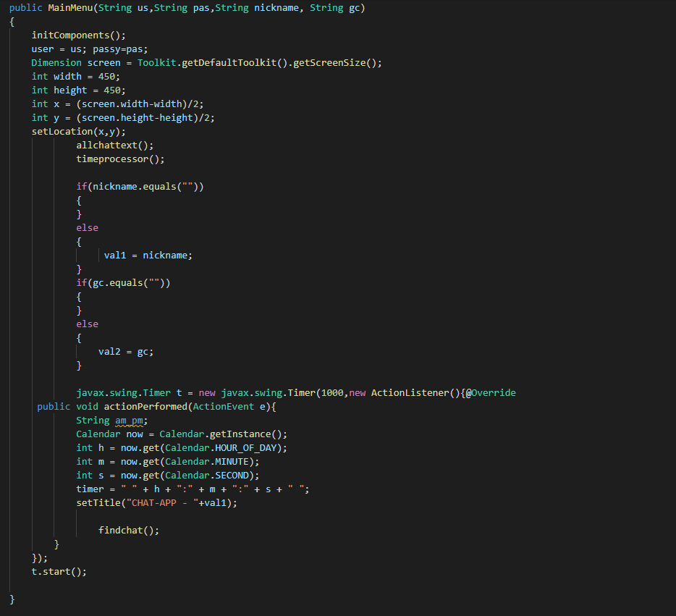
CHAT WINDOW CODE

Slide 14
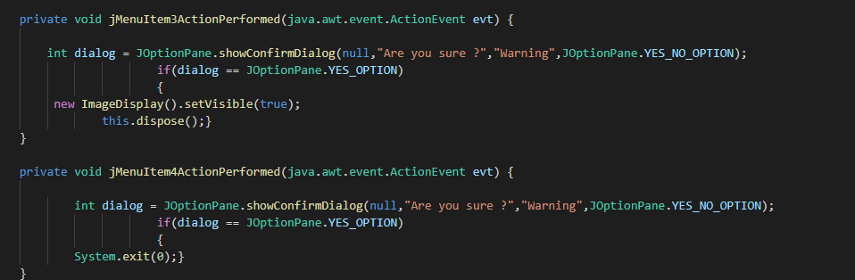
DIALOGUE BOX CODE

Slide 15
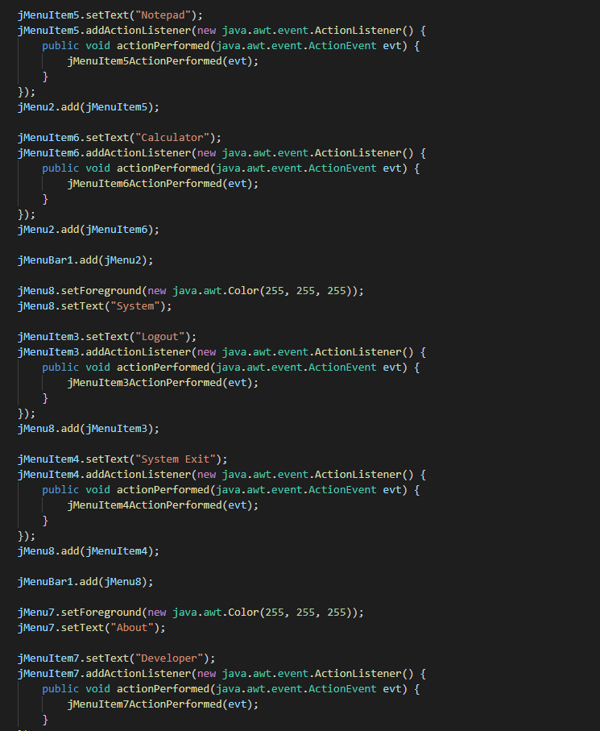
OTHER IMPORTANTCODE SEGMENT

Slide 16
REFERENCES
https://www.wikipedia.org/
https://www.geeksforgeeks.org/
Herbert Schildt, “Java – The Complete Reference” –, 9th Edition, 2014, Oracel Press.

Slide 17
THANK YOU

