Slide 1
Our Database
Tanner Coffman
Nick Purdom

Slide 2
Responsibilities
Tanner: ER Diagram, Database Schema, Home Page, Cart, Book Search, Book Reviews
Nick: Database entries, Database schema, User Profile, Admin Page

Slide 3
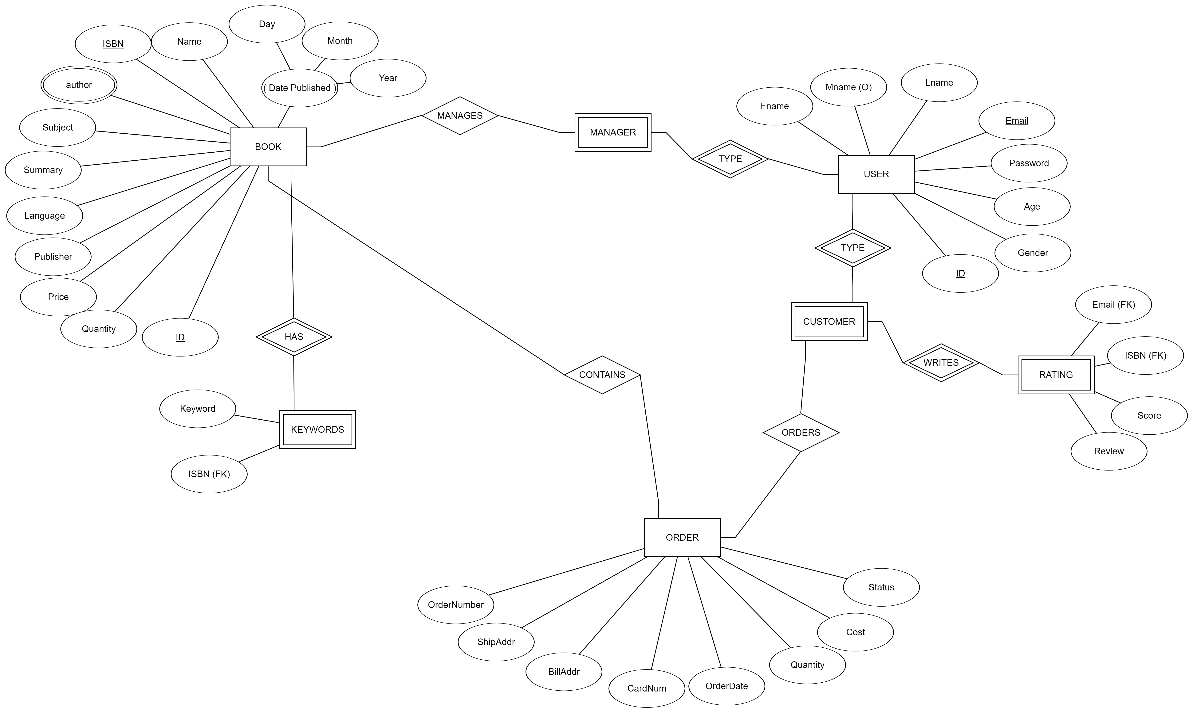

Slide 4
Database Schema
Orders
id | int(11) PK
shipaddr | varchar(40)
billaddr | varchar(40)
cardnum | int(16)
ordered | date
quantity | int(5)
cost | varchar(10)
status | varchar(20)
oisbm | int(11) FK
oid | int(11) FK
keywords
keyword | varchar(20)
bookid | int(11) FK
books
id | int(11) PK
name | varchar
ISBN | varchar
author | varchar
subject | varchar
summary | varchar
language | varchar
publisher | varchar
published | date
price | decimal(8,2)
quantity | int(5)

Slide 5
Database Schema Cont.
User
id | int(11) PK
fname | varchar(20)
mname | varchar(20)
lname | varchar(20)
email | varchar(30)
password | varchar(256)
age | int(3)
gender | char(1)
type | varchar(8)
User_Reviews
id | int(11) PK
uid | int(11) FK
bid | int(11) FK
rating | int(1)
comments | varchar(100)

