Slide 1
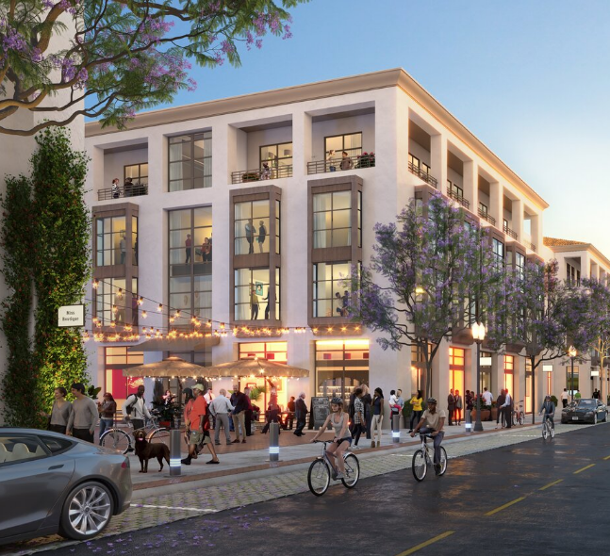
XXXXX 2024 TruTrade Report of Findings
Do a Find & Replace (Ctrl+H) to replace all XXXXX with the correct study Location Name
Replace the photo with one of the client location or location being analyzed (Height: 7.92” x Width: 8.68”)
Update the client logo
Delete this box
REPLACE WITH CLIENT LOGO
Do a Find & Replace (Ctrl+H) to replace all
“Source: TruTrade, 12 months ending on March 31, 2022; Esri”
with the correct end date
June 10, 2026

Slide 2
Report contents
Executive summary
Key findings
Recommendations
XXXXX visitor overview
On-site visitor behavior
Competitive landscape
Appendix

Slide 3
Executive Summary
Insert photo of the client location or location being analyzed and resize/crop to fit properly, then ‘Send to back’
(Height: 14.0” x Width: 6.39”)
Delete this box

Slide 4
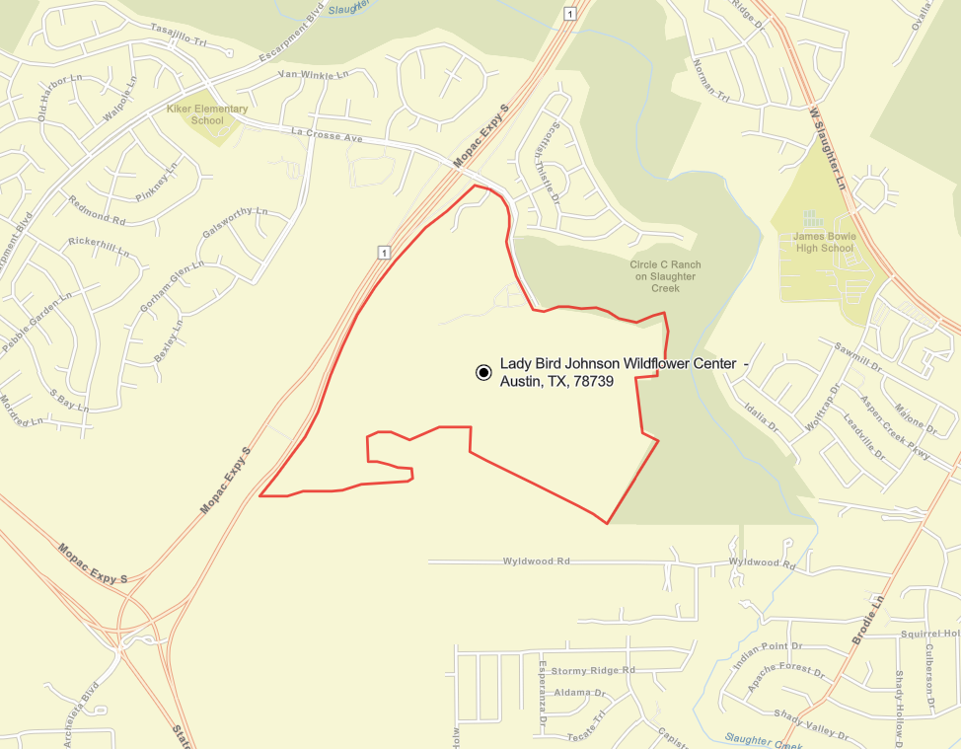
Mobile devices seen within the shaded (geo-fenced) area were analyzed to determine the where, who and what of actual visitors to XXXXX
Geofence image to include full boundaries at appropriate zoom level
Time period of the data: January 2024 – December 2024
Update timeframe

Slide 5
Summary of Key Findings
EXECANALYSIS5
IGNORE – ANALYST WILL UPDATE

Slide 6
Key Implications
Text
IGNORE – ANALYST WILL UPDATE

Slide 7
XXXXX Trade Area Overview

Slide 8







XXXXX Actual Visitors Key Metrics
XXXXX
Visitor Data:
COMPARED TO THE MARKET
HH08
OF THE VISITOR HOUSEHOLDS EARN $100K+ A YEAR
VS. VHMSA08 IN MSA
VL10
of visitors live within 10 miles of XXXXX
DRAWS FROM A TRADE AREA POPULATION OF VOP08
HHI08
vs. HHIMSA08
AVERAGE VISITOR ANNUAL HOUSEHOLD INCOME VS. THE MSA
LD08
OF VISITORS LIVE WITHIN A 50-MILE LOCAL TRAVEL DISTANCE
TOP 5 ZIPS BASED ON PERCENT OF VISITS
CD08
OF VISITORS HAVE A COLLEGE OR POST-GRADUATE DEGREE VS. CDMSA08 IN THE MSA
MT08
OF VISITORS COME FROM BEYOND 50-MILE TOURIST TRAVEL DISTNCE
ZIP1
ZIP2
ZIP3
ZIP4
ZIP5
VC08
OF VISITORS HAVE CHILDREN UNDER 18 LIVING AT HOME VS. VCMSA08 IN THE MSA
ETHNIC MAKEUP
AVG. ANNUAL VISIT FREQUENCY
VISIT DWELL TIME
VF08 visits
DT08 minutes

Slide 9
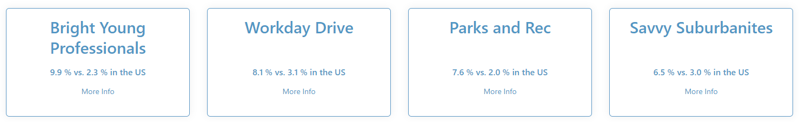
Get Tapestry Data from Dashboard > Overview> Tapestry Profile
Descriptions [do not copy from dashboard]: https://aro36579709.sharepoint.com/:x:/s/ABResources/EZVOKAglh91BvD0g445LEmABqmndIIaAOjxMFMIEwvQPIQ?e=5ZdPF8
XXXXX
Visitor Lifestyles
Cover “more info” with MSA Index
Top 4 Visitor Lifestyles
MSA Index: 100
Update MSA Index
MSA Index: 100
MSA Index: 100
MSA Index: 100
Bright Young Professionals is a large market, primarily located in urban outskirts of large metropolitan areas. These communities are home to young, educated, working professionals. More than one out of three householders are under the age of 35. Slightly more diverse couples dominate this market, with more renters than homeowners.
Workday Drive is an affluent, family-oriented market with a country flavor. Residents are partial to new housing away from the bustle of the city but close enough to commute to professional job centers. Life in this suburban wilderness offsets the hectic pace of two working parents with growing children. They favor time-saving devices, like banking online or housekeeping services, and family-oriented pursuits.
These suburbanites have achieved the dream of home -ownership. They have purchased homes that are within their means. Their homes are older, and townhomes and duplexes are not uncommon. Many of these families are two-income married couples approaching retirement age; they are comfortable in their jobs and their homes, budget wisely, but do not plan on retiring anytime soon or moving.
Savvy Suburbanites residents are well educated, well read, and well capitalized. Families include empty nesters and empty nester wannabes, who still have adult children at home. Located in older neighborhoods outside the urban core, their suburban lifestyle includes home remodeling and gardening plus the active pursuit of sports and exercise. They enjoy good food and wine, plus the amenities of the city’s cultural events.
Replace Tapestry source
“Source: TruTrade (January 2023 - December 2023); Tapestry Esri”
with the correct end date
Source: TruTrade (January 2023 - December 2023); Tapestry Esri
9

Slide 10
CMPANALYSIS10
 | TruTrade Population | Visitor Avg. HH Income | % Visitors >$100,000 HHI | Avg. Age of Head of Visitor Household | % Visitor Households with Children | % College Degree or Higher
AVERAGE / TOTAL
Source: TruTrade, 12 months ending on March 31, 2022; Esri

Slide 11
MILANALYSIS11
 |  | Potential Visitors |  |  | Actual Visitors | Actual vs. 10 mi Potential
Estimated Demographics |  | 3 miles | 5 miles | 10 miles | TruTrade | Index
Population |  | MA121 | MB121 | MC121 | MD121
Households |  | MA122 | MB122 | MC122 | MD122
Age | 18-24 | MA123 | MB123 | MC123 | MD123
 | 25-34 | MA124 | MB124 | MC124 | MD124
 | 35-44 | MA125 | MB125 | MC125 | MD125
 | 45-54 | MA126 | MB126 | MC126 | MD126
 | 55-64 | MA127 | MB127 | MC127 | MD127
 | 65+ | MA128 | MB128 | MC128 | MD128
 | Average Age | MA129 | MB129 | MC129 | MD129
HH Income | Less than $50,000 | MA130 | MB130 | MC130 | MD130
 | $50,000 - $74,999 | MA131 | MB131 | MC131 | MD131
 | $75,000 - $99,000 | MA132 | MB132 | MC132 | MD132
 | $100,000 - $149,999 | MA133 | MB133 | MC133 | MD133
 | $150,000 or more | MA134 | MB134 | MC134 | MD134
 | Average Household Income | MA135 | MB135 | MC135 | MD135
Children in Household |  | MA136 | MB136 | MC136 | MD136
Education | Less than College | MA137 | MB137 | MC137 | MD137
 | Some College | MA138 | MB138 | MC138 | MD138
 | College Degree | MA139 | MB139 | MC139 | MD139
 | Post-Graduate Degree | MA140 | MB140 | MC140 | MD140
Ethnicity | Caucasian/White | MA141 | MB141 | MC141 | MD141
 | African-American/Black | MA142 | MB142 | MC142 | MD142
 | Hispanic/Latino | MA143 | MB143 | MC143 | MD143
 | Asian | MA144 | MB144 | MC144 | MD144
 | Other | MA145 | MB145 | MC145 | MD145
Copy/paste table data from “CompetitiveMarketPosition” tab in workbook
Update ending month in footnote at bottom
Delete this box
Source: TruTrade, 12 months ending on March 31, 2022; Esri

Slide 12
Visitor Profile Competitive Comparison
AGE
18-24
25-34
35-44
45-54
55-64
65+
Average Age
HOUSEHOLD INCOME
Less than $50,000
$50,000-$74,999
$75,000-$99,999
$100,000-$149,999
$150,000 or more
Average HH Income
CHILDREN IN HOUSEHOLD
EDUCATION
Less than college
Some college
College degree
Post-graduate degree
ETHNICITY
Caucasian/White
African-American/Black
Hispanic/Latino
Asian
Other
Copy/paste table data from “DrawDemo” tab in workbook
Update ending month in footnote at bottom
Delete this box
Source: TruTrade, 12 months ending on March 31, 2022; Esri

Slide 13
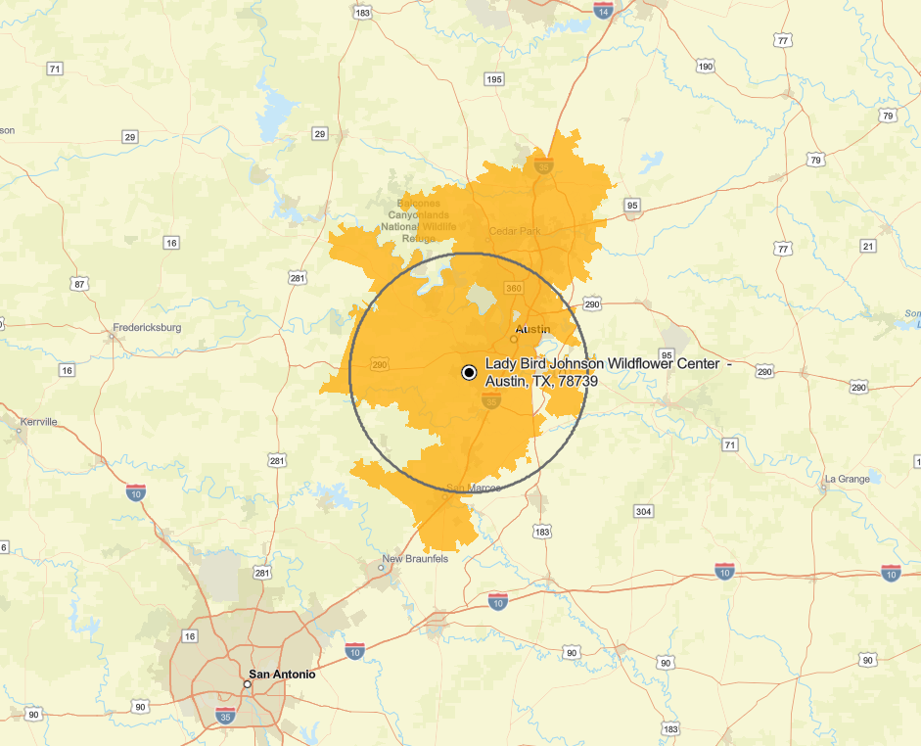
XXXXX Trade Area Population – Regional View
VOANALYSIS13
One zoom out from default zoom.
Legend
20 miles
Top ~75% of Visits

Slide 14
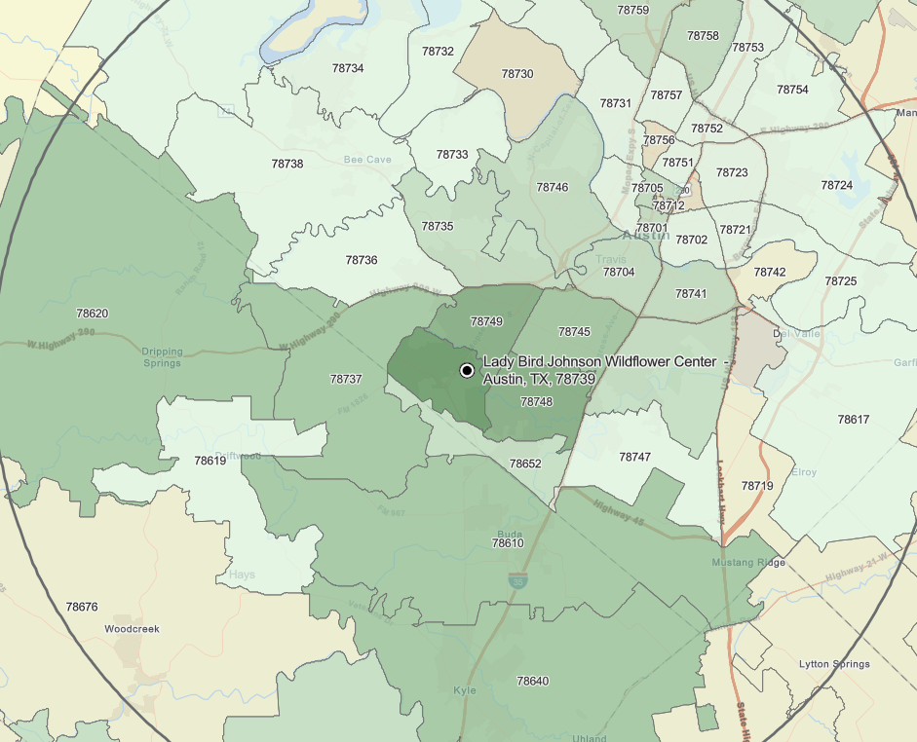
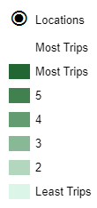
XXXXX Most Trips – Local View
MTZIP1
MTZIP2
MTZIP3
MTZIP4
MTZIP5
MTZIP6
MTZIP7
MTZIP8
MTZIP9
MTZIP_10
MTANALYSIS14
MOST TRIPS MAP (not yellow TA map) One zoom in from default zoom. Add zip code boundaries.

Slide 15
ZIPANALYSIS15
ZIP | City | State | Miles from ZIP to XXXXX | Percent of Visits | Cumulative Percent Visits | Total Households | Total Population | 5-Year Population Growth | Average HH Income
Copy/paste table data from “ZipCodes” tab in workbook
Update ending month in footnote at bottom
Delete this box
Source: TruTrade, 12 months ending on March 31, 2022; Esri

Slide 16
On-Site Visitor Behavior
Insert photo of the client location or location being analyzed and resize/crop to fit properly, then ‘Send to back’
(Height: 14.0” x Width: 6.39”)
Delete this box

Slide 17
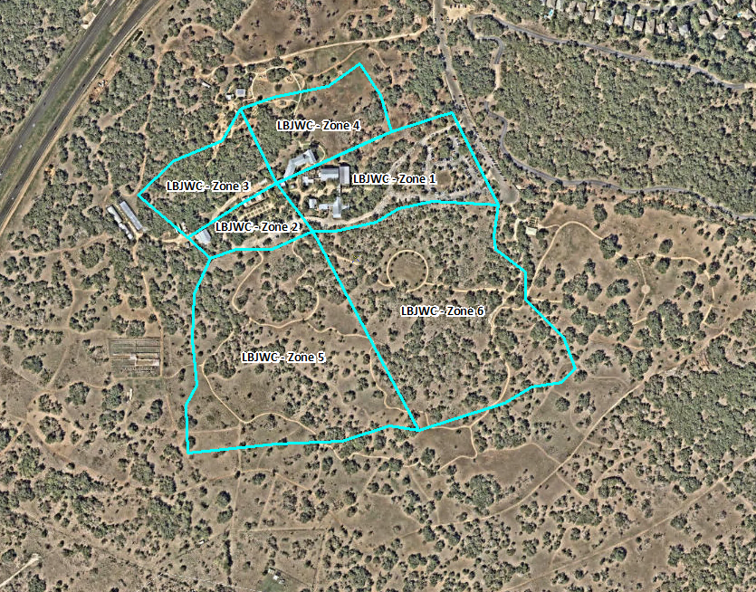
XXXXX Zone Analysis
Process ZA using the CV Notebook https://dbc-4659a8af-9737.cloud.databricks.com/?o=5020840785703105#notebook/4268345134498833
Specific Areas Visited | Percent of All Visitors

Slide 18
Visitor Distance Traveled Analysis
Update links in charts to link to the workbook (Click on chart > Edit Links to Files) and update “Select Data” if necessary (click on chart > Chart Design)
Update overall average numbers at the bottom from “Distance Travelled” tab in workbook
Delete this box
Actual Visitor Distance Traveled
Avg. Distance (All Domestic Visitors)
246 mi.
141 mi.
93 mi.
121 mi.
322 mi.
137 mi.
75 mi.
115 mi.
166 mi.
184 mi.
160 mi.
Avg. Distance (<50mi.)
13.5 mi.
4.8 mi.
13.4 mi.
10.1 mi.
6.4 mi.
4.2 mi.
8.4 mi.
4.5 mi.
7.5 mi.
8.2 mi.
8.1 mi.
33%
7%
12%
12%
35%
Averages
Distance Traveled is measured as the distance from the center of the block group to the location, used to compare between locations and compute a weighted average distance. Note, this will not compare to traditional methods as it includes the distance traveled for people who are visiting the market (perhaps on business, or for leisure) and who are visiting the tested location. Can be used to see who is the biggest regional or national draw.

Slide 19
Visitor Behavior Analysis
Dwell Time at Location
Annual Visit Frequency
Average Duration – AVGDUR19
Average Annual Frequency – AVGFREQ10
Duration as measured using mobile trips may be compared between locations but will not compare to stated duration when captured using other sampling techniques, i.e. Intercepts, due to the frequency with which the device registers activity; Frequency is the number of times the same device was seen at a given location during the time period. Note, this typically understates frequency given the amount of app activity and the app’s settings but can be used to consistently compare between locations.

Slide 20
Competitive Landscape
Insert photo of the client location or location being analyzed and resize/crop to fit properly, then ‘Send to back’
(Height: 14.0” x Width: 6.39”)
Delete this box

Slide 21
Process ZA using the CV Notebook https://dbc-4659a8af-9737.cloud.databricks.com/?o=5020840785703105#notebook/4268345134498833
SOP provided here: Standard Cross-Visitation SOP.docx
Competitive Cross-Visitation looks at the number of unique visitors who were observed at two locations during the twelve months of the study.
The percentages represent visitors who were observed at both the locations named in the column header and at the locations listed in the row on the left at some point during the study period.
The top row is the percentage of visitors who were only seen at the location named in the column and at none of the other locations during the 12 months.
Source: TruTrade, 12 months ending on March 31, 2022; Esri

Slide 22
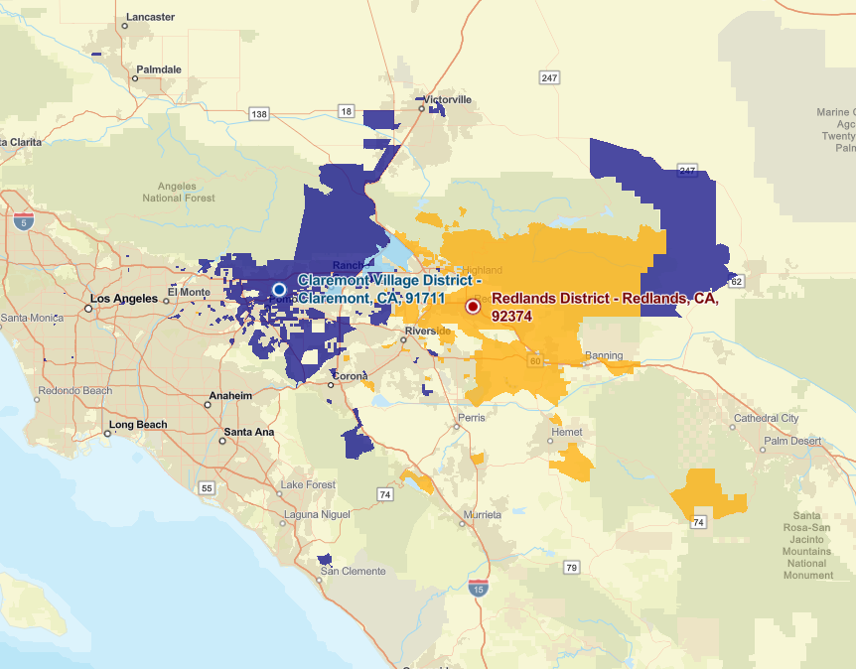
COMP Geographic Overlap
One per competitor selected.
One zoom out from default zoom.
Demographic | XXXXX Only | Overlap | COMP Only
Population
Households
Avg. HH Income
Legend
Visit only XXXXX
Visit only COMP
Visit both XXXXX & COMP

Slide 23
Year-on-Year Comparison
Insert photo of the client location or location being analyzed and resize/crop to fit properly, then ‘Send to back’
(Height: 14.0” x Width: 6.39”)
Delete this box

Slide 24







XXXXX Visitor: Where and Who FY 2023 vs. FY 2024
Get details from
Dashboard > Report > Summary
Dashboard > Report > ZIP Codes
Dashboard > Report > Distance Travelled
For both Present and Previous Year.
2023
2024
2023
2024
CHANGE
CHANGE
YOYPrevPop | YOYPresPop
YOYPrevM1% | YOYPresM1%
YOYPrevM2% | YOYPresM2%
YOYPrevM3% | YOYPresM3%
YOYPrevM4 | YOYPresM4
YOYPrevM5 | YOYPresM5
YOYPrevM6
YOYPrevM7%
YOYPresM6
YOYPresM7%
TruTrade Visitor
Origin Population
Average Income
$100k or more
Less than 20 miles
YOYPrevM8%
YOYPresM8%
20-50 miles
College or Post-
Graduate Degree
More than 50 miles
YOYPrevM9%
YOYPresM9%
Avg Distance
(Live within 50mi)
Having Children <18
Living at Home
Avg Distance
(All Visitors)
Ethnic/Racial
Composition
2023
2024
ZIP_P1
ZIP_P2
ZIP_P3
ZIP_P4
ZIP_P5
ZIP1
ZIP2
ZIP3
ZIP4
ZIP5
Top 5
ZIP
Codes
Total Percent of Visits
YOYZIPPrevSUM%
YOYZIPPresSUM%
Source: TruTrade

Slide 25
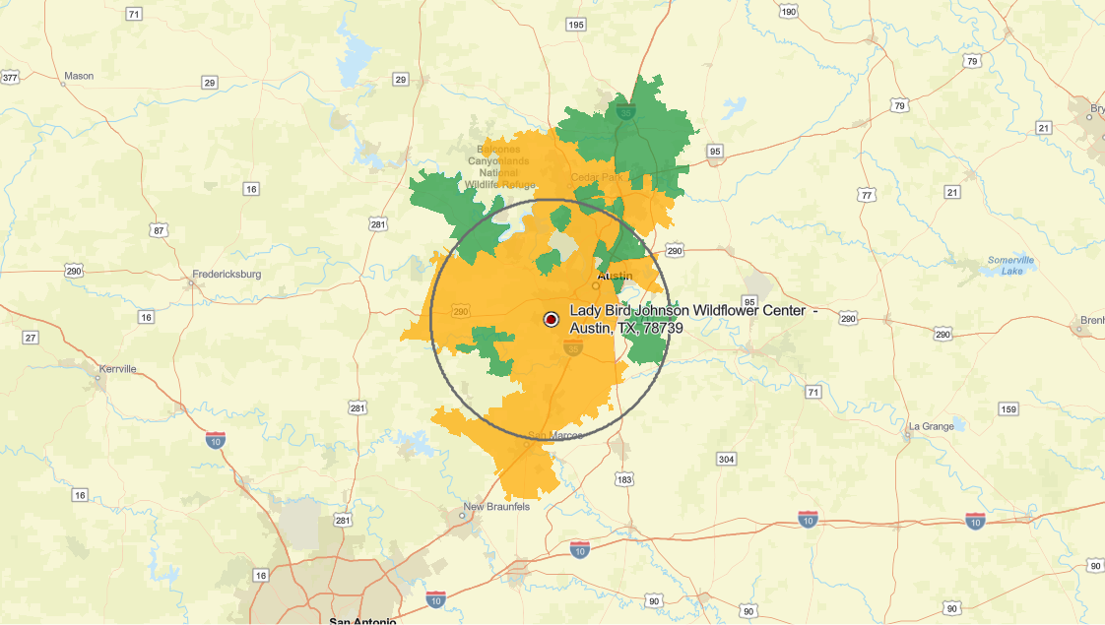

XXXXX Change Map
September 2022-August 2023 vs September 2023-August 2024
Get Map and Data from Dashboard>Overview> Compare Timeframes
Demographic | Retained in CY 2023 | Lost in CY 2023 | Gained in CY 2023
Avg. Income
Households

Slide 26
Appendix
Insert photo of the client location or location being analyzed and resize/crop to fit properly, then ‘Send to back’
(Height: 14.0” x Width: 6.39”)
Delete this box

Slide 27
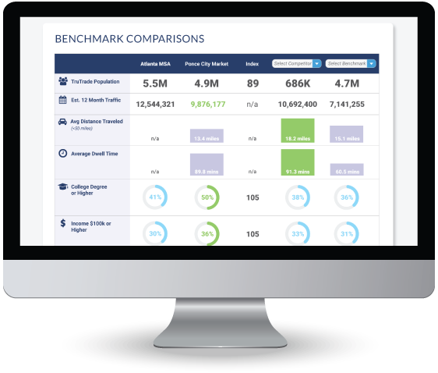
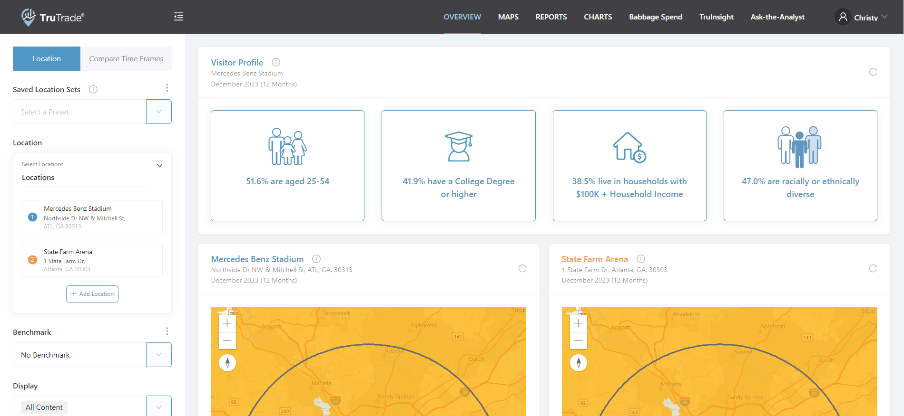
TruTrade Dashboard Access
Dashboard access to TruTrade is available online 24/7:
https://trutrade.alexanderbabbage.com
If additional logins are needed, please contact Christy Loudermilk at:
cloudermilk@alexanderbabbage.com
If you need access to additional locations within your dashboard, please submit a request for additional locations on the “My Profile” page

Slide 28
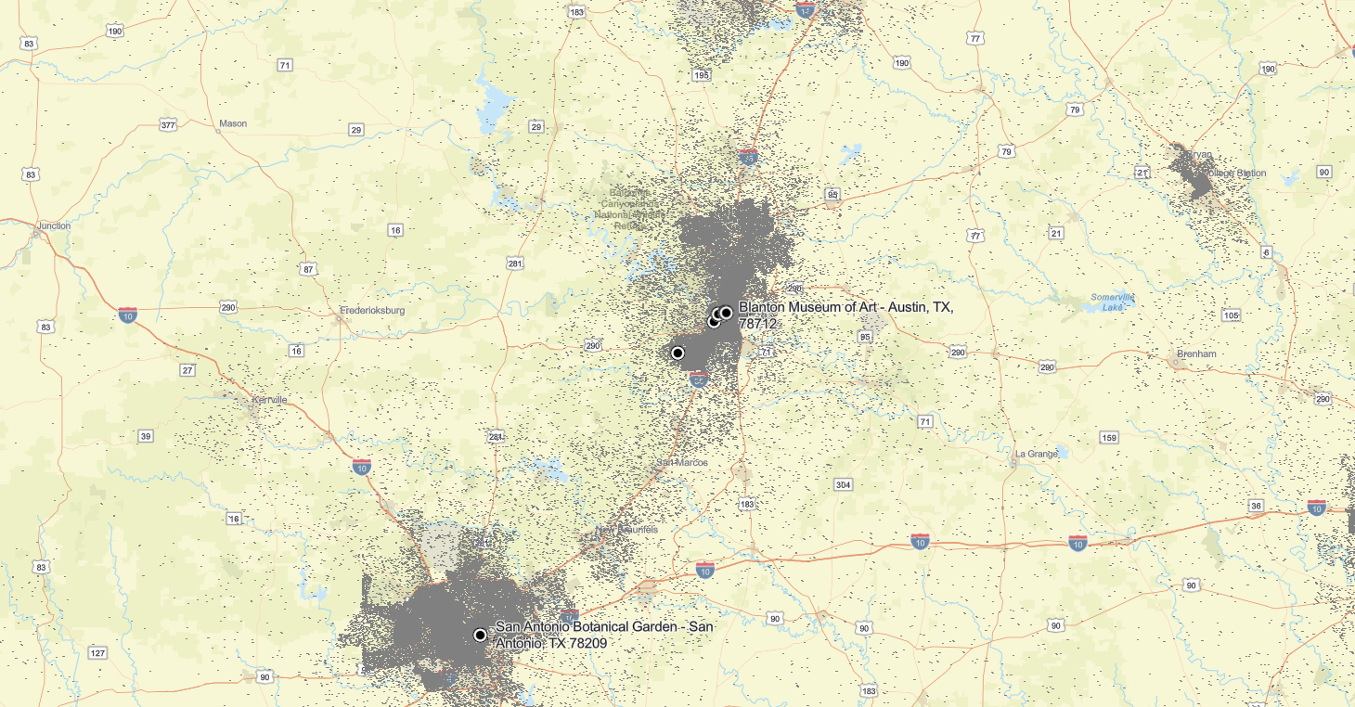

Regional Population Density
Delete map to left and update with POPULATION DENSITY map (identical zoom as the first Trade Area Population and first Geographic Penetration and the Overlay maps, all competitors, but no mileage ring)
Size map to correct size
(Height: 10.14” x Width: 7.92”)

Slide 29
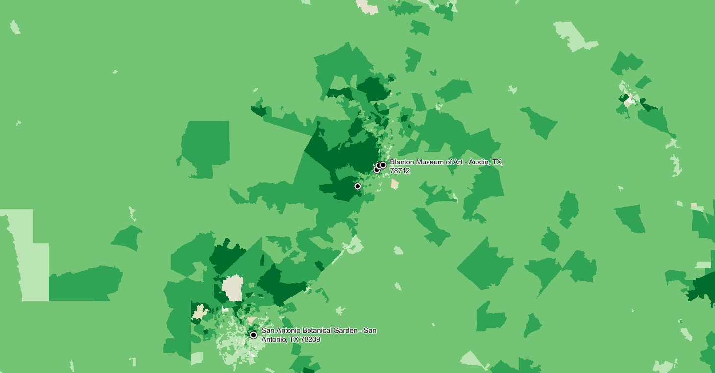
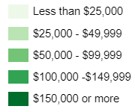
Regional Income Distribution
Delete map to left and update with HOUSEHOLD INCOME map (identical zoom as the first Trade Area Population and first Geographic Penetration and the Overlay maps, all competitors, but no mileage ring)
Size map to correct size
(Height: 10.14” x Width: 7.92”)

Slide 30
DEFINITIONS
Demographics – the demographics of the block group of the home location for the device. This allows comparisons between the demographic make up of the households who are visiting a location but may not reflect the actual visitor.
Demographic Indices – the demographic profile of a given center indexed against the market. This is the easiest way to see the strengths and opportunities for a given location.
Visitor Distance Traveled – the distance from the center of the block group to the location, used to compare between locations and compute a weighted average distance. Note, this will not compare to traditional methods as it includes the distance traveled for people who have flown to the market (e.g. on business, or for leisure) and who are visiting the location. Can be used to see which location has the biggest regional or national draw.
Visitor Frequency – the number of times the same device was seen at a given location during the tested 12-month period.
Visitor Duration – the duration between the first and last “pings” to the mobile application while at the location.
Top 25 ZIPs – trips are organized based on number of trips to a given location, then sorted into the top 25 ZIPs that produce visits to that location. The table is sorted on Percent of Visits.
Trade Area Population – Trade Area Population is defined by ranking block groups in descending order based on 1.) the number of trips originating from each block group, and 2.) the Average Household Income for each block group. The percent of visits from each block group, along with a cumulative total, is calculated and the block groups that represent the top 75% of visits are shown on the Trade Area Population map.
Trade Area Population Population – sum of the population of the block groups which comprise the top 75% of location visits.

Slide 31
DTANALYSIS37
Estimated Distance Travele aad
 | Less than 5 miles | 5 to 10 miles | 11 to 20 miles | 21 to 50 miles | More than 50 miles | Avg. Distance (miles) | Avg. Distance (<50mi)
Source: TruTrade, 12 months ending on March 31, 2022; Esri

Slide 32
FREQANALYSIS38
Annual Visit Frequency
 | Visited once | Visited 2-4 times | Visited 5+ times | Avg. Number Annual Visits
Copy/paste table data from “Frequency” tab in workbook
Update ending month in footnote at bottom
Delete this box
Source: TruTrade, 12 months ending on March 31, 2022; Esri

Slide 33
DURANALYSIS39
Copy/paste table data from “Duration” tab in workbook
Update ending month in footnote at bottom
Delete this box
Visit Duration
 | Less than 15 mins. | 15 to 60 mins. | 60 mins. to 3 hours | More than 3 hours | Average Duration (mins)
Source: TruTrade, 12 months ending on March 31, 2022; Esri

Slide 34

Christy’s Version
Alan McKeon
President & CEO
amckeon@alexanderbabbage.com
Stacy Sheldon
Vice President of Client Insights
ssheldon@alexanderbabbage.com
Christy Loudermilk
Client Success Manager
cloudermilk@alexanderbabbage.com

Slide 35
Erica’s Version
Alan McKeon
President & CEO
amckeon@alexanderbabbage.com
Stacy Sheldon
Vice President of Client Insights
ssheldon@alexanderbabbage.com
Erica Brown
Client Success Manager
ebrown@alexanderbabbage.com

