Slide 1
IBM HR Attrition Analysis
By Deepanraj A
Date: July 09, 2025

Slide 2
Project Objective
This project analyzes employee attrition using the IBM HR Analytics dataset.
It aims to help HR teams understand why employees leave, identify risk factors, and support retention strategies through data-driven insights.

Slide 3
About the Dataset
- Source: IBM HR Analytics Employee Attrition Dataset
- Fields: Age, Department, Monthly Income, Education, Gender, Job Role, Attrition, etc.
- Format: CSV file
- Total records: 1470 employees

Slide 4
Tools and Technologies Used
- Python
- pandas
- seaborn
- matplotlib
- Jupyter Notebook
- Visual Studio Code
- GitHub

Slide 5
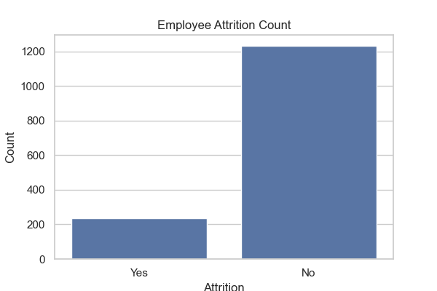
Attrition Count

Slide 6
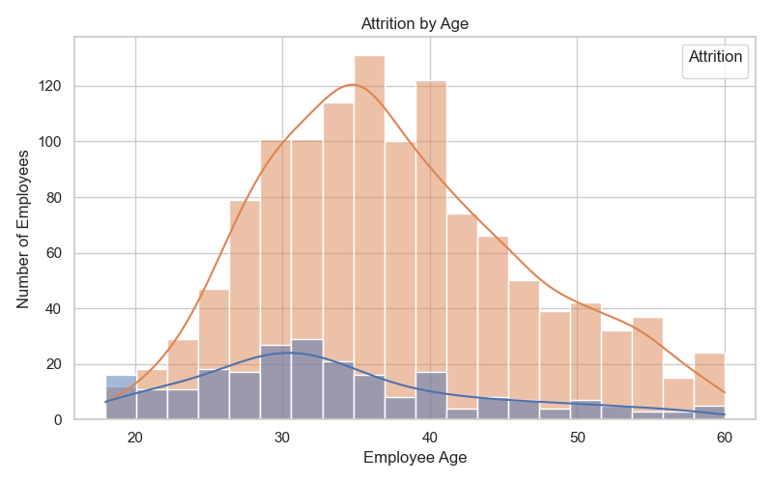
Age vs Attrition
(Image age_vs_attrition.png not found)

Slide 7
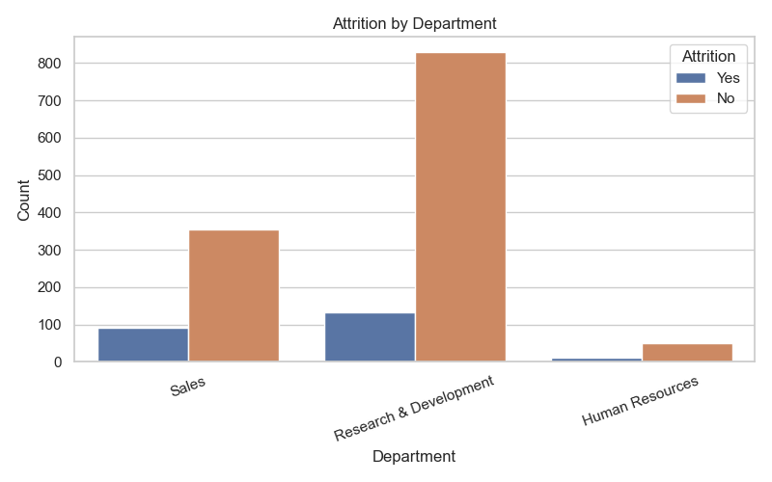
Attrition by Department
(Image department_chart.png not found)

Slide 8
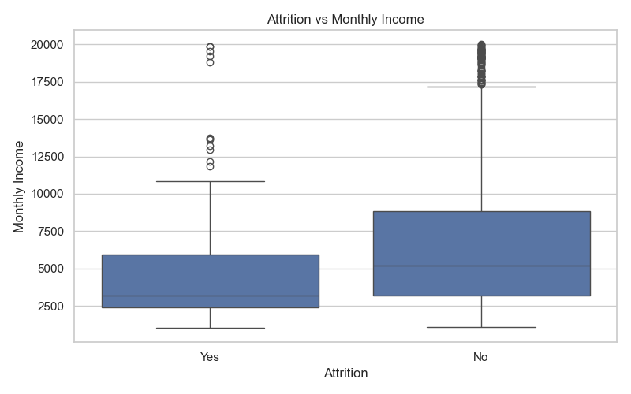
Salary vs Attrition
(Image salary_vs_attrition.png not found)

Slide 9
Conclusion & Insights
- Younger employees (under 35) showed higher attrition rates
- Lower salaries were associated with higher attrition
- Sales and HR departments had noticeable attrition
HR can use this analysis to design better retention strategies.

