Slide 1

INTRODUCTION TO CORRUPTION
◆ Definition of Corruption
Corruption refers to the abuse of power for personal gain, leading to social and economic inequality.
◆ Prevalence in India
India has been ranked as one of the most corrupt countries in the world, with widespread bribery and embezzlement.
◆ Impact on Society
Corruption affects the common people, leading to poor public services, increased poverty, and social unrest.

Slide 2

FORMS OF CORRUPTION
◆ Bribery
Bribery involves the exchange of money or favors for influence or services.
◆ Embezzlement
Embezzlement is the theft of funds or assets by individuals in positions of power.
◆ Nepotism
Nepotism refers to the practice of giving favors or jobs to family members or friends.

Slide 3

CAUSES OF CORRUPTION
◆ Lack of Transparency
Lack of transparency in government and business dealings creates an environment conducive to corruption.
◆ Poor Governance
Poor governance and weak institutions enable corrupt practices to thrive.
◆ Economic Inequality
Economic inequality and poverty can drive individuals to engage in corrupt activities.

Slide 4
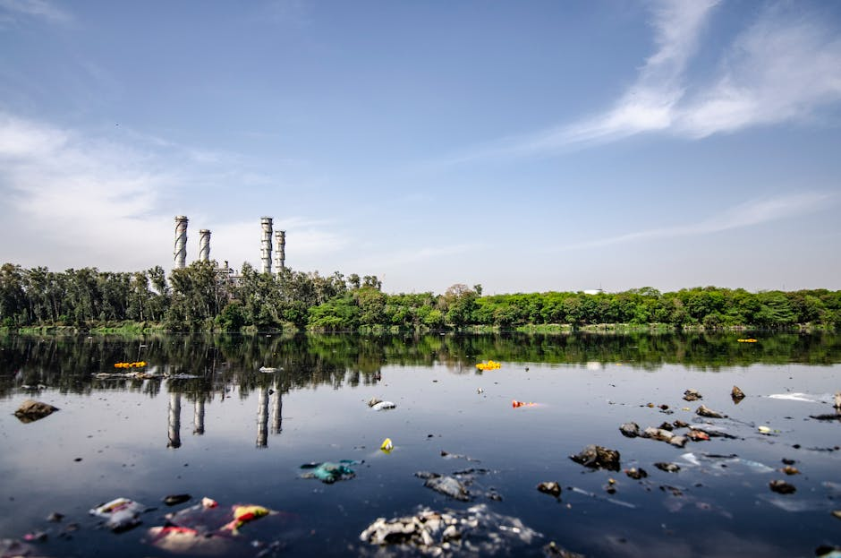
EFFECTS OF CORRUPTION
◆ Economic Consequences
Corruption can lead to economic instability, inflation, and reduced economic growth.
◆ Social Impact
Corruption affects the social fabric, leading to increased poverty, inequality, and social unrest.
◆ Environmental Degradation
Corruption can also lead to environmental degradation, as regulations are ignored or bypassed.

Slide 5
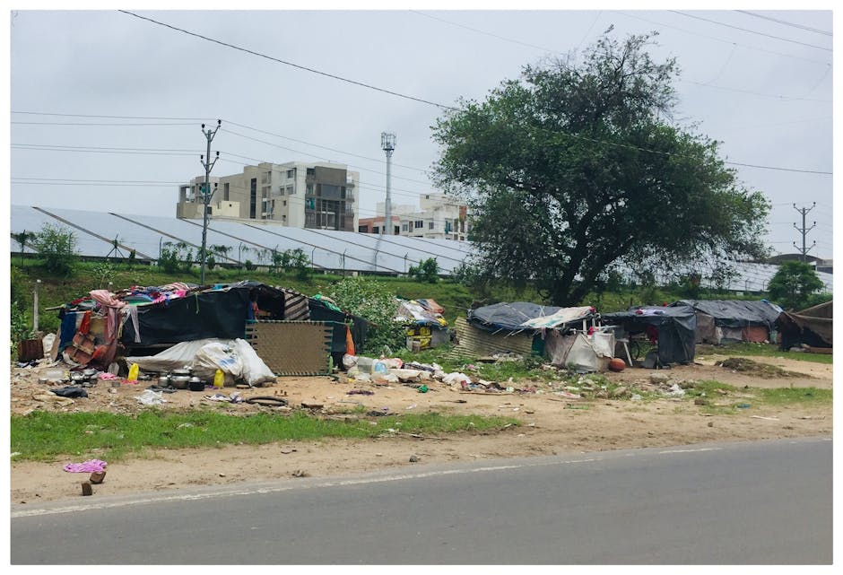
COMMON PEOPLE'S SUFFERING
◆ Poor Public Services
Corruption leads to poor public services, including healthcare, education, and infrastructure.
◆ Increased Poverty
Increased poverty and economic inequality are direct consequences of corruption.
◆ Lack of Access to Basic Needs
The lack of access to basic needs, such as clean water and sanitation, is a result of corrupt practices.

Slide 6

MEASURES TO CONTROL CORRUPTION
◆ Strengthening Institutions
Strengthening institutions, such as the judiciary and law enforcement, is crucial to combating corruption.
◆ Increasing Transparency
Increasing transparency in government and business dealings can help prevent corrupt practices.
◆ Implementing Anti-Corruption Laws
Implementing and enforcing anti-corruption laws can deter individuals from engaging in corrupt activities.

Slide 7

ROLE OF CITIZENS
◆ Reporting Corruption
Citizens can play a crucial role in reporting corruption and bringing it to the attention of authorities.
◆ Participating in Governance
Participating in governance, such as voting and engaging in public debates, can help prevent corruption.
◆ Supporting Anti-Corruption Efforts
Supporting anti-corruption efforts, such as NGOs and advocacy groups, can help create a culture of transparency and…

Slide 8

CHALLENGES IN CONTROLLING CORRUPTION
◆ Lack of Political Will
The lack of political will to address corruption can hinder efforts to combat it.
◆ Inadequate Resources
Inadequate resources, such as funding and personnel, can limit the effectiveness of anti-corruption efforts.
◆ Social and Cultural Norms
Social and cultural norms, such as the acceptance of bribery, can make it difficult to change behaviors and attitudes.

Slide 9

SUCCESS STORIES
◆ Anti-Corruption Campaigns
Anti-corruption campaigns, such as awareness-raising initiatives, can help change public perceptions and behaviors.
◆ Whistleblower Protection
Whistleblower protection laws can encourage individuals to come forward and report corruption.
◆ Increased Transparency
Increased transparency, such as through open data initiatives, can help prevent corruption and increase accountability.

Slide 10

CONCLUSION
◆ Corruption is a Complex Issue
Corruption is a complex issue that requires a comprehensive approach to address.
◆ Addressing Corruption Requires Collective Effort
Addressing corruption requires the collective effort of governments, citizens, and institutions.
◆ Creating a Corruption-Free Society is Possible
Creating a corruption-free society is possible, but it requires sustained efforts and a commitment to transparency and…

