Slide 1

INTRODUCTION TO AI IN HEALTHCARE
◆ Artificial Intelligence in Healthcare
Artificial Intelligence is being increasingly used in healthcare to improve diagnostics and patient care.
◆ Transforming Healthcare Systems
AI is transforming healthcare systems by optimizing operations and enabling personalized medicine.
◆ Improving Patient Outcomes
The ultimate goal of AI in healthcare is to improve patient outcomes and save lives.

Slide 2

KEY BENEFITS OF AI IN HEALTHCARE
◆ Improved Diagnostics
AI can help improve diagnostics by analyzing large amounts of medical data and identifying patterns.
◆ Enhanced Patient Experience
AI-powered chatbots and virtual assistants can enhance the patient experience by providing personalized support.
◆ Increased Efficiency
AI can increase efficiency in healthcare by automating routine tasks and streamlining clinical workflows.

Slide 3
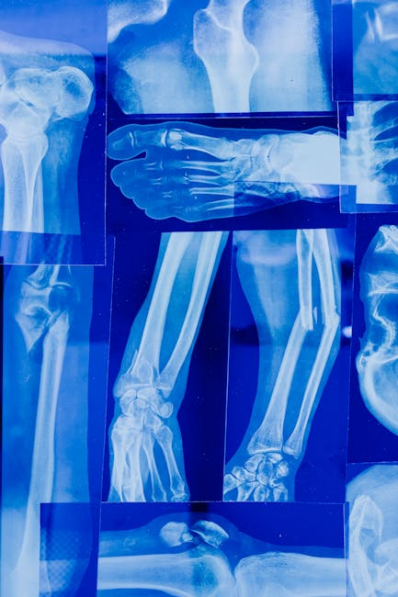
REAL-WORLD APPLICATIONS OF AI IN HEALTHCARE
◆ Predictive Analytics
Predictive analytics can be used to forecast patient outcomes and identify high-risk patients.
◆ Computer Vision
Computer vision can be used to analyze medical images and detect diseases such as cancer.
◆ Natural Language Processing
Natural language processing can be used to analyze clinical notes and identify patterns in patient data.

Slide 4

ETHICAL AND OPERATIONAL CHALLENGES
◆ Data Privacy
Ensuring data privacy is a major challenge in AI-powered healthcare, as sensitive patient data must be protected.
◆ Bias in AI Algorithms
Bias in AI algorithms can lead to unfair outcomes and perpetuate existing healthcare disparities.
◆ Regulatory Frameworks
Regulatory frameworks are needed to ensure the safe and effective development and deployment of AI in healthcare.

Slide 5

FUTURE POTENTIAL OF AI IN HEALTHCARE
◆ Personalized Medicine
AI can enable personalized medicine by tailoring treatments to individual patients' needs and characteristics.
◆ Telehealth
Telehealth can expand access to healthcare services and improve health outcomes for remote and underserved populations.
◆ Population Health Management
AI can help manage population health by analyzing large datasets and identifying trends and patterns.

Slide 6

CONCLUSION
◆ AI is Transforming Healthcare
AI is transforming healthcare by improving diagnostics, optimizing operations, and enabling personalized patient care.
◆ Addressing Challenges is Crucial
Addressing ethical and operational challenges is crucial to ensuring the safe and effective development and deployment…
◆ Investing in AI is Essential
Investing in AI is essential to realizing its full potential and improving health outcomes for patients around the…

