Slide 1
Priority-Based Rewriting
Presented By:
Ian Johnson
Northeastern University

Slide 2



Introduction

Slide 3
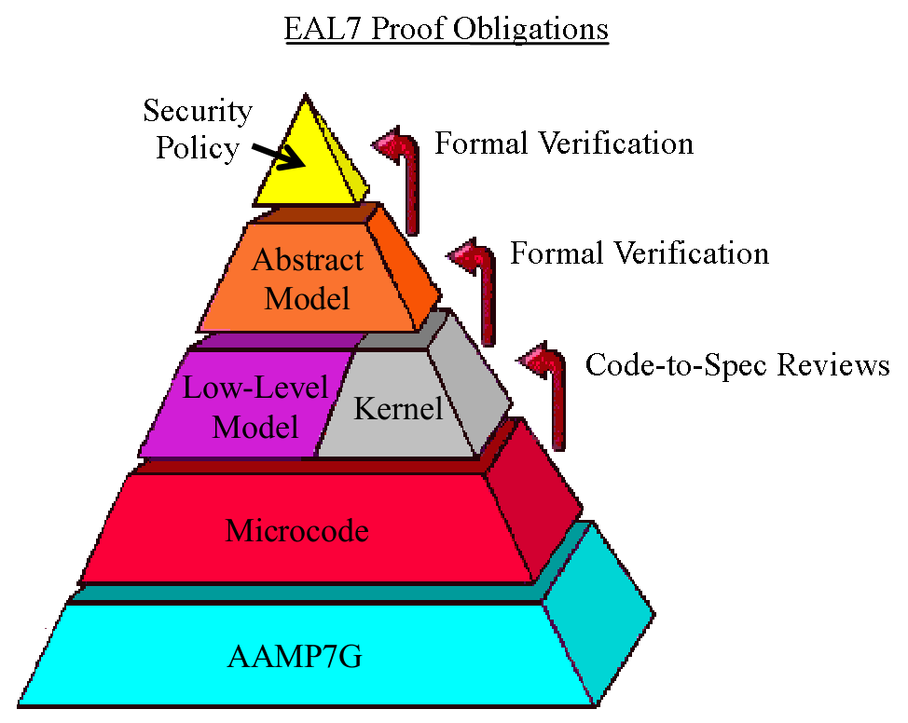

Engineered Proofs

Slide 4
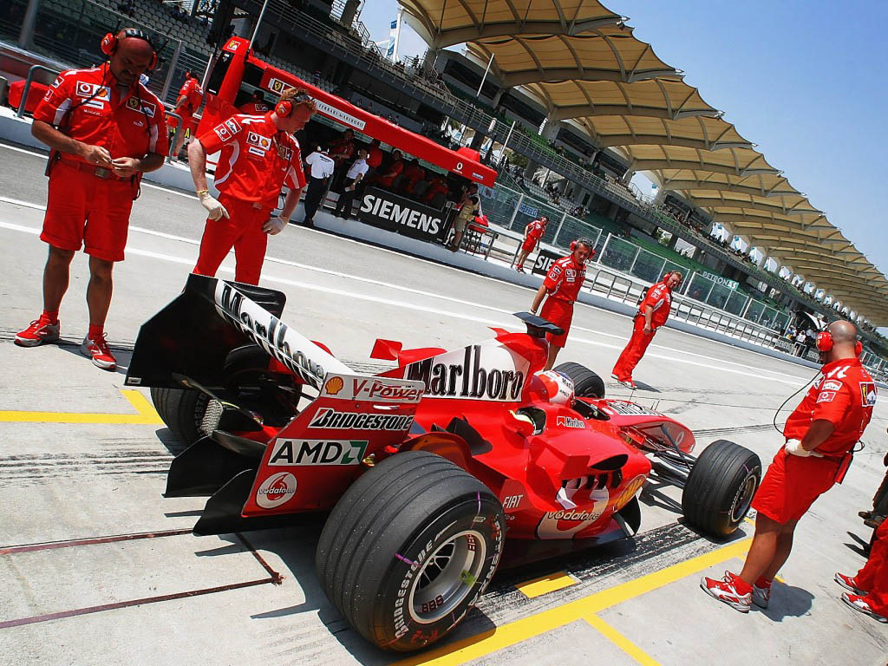
High-Octane Libraries
In large projects, many libraries are needed.
Experts must “tune” the libraries for high performance.
This is largely due to the rewriter's rule selection strategy.

Slide 5
Tuning Takes Time
Tuning a theorem library is hard.
ACL2 - rules are tried in reverse order.
Inspired by a mathematician's proof format.
Does this work well for complex systems?

Slide 6
Prioritize
Order rules by structure, not time.
Requires a few linear algorithms.
Composing libraries is much easier.
Simplifies proof management.
Can get vast performance increases.

Slide 7
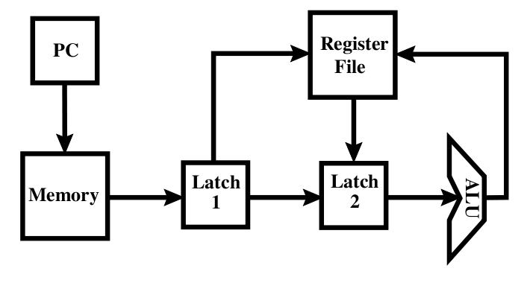
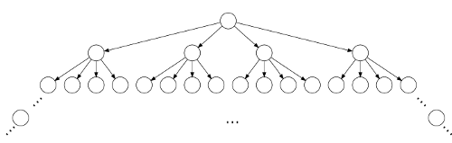
Expert Effort Emancipated
WEB-based refinement theorem on a simple machine is still computationally intensive.
Our framework increases performance by an order of magnitude (20 minutes to 3 minutes) and performs the proof with fewer memory resources (originally had a stack overflow)

Slide 8
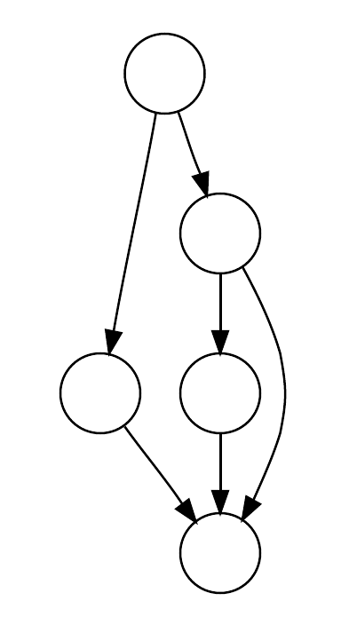
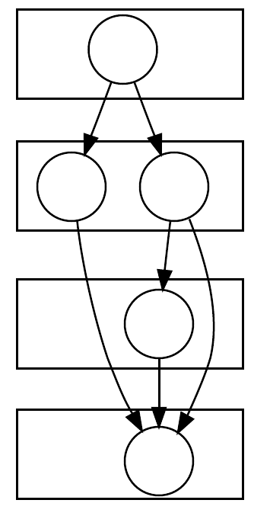
How to DIY
First we prioritize functions by call dependence.
Create a call graph.
(Collapse SCCs)
Obtain length of longest path to each node.

Slide 9
Static Notion of Goodness
Unconditional is good.
We consider two different types of theorems – assertions and equalities.
(hypotheses => (f ...))
(hypotheses => (f …) = r)

Slide 10
Syntactic Difficulty
r is a constant
  4, 'a', “hello”
r is a subterm of (f …)
  (f x (g y)) = (g y)
r is a deleted term of (f …)
  (f x (g y)) = (f x y)

Slide 11
Syntactic Difficulty (cont.)
r has strictly fewer variables/function calls than (f …)
  (f x y (g z)) = (h x y z)
r has the same number of variables/function calls as (f …)
  (app (app x y) z) = (app x (app y z))
Assertions and other equalities.

Slide 12
Order by Structure
Prefer unconditional rules.
Prefer less syntactic difficulty.
Prefer more abstract rules.
(hypotheses => (f ...))
(hypotheses => (f …) = r)
Prefer f has high priority.

Slide 13
Future Work
Dynamic Re-prioritization?
  There are kludgey tricks to get some of this, but really what we need is an enabling rewrite engine.
More examples of the method's effectiveness

Slide 14
Thank You
Questions?

