Slide 1


Statistical Analysis of used Car Prices
Objective: Identify factors influencing the price of used cars.
by Deeksha Chawla

Slide 2
Research Question and Hypothesis
1
Research Question
2
Hypothesis
What factors have the most significant impact on the price of used cars?
Cars with higher mileage, low engine size have lower prices.
Cars with higher engine size, less mileage , will have higher prices.
Dataset Overview
Dataset Information
Source: Kaggle - Car Price Prediction.
Variables Selected: 'price', 'citympg', 'highwaympg', 'symboling', 'enginesize'.

Slide 3
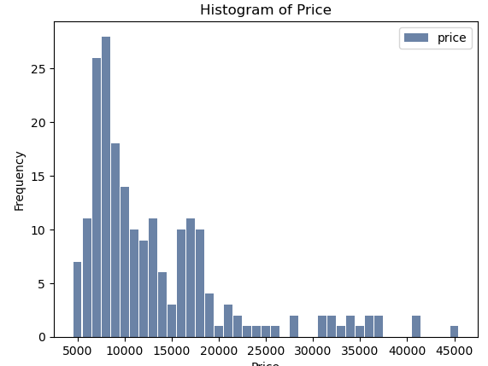
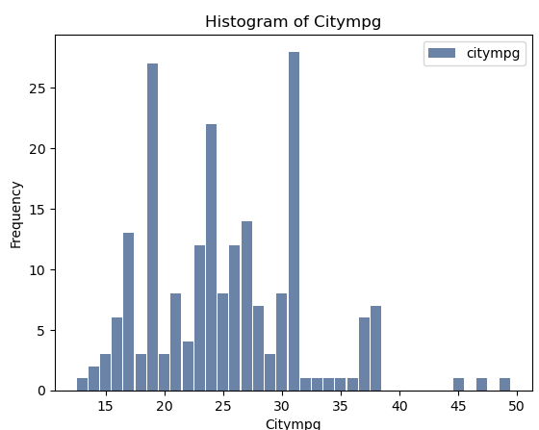
Exploratory Data Analysis (EDA)
Visualizations
Insights
Price is the dependent variable we aim to understand. It represents the monetary value assigned to a used car. Our analysis focuses on identifying factors that significantly impact the price of used cars.
Examining the histogram, we notice that the distribution of prices is right-skewed, with a few outliers at the higher end. These outliers may represent premium or luxury cars, which could significantly impact the overall analysis.
City MPG (miles per gallon) is a measure of a car's fuel efficiency in urban conditions. Lower city MPG values may suggest higher fuel consumption, potentially affecting a car's operating cost and, consequently, its price.
Analyzing the histogram for City MPG, we observe a balanced distribution. Most cars have higher city MPG >25, indicating good fuel efficiency. However, there are a few outliers with lower City MPG, potentially representing performance or specialized vehicles

Slide 4
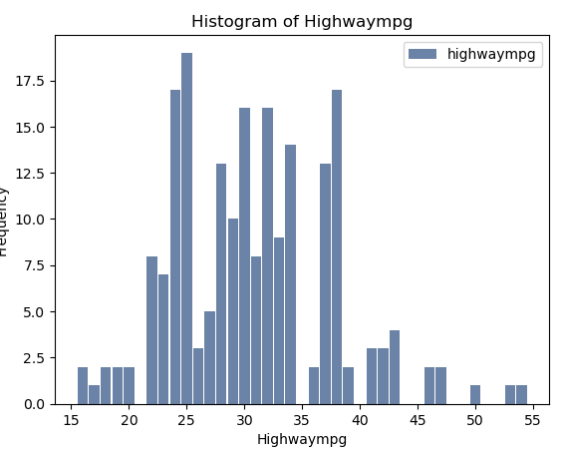
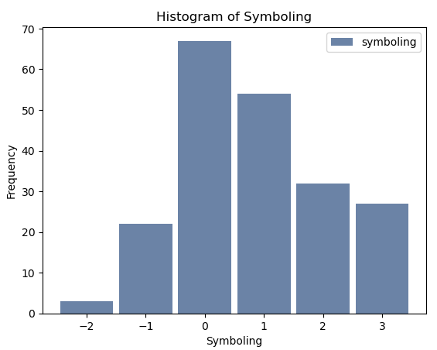
Exploratory Data Analysis (EDA) –contd.
Visualizations
Insights
Highway MPG indicates a car's fuel efficiency on highways. Cars with higher highway MPG values are often considered more fuel-efficient for long-distance travel, influencing their perceived value in the used car market..
Analyzing the histogram for Highway MPG, we observe a balanced distribution. Most cars have higher city MPG >25, indicating good fuel efficiency. However, there are a few outliers with lower City MPG, potentially representing performance or specialized vehicles
Symboling is a measure of a car's risk or insurance risk rating. Positive values indicate a safer-than-average car, while negative values suggest a higher risk. Symboling may influence insurance premiums and, consequently, the total cost of ownership.
Symboling histogram showcases a distribution centered around neutral values, suggesting an average risk rating for most cars. Outliers with extreme positive or negative values may represent exceptionally safe or high-risk vehicles, impacting insurance considerations.

Slide 5
Exploratory Data Analysis (EDA) –contd.
Visualizations
Insights
Engine size is a crucial variable as it represents the size of the car's engine. A larger engine size may suggest higher performance and potentially influence the price of a used car
Examining the histogram for Engines Size, we notice a right-skewed distribution. The majority of cars have moderate engine size, but there are outliers with larger engines, indicating high-performance or luxury vehicles that may significantly influence pricing.
Descriptive Characteristics
Citympg:
Mean: 25.21951219512195
Mode: 31
Spread: 6.54214165300162
Price:
Mean: 13258.536585365853
Mode: 8000.0
Spread: 8005.910059895457
Highwaympg:
Mean: 30.75121951219512
Mode: 25
Spread: 6.88644313094182
Symboling:
Mean: 0.8341463414634146
Mode: 0
Spread: 1.24530682810553
Enginesize:
Mean: 126.90731707317073
Mode: 92
Spread: 41.642693438179826

Slide 6
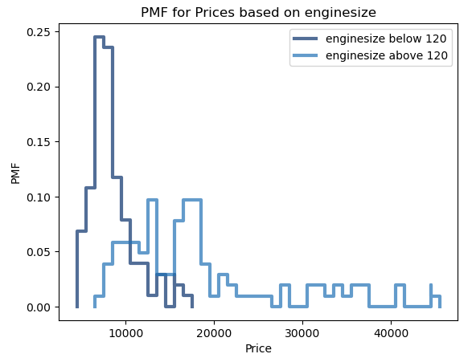
Probability Mass Function (PMF)
Engine Size Median =120
Context
In exploring engine size as a key variable, we've constructed a Probability Mass Function (PMF) to compare two scenarios within the dataset.
Scenario 1: Cars with Engine Size ≤ Median
The second scenario focuses on cars with engine sizes equal to or below the median. This allows us to observe how smaller engines correlate with pricing dynamics.
Scenario 2: Cars with Engine Size > Median
PMF depicts the distribution of prices for cars with engine sizes above the median. This scenario helps identify pricing patterns for larger engines.
Interpretation
Scenario 1 reveals highlight pricing patterns for cars with smaller engines, offering insights into affordability and market preferences.
Scenario 2 reveals a concentration of higher-priced cars, emphasizing the impact of larger engines on pricing.

Slide 7
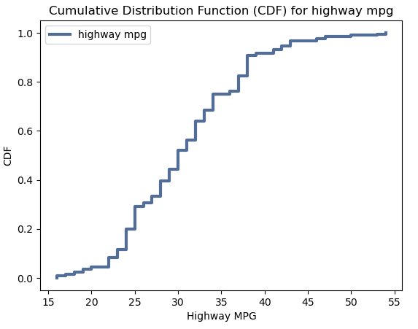
Cumulative Distribution Function (CDF)
Context
Through the application of a Cumulative Distribution Function (CDF), we delve into the distribution of Highway MPG across our dataset
The CDF curve visually illustrates the cumulative probability of encountering cars with varying levels of Highway MPG
Steep inclines or plateaus in the curve highlight concentrations of cars with specific Highway MPG values, offering insights into common efficiency ranges.
Interpretation
This analysis aids in identifying predominant trends in the distribution of Highway MPG, allowing us to recognize fuel efficiency patterns within the dataset..
As we explore the spread of Highway MPG values, we gain valuable perspectives on market preferences and potential correlations with pricing dynamics.

Slide 8
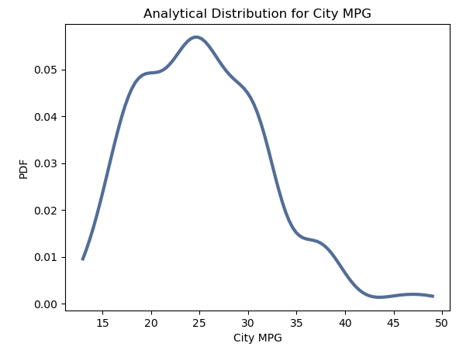
Analytical Distribution
Context
Our exploration extends to an analytical distribution plot, focusing on City MPG as a critical variable influencing used car pricing
The analytical distribution provides a fitted probability density function (PDF) that models the theoretical distribution of City MPG in our dataset
Comparing the analytical distribution to the actual data distribution allows us to assess how well the chosen theoretical model aligns with real-world observations..
Interpretation
A close alignment between the analytical distribution and the empirical data suggests that the chosen model accurately represents the distribution of City MPG in the dataset.
This analysis contributes to our understanding of how well theoretical distributions can explain the observed patterns in City MPG, providing valuable insights into the variable's potential impact on used car pricing

Slide 9
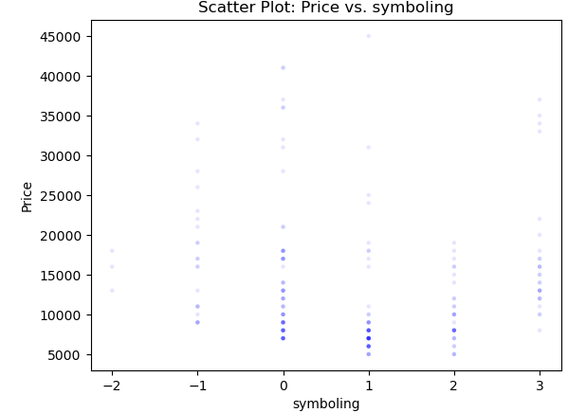
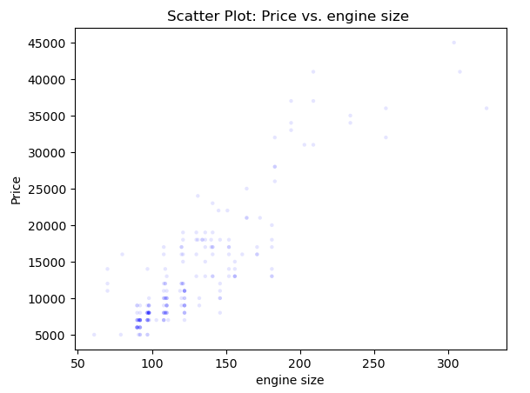
Scatter Plots and Correlation Analysis
Context
In examining the relationship between key variables and car prices, we present scatter plots for Symboling and Engine Size against Price.
This plot illustrates the dispersion of car prices based on their Symboling values, providing insights into how safety ratings may correlate with pricing
Here, we observe how the engine size of cars corresponds to their prices, aiming to uncover potential patterns in the dataset.
A noticeable trend in the scatter plot suggest a correlation between Symboling and Price. Positive Symboling values may not correspond to higher prices, but more demand.
A positive correlation in this scatter plot imply that larger engine sizes are associated with higher prices. This could signify a market preference for cars with more powerful engines, impacting pricing dynamics.

Slide 10
Hypothesis Testing - City MPG and Car Prices
Context
To investigate our hypothesis regarding the impact of city mileage on used car prices, we conducted a classical hypothesis test using a t-test.
Results
T-statistic: -10.286158439804916 P-value: 3.0489665978885816e-20
Reject the null hypothesis: There is a significant difference in prices between cars with high and low city mileage.
Interpretation
The negative t-statistic indicates that cars with higher city mileage tend to have significantly lower prices than those with lower city mileage.
The p-value being much smaller than the significance level (alpha) supports the rejection of the null hypothesis.
This finding suggests that city mileage is a significant factor influencing used car prices

Slide 11
Regression Analysis Conclusion
Model Summary
R-squared: 0.783
Adj. R-squared: 0.779
F-statistic: 180.5
Prob (F-statistic): 3.40e-65
Interpretation
Conclusion
Constant (Intercept): 1629.34
Baseline 'price' when all predictors are zero.
City MPG (citympg): -257.88
For each unit increase in city MPG, 'price' decreases by $257.88 (non-significant).
Highway MPG (highwaympg): 6.74
Not statistically significant (p-value > 0.05).
Symboling: -55.27
Not statistically significant (p-value > 0.05).
Enginesize: 141.61
For each unit increase in enginesize, 'price' increases by $141.61 (statistically significant).
The model is statistically significant.
Only 'enginesize' significantly predicts 'price'.
Other variables lack significant associations.
The model explains 78.3% of 'price' variance.

Slide 12
Thank You!

