Slide 1

Sprocket Central Pty Ltd
Data analytics approach
[Division Name] - [Engagement Manager], [Senior Consultant], [Junior Consultant]

Slide 2
Agenda
Introduction
Data Exploration
Model Development
Interpretation

Slide 3
Introduction
Sprocket Central Pty Ltd is a long-standing KPMG client whom specialises in high-quality bikes and accessible cycling accessories to riders.
Marketing team is looking to boost business by analysing their existing customer dataset to determine customer trends and behaviour.
Data analysis content
Age distributions
Number of bike purchases in 3 years by gender
Job industry distribution.
Wealth segments by age and gender
Number of cars own on each states

Slide 4
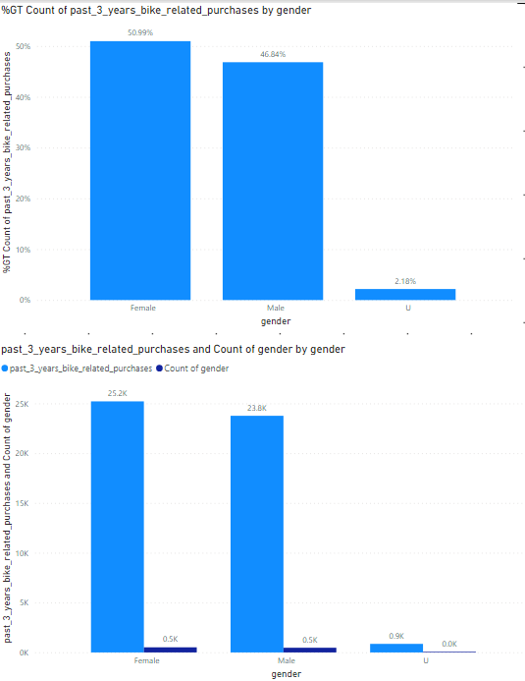
Data Exploration
Bike purchases over last 3 years
Over the 3 years 50% of bike purchases were by females and 48% of purchases by males .Around 2% by unknown gender.
Females have more bike purchases than males
Females have majority bike sales.

Slide 5
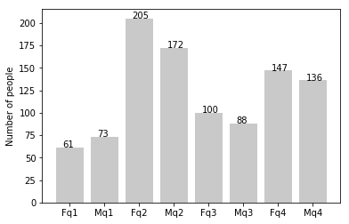
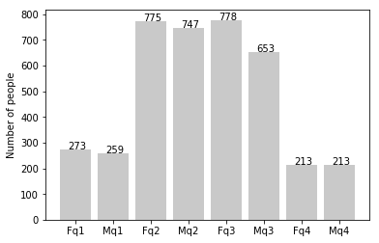
Note: The data and information in this document is reflective of a hypothetical situation and client. This document is to be used for KPMG Virtual Internship purposes only.
Data Exploration
new
Customers’ age distribution
As we can see, mostly our new customers are between 25 to 48 years old.
Number of customers from 48 to 59 years old has big drops on percentages.
There is a slightly increase in number of customers over 59 years old in term of percentages
It looks like the percentages of under 25 years old not really change.
old

Slide 6
Note: The data and information in this document is reflective of a hypothetical situation and client. This document is to be used for KPMG Virtual Internship purposes only.
Data Exploration
new
Customers’ age distribution
As we can see, mostly our new customers are between 25 to 48 years old.
Number of customers from 48 to 59 years old has big drops on percentages.
There is a slightly increase in number of customers over 59 years old in term of percentages
It looks like the percentages of under 25 years old not really change.
old

Slide 7
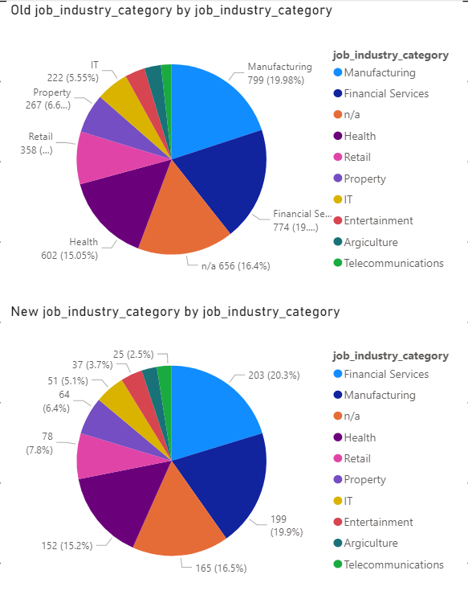
Note: The data and information in this document is reflective of a hypothetical situation and client. This document is to be used for KPMG Virtual Internship purposes only.
Interpretation
Job industry category
Mostly our new customers are on Finance industry and our Manufacturing customers are still on top 2.
The smallest number of customer are in agriculture and telecommunication.
The rest industries is still same

Slide 8
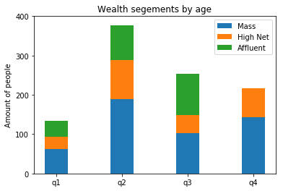
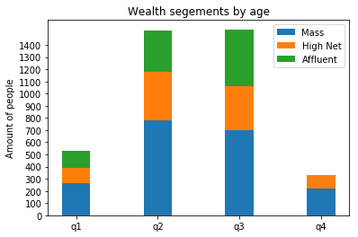
Interpretation
Wealth segments
In all ages, the number of Mass Customers is the highest so we should focus on this social class.
After that, we should focus on High Net Customer.
Then Affluent Customers but mostly second and third quadrant

Slide 9
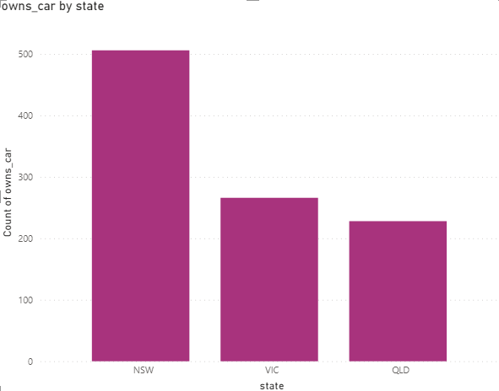
Interpretation
Numbers of cars owned
NSW should be considered the most since numbers of customers don’t own cars is significantly larger than that own.
VIC and QLD has more customers that own car that who don’t but we can try to have something so that those owns car will buy bikes.

Slide 10
Note: The data and information in this document is reflective of a hypothetical situation and client. This document is to be used for KPMG Virtual Internship purposes only.
Appendix

Slide 11
Appendix
All supporting items in that attachment.

