Slide 1

DIABETES PREDICTION USING
MACHINE LEARNING

Slide 2
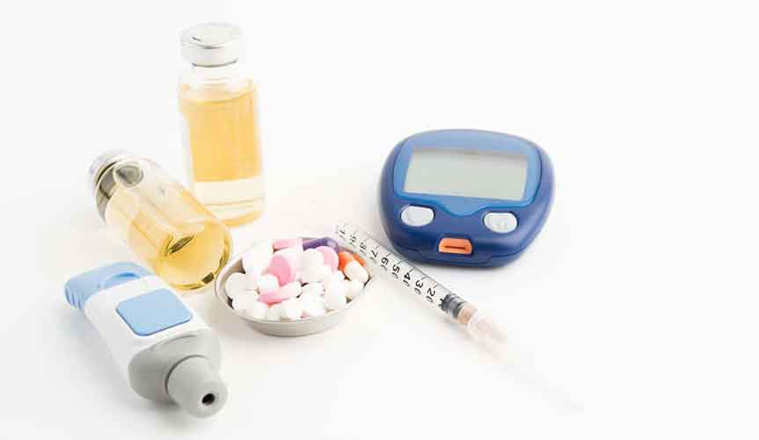
Diabetes is a disease that occurs when the blood glucose level becomes high , which ultimately leads to other health problems such as heart diseases , kidney diseases , etc. Diabetes is caused mainly due to the consumption of highly processed food , bad consumption habits , etc. According to WHO , the number of people with diabetes has been increased over the years.

Slide 3
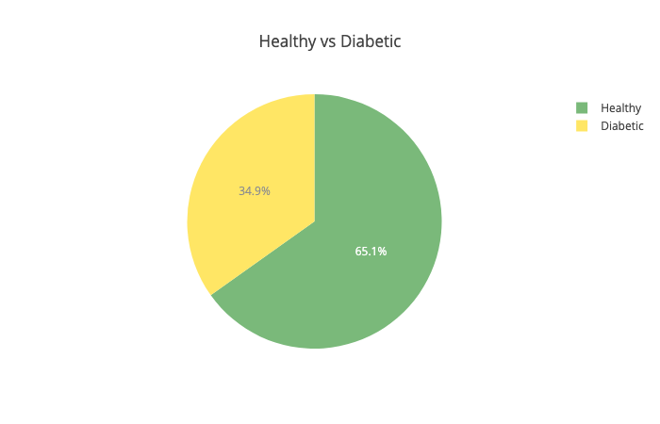
End-to-End Data Science
Here we used Machine Learning to predict whether a person has diabetes or not, based on information about the patient such as blood pressure, body mass index (BMI), age, etc.

Slide 4
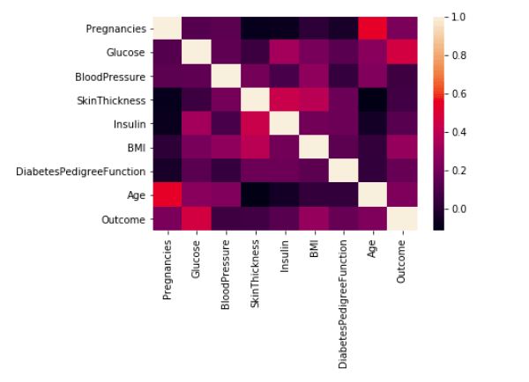

Slide 5
The following features have been provided to help us predict whether a person is diabetic or not:
Pregnancies: Number of times pregnant
Glucose: Plasma glucose concentration over 2 hours in an oral glucose tolerance test
Blood Pressure: Diastolic blood pressure (mm Hg)
Skin Thickness : Triceps skin fold thickness (mm)
Insulin: 2-Hour serum insulin (mu U/ml)
BMI: Body mass index (weight in kg/(height in m)2)
Diabetes Pedigree Function: Diabetes pedigree function (a function which scores likelihood of diabetes based on family history)
Age: Age (years)
Outcome: Class variable (0 if non-diabetic, 1 if diabetic)

Slide 6
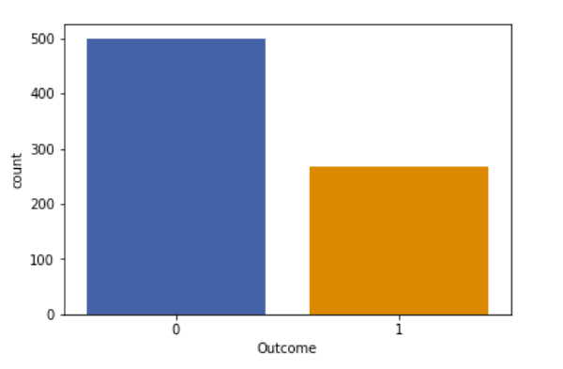
Bar plot visualization of number of non-diabetic (0) and diabetic (1) people in the dataset

Slide 7
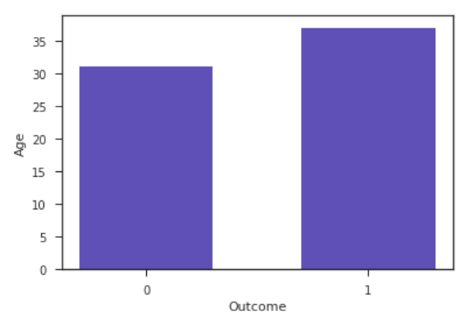
Average age of non-diabetic and diabetic people in the dataset

