Slide 1
DCT-Based Image Steganography in C
CAPSTONE PROJECT
Presented By:
Deeksha L J
-- Mangalore Institute of Technology & Engineering, Moodabidre
-- CSE-IoT & Cybersecurity with Blockchain Technology

Slide 2
OUTLINE
Problem Statement System
Development Approach
Algorithm & Deployment (Step by Step Procedure)
Result
Conclusion
Future Scope
References

Slide 3
Problem Statement
This project addresses the need for secure and covert communication by hiding secret information within digital images. Traditional spatial domain techniques, which modify pixel values directly, are easily detected and vulnerable to compression. To overcome this, the project applies Discrete Cosine Transform (DCT)-based steganography to embed data in the frequency domain, making it less perceptible. The solution targets 8-bit grayscale BMP images (256×256) and implements efficient encoding and decoding in C while preserving image quality.

Slide 4
System Approach
System requirements
- Windows / Linux system with C compiler (GCC or MinGW)
- 4 GB RAM (minimum)
- 256×256 grayscale BMP image as input
- Command-line terminal for compilation & execution
- Recommended: Visual Studio Code or any C IDE

Slide 5
System Approach
Library required to build the model
Standard C Libraries:
- stdio.h → File I/O
- stdlib.h → Memory management
- math.h → DCT calculations
Custom Project Library:
- dct.h → DCT & IDCT functions

Slide 6
Algorithm & Deployment
Algorithm
Divide the image into 8×8 blocks of pixels.
Apply Discrete Cosine Transform (DCT) to each block.
Embed secret bits by modifying the LSB of selected DCT coefficients.
Apply inverse DCT, reconstruct the image, and save as stego-image.

Slide 7
Algorithm & Deployment
Deployment
Compile the C code using GCC or MinGW on your system.
Run the executable to encode or decode messages.
Provide required input files (BMP image, secret text).
View output stego image and decoded message in terminal.

Slide 8
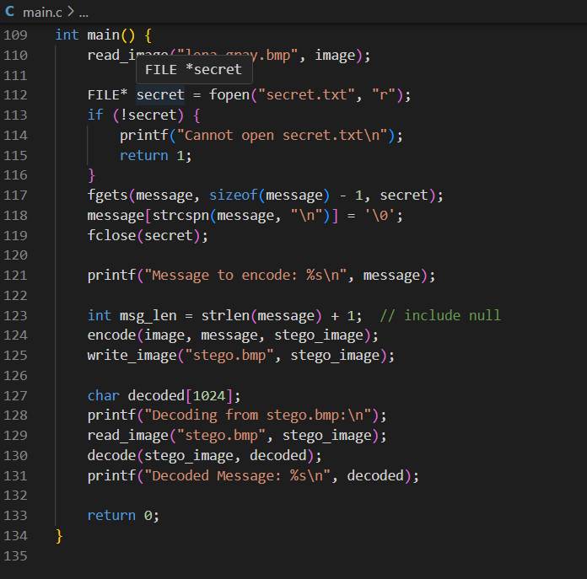
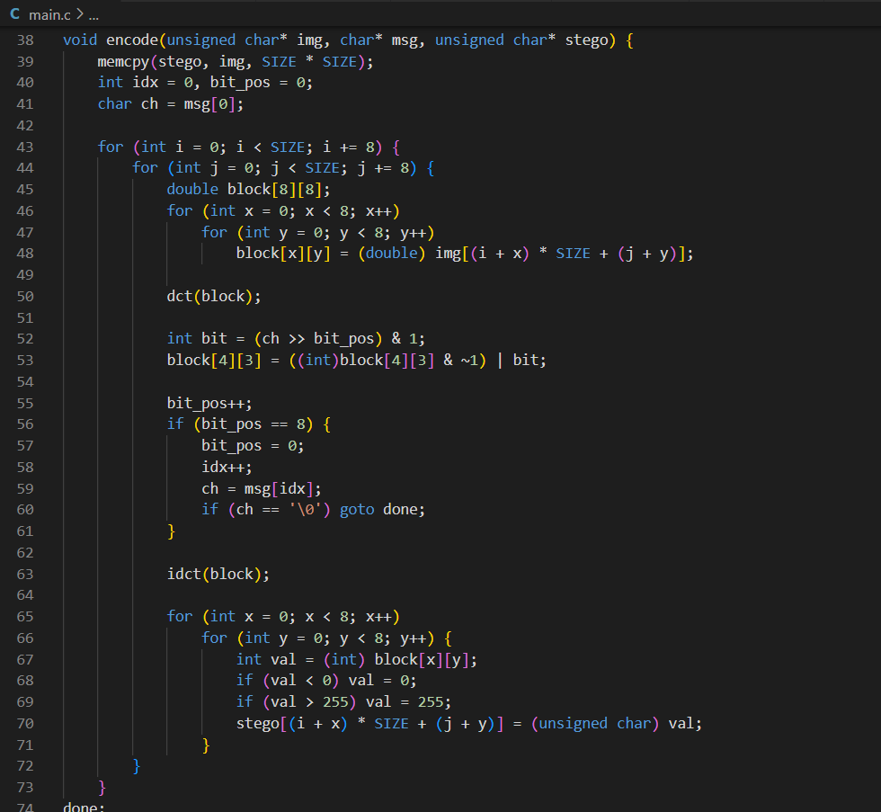
Result

Slide 9
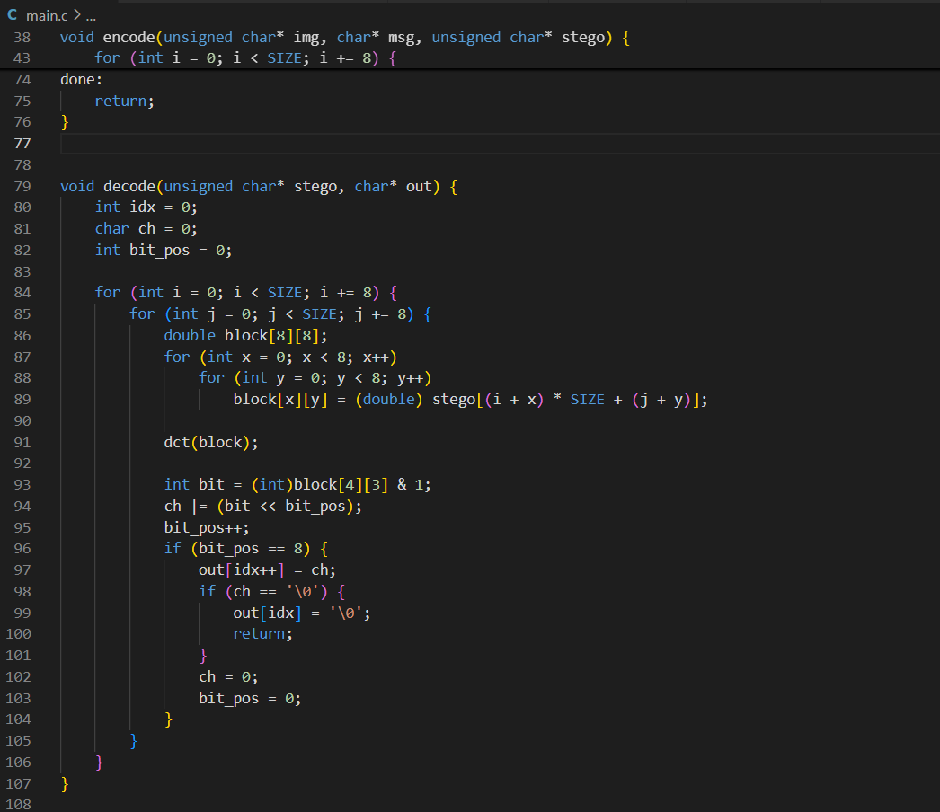
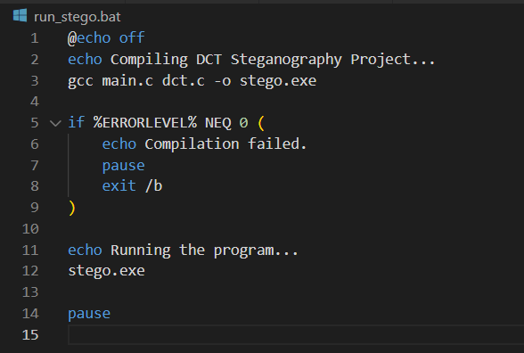
Result

Slide 10

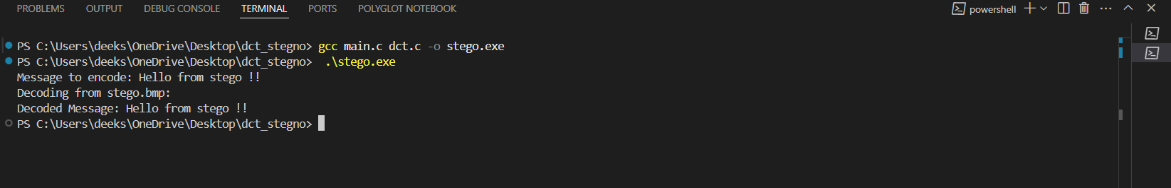
Result
Github link
https://github.com/deeksha2824/dct_stegno_c

Slide 11
Conclusion
The proposed DCT-based steganography effectively hides messages within grayscale images with minimal visible distortion, ensuring secure data embedding. Decoding retrieves messages accurately. Challenges included handling BMP image format limitations and ensuring precise bit manipulation in C. Potential improvements are extending support to color images, increasing payload capacity, and adding encryption for enhanced security.

Slide 12
Future scope
Extend the method to support RGB/color images for higher data capacity.
Integrate encryption techniques for added security before embedding.
Improve compression resistance to withstand JPEG or other lossy formats.
Develop a GUI tool for user-friendly encoding and decoding.

Slide 13
References
R. Chandramouli and N. Memon, “Analysis of LSB based image steganography techniques”, Proceedings of ICIP 2001, Vol. 3, pp. 1019-1022. DOI:10.1109/ICIP.2001.958943
N. Provos and P. Honeyman, “Hide and seek: An introduction to steganography”, IEEE Security & Privacy, vol. 1, no. 3, pp. 32–44, 2003. DOI:10.1109/MSECP.2003.1203220
J. Fridrich, “Applications of data hiding in digital images”, Proceedings of the Conference on Information Sciences and Systems, 1999.
M. Hussain and M. Hussain, “A survey of image steganography techniques”, International Journal of Advanced Science and Technology, vol. 54, pp. 113-124, 2013.

Slide 14
THANK YOU

