Slide 1
Toronto Real-Estate Investment Development

Slide 2
Key facts about the Real Estate Prices In Toronto
Did you know that the average price of real estate properties have risen by at least 70% in the last 5 years in Toronto.
Did you know apartments are the most affordable housing type in Toronto. An average price around 500K$.
Toronto eastern district 01 is the most expensive area to live in in 2021.

Slide 3
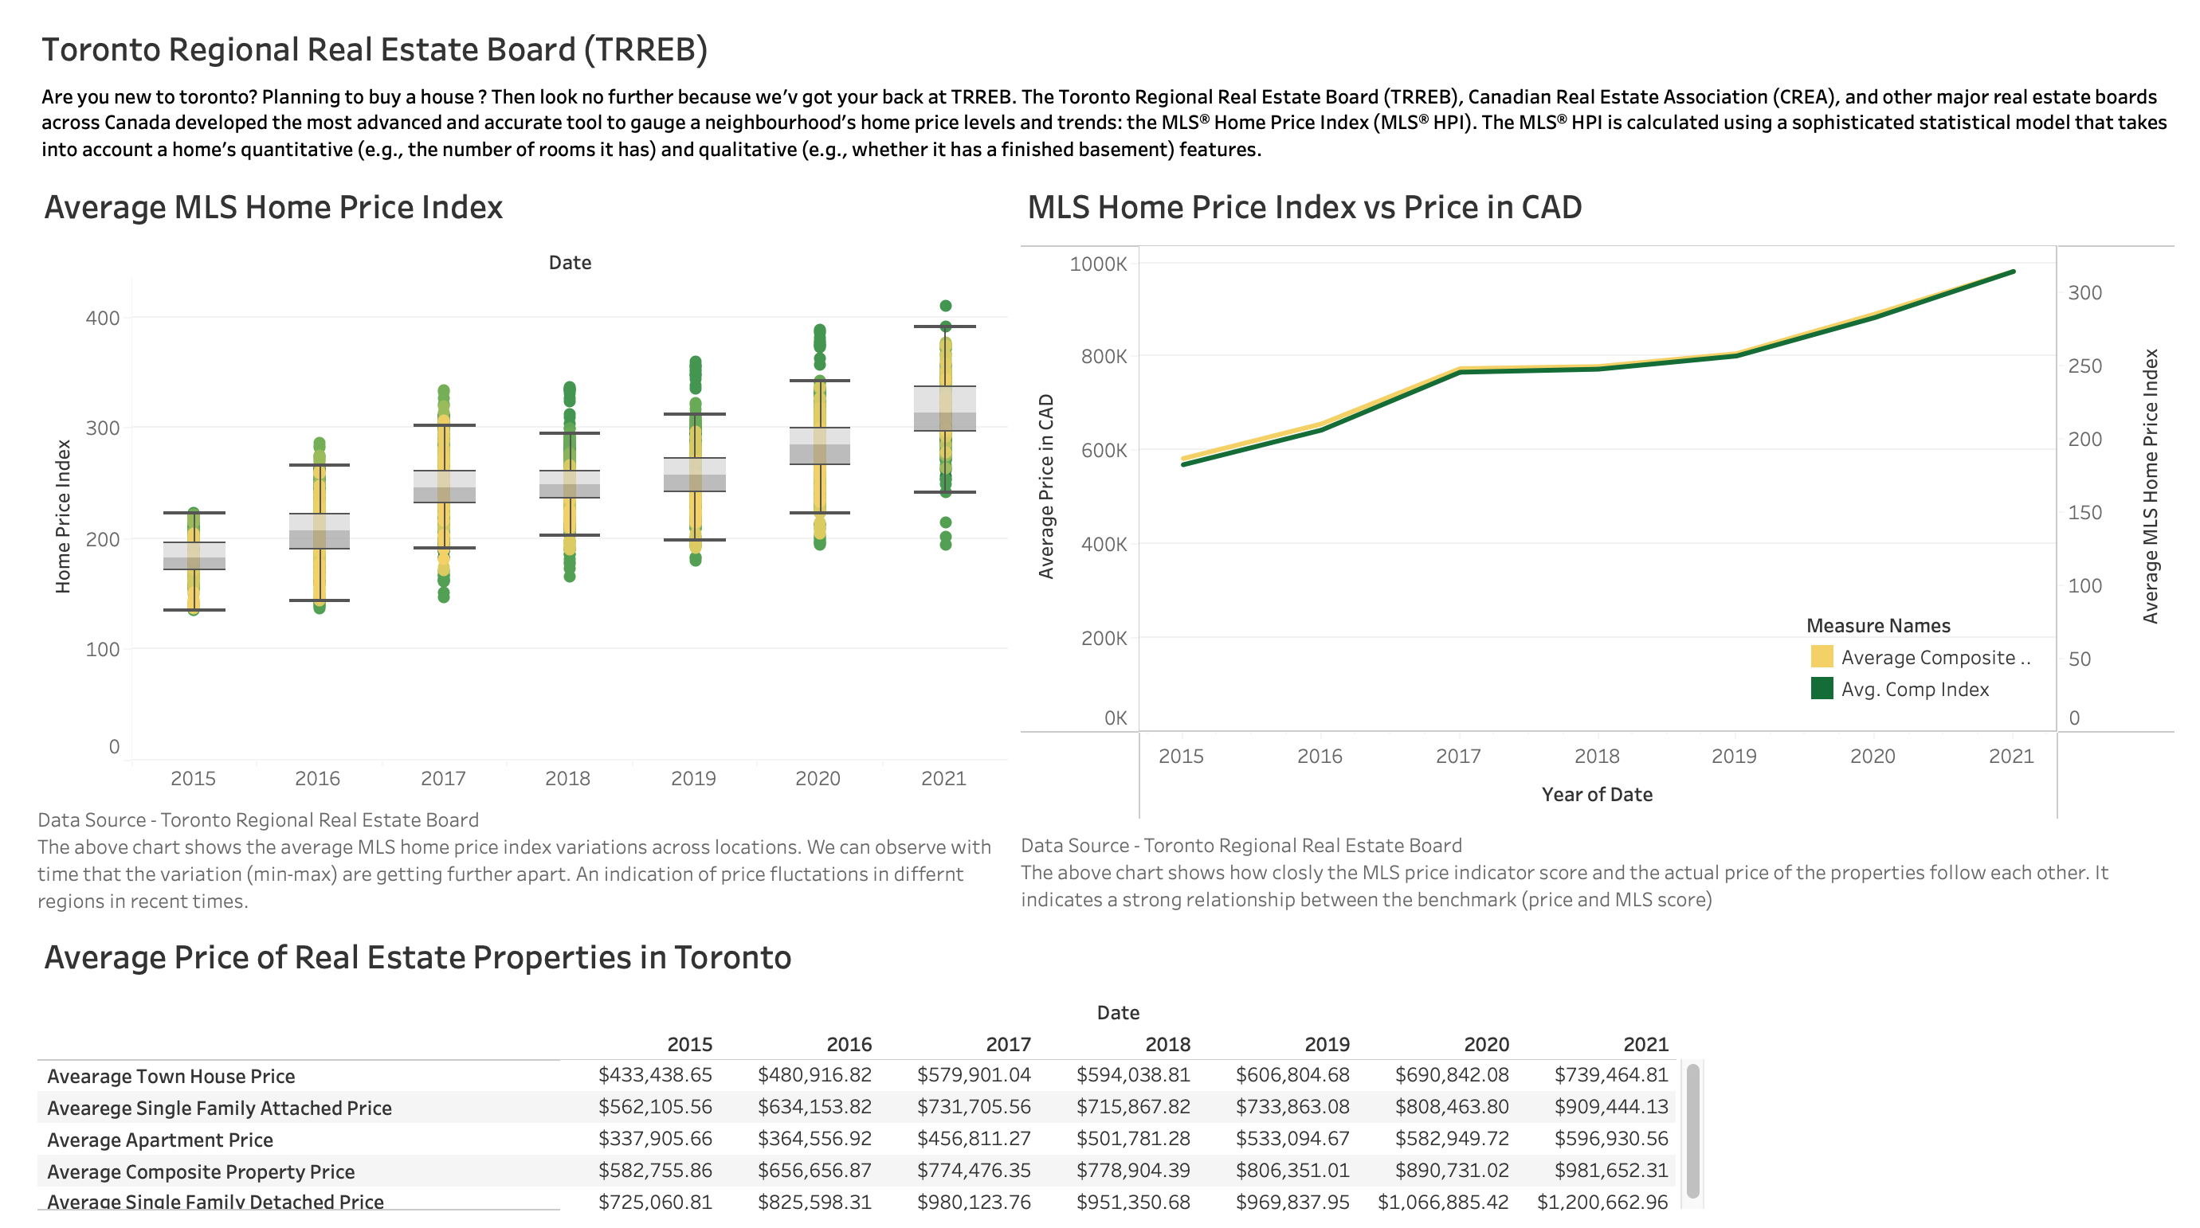

Slide 4
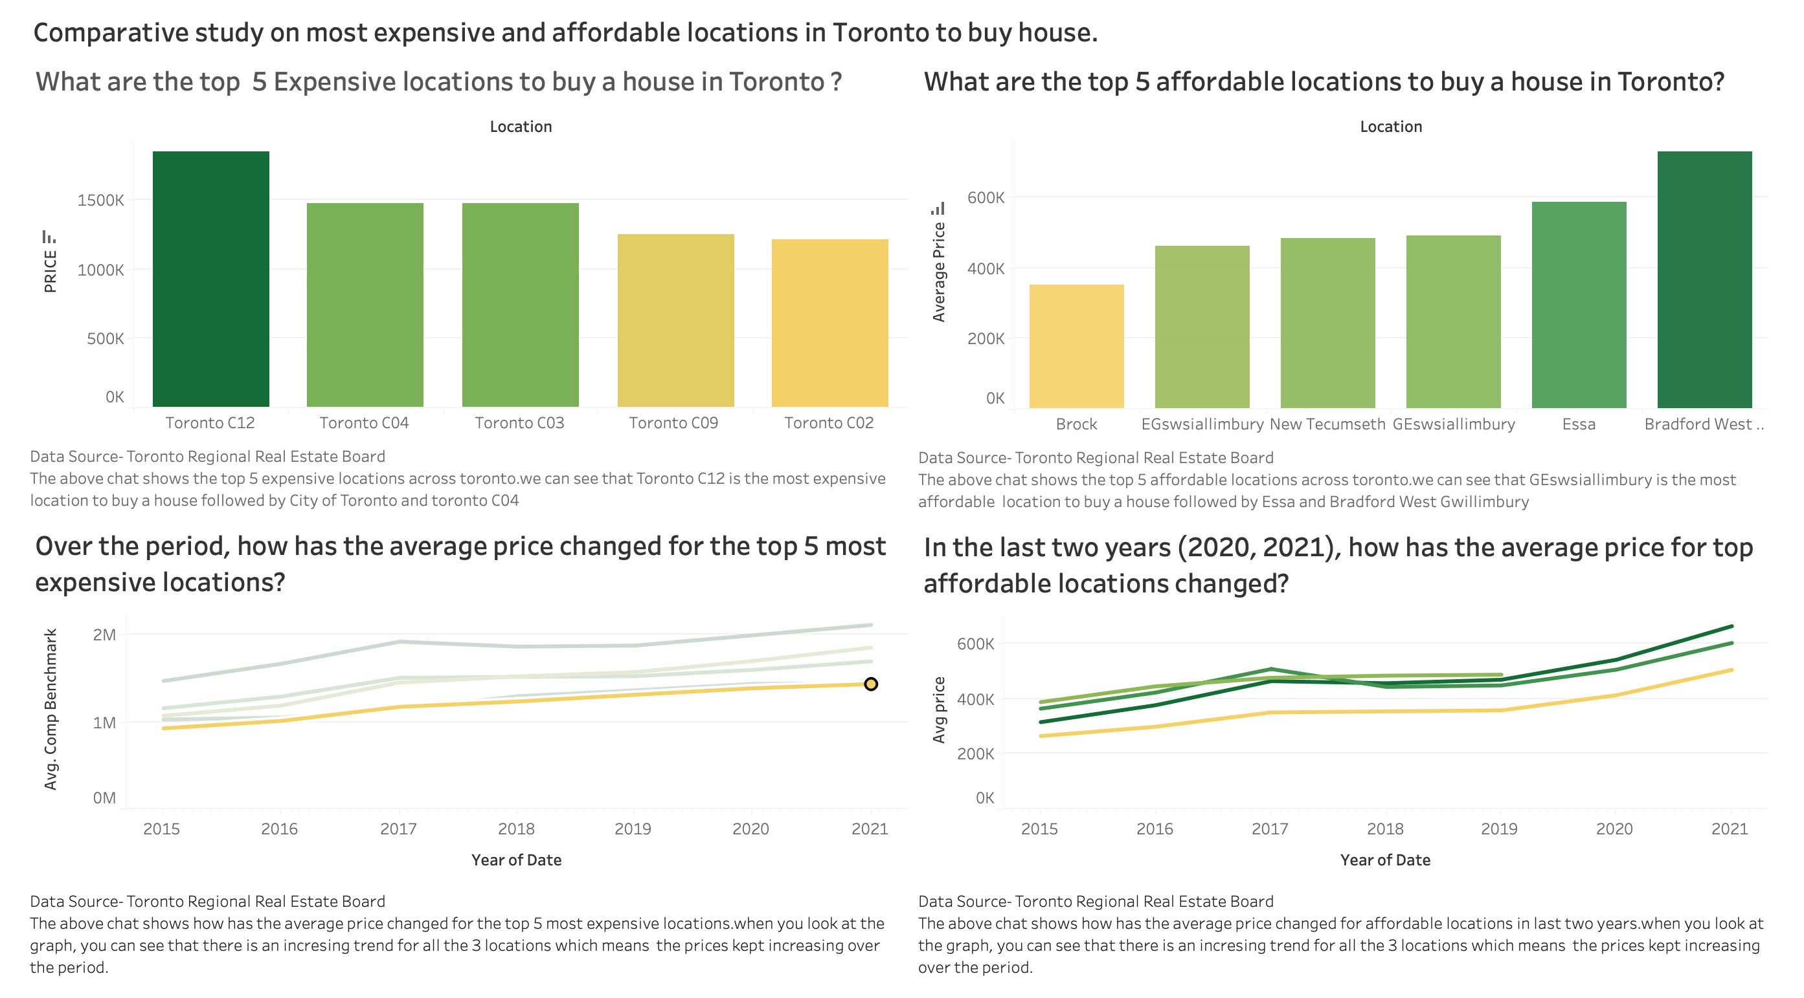

Slide 5
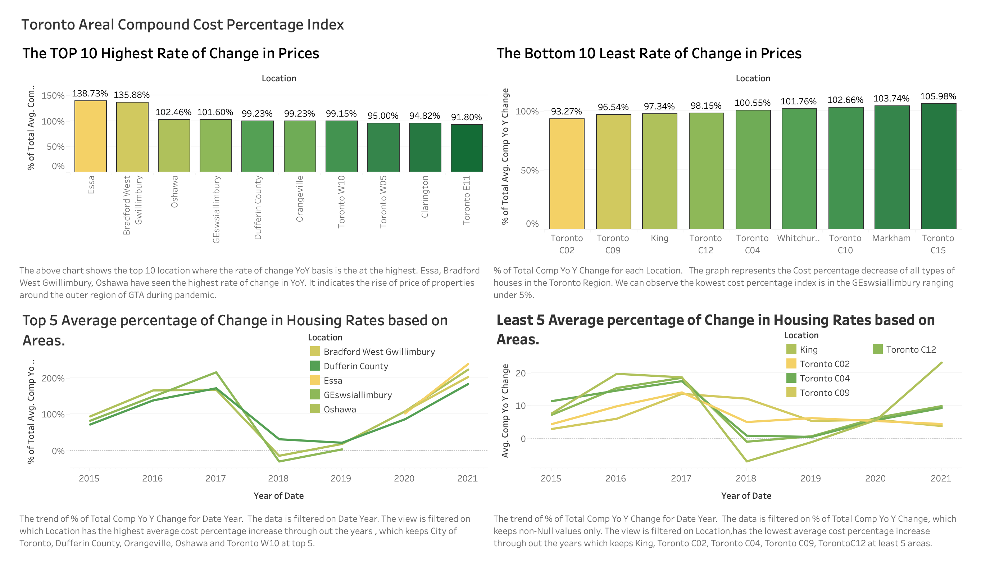

Slide 6
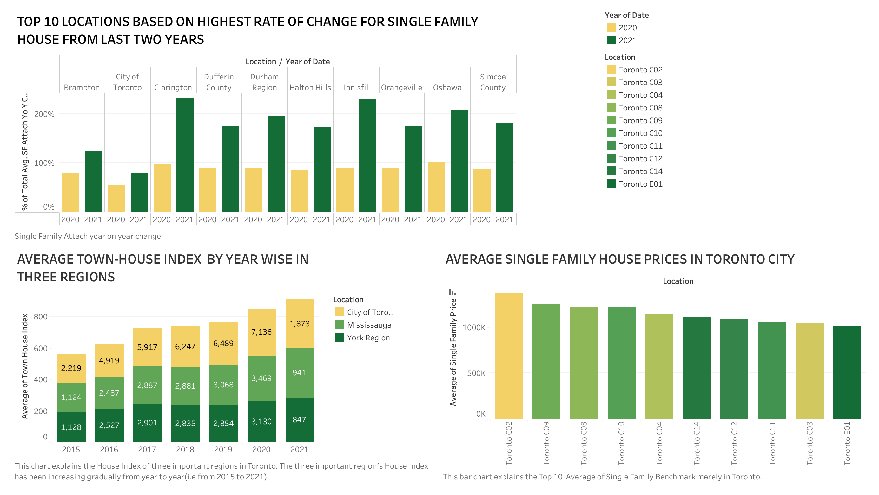

Slide 7
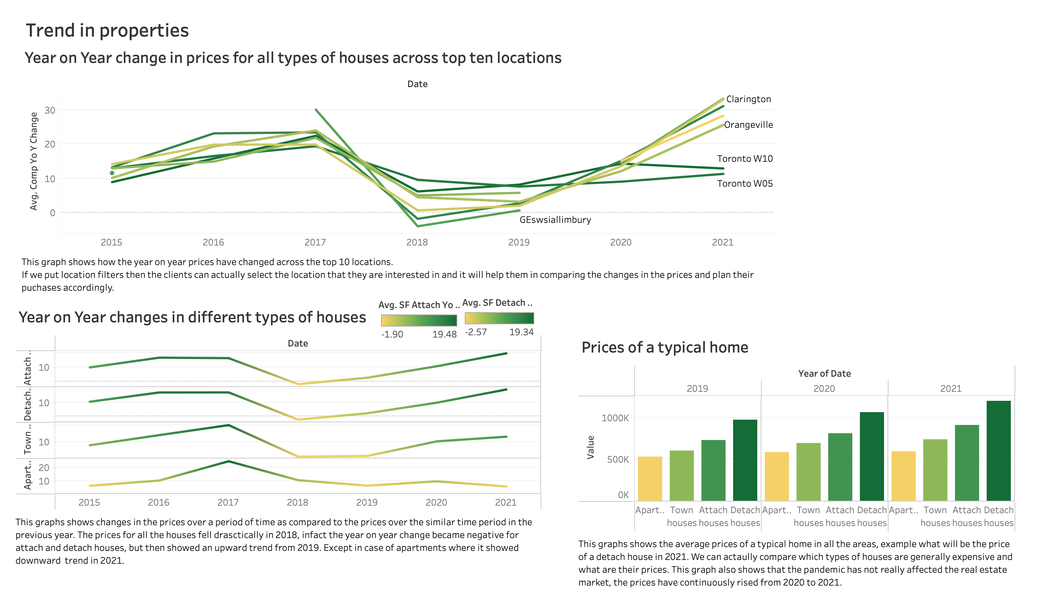

Slide 8
Conclusion
MLS Home price index follows the actual property prices closely and are highly correlated.
York mill is the most expensive region in Toronto with average price in the range of 1.8M$. The most affordable region is Bradford West Gwillimbury.
The City of Toronto has observed the highest rate of change. Oshawa has observed the least change in YoY rate.
The detached family home are the most expensive type of property to purchase.

Slide 9
Future Scope
The data is updated quarterly by the Toronto Regional Real Estate Board. We can make an online dashboard.
The map of GTA would add further additional information. It would be an intuitive way to look at the real estate prices.

Slide 10
Thank you

