Slide 1
Business Scenario – FAULT DETECTION
When deciding upon resourcing plans it is important to consider likely fault volumes. Since the orders that fuel the provision work are typically taken 2 weeks in advance, a forward looking forecast of fault volumes would enable a more accurate prediction of the number of provision volumes to take on each week.
You have been provided with the fault volume and rainfall data for a single geographic area for 3 years. Please use this data to create a model to predict the expected daily fault intake based on weather events. Detailed explanation of the fields provided is given below.
At the interview you will be given 10 minutes to present your findings. The presentation should give an overview of your findings and be targeted at a senior stakeholder level. Please provide a copy of your findings for review before the interview.
Things you may want to consider in the model;
1. Both short term and long term impact of rainfall
2. Impact of weather events on different fault types
3. Other things that might impact fault volume

Slide 2
DATA PROCESSING
Key Features of Data Processing
    Short Term Fault’s (15 to 21 Days)
    Long Term Fault’s (29 to 35 Days)
Scenarios for Data Analysis
    Cumulative rainfall (mm) for 7 days
    Past 7 Days rainfall from day 1 to day 7
Data Cleaning
    Remove top 7 days and last 21 days from short term Fault’s Data
    Remove top 7 days and last 35 days from Long term Fault’s Data
    Remove all NAN/NA while processing records

Slide 3
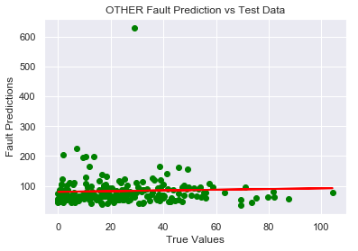
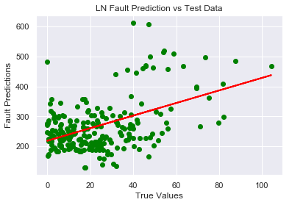
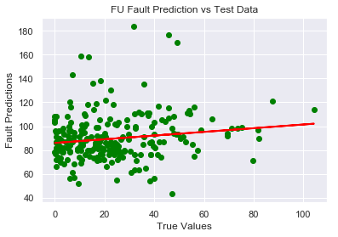
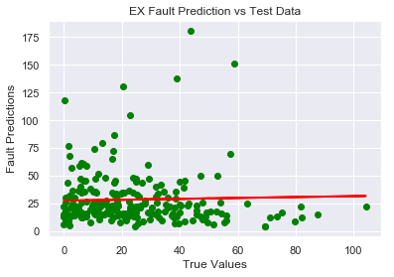
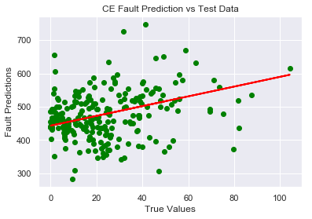
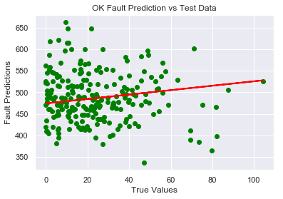
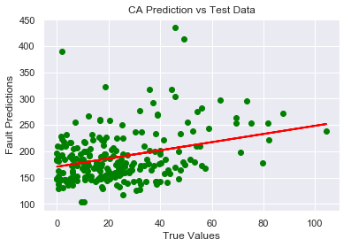
PREDICT FAULT INTAKE

Slide 4
FAULT INTAKE
SHORT TERM (15 to 21 Days) LONG TERM (29 to 35 Days)
RMSE of different types of Faults is small.
As the duration increase between Days of Rainfall and Fault Prediction week, the error between true label and predicted label is small.
RMSE of different types of Faults is large.
As the duration increase between Days of Rainfall and Fault Prediction week, the error between true label and predicted label is large.

Slide 5
IMPACT OF WEATHER EVENTS ON DIFFERENT FAULT TYPES
The faults apart from EX has RMSE between 10% to 45%. And these are all positively co-related (between 0.1 to 0.3) with the rainfall (only slightly dependent).
The model is able to predict different faults with following RMSE :
For EX type faults, the correlation is negative and the model has very high RMSE. (Long Term RMSE = 204%, Short Term RMSE = 125% )
FAULT TYPE | SHORT TERM RMSE (%) | LONG TERM RMSE (%)
LN: E-side Underground network | 29.48 | 32.71
FU: Frames (exchange) | 21.34 | 21.56
CE: D-side overhead network | 12.09 | 14.24
CA: Customer appointed (home) | 22.58 | 24.49
OK: Line has tested OK | 12.09 | 14.24
OTHER: Other faults | 43.38 | 44.75

Slide 6
OTHER THINGS THAT MIGHT IMPACT FAULT PREDICTION
Wind
Temperature
Age of Machine
Maintenance
Electricity Demand
Natural disaster like earthquake, lightning etc.

Slide 7
          THANK YOU!

