Slide 1

Low Resource Sentiment Analysis
Sentiment analysis is a valuable tool for e-commerce companies, providing insights into customer sentiment. By analyzing customer feedback, businesses can identify areas for improvement in their products or customer service, leading to enhanced sales and customer loyalty.

Slide 2
Understanding the Challenges of Low-Resource Sentiment Analysis
1
Limited Labeled Data
2
Computational Constraints
Scarcity of annotated datasets in under-represented languages like Hindi poses a significant challenge for training robust machine learning models. These models require extensive data to learn the complex linguistic patterns and nuances present in the language.
Resource-limited environments often lack access to powerful hardware like GPUs, which are crucial for training complex deep learning models, especially those based on large language models like BERT.
3
Storage and Memory Limitations
4
Code-Mixed Data
Limited memory and storage capabilities make it challenging to deploy large language models, which require substantial resources for processing and storing the trained parameters.
Hindi text often incorporates English words and phrases, creating a unique challenge for sentiment analysis as models need to understand both languages and their interrelationships.

Slide 3
Hindi Dataset: Movie and Product Reviews
Dataset Type
Split
Total
Positive
Negative
Neutral
HINDI (MOVIE)
Train
2475
1039
743
693
Validation
309
121
108
80
Test
309
121
96
92
HINDI (PRODUCT)
Train
4177
1838
1754
585
Validation
522
225
225
72
Test
522
240
214
68
The datasets, compiled from IIT Patna, consist of movie and product reviews annotated with sentence-level sentiment labels: positive, negative, and neutral. Each review also includes word-level language identification, capturing the presence of English words within the Hindi text.

Slide 4

ML BASED APPROACH

Slide 5
Data Preprocessing
1
1. Cleaning and Preprocessing
The text is cleaned by removing special characters, punctuation, and extra spaces, while also converting it to lowercase. Stop words are removed to reduce noise and focus on meaningful words.
2
2. Translation
The cleaned Hindi text is translated into English using Googletrans to leverage the rich resources available in the English NLP domain.
3
3. Stemming
Stemming reduces words to their root form to unify variations of the same word, improving model generalization by treating variations as the same concept.
4
4. Vectorization
Bag-of-Words (BoW) vectorization is employed, creating a numerical representation of the text by counting the frequency of each word. This process transforms text data into a format suitable for machine learning algorithms.

Slide 6
Machine Learning Approaches for Sentiment Analysis
Naive Bayes (NB): A probabilistic classifier based on Bayes' theorem, it assumes independence among features.
Support Vector Classifier (SVC): A supervised learning algorithm that seeks the optimal hyperplane to separate different classes.
Logistic Regression (LR): A statistical model that predicts the probability of a binary outcome, useful for sentiment classification.
Random Forest (RF): An ensemble learning technique that combines multiple decision trees to improve accuracy and reduce overfitting.
K-Nearest Neighbors (KNN): A non-parametric lazy learning algorithm that classifies data points based on their similarity to nearest neighbors.
Gradient Boosting (GB): An ensemble method that sequentially builds an additive model by fitting weak learners on the residuals of the previous ones, improving model accuracy and generalization.

Slide 7
Machine Learning Approaches for Sentiment Analysis
Model
Movie Review Dataset Performance
Product Review Dataset Performance
Multinomial Naive Bayes
Accuracy: 0.40, F1-score: 0.39, Precision: 0.42, Recall: 0.37
Accuracy: 0.58, F1-score: 0.53, Precision: 0.60, Recall: 0.48
Support Vector Machine (SVM)
Accuracy: 0.45, F1-score: 0.33, Precision: 0.35, Recall: 0.31
Accuracy: 0.61, F1-score: 0.56, Precision: 0.63, Recall: 0.51
Random Forest
Accuracy: 0.41, F1-score: 0.41, Precision: 0.43, Recall: 0.39
Accuracy: 0.55, F1-score: 0.50, Precision: 0.52, Recall: 0.49
Gradient Boosting
Accuracy: 0.40, F1-score: 0.38, Precision: 0.41, Recall: 0.36
Accuracy: 0.61, F1-score: 0.59, Precision: 0.64, Recall: 0.56
K-Nearest Neighbors (KNN)
Accuracy: 0.43, F1-score: 0.30, Precision: 0.32, Recall: 0.29
Accuracy: 0.43, F1-score: 0.43, Precision: 0.45, Recall: 0.42
Logistic Regression
Accuracy: 0.45, F1-score: 0.44, Precision: 0.47, Recall: 0.42
Accuracy: 0.54, F1-score: 0.51, Precision: 0.55, Recall: 0.48
We evaluate the performance of several traditional machine learning models, including Multinomial Naive Bayes, Support Vector Machines, Random Forest, Gradient Boosting, K-Nearest Neighbors, and Logistic Regression. Performance is measured using metrics such as accuracy, precision, recall, and F1-score on both movie and product review datasets. Gradient Boosting and Logistic Regression showed promising results, achieving higher accuracy and F1-scores on both datasets and SVC was consistent in both the dataset.

Slide 8
CNN
APPROACH

Slide 9



Deep Learning Approach: CNN on BERT Embeddings
1. BERT Embeddings
2. Convolutional Neural Network
3. Classification
BERT (bert-base-multilingual-cased) is used to generate contextualized word embeddings, capturing the semantic meaning of each word within the context of the sentence.
The output of the CNN is passed through a fully connected layer that predicts the sentiment class (positive, negative, or neutral) for each review.
The generated embeddings are then fed into a CNN model with multiple convolutional and pooling layers to extract local patterns and features from the embeddings.
To overcome the limitations of traditional ML, we employ a deep learning approach by using BERT for generating contextualized word embeddings, which are then processed by a Convolutional Neural Network (CNN) for sentiment classification.

Slide 10
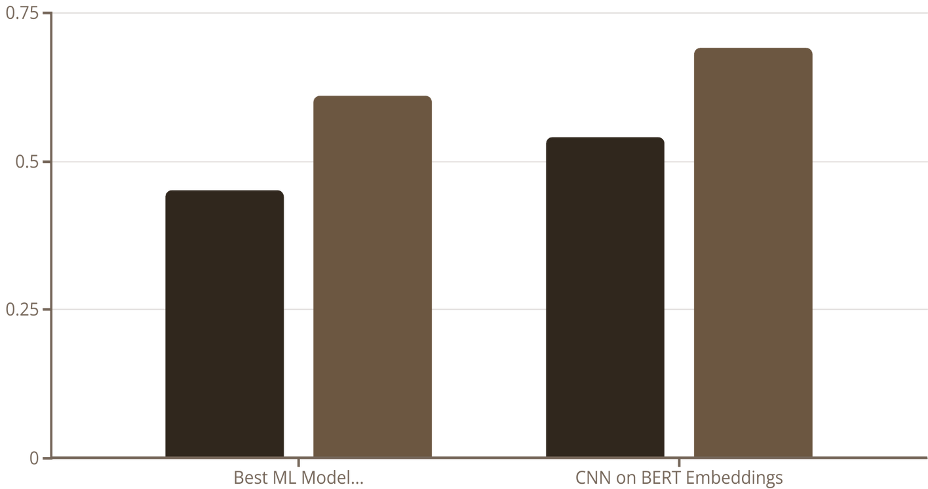
Model Performance Comparison: ML vs. Deep Learning
Movie Dataset Accuracy
Product Dataset Accuracy
The CNN-based deep learning approach consistently outperforms the traditional ML models, achieving higher accuracy on both datasets. This highlights the potential of leveraging powerful pre-trained language models like BERT for low-resource sentiment analysis.

Slide 11




Future Research Directions
Advanced Deep Learning Architectures
Fine-tuning Pre-trained Language Models
Larger and More Diverse Datasets
Ensemble Methods
Combining traditional and deep learning models to leverage the strengths of both approaches for robust and accurate sentiment analysis.
Expanding the datasets to include a wider range of domains and data sources like social media posts, news articles, and diverse user-generated content to improve model generalization.
Exploring architectures like LSTMs, Transformers, and attention-based models to capture longer dependencies and contextual information in the text, potentially improving performance.
Utilizing advanced BERT variations like RoBERTa and XLM-R, which have been trained on massive multilingual datasets, to enhance sentiment analysis capabilities.
This project sets the foundation for ongoing research in low-resource sentiment analysis. Future work aims to explore advanced deep learning architectures, leverage pre-trained language models, utilize larger and more diverse datasets, and investigate ensemble methods to further improve sentiment classification accuracy.

Slide 12
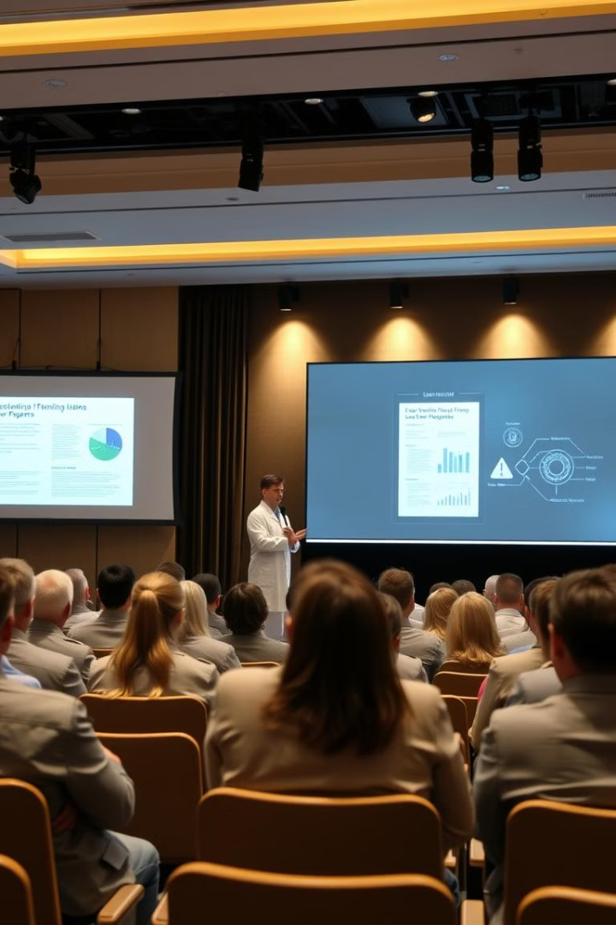
Conclusion
This research demonstrates that deep learning models, particularly a CNN on top of BERT embeddings, outperform traditional machine learning models for sentiment analysis in the low-resource Hindi language. This work paves the way for bridging the gap in NLP coverage for under-represented languages and emphasizes the potential of utilizing these techniques for various real-world applications.

Slide 13
References
Dataset Link
CNN Approach
ML Approach

