Slide 1

Contribution To Honeywell
- By Deeksha Pai

Slide 2
    Niagara Training
    Understood Niagara Workbench and its various aspects.
    Completed Lab exercises, TCP Training.
    Tried to understand the complications faced by a new user and proposed some ideas to overcome these complications.
    Suggested additional functionalities to Niagara.
    Documented aforementioned suggestions.
    Underwent developer training.

Slide 3
NLP Integration With Niagara
Google Home Integration With Niagara
Understood the pre-existent code for Amazon Echo
Added the features requested by the customers for Google Home
Demo was given to the customers
Creation of Topic in Google cloud Platform.
Wrote a code for publisher and subscriber in Java and in Python to communicate via Topic on Google Cloud

Slide 4
Integration with Facebook Messenger which acts like a Chat Bot
Created a module in Niagara and adding Java code of publisher and subscriber in Intellij for the purpose of integration with Niagara.
Optimization of process
Removal of unnecessary libraries and adding dependencies to the existing ones

Slide 5
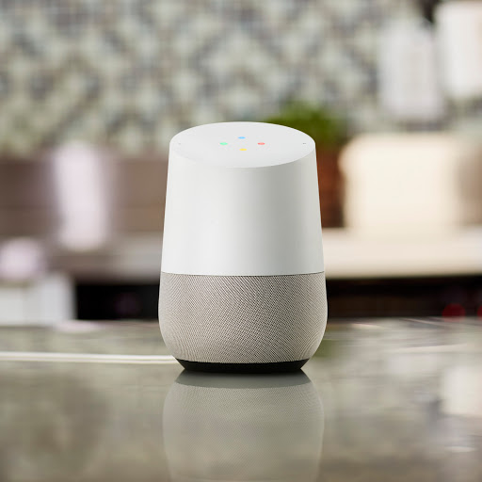
Google Home :
Google Home is a smart speaker developed by Google. It enables users to speak voice commands to interact with services through Home’s intelligent personal assistant called Google Assistant.
Google Home also has intelligent support for building automation, letting users speak commands to the device to control smart building appliances.

Slide 6
API.AI :
API.AI is a developer of human-computer interaction technology based on natural language conversion. It is used for creating agents for Google Assistant.
API.AI Rest-like HTTP endpoints. It allow you to submit queries and manage and modify the various parts of your agent( Intent, entity etc)

Slide 7

The Task
The task was to integrate Google Home with Niagara
Where the users speaks to Google Home asking for it to increase or decrease the temperature, light intensity, or set the media or VAV status ON or OFF, Open or close the blinds.
Google Home sends this information to Niagara via API.AI, Niagara processes the user requests and send back the reply via API.AI to Google Home. Google Home then sends a voice responds to the user.

Slide 8
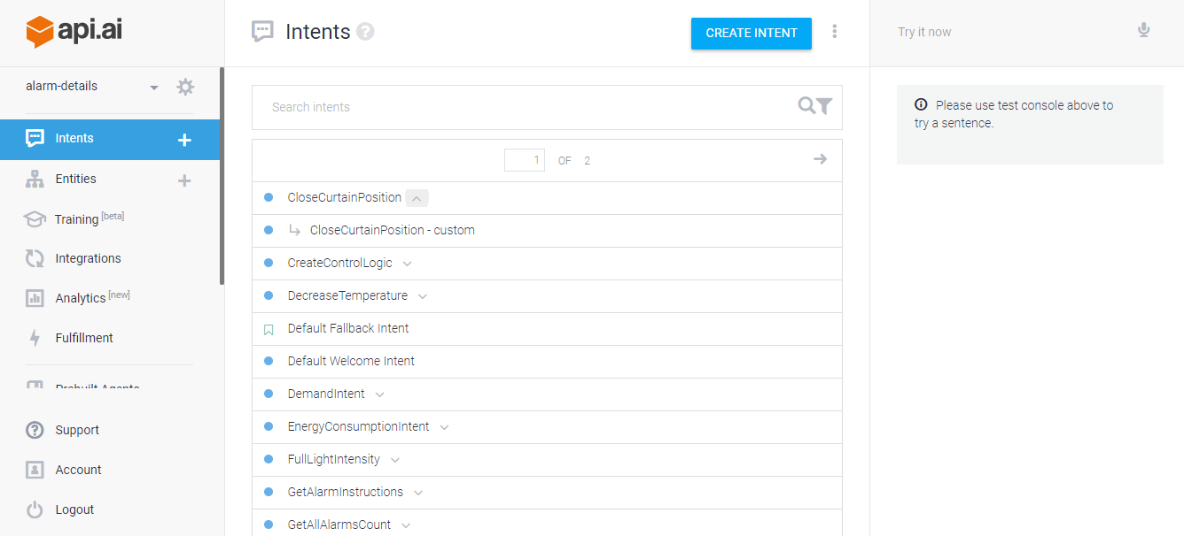

Slide 9
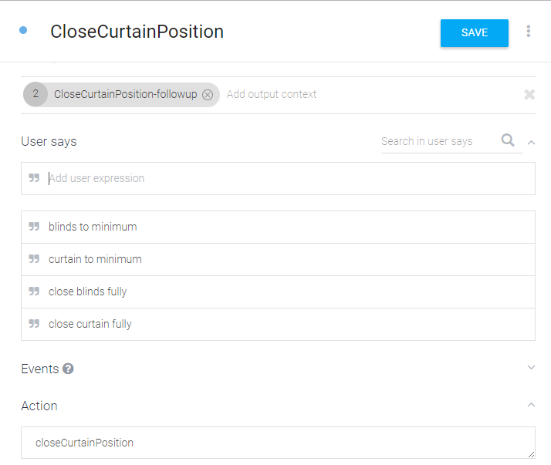

Slide 10
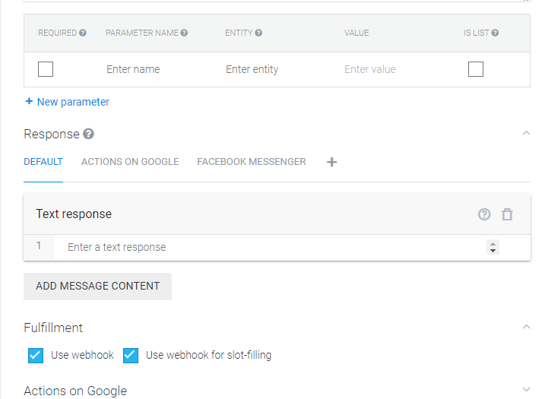

Slide 11
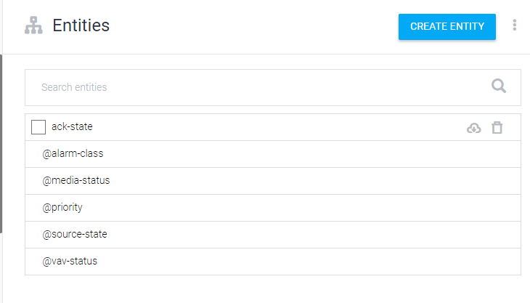
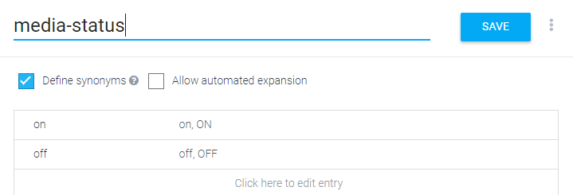

Slide 12
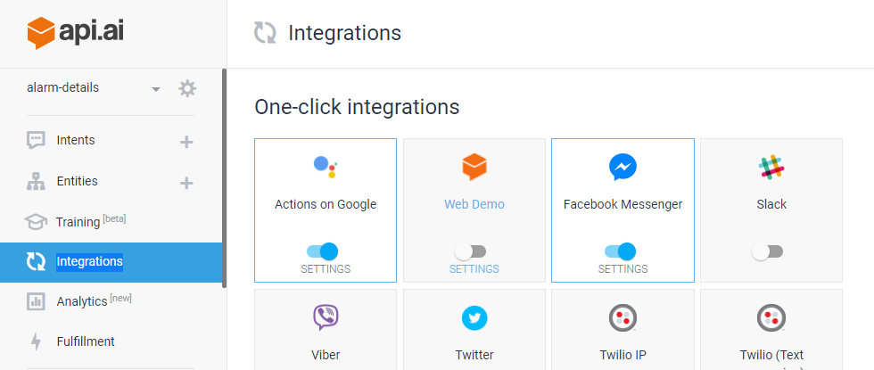

Slide 13
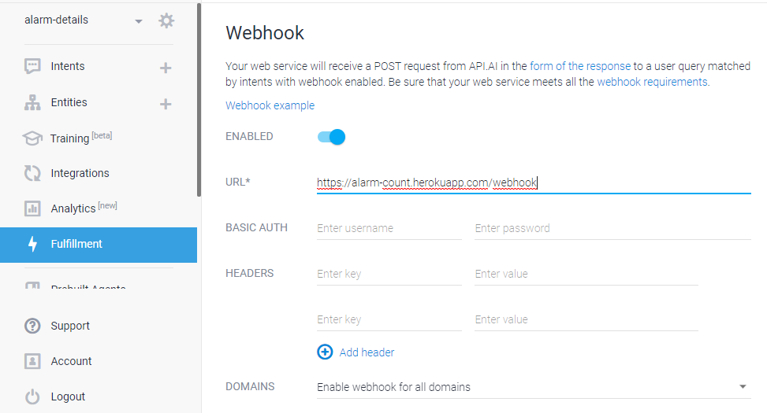

Slide 14
Web simulator was used to check with the voice commands
Method 1:
Google Cloud Platform was used to create a Service Account and download it as a json file because it was required for authentication
The code for integration was written in Python in webhook
This code was added in Github, including the service account in json format and was then deployed in Heroku
The URL obtained here is then added to the fullfilment part in API.AI
This makes the connection from API.AI to webhook.

Slide 15
Heroku :
Heroku is a cloud based Platform as a Service(PAAS).
First cloud platform, and it supports several programming languages.

Slide 16
Method 2 :
More efficient way for integration of Google Home With Niagara
By creating Topics in Google Cloud Platform
Writing a publisher and Subscriber code in java to talk to the topic on cloud.
Publisher code will send a message to topic and subscriber code will subscribe from the topic.
A module was created in Niagara and the Java code was added in Intellij.
Some libraries were third party libraries. Hence uber jar dependencies were added.

Slide 17
Google Home Workflow
User speaks to Google Home.
Google Home extracts the parameters from the speech after figuring out which intent to call.
These parameters are sent to API.AI.
API.AI sends these parameters to the webhook.
Webhook based on the action name forms a payload and publishes this payload to Topic(webhook Pub).
Webhook returns the speech to API.AIs saying that “The data has been sent to Niagara”.
Meanwhile, in Niagara a subscriber to WebhookPub, ie: WebhookSub, keeps on subscribing every 5-10 seconds, waiting for a payload and action name.

Slide 18
As soon as WebhookSub gets the payload, it sends the payload to Niagara and processes the user request.
Once it is done with the processing, it publishes the appropriate message to NiagaraPub
While this process occurs in the background in API.AI, the follow-up intent is triggered, which will again call the webhook
The webhook checks the action name, and if the action name is that of the follow up intent(getNiagaraData), it will try to receive the message from NiagaraPub via the NiagaraSub subscriber
Once it receives this message , the webhook will send it to API.AI via the speech parameter, which will send it to Google Home
Google Home will speak the message to the user.

Slide 19
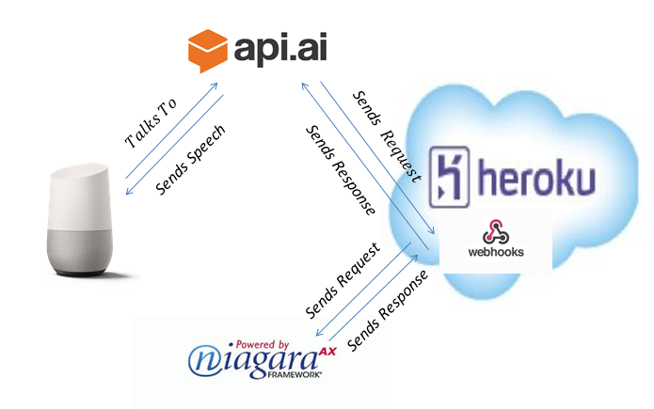
Method 1

Slide 20
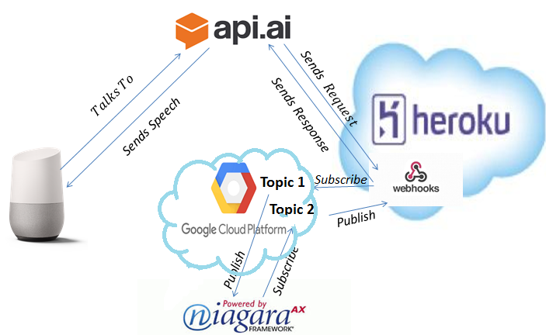
Method 2

Slide 21
Remaining Work
Implementing new features as and when the requirements come from the customer
Look to solve the problem in more efficient way by reducing some of the software tools , trying to get the model working in only one/two platform.

Slide 22
        Thank You

