Slide 1
EVALUATING SPEECH SEPARATION THROUGH PRE-TRAINED DEEP NEURAL NETWORKS MODELS
Jose Ignacio Pozuelo
VIJAY Gurbani
Dan Pluth
Ayush Panda
Notes:
Good morning, my name is Jose Ignacio Pozuelo and together with Vijay Gurbani, Dan Pluth and Ayush Panda we have developed the project that I am going to present: EVALUATING SPEECH SEPARATION THROUGH PRE-TRAINED DEEP NEURAL NETWORKS MODELS

Slide 2
Introduction
Notes:
First of all, let's make a short introduction about what we are trying to achieve and the tools we are going to use to achieve it.

Slide 3
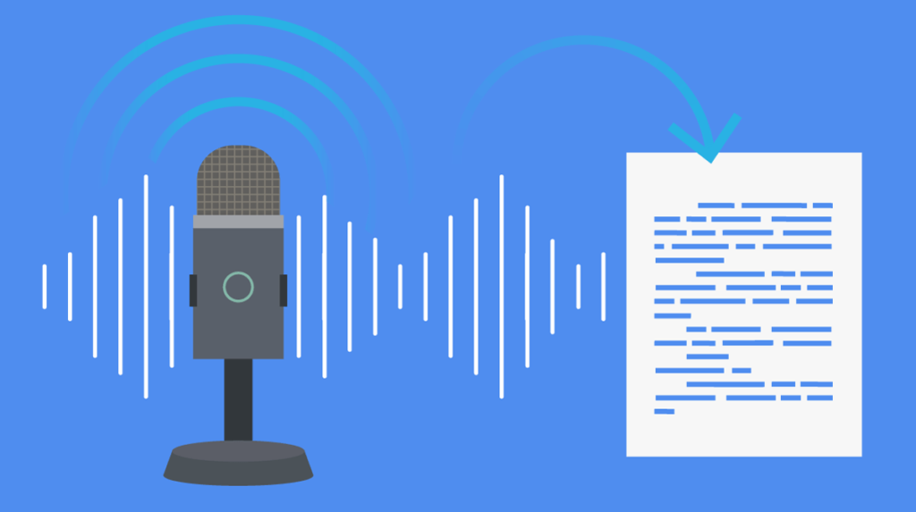
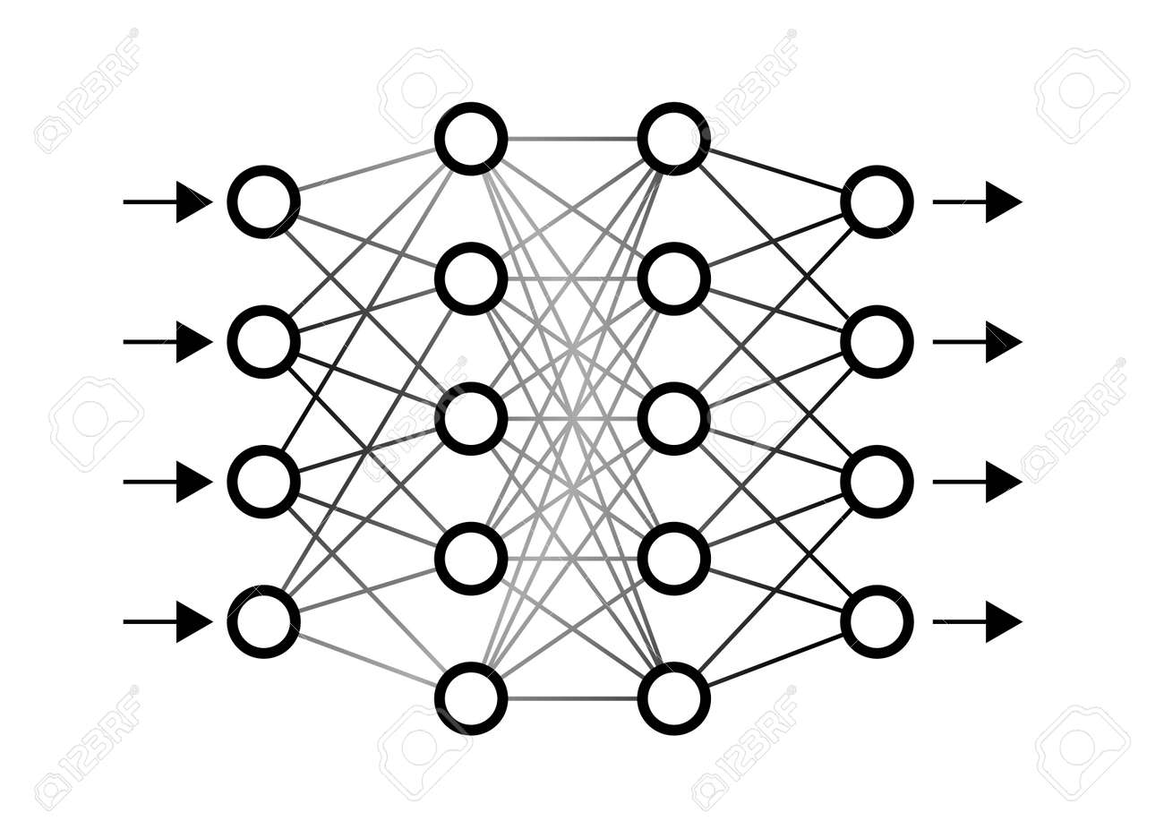
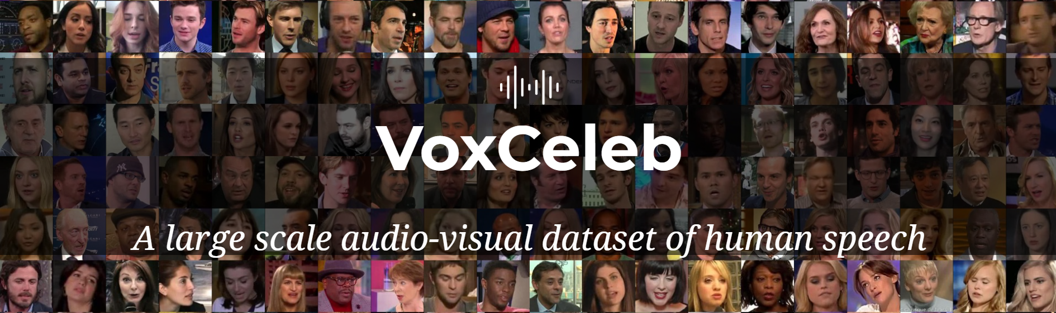

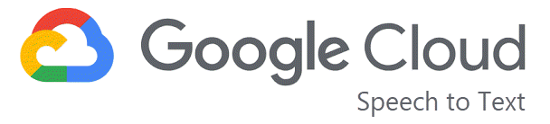
Notes:
Speech separation is the task of separating the target speech from the interference in the background. This is a problem which in recent years has shifted the traditional approach of signal separation to focus on using deep learning algorithms to solve this problem.
Our work uses voices from the VoxCeleb dataset to create mixtures, i.e., two independent voice streams are mixed into one voice stream. Using for speech separation, we subsequently separate the mixed voices into their constituent streams.
To evaluate the quality of after-separation stream, we use Speech-to-Text tools such as AWS Transcribe and Google Cloud Transcribe to obtain transcriptions which will be analyzed through the Word Error Rate (WER) and the MOSNet, so we can draw conclusions about under what kind of circumstances the model offers better results.

Slide 4
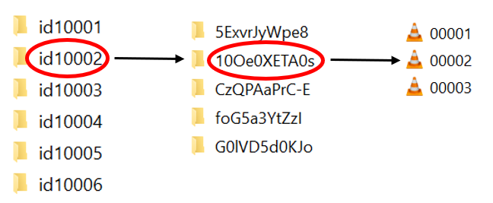
VoxCeleb dataset
Notes:
To do so we will use the Voxceleb dataset which contains over 100,000 utterances of 1,251 celebrities, extracted from videos uploaded to YouTube
Once we have downloaded the compressed dataset, we will proceed to unzip it, in this way we will obtain all the folders corresponding to each celebrity as we can see here. At this point we are ready to mix pairs of different utterances as we will see later.

Slide 5
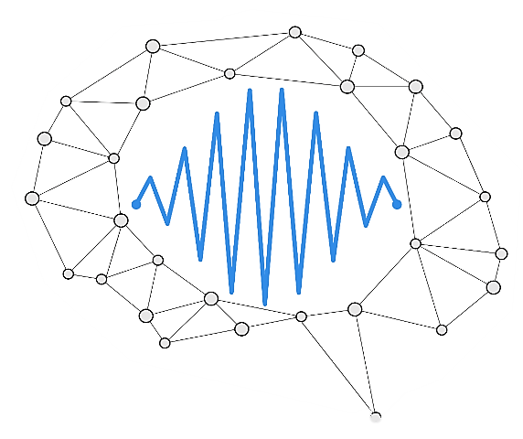
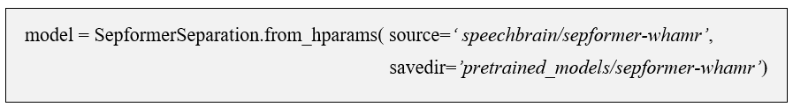
SepFormer model
Notes:
The model we are going to use to perform the audio source separation is a SepFormer model implemented with SpeechBrain, which is an open-source and all-in-one speech toolkit based on PyTorch, and pre-trained with the WHAMR! dataset.
WHARM! is a dataset for noisy and reverberant speech separation. It extends the previous version by introducing synthetic reverberation to the speech sources in addition to the existing noise. Reverberation times were chosen to approximate domestic and classroom environments (expected to be similar to the restaurants and coffee shops where the previous version noise was collected), and further classified as high, medium, and low reverberation based on a qualitative assessment of the mixture’s noise recording.
To create the model, we will use the from_hparams method to fetch and load the location of the pre-trained model (source) and to save the obtained material (savedir).

Slide 6

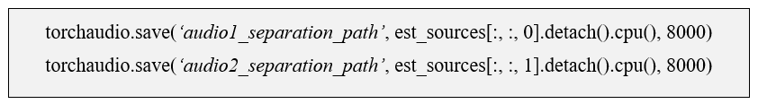
Separation Procedure
Notes:
Once we have the model created, we will use the separate_file method to separate the audio mix we have created, note that the model requires the sampling frequency of the input audio signal to be 8000 Hz.
Next step is proceed to save the new separated audios using torchaudio in the location of our choice specifying the sample rate which in our case is 8000 Hz.
At this point we have the two audios separated and ready to analyze the quality of the separation by different methods that will be explained later.
Before we continue, let's play an example of this separation to give you an idea of how it worked.

Slide 7
Analysis I
Notes:
For this first analysis we will randomly mix the audios by introducing, after normalizing certain parameters, a delay in one of them and without taking into account the lengths of each audio.
First, we will analyze the separation of 15 mixes and based on the general conclusions we obtain we will change the corresponding parameters. Subsequently we will analyze the separation of 80 mixes using a 1 to 5 grading scale to obtain a subjective result of the quality of the separation.

Slide 8
Audio Mixture Procedure
Filter Parameters | Value
Delay | 0 – 3 seconds (random)
Volume | 1.7
Inputs | 2
Duration | shortest / longest
Notes:
To mix the audios the first thing we will do is to randomly choose any audio from all the downloaded ones by browsing through all the folders using a script. Once we have it, we will proceed to normalize them by means of the module of ffmpeg loudnorm.
The purpose of this normalization is to make the mean and maximum value of all audio signals as similar as possible. In this way, when mixing them, we can better check the performance of the model since we eliminate the problems that could be caused by the fact that there are large differences between the mixed audios.
The values have been chosen after a small analysis in which the signal has been measured by testing different values for each parameter. We have found that the values of Integrated Loudness Target and Loudness Range Target have no effect on the mean and maximum values of the signal, so we will use the default values. For Integrated Loudness Target, on the other hand, we will use -25 for all selected audios.
Once we have the normalized audios, we proceed to mix them with the following command in which we specify the path of both audios and the selected sampling frequency, in our case 8000 Hz. Additionally, we will add in -filter_complex a series of parameters that we will discuss below.
To test how it affects the fact that one of the audios starts a little later we will introduce a certain delay in the first input, this delay will be chosen randomly from 0 to 3 s with 0.2 second steps.
We will also increase the volume of both inputs by 70% so that the voices can be heard more clearly, if we increase it much more, we will start to notice a certain distortion that we are not interested in.
Finally, we will choose the length of the audio mix by selecting shortest or longest to keep the length of the longest or the shortest input. To contemplate all the cases the script will choose randomly this parameter.

Slide 9
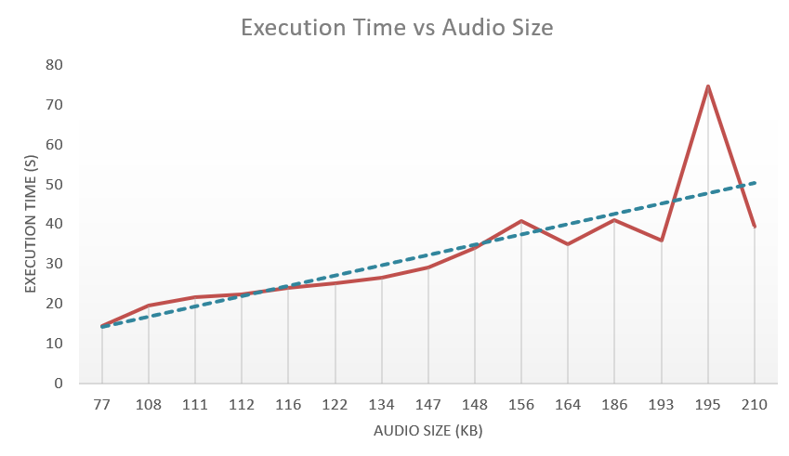
15 Mixture Separation
delay | background noise | audio length | execution time
Introduced Delay → No effect
Length unrelated with after-separation quality
Runtime separation & Mixture size
Notes:
Once we have applied the deep learning model used to separate the mixes, we proceed to perform a first analysis on 15 mixes in which we will analyze a series of basic parameters (delay, background noise, audio length and execution time) to see if we find any clear correlation between these parameters and the final quality obtained after separation.
After this analysis, we draw the following conclusions:
• We verify that the delay introduced in audio 1 has practically no effect in terms of quality level.
• About 70% of the part corresponding to the introduced delays remains practically noiseless or very low.
• The length of the mixed audio does not seem to be related to the quality obtained after separation.
• The model manages to eliminate the background noise almost all the time and it does not affect the final quality.
• As we can see in the graph, the relationship between the run time (time taken by the model to separate the two audios) and the size of the mixed audio file is practically linear.

Slide 10
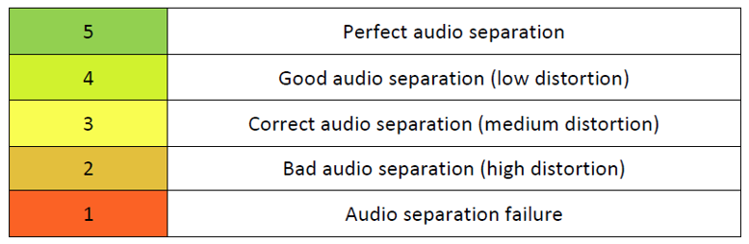
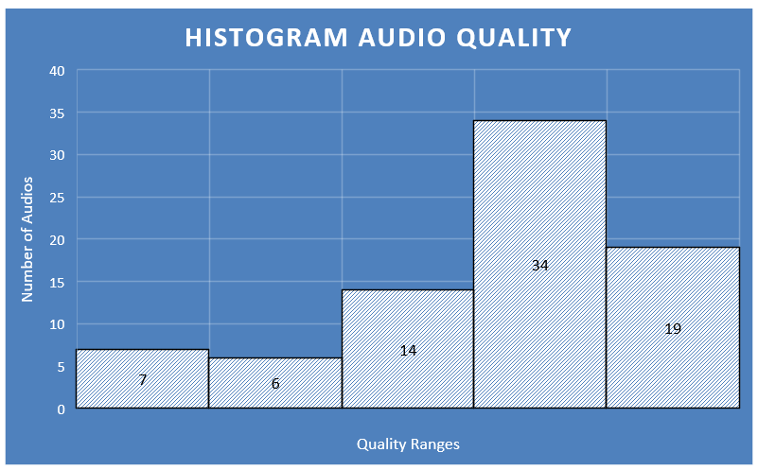
80 Mixture Separation
Different languages → Higher quality after-separation
Audio quality seems to improve towards the end of the audio
Great background music detection and elimination
AVERAGE QUALITY → 3.7
Notes:
Once this preliminary analysis has been carried out, we proceed to analyze a total of 80 mixtures and assign them a quality based on the legend below.
After analyzing the 80 mixes we obtain the following histogram in which the number of audios that have each quality is shown. We can see that the most numerous quality is 4 and the least is 1 (since this means that the separation of the audios has failed). The average quality is 3.7 out of 5.
Once the analysis has been completed, we will discuss a series of observations about the performance of the model:
• Separation when there are 2 very distinctly different languages/accents is much better.
• Audio quality often seems to improve towards the end of the audio.
• When a person gets stuck while speaking it is considered as noise and eliminated.
• The model detects the music very well and usually removes it almost completely when recomposing the audio, often it also removes the background noise when recomposing the audio.
• When a separation fails, both audios usually fail.

Slide 11
Analysis II
Notes:
For this second analysis we will try to obtain an more objective result about how the separation of the audios has worked compared to the originals.
First we will focus on the correct choice of audios, matching only those with the same duration (for this analysis we will use 200 mixes), we will make a series of transcriptions to later compare them with the ones we will obtain after the separation, the metrics we will use will be the Word Error Rate (WER) and the MOSNet to measure the accuracy between the different transcriptions.

Slide 12
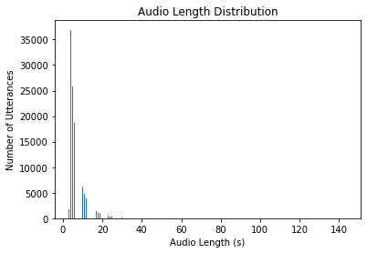
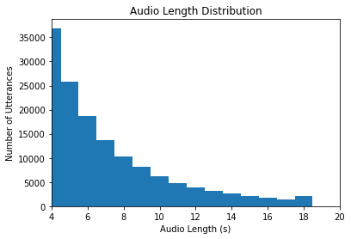
Utterances Selection
400 utterances → random choice (4 – 10 seconds)
Notes:
For this analysis we will choose the utterances to be mixed more carefully so that the results we obtain at the end are as reliable as possible.
For this, after an analysis of all the utterances available in the Voxceleb dataset we can verify that the most common length distribution is approximately between 4 and 10 seconds, so it will be among these utterances the ones we will choose to mix in pairs.
Another change with respect to the previous analysis is that this time the pairs of utterances that we mix will all be of the same length.
Taking all this into account, we will randomly select 400 utterances between 4 and 10 seconds, which after mixing them will give us 200 mixtures to perform our analysis.

Slide 13
Audio Mixture Procedure
Same configuration → Analysis I
Same length in the audios before mixing
No delay
200 mixtures
Notes:
The procedure for mixing the pairs of utterances will be exactly the same as in the previous analysis but with two important modifications.
One that has already been discussed is that the script will randomly mix utterances that have the same length to avoid loss of information. And the other difference is that this time we will not introduce any delay in any of the inputs since we saw previously that it did not provide any relevant result.
After this process we will have 200 mixtures ready to separate with the SepFormer model.

Slide 14
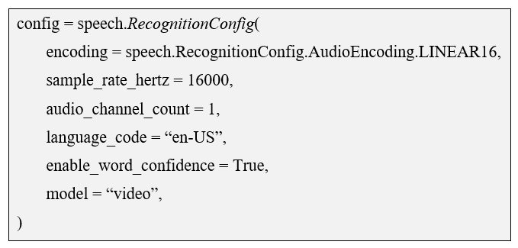
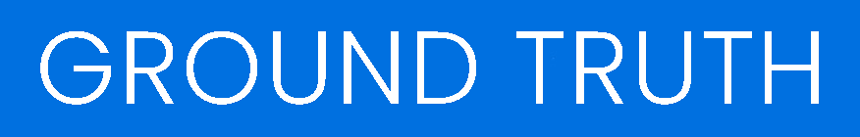
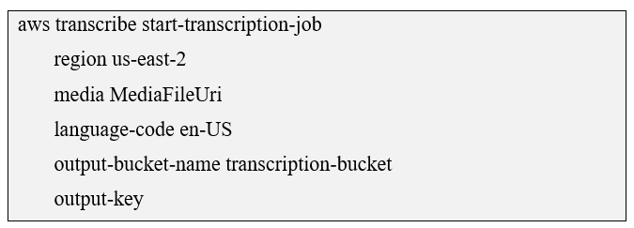
Transcriptions
Canonicalize!
Notes:
In order to check the performance of the model when separating the audios, we are going to make a series of transcriptions both before and after the separation in order to compare them later.
We will use three types of transcriptions: human transcription, Google Cloud Transcribe and AWS Transcribe.
The first transcription we are going to perform is the so-called ground truth transcription, which consists of simply listening to the audios and writing down what is heard as accurately as possible. These transcripts will be used to compare with those obtained by Amazon and Google.
Another of the transcriptions we are going to perform are the Speech-To-Text services provided by Google Cloud through its API. These are the parameters that we will introduce to obtain the transcriptions correctly, the sampling rate of 16000 Hz is the one recommended by Google to obtain better results. The recognition model chosen is called "video", which is the best for audio that originated from video or includes multiple speakers, which is our case.
The last transcriptions we will make will be the ones provided by the Amazon Transcribe tool. As we can see in the image, in this case we have fewer parameters that we can modify, basically the language in which we want the transcriptions and where the audios to be transcribed are located.
Once we have these 3 transcripts, both before and after the separation, we will perform a canonicalization process in order to correctly evaluate the transcripts. This process consists of converting numbers into letters, removing punctuation, special characters, filler words... among other things. Once all this is done, we are ready to start analyzing the transcripts comparing the transcripts obtained before and after the separation to see how much information we have lost.

Slide 15

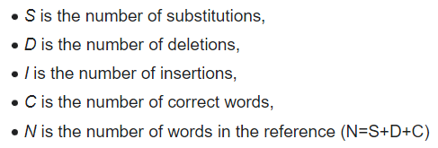
Word Error Rate (WER)
Substitution → “shipping” is transcribed as “sipping”
Deletion → “get it done” is transcribed as “get done”
Insertion → “hostess” is transcribed as “host is”
Notes:
We will now discuss the methods used to evaluate the performance of the model in separating the 200 mixtures.
The first one we will use is the Word Error Rate, which is a common metric for measuring speech-to-text accuracy of automatic speech recognition (ASR) systems. The Word Error Rate is a straightforward concept and simple to calculate – it’s basically the number of errors divided by the total number of words. This is the number of substitutions, deletions and insertions divided by the number of words spoken. Let's see what each of these is:
Substitution: is when a word is replaced
Deletion: is when a word is omitted from the transcript
Insertion: is when a word is added that wasn’t said
Now that we know how this evaluation tool works, we will proceed to apply it to our different transcripts to see what results we obtain.

Slide 16
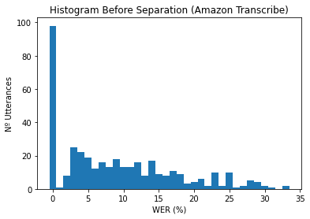
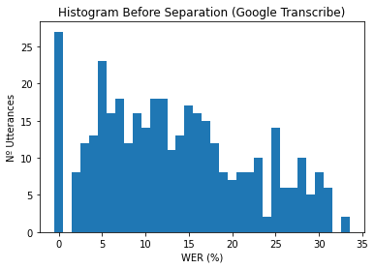
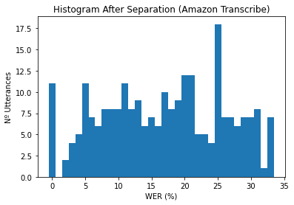
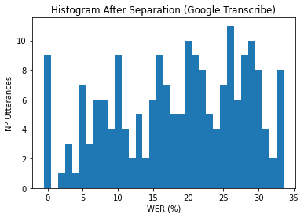
Word Error Rate (WER)
 | Before | After
Human / Amazon | 12.95 % | 33.05 %
Human / Google | 19.15 % | 39.90 %
Notes:
Here we can see the WER results comparing human transcriptions with those obtained by google and amazon. As the table shows, the WER for both before the separation is less than 20% which is an expected value, but after the separation we see that the WER increases practically the same amount in both, this is due to the loss of information occurred in the process of separating both audio streams through our model.
A WER above 35% is not a valid result that can be applied, so in the following histograms we see how the WER values are distributed below this threshold.
The graphs on the left with those corresponding to Amazon Transcribe before and after the separation, you can clearly see how after the separation the values are moving to the left approaching the 35%.
In the graphs on the right, we see the WER values obtained with Google Transcribe, we can see that it has a similar behavior to the previous ones with the difference that the WER before the separation is a little worse than in the case of Amazon.

Slide 17
Word Error Rate (WER)
AFTER-SEPRATION (WER) | Amazon Transcribe | Google Transcribe
WER ≤ 15 % | 104 | 60
15 % < WER < 35 % | 149 | 141
WER ≥ 35 % | 147 | 199
63 %
50 %
Notes:
Here we can see the results obtained after analyzing the WER.
In the first row we have the number of transcripts that have obtained a WER lower than 15%, excellent performance of the model, when compared to human transcripts. On the other hand, in the last row we can see the transcripts above 35%, a result that implies that the audios corresponding to these transcripts are not valid after separation.
Taking into account all this and taking only the first two rows, which are the ones that give us valid results, we obtain that for Amazon Transcribe and Google Transcribe we have 63% and 50% respectively of audios in which after separation the result is good enough to be used.

Slide 18
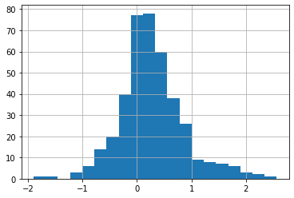
Mean Opinion Score Network (MOSNet)
MOSNet (before) → 3.1
MOSNet (after) → 2.8
Notes:
The Mean opinion score is a measure that represents overall quality of a stimulus or system. For our set of utterances, the original mean score was 3.1 on a range between 0 and 5 with 5 being the best score. After separation the mean score dropped to 2.8, this is almost a 9% decrease. When looking at the overall distribution of scores in the histogram, we see that the score could drop up to 2.5 points in some cases. However, we also notice interestingly that the score actually increases for some separations.

Slide 19
WER DECREASE
3 transcripts
MOSNet INCREASE
2 background noise
&
1 background music
Eliminated
After-Separation
Notes:
We wanted to understand observations at the intersection where the WER decreased after separation using the Amazon ASR engine. (19 samples.), where the WER decreased after separation using the Google ASR engine. (22 samples.) and where the MOS increased after separation. (116 samples.)
The intersection of these 3 conditions gives us 3 observations in which 2 samples had background noise that was eliminated after separation and 1 sample had background music that was eliminated after separation. It seems that background music and noise can be effectively eliminated after separation, but only an empirical observation right now; sample size is too small to draw inferences.

Slide 20
Conclusions
The model works very well when separating male and female voices
The model detects noise and background music very accurately and it is often eliminated
Notes:
As final conclusions we have seen that the model works very well when separating male and female voices, or very different voices. Also that it detects noise and background music very accurately and that after separation it is often eliminated. Seeing these conclusions and the analysis performed we can say that the performance of the model is adequate to apply it in the scenarios that we have discussed above, obtaining quite reliable results.

