Slide 1
Koopman Operator: Modeling nonlinear drone dynamics
Supriya cb.sc.u4aie24025

Slide 2

Why Koopman
Drone motion involves position, velocity, orientation and control inputs.
The relationship between state and next state can be nonlinear.
Simple linear models may not capture complex dynamics accurately.
Koopman represents system evolution through functions of the state.
xk: drone's state at time step \(k\).
x(k+1): state at the next time step.
uk: control input, such as a motor command.
F: function describing the system's state evolution.
k: discrete time-step index.

Slide 3




Koopman operator and Lifting
Symbol | Meaning
x | Original system state
F | State-transition function
g | A scalar-valued observable of the state
K | Koopman operator
psi | Vector of chosen observable functions
z | Lifted state containing the observable values
k | Discrete time index; the subscript indicates a time step
1. Original dynamics
2. Define an observable
3. Koopman operator
4. Lift the state

Slide 4







Formulae- extended DMD
EDMD estimates a finite-dim approximation of the Koopman operator from data.
1. Collect state transitions
2. Evaluate observables
3. Estimate the operator
Symbol | Meaning
m | Number of observed state transitions
Psi(xi) | Vector of observable values at state (xi)
Psi(X) | Matrix of lifted current states
Psi(Y) | Matrix of lifted next states
K | Estimated finite-dimensional Koopman matrix
 | Moore–Penrose pseudoinverse
p | no. of observables

Slide 5
How it connects to our project
Drone state data
  Position, velocity, orientation and control inputs
Learn an approximate model​
  Use data-driven dynamics and suitable observables​
Prediction and control​​
  Use the model to predict future behavior and support control design​​
Advantages
Can represent nonlinear behavior in a lifted feature space.
Learns an approximate model from measured data.
Can support prediction and model-based control.
Limitations
Results depend on the chosen observables and quality of data.
A finite-dimensional approximation may be inaccurate.
Prediction errors can accumulate over time.

Slide 6
Why Koopman
Drone motion involves position, velocity, orientation and control inputs.
The relationship between state and next state can be nonlinear.
Simple linear models may not capture complex dynamics accurately.
Koopman represents system evolution through functions of the state.
xk: drone's state at time step \(k\).
x(k+1): state at the next time step.
uk: control input, such as a motor command.
F: function describing the system's state evolution.
k: discrete time-step index.

Slide 7
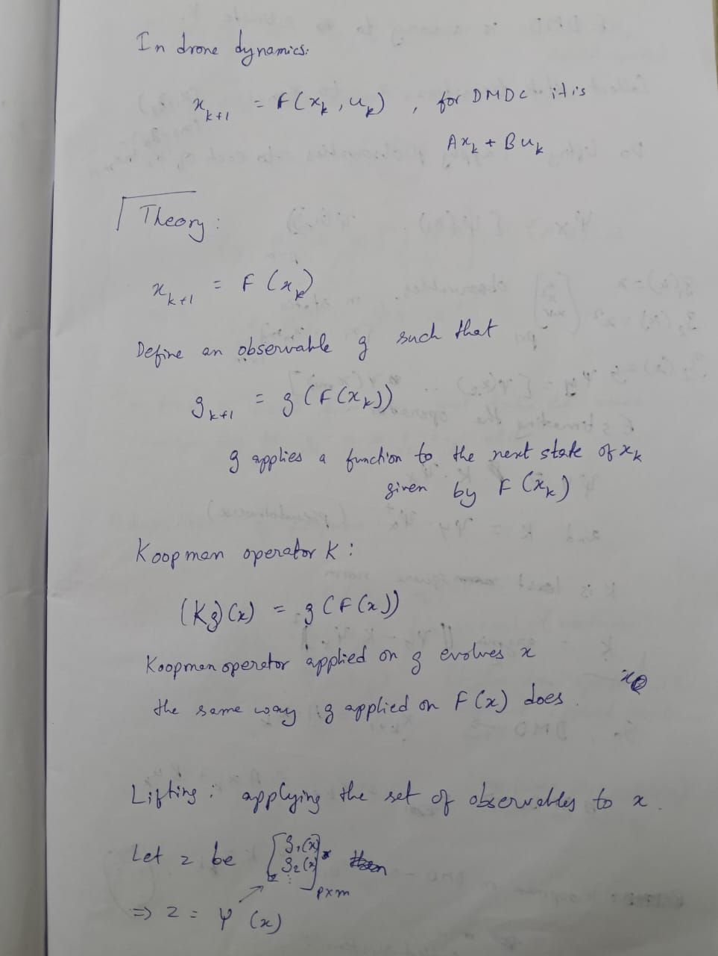
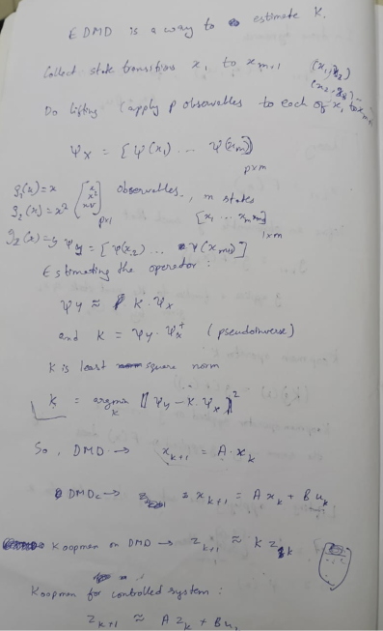
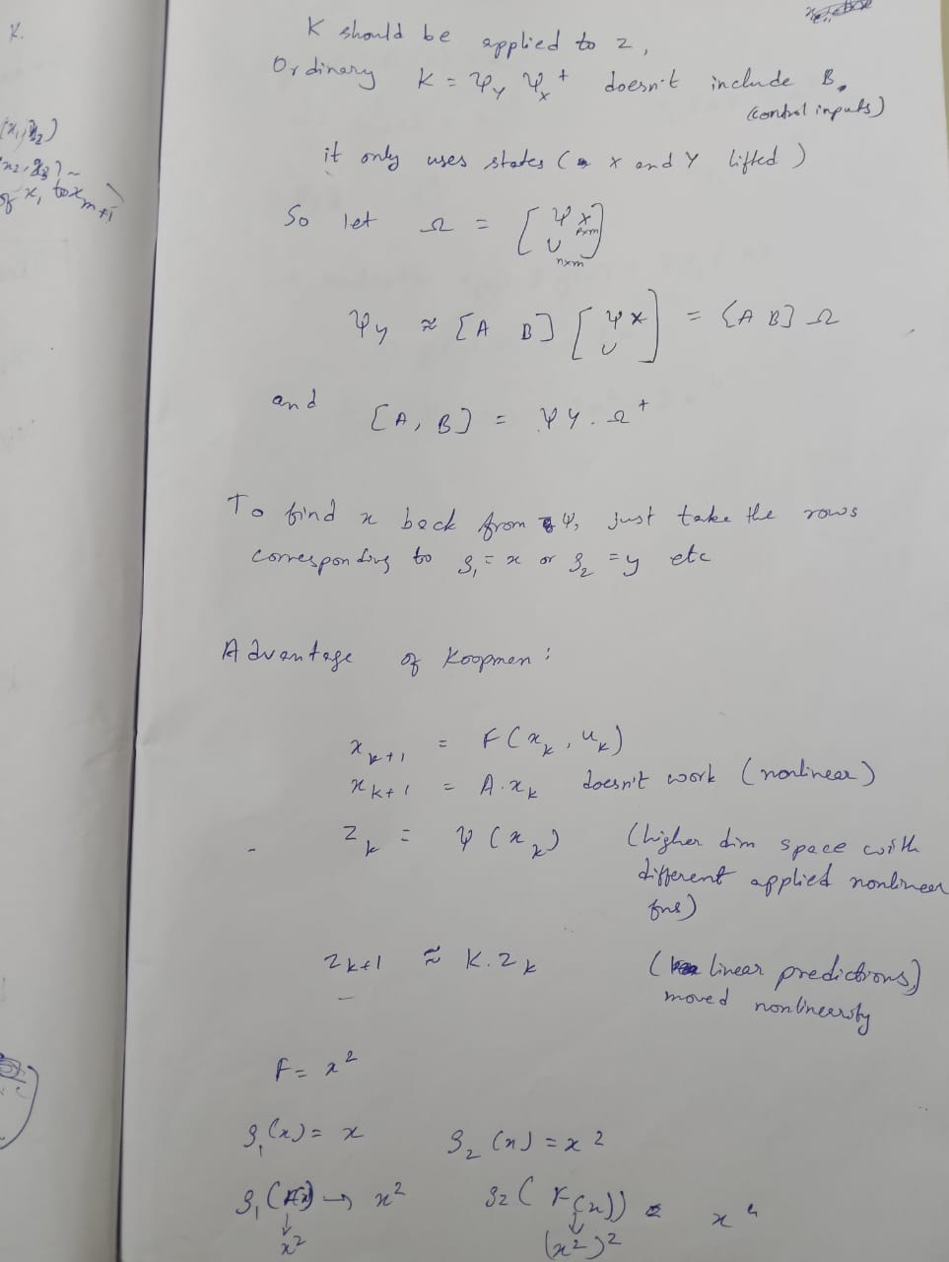
Notes.. Please find the transcribed notes in the uploaded pdf for readability ☺

Slide 8
THANK YOU!

