Slide 1

EDUGENIE
Google Gemini-Powered
Learning Assistant
Learn smarter. Ask freely. Practise anytime.
PROJECT PRESENTATION
Presented by: ____________________
EDUGENIE • GEMINI-POWERED LEARNING ASSISTANT
01

Slide 2
1. What is EduGenie?
Project overview
EduGenie is an AI learning helper that uses Google Gemini to answer student questions in simple language.
• Explains difficult topics
• Creates short notes and examples
• Helps students practise
EDUGENIE • GEMINI-POWERED LEARNING ASSISTANT
02

Slide 3
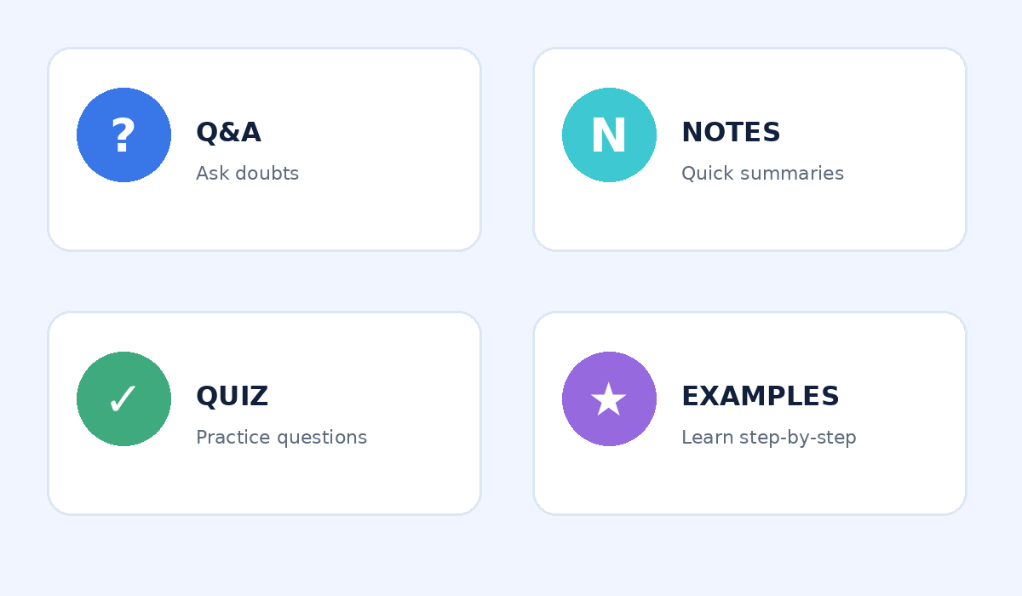
2. Main Features
Four key ways EduGenie helps
EDUGENIE • GEMINI-POWERED LEARNING ASSISTANT
03

Slide 4
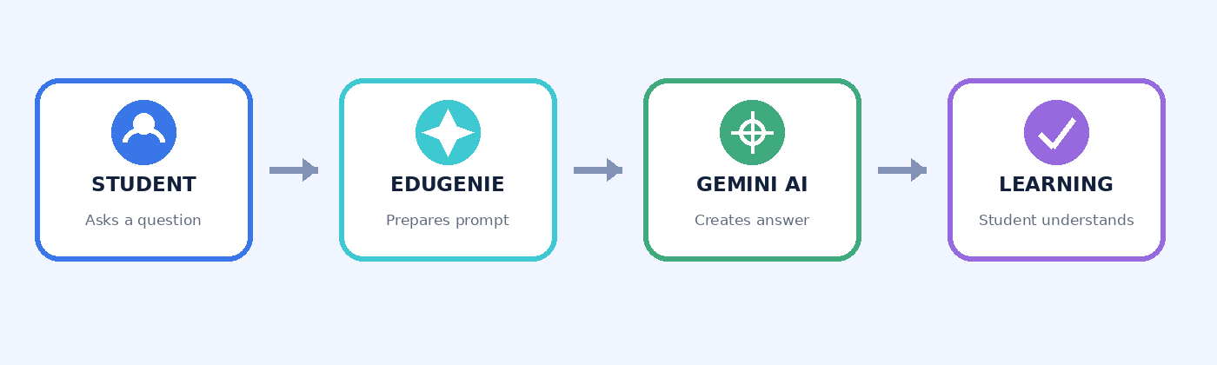
3. How It Works
Simple student-to-AI workflow
Ask a question → Gemini creates a response → Student learns and practises
EDUGENIE • GEMINI-POWERED LEARNING ASSISTANT
04

Slide 5
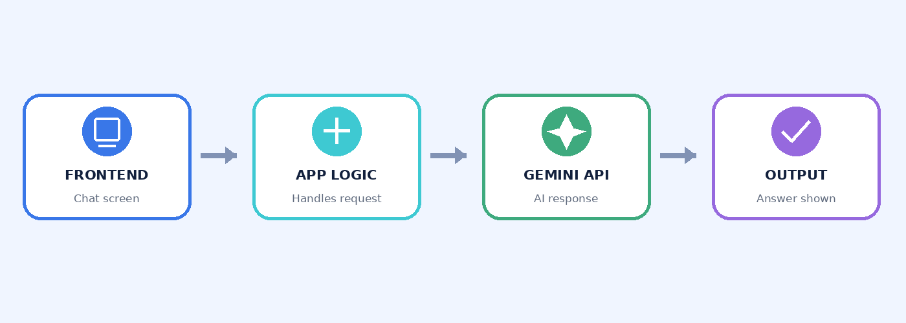
4. Technology Used
Main components
Suggested tools: Google Gemini API • HTML/CSS/JavaScript • Python or Node.js backend
EDUGENIE • GEMINI-POWERED LEARNING ASSISTANT
05

Slide 6
5. Benefits & Conclusion
Why EduGenie is useful
• Quick learning support
• Self-paced study
• Simple explanations and practice
• Always verify important AI answers
THANK YOU!
EDUGENIE • GEMINI-POWERED LEARNING ASSISTANT
06

