Slide 1
Audio Amplifier

Slide 2
Stages in Audio Amplifier:
preamplifier
filtering
Power amplification

Slide 3
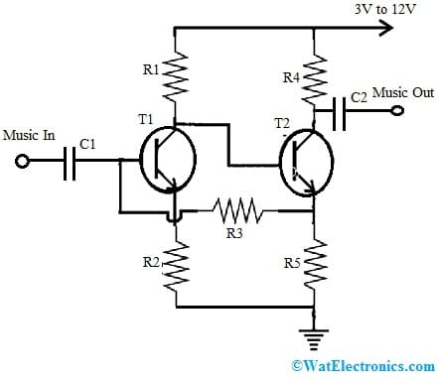
The preamplifier:
The preamplifier circuit is very simple to design with two transistors through a feedback loop to improve the amplification.
when that changing input is given across the specified C1 end terminals then the same signal is generated across the T1 transistor and GND. Generally, the high amplitudes are normally processed & regenerated by a potential that is approximately equivalent to the voltage supply. But for the low misc amplitudes, the second transistor ‘T2’ is simply allowed to perform at the high ratio which is allowable for supplying to its emitter terminal.

Slide 4
At the moment, once the actual improvement of the music is executed by transmitting this accumulated high potential back to the T1 transistor’s base terminal that equally saturates at a much optimal speed.
So ultimately this push-pull act will result in an overall amplification of slightly small music otherwise input data into a larger output significantly.
This simple preamplifier circuit simply allows the user to boost very small otherwise least frequencies to noticeably higher outputs which can be next utilized for feeding big amplifiers.
Actually, this circuit was commonly used in old cassette-type playback recorders within their preamp stages to boost the small signals from the tape head, thus this small amplifier’s output will become well-matched for the connected high-power amplifier.

Slide 5
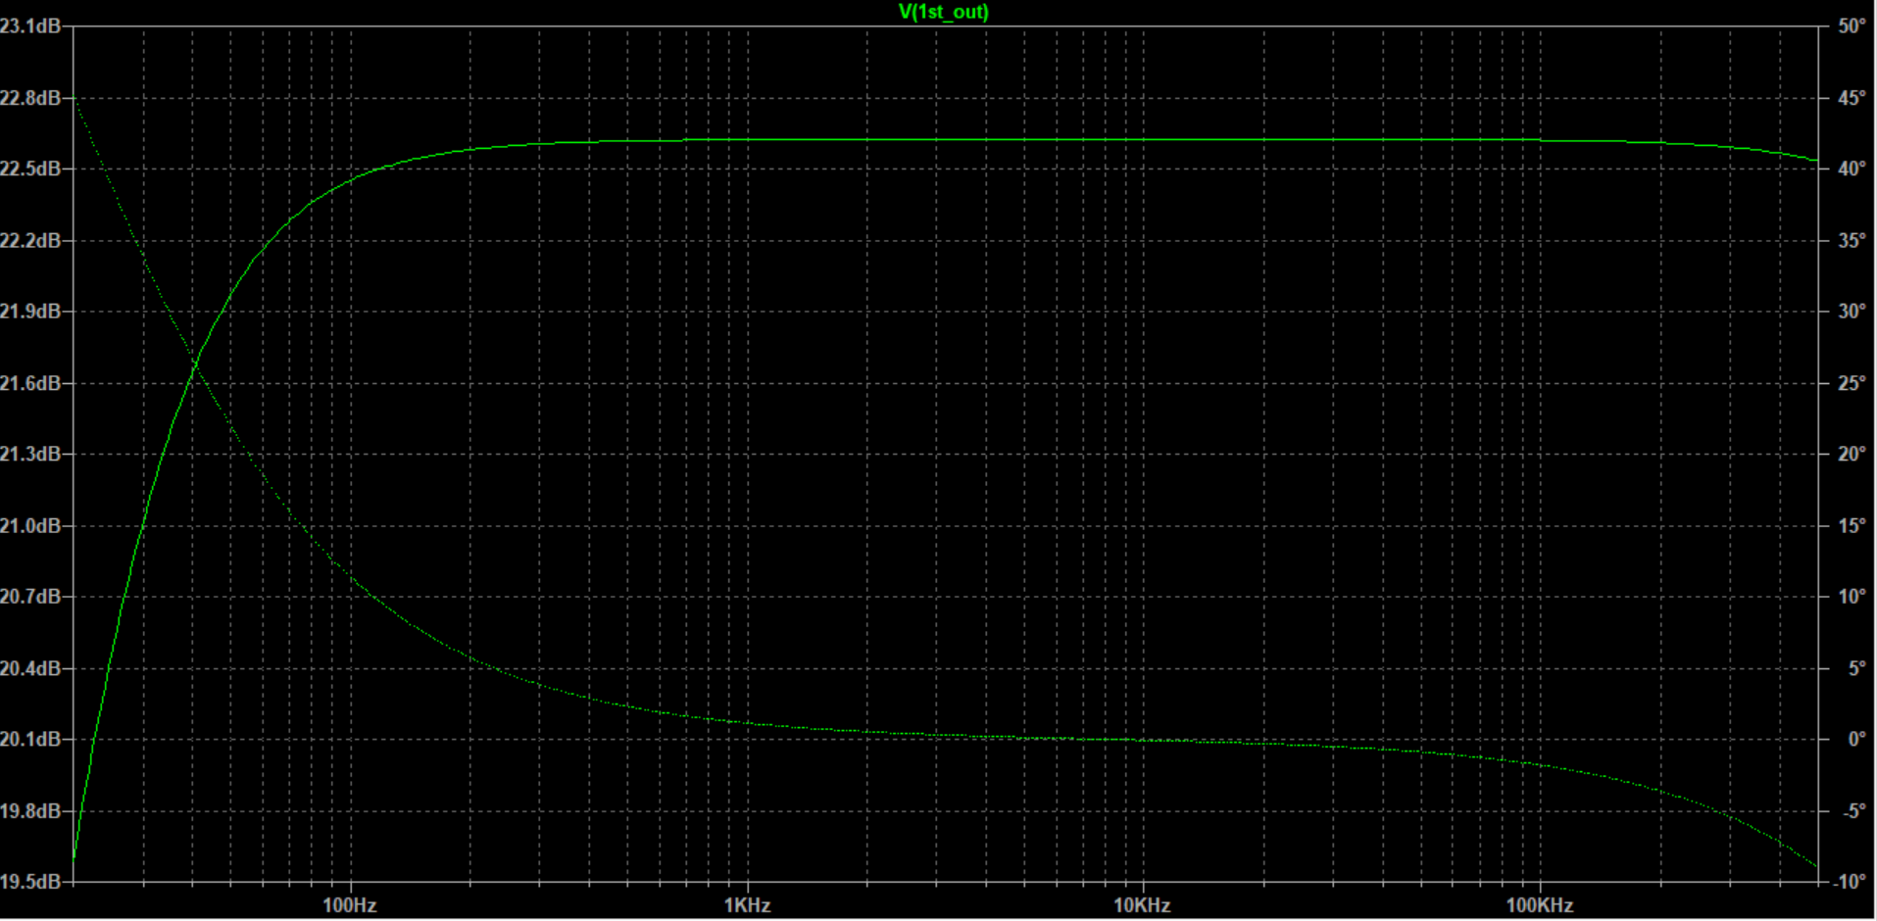
Frequency Response of the Preamplifier

Slide 6
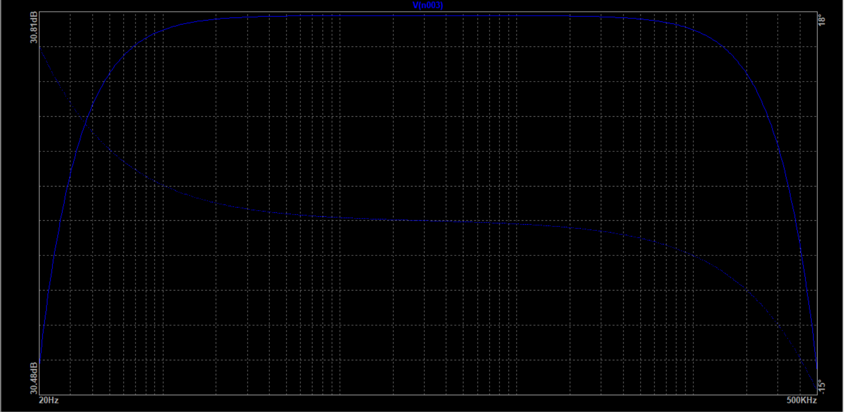
Comparision with a Differential amplifier
The graph on the right is the gain frequency
curve of the differential amplifier.
As can be seen, the curve cut off much before that of the preamplifier shown above.
The curve in the graph above, is also flatter indicating more stability

Slide 7
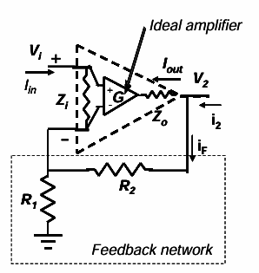

Effect of Feedback on the Input
The circuit can be loosely modelled as an op amp
Consider a series-shunt connection. The feedback network draws the same input current as the op-amp. This means that
The input impedance appears amplified by a factor (1+GH) (the feedback factor!). provided that the feedback network elements are small compared to Zi

Slide 8
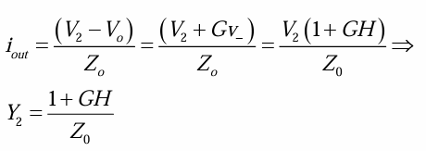
Effect of Feedback on the Output
For the output admittance of the closed loop amp: Consider zero input voltage (i.e. take partial derivative of V2 with respect to i2
The output impedance in the shunt connection appears reduced by the feedback factor.
This time we have assumed that the feedback network resistors are much larger than the output impedance of the amplifier

Slide 9
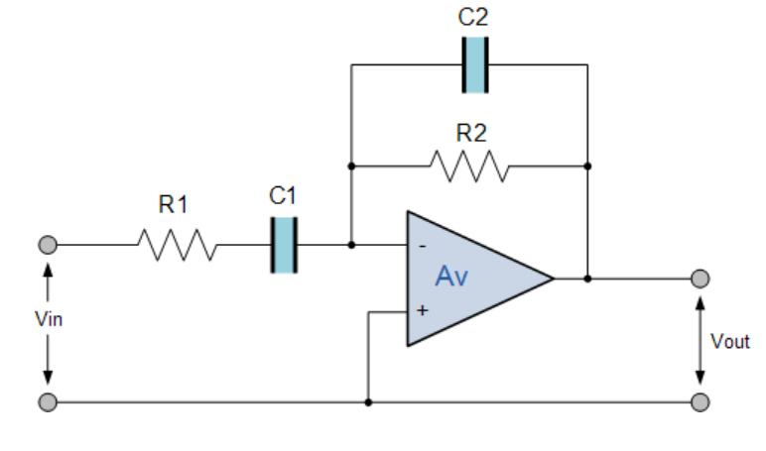
Filtering: *Active BandPass Filter:
The cascading together of the individual low and high pass filters produces a low Q-factor type filter circuit which has a wide pass band .
The first stage of the filter will be the high pass stage that uses the capacitor to block any DC biasing from the source.
This design has the pass band frequency response with one half representing the low pass response and the other half representing high pass response .

Slide 10
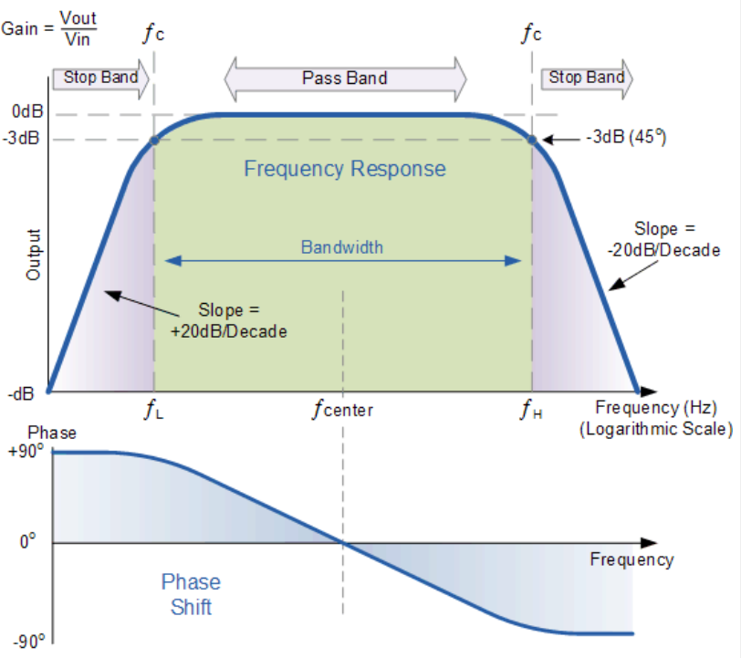
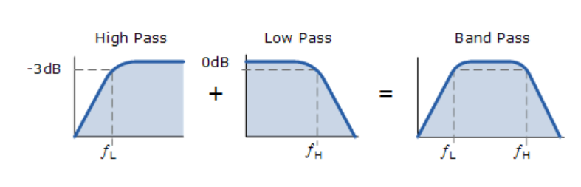
Frequency response:
For low pass filter part and high pass filter part in the Bandpass filter:

Slide 11
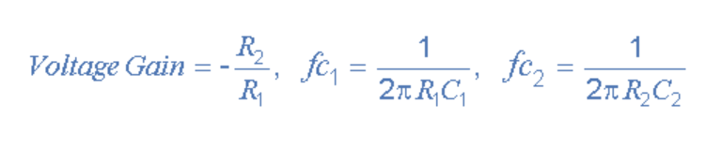
Calculations for the range of frequencies in the bandpass filter :
for the ranges of frequencies 50Hz to the 20kHz in the bandpass filter :
Here we are considering the values of capacitor and resistor to get the frequency 50Hz are:
C1=10uF
R1=320 ohm
for the frequency 20KHz:
C2=10nF
R2=800 ohm
By using the above formulae we are considering the capacitor and resistor values as given below: fc1=1/(2*pi*320*10*10^(-6))=49.76Hz fc2=1/(2*pi*800*10*10^(-9))=19.904KHz Voltage Gain = -(800/320)=2.5

Slide 12
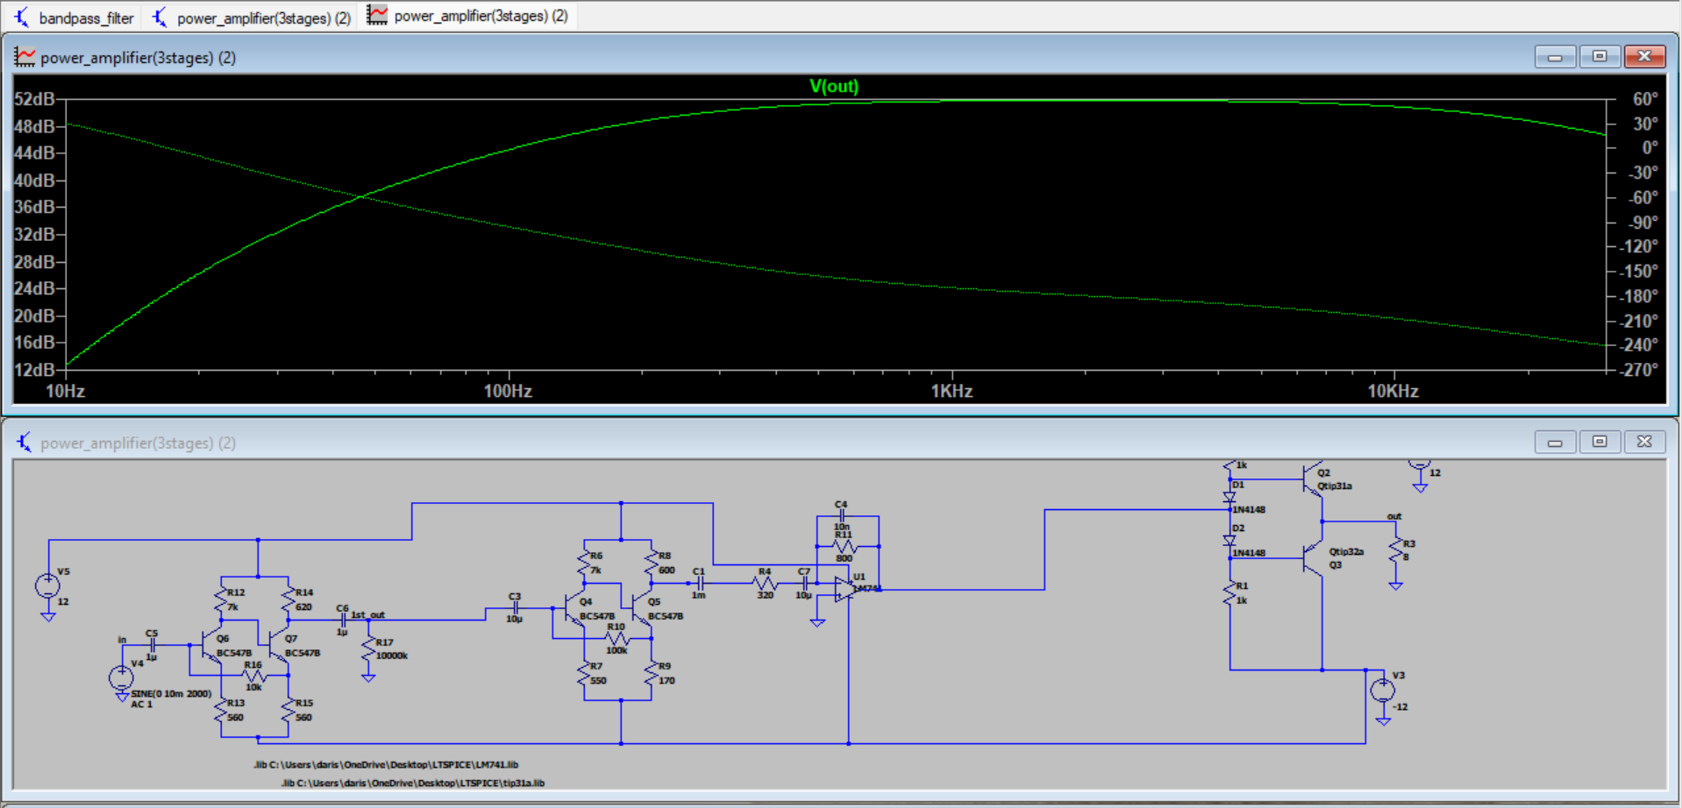
Calculations for the frequency ranges:
Here we are using the Band pass filter to allow only the particular range of
Frequencies(i.e here the range of frequencies we need to allow are 50Hz to 20KHz).

Slide 13
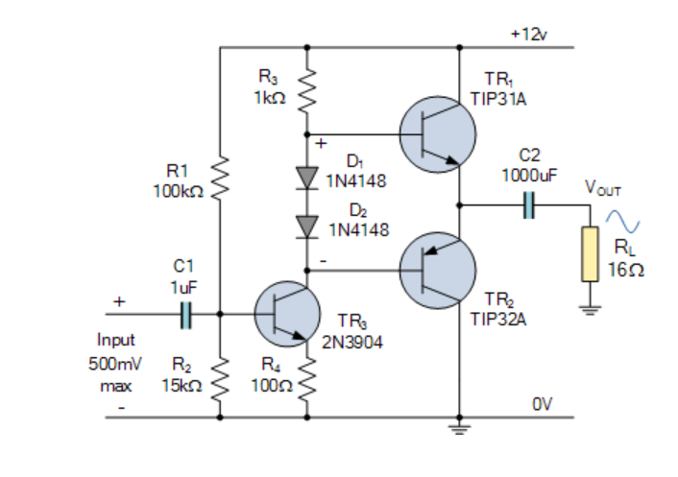
Power Amplifier :
Here we are using the class AB-amplifier.
Class AB amplifier is biased so that
the output current flows for less
than one full-cycle of the input
Waveform but more than a half cycle.
The implementation of class AB is
Similar to the standard class B
In that configuration it uses two
Switching transistors as part of a
Complementary output stage with each
Transistor conducting on opposite
Half cycles of the input waveform
Before being combined at the load.

Slide 14
About the Class AB amplifier.
Class AB amplifier configuration is more efficient than Class A amplifier but slightly less efficient than that of Class B.
The Class AB amplifiers are one of the most preferred audio power amplifier designs.
Their combination of reasonably good efficiency and high–quality output as they have low crossover distortion and a high linearity similar to the Class A amplifier design.

Slide 15
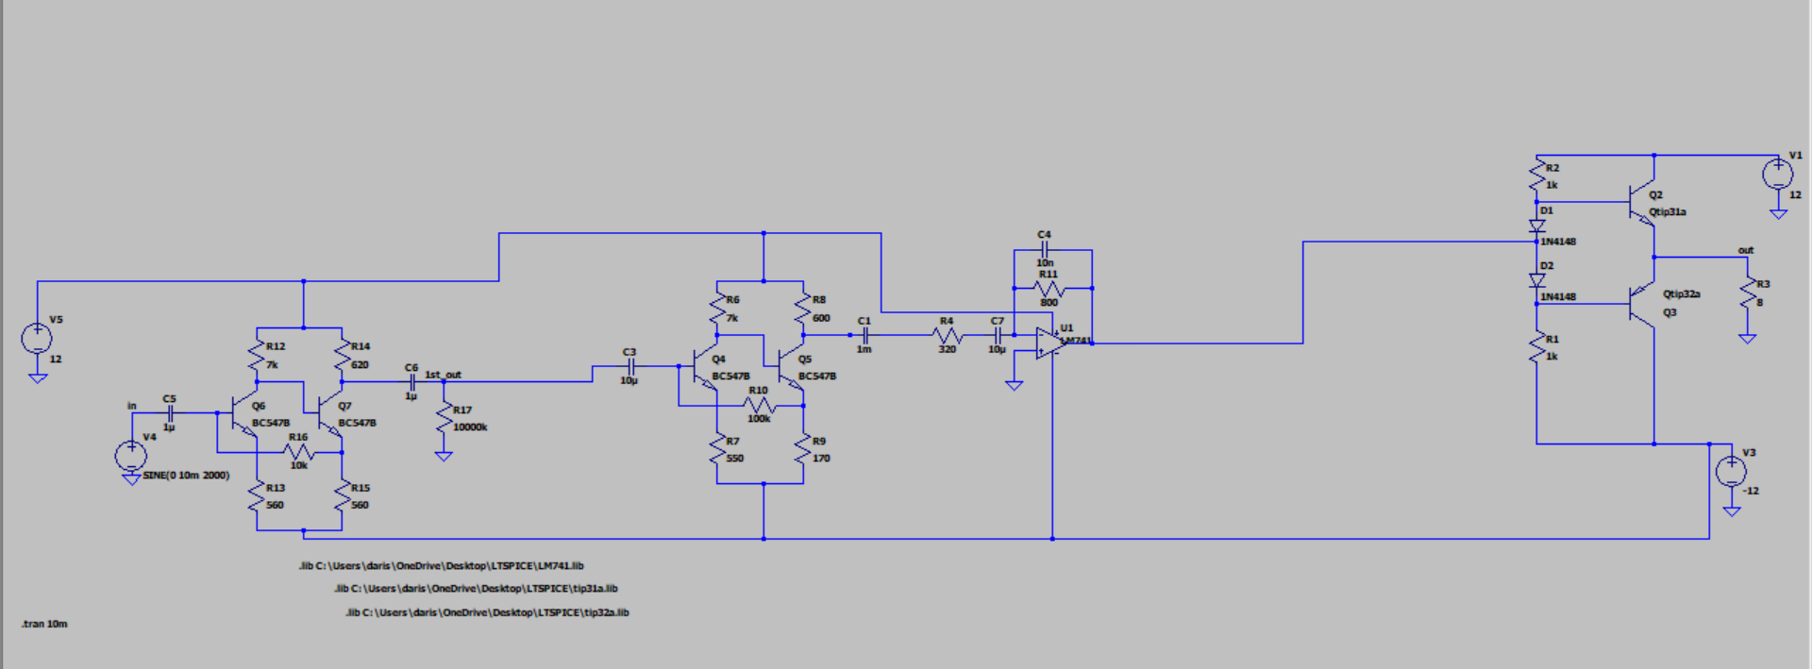
Full Circuit:

Slide 16
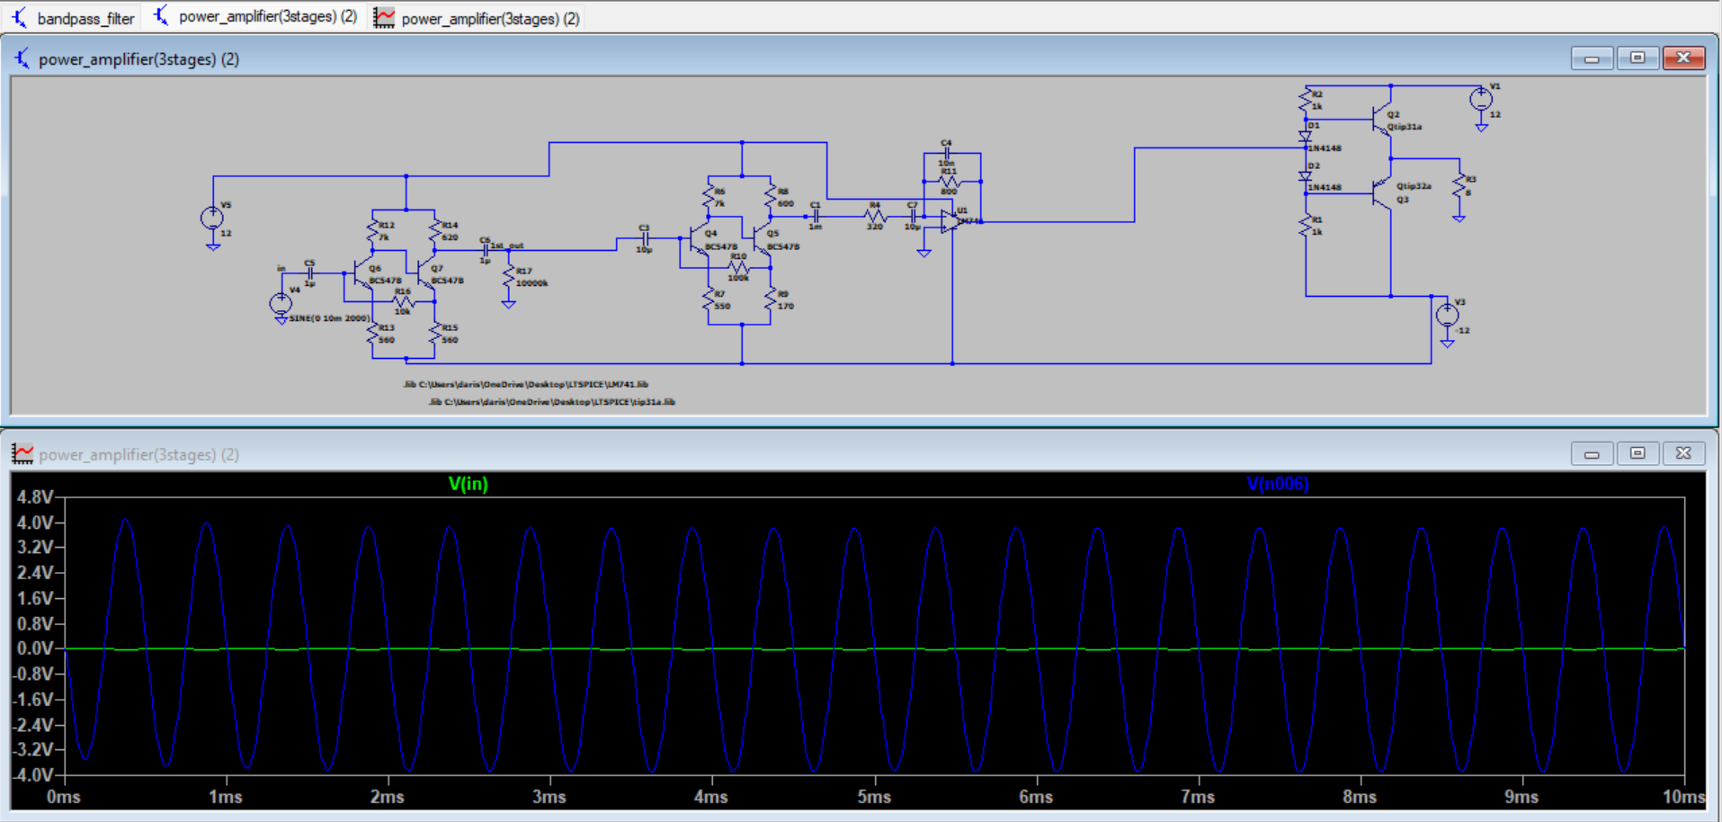
Transient analysis: Plot of output and input Here we are taking the input as 10mV and getting the output as 3.8337V So total gain is 383.37

Slide 17
AC analysis:

Slide 18
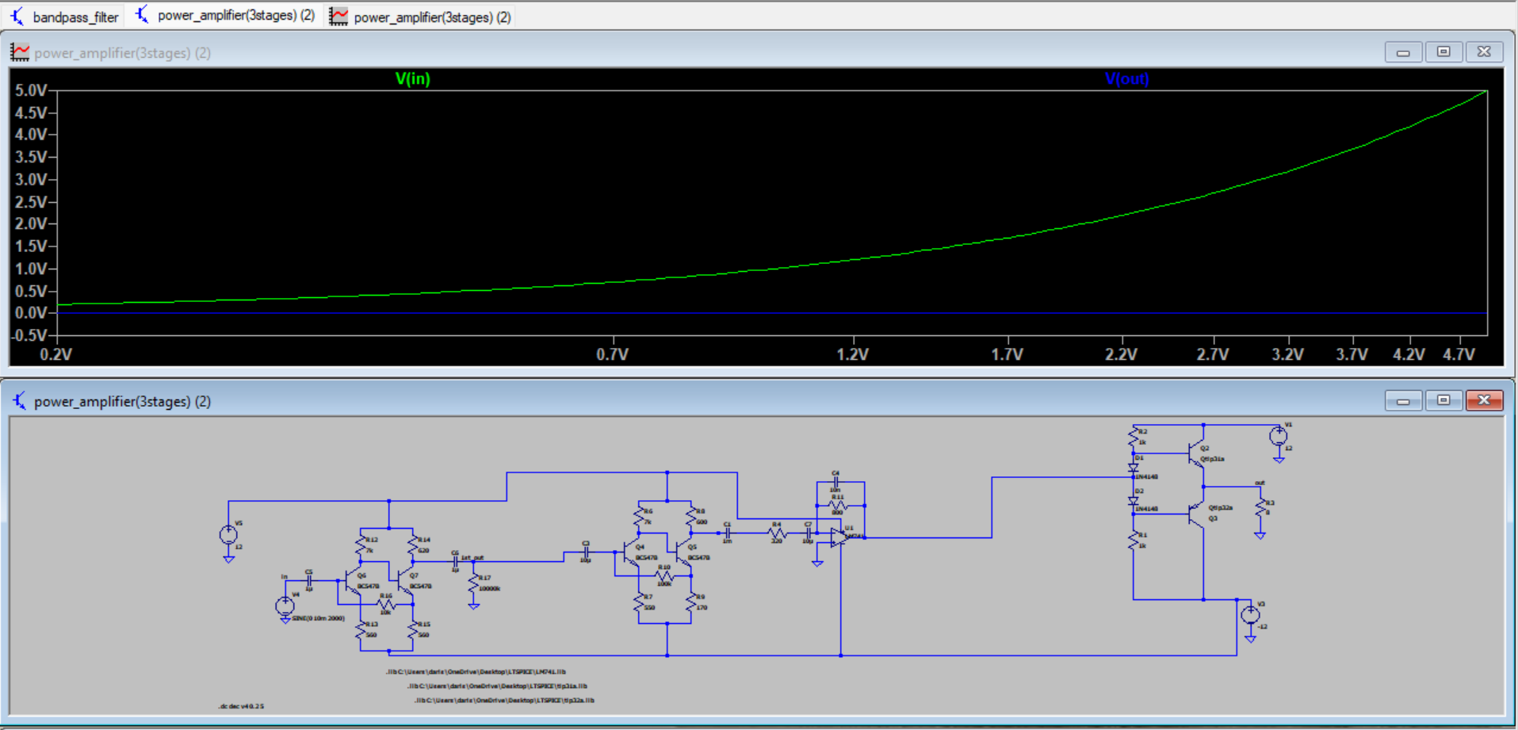
DC analysis:

Slide 19
Reason for placing the capacitor at the output side or at the input side : We place the capacitor at the output because for DC blocking: capacitors block DC voltage while allowing AC signals to pass through. In audio amplifiers, the audio signal is an AC signal and the capacitor blocks any DC offset from the amplifier circuitry, preventing it from reaching the output. *We place the capacitor at the input side because here also capacitors are used at the input to block any DC voltage that might be present in the input signal source or that could arise from biasing within the amplifier circuit. * This prevents any DC offset from reaching the amplifier’s input stage, which could potentially damage the amplifier or distort the signal.

Slide 20
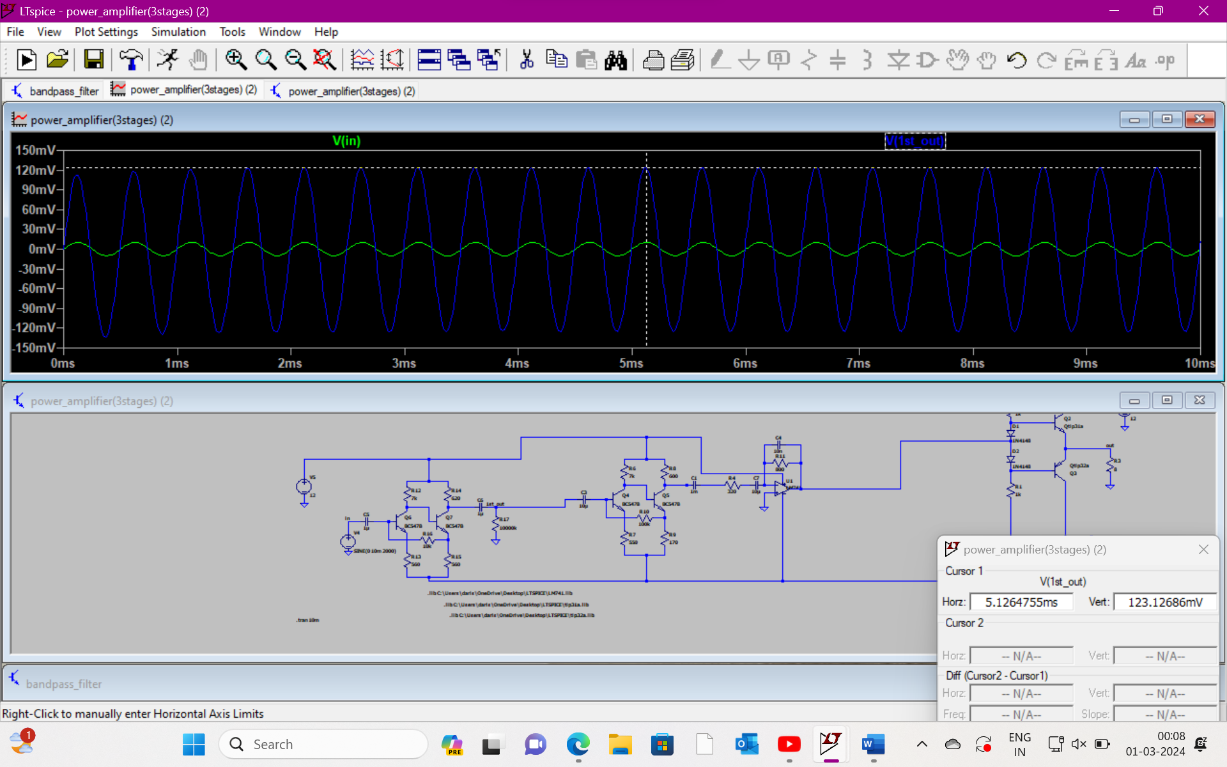
Stage -1: Input:10mv Output:123.16mv Gain : 12.316 The input and output are in same phase.

Slide 21
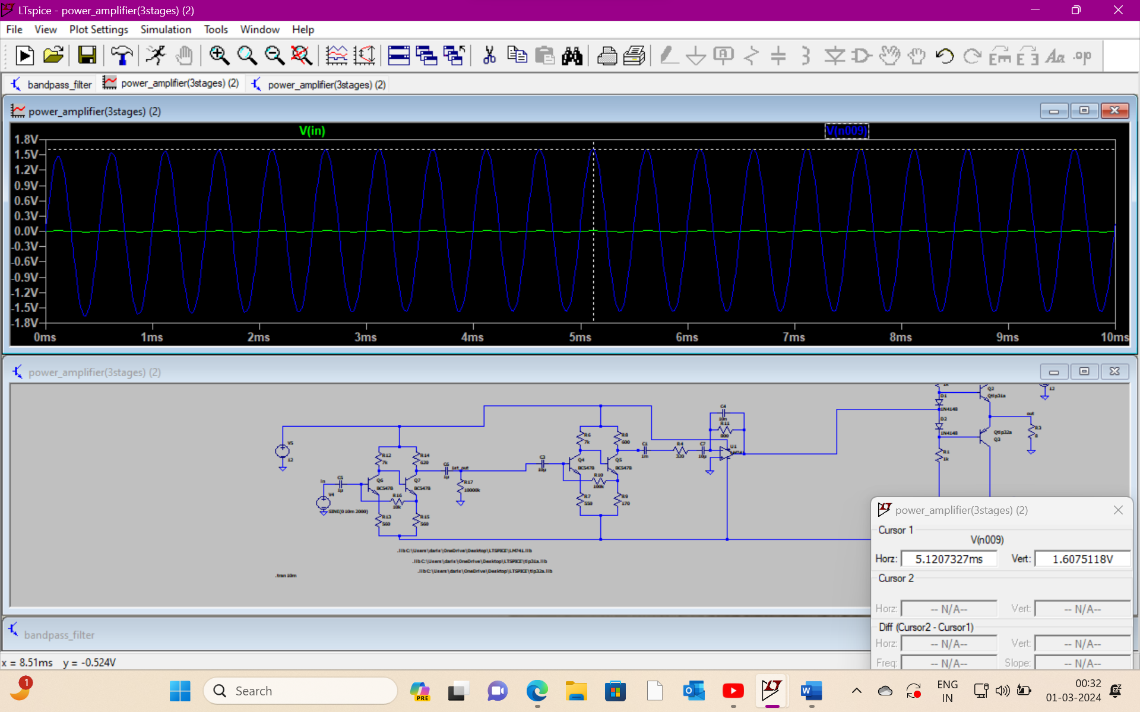
Stage -2: input:123.16mV Output:1.6075v Gain:11.048

Slide 22
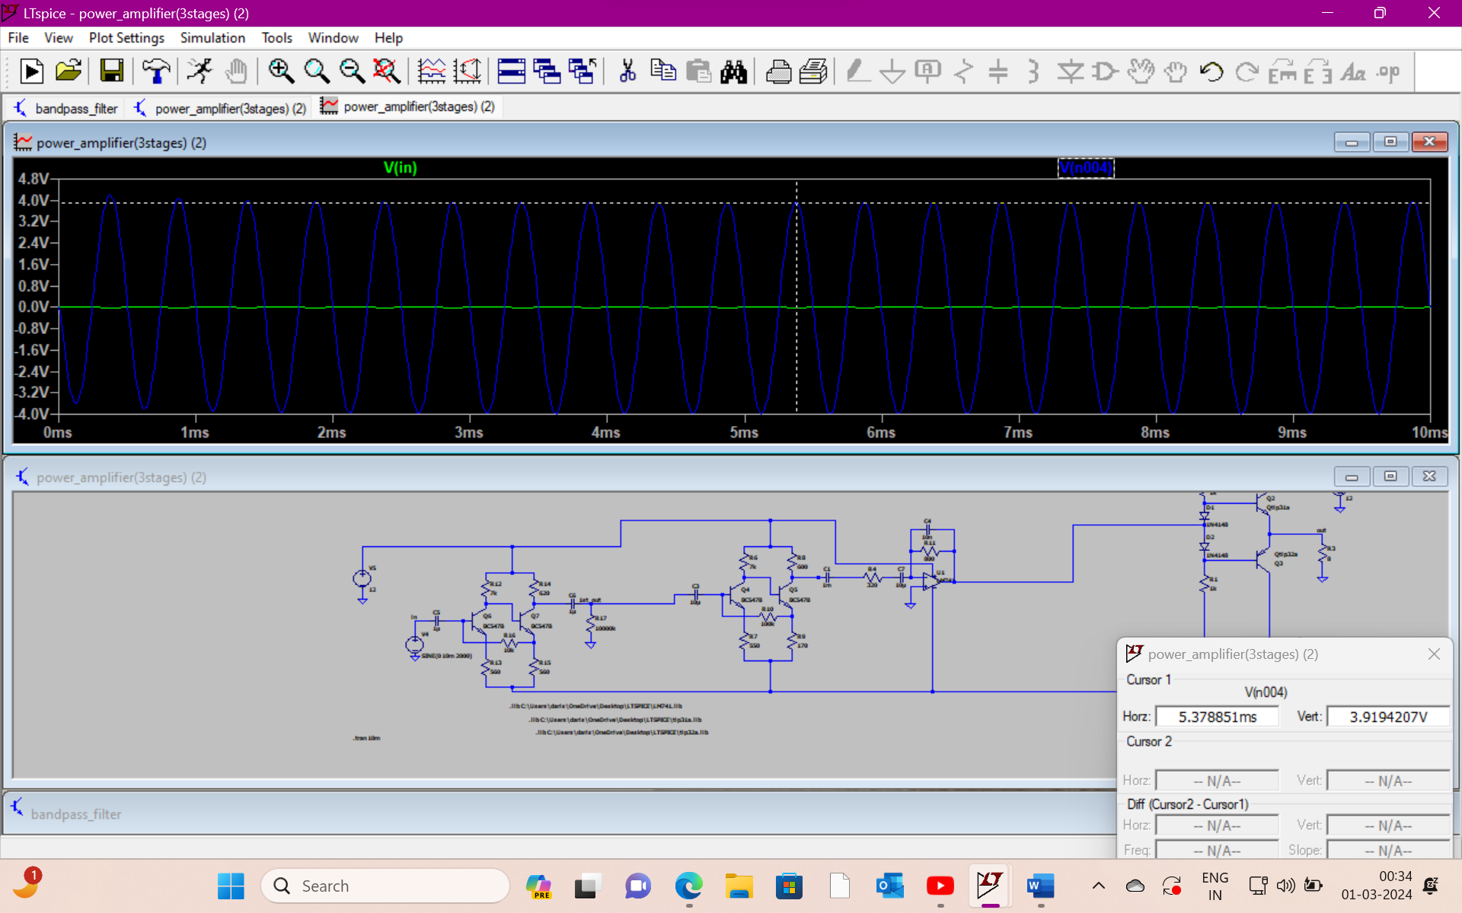
Stage-3: Input :10mv Output:3.9149 Gain:2.4354

Slide 23
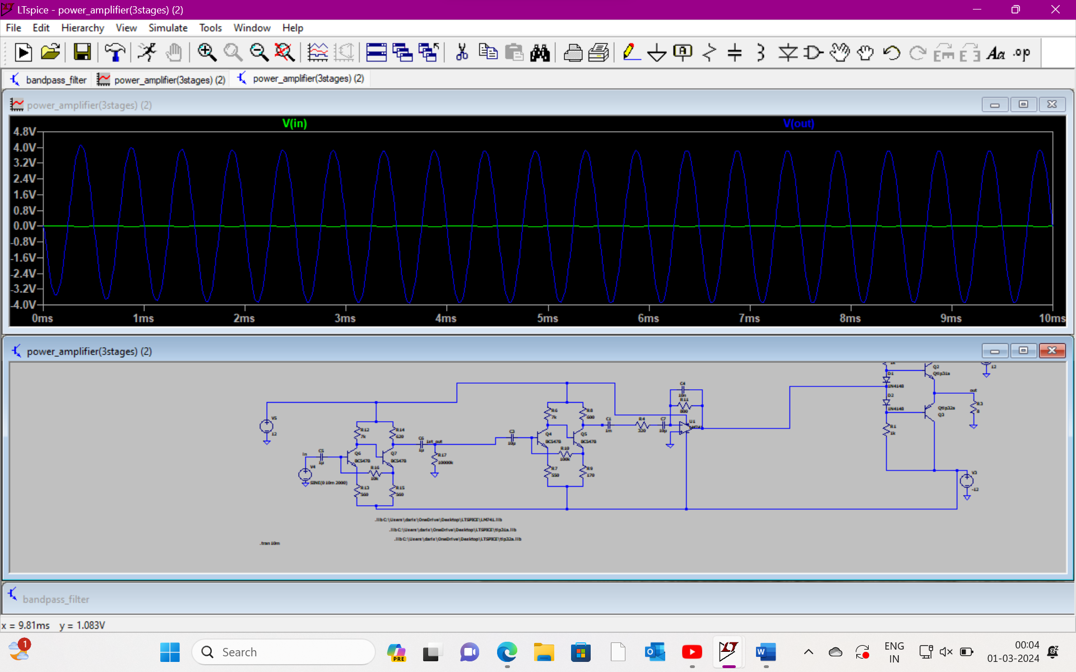
Overall circuit: *For overall circuit: input :10mv output : 3.8337V Overall gain :383.37

Slide 24
Team:36
Electonic workshop –II
Project : Audio amplifier
1.Name:
Darisa Manonga
Roll No: 2022102021
2.Name:
Deekshitha
Roll No: 2022102079

