Slide 1
INDOOR AND OUTDOOR AIR POLLUTION MONITORING SYSTEM
By
Sai Duth Deekshit G
Rohith Reddy G
Saaketh L
Kavya A
Rohit Varma J

Slide 2
contents
Abstract
Block Diagram
Hardware and Software Requirements
Working
Conclusion and future work
References

Slide 3
Abstract
Along with development of industries there seem a rapid increase in different kinds of pollution caused by it.
Among them pollution of air is major problem which is directly related to human health.
Several studies exposed the importance of micro-level pollution information, including human personal exposure and acute exposure to air pollution.
The quality of air is vital for human beings for maintaining good health.
So, for healthy and better life it is very important to keep track of air quality.
In this project, we are designing a system which will monitor the air quality as well sound pollution in indoor and outdoor places like home, communities, hospitals, schools etc. using technologies and concepts of IOT.

Slide 4
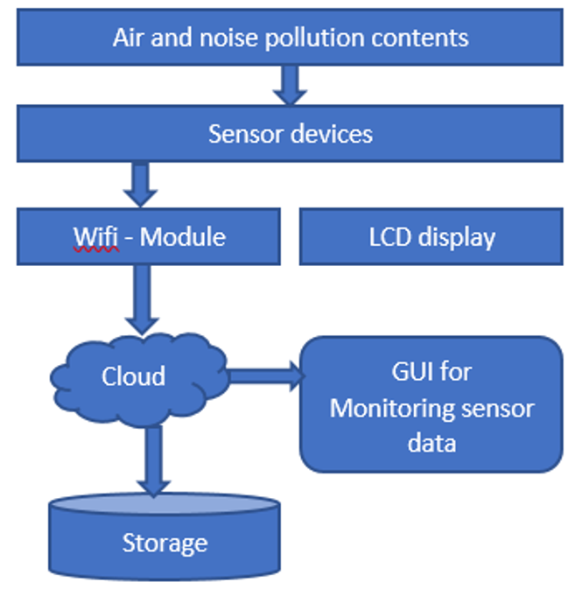
Block diagram

Slide 5
Hardware and software requirements
Hardware Requirements:
Air Pollution Sensors
Sound sensors
Atmega 328 Micro controller
Wifi Modem
LCD display
Arduino UNO R3 and Linknode D1
Software Requirements:
Arduino Compiler
MC Programming Language: C
Python

Slide 6
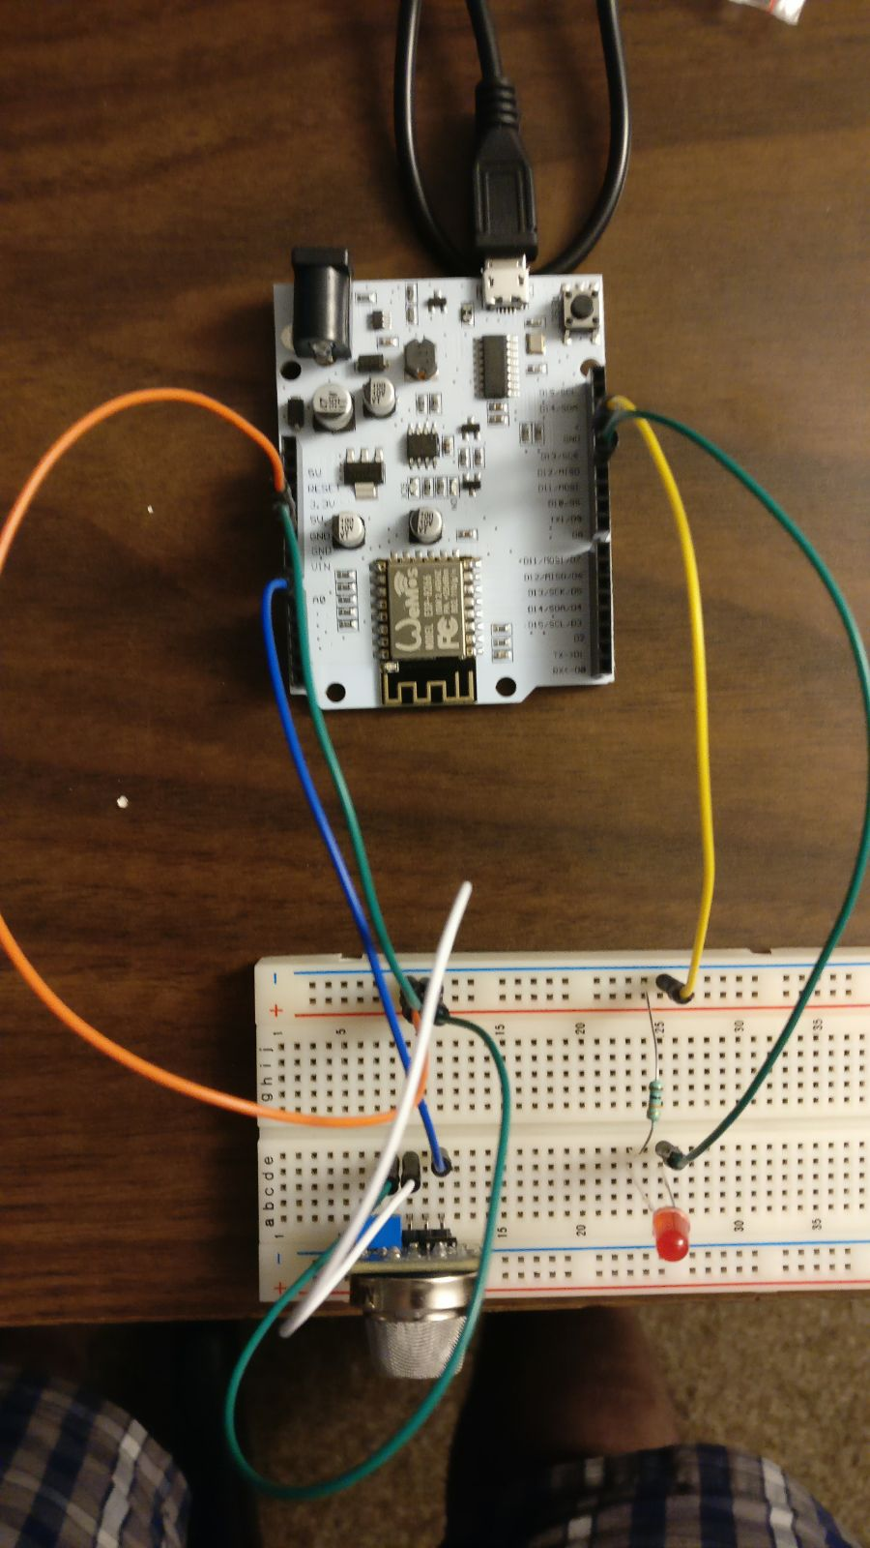
working

Slide 7
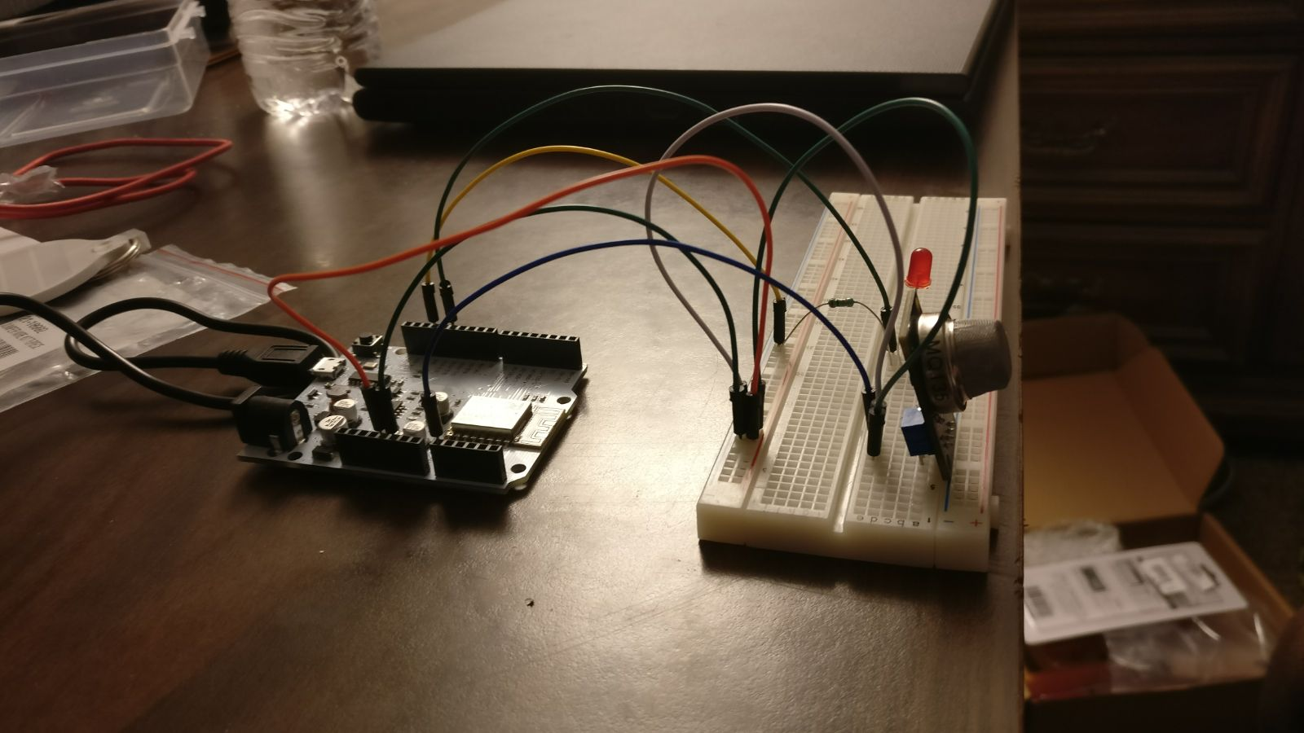

Slide 8
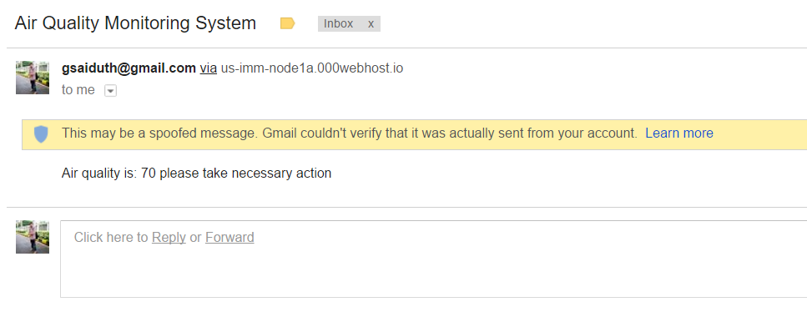

Slide 9
Conclusion and future work
Increase in the number of industries led to various types of pollution, Among them air pollution has a major impact on mankind as it effects human health. So monitoring quality of air is very important for maintaining healthy and better life. Previously air monitoring systems used conventional approach which incur huge costs and large equipment to monitor the quality of air. In this project, we have designed an air quality monitoring system using technologies and concept of IOT which monitors the quality of air and sound pollution in both indoor and outdoor places. This system is very small and easily movable so that we can use this at anytime and anyplace like schools, hospitals to check the quality of air and use this information to reduce air pollution.

Slide 10
references
Xiaojun, Chen, Liu Xianpeng, and Xu Peng. "IOT-based air pollution monitoring and forecasting system." 2015 International Conference on Computer and Computational Sciences (ICCCS) (2015): n. pag. Web
www.iotgecko.com
www.000webhost.com

