Slide 1
School of Engineering and technology
Department of Computer Science and Engineering
Arduino Project
on
GPS TRACKER
Team Members
Presented By(Individuals)
Project Guide
DEEKSHITHA M-
22BBTCS082
BOREDDY SAHASTRA REDDY-
22BBTCS064
Dr. PRACHI GUPTHA
DEEKSHITHA M-
22BBTCS082
BOREDDY SAHASTRA REDDY-
22BBTCS064
Date: 05 / 01 / 2024

Slide 2
Outline
Abstract
Introduction
Objective
Methodology
Hardware Description
Software Used
Advantages
Application
Conclusion
References

Slide 3
ABSTRACT:
The GPS Tracker project utilizing an Arduino UNO and NEO 6M GPS Module aims to create a portable and cost-effective solution for real-time tracking of geographical coordinates. In an era dominated by technology, the integration of GPS tracking systems has become paramount for numerous applications, ranging from navigation to location-based services.
This project aims to harness the power of Arduino UNO and the NEO 6M GPS module to develop a GPS tracker. The system not only provides real-time longitude and latitude coordinates but also offers additional functionality by displaying the date and time on the serial monitor. Furthermore, to enhance user interaction, the project incorporates an LCD display that conveniently showcases the latitude and longitude values.

Slide 4
This GPS tracker holds significant potential for applications such as vehicle tracking, wildlife monitoring, and personal navigation
Key components of the project include GPS data parsing, serial communication between the GPS module and Arduino, and efficient handling of data for optimal display on the LCD. The project not only provides a functional GPS tracking solution but also offers a valuable learning experience for electronics enthusiasts, allowing them to gain hands-on experience with GPS technology and Arduino programming.
The integration of Arduino and the NEO-6M GPS module offers a cost-effective and versatile solution for those seeking a customizable and DIY approach to real-time location tracking.

Slide 5
INTRODUCTION:
The GPS Tracker project, featuring the Arduino UNO and NEO 6M GPS Module, stands as a pioneering solution in the contemporary landscape of location-based technology. In an era where precision and accessibility define user expectations, this project addresses the burgeoning need for a portable, cost-effective GPS tracking system. The core objective is to seamlessly combine the capabilities of the Arduino UNO microcontroller and the NEO 6M GPS Module to provide real-time latitude and longitude coordinates, presented intuitively on a 16x2 LCD display.
The Arduino UNO serves as the project's central hub, efficiently managing communication with the NEO 6M GPS Module to extract accurate global positioning data. The output is elegantly displayed on the LCD screen, ensuring users receive immediate and comprehensible information.

Slide 6
This synthesis of hardware components results in a versatile solution with applications ranging from personal navigation to asset tracking.
This project's significance lies in its accessibility and adaptability, allowing users to harness the power of location tracking without the complexities associated with high-cost systems. As we explore the project's intricacies, from hardware setup to programming logic, we uncover a solution that not only meets the demands of modern tracking needs but also serves as a testament to the convergence of innovation and affordability in the realm of GPS technology

Slide 7
OBJECTIVE:
Location Tracking: The primary goal of the project is to create a GPS tracker that can determine and
display the current latitude and longitude coordinates using the NEO 6M GPS module.
Real-time Display: Provide real-time updates of the GPS coordinates on a 16*2 LCD display. This
allows for a convenient on-site display of location information.
Serial Monitor Output: Display additional information such as date and time of the GPS fix on the
Serial Monitor, allowing for debugging and monitoring when connected to a computer.
No Signal Indication: Implement a feature to notify the user when no GPS signals are available. This
can be helpful for ensuring that the system user is aware of situations where the GPS fix might not
be accurate.
SMS Notification: Send an SMS notification to a specified mobile number (configurable in the code)
containing the location link when a predefined command (in this case, "location") is received. This
allows users to request location information remotely.

Slide 8
Google Maps Link: Include a link in the SMS message that directs the recipient to view the location
on Google Maps. This adds convenience for the user to quickly visualize the tracked location.
Flexible Power Supply: The project should be flexible in terms of power supply, allowing the use of
either USB, external power through the DC jack, or an external power supply. This enhances the
versatility and adaptability of the project.
Adjustable LCD Contrast: Utilize a potentiometer to allow the user to adjust the contrast of the LCD
display for optimal visibility under varying lighting conditions.
Simple User Interface: Design a simple and user-friendly interface with minimal components,
making it accessible for hobbyists and individuals interested in experimenting with GPS and GSM
modules.
Educational Purposes: Serve as an educational project to help individuals understand the
integration of GPS, GSM, and LCD modules with Arduino for real-world applications like location
tracking.

Slide 9
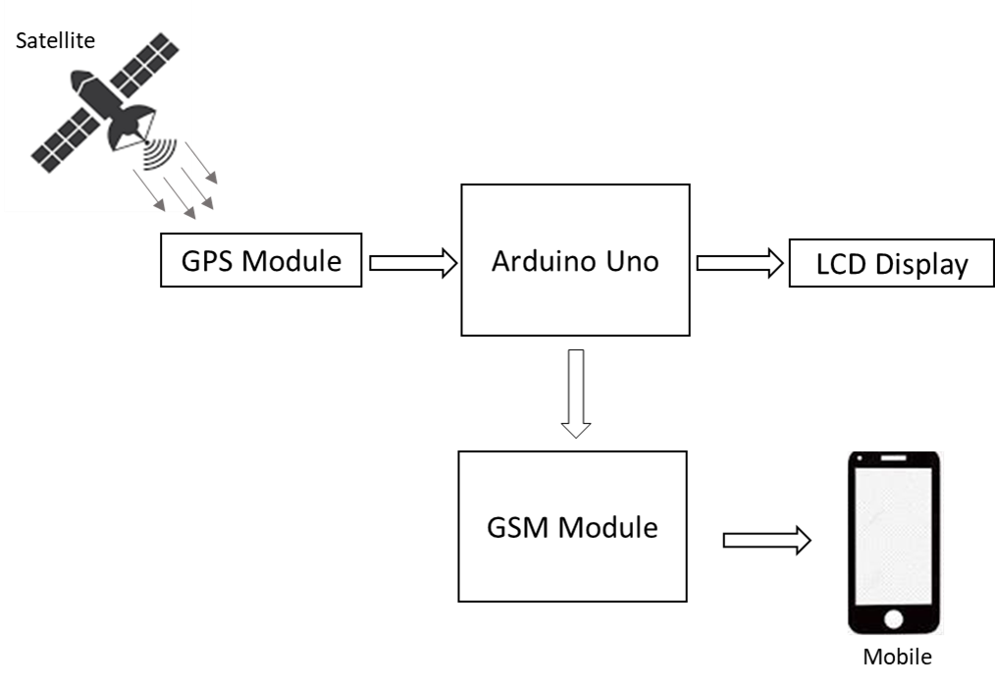
METHODOLOGY:
Hardware Description:
The block diagram illustrates the seamless
flow of data within the system. The GPS Module
communicates with the Arduino UNO, which
in turn disseminates information to both the Serial
Monitor and the LCD Display. This dual-output system
enhances the project's versatility, catering to developers
for debugging purposes while also providing a user-friendly
display for real-world applications such as navigation and
location tracking.
Block diagram of automatic street light system
Fig. 3.2: circuit diagram of GPS Tracker
The components are connected as shown above the circuit diagram:
Connect the VCC and GND pins of the Neo 6M GPS Module to the 5V and GND pins on the Arduino Uno, respectively.
Connect the TX pin of the GPS module to the RX pin on the Arduino Uno and vice versa.
Connect the VCC and GND pins of the LCD display to 5V and GND on the Arduino, respectively.
Connect the SDA and SCL pins of the LCD display to the Analog pins on the Arduino, respectively.
Connect one end of the potentiometer to the VCC, the other end to GND, and the middle pin to the VO (contrast) pin on the LCD.
Connect one end of the 330-ohm resistor to the LCD and the other end to the Arduino.
Connect pins D4 to D7 on the LCD to pins 4 to 7 on the Arduino.
The GPS Tracker project integrates an Arduino UNO with the NEO-6M GPS Module to create a robust location tracking system. The NEO-6M, equipped with an integrated antenna, communicates with satellites to capture precise latitude, longitude, date, and time data. This information is relayed to the Arduino UNO through UART communication, initiating the core processing stage.
The Arduino UNO, functioning as the central processing unit, receives and interprets the GPS data. Programmed logic extracts the latitude, longitude, date, and time values, facilitating two key outputs: the Serial Monitor and a 16x2 LCD Display.
The Serial Monitor output provides a comprehensive view of the real-time GPS data during the development phase. This feature aids in debugging and ensures the system is acquiring and processing information accurately. Simultaneously, the Arduino UNO interfaces with a 16x2 LCD Display using I2C communication. The LCD visually presents the latitude, longitude, date, and time information in a user-friendly format, making it easily readable and accessible.

Slide 10
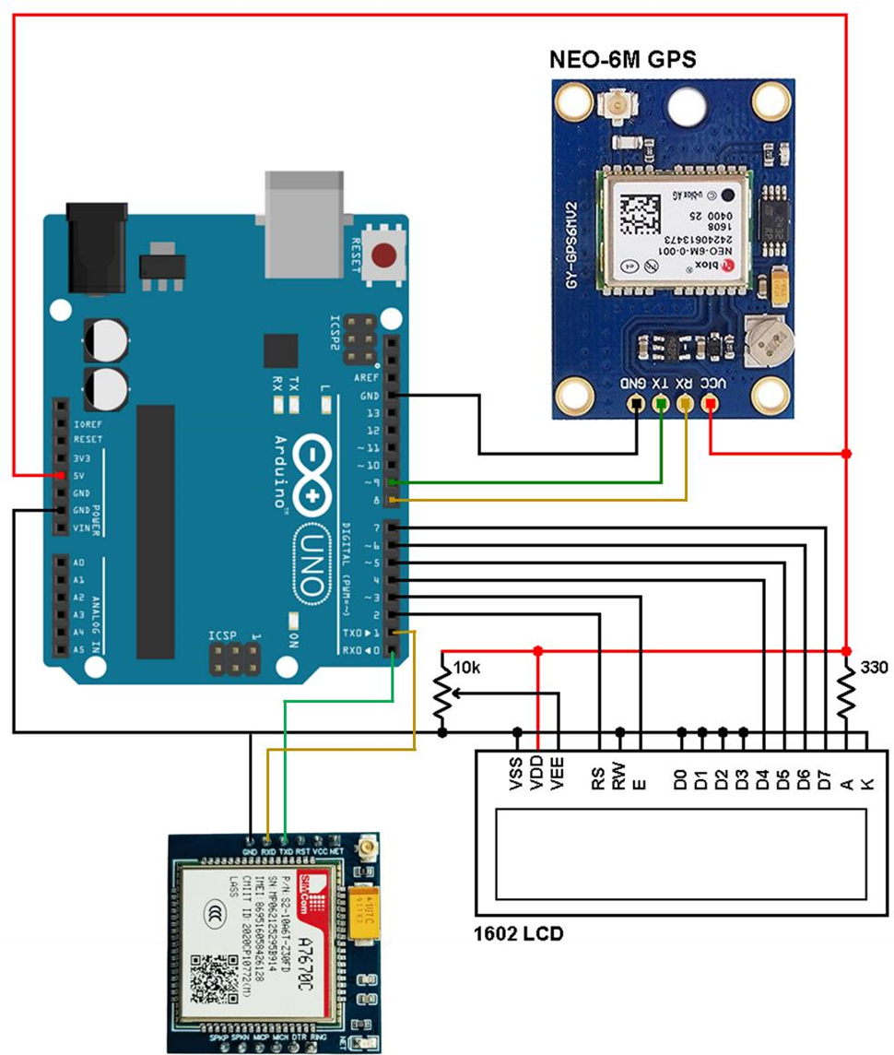
The components are connected as shown in the circuit diagram:
Connect the VCC and GND pins of the GPS Module and GSM Module to the 5V and GND pins on the Arduino Uno, respectively.
Connect the TX pin of the GPS and GSM modules to the RX pin on the Arduino Uno and vice versa.
Connect the VCC and GND pins of the LCD display to 5V and GND on the Arduino, respectively.
Connect the VSS, RW, D0,D1,D2,D3,K to GND of Arduino.
Connect D4, D5, D6, D7 to digital pins 4,5,6,7 respectively.
Connect one end of the potentiometer to the VCC, the other end to GND, and the middle pin to the VO (contrast) pin on the LCD.

Slide 11
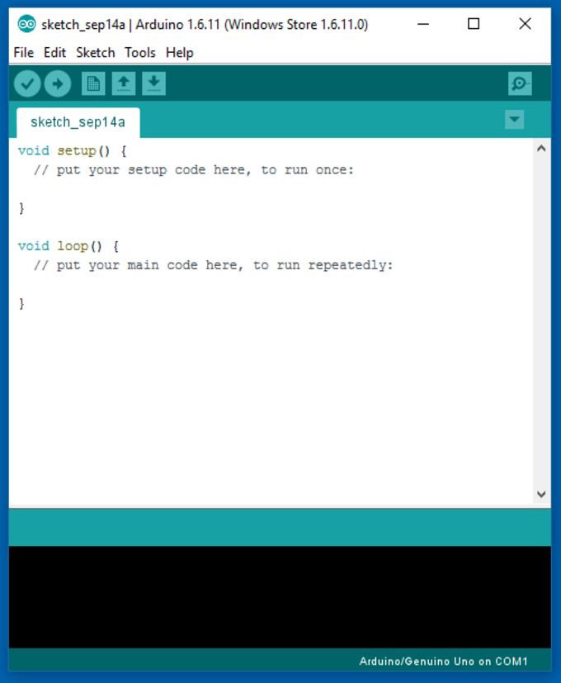
SOFTWARE USED:
Arduino IDE software is an open-source software to which a hobbyist can connect the AT mega chips. In this software the code can be written and uploaded to any AT mega chip and then the code can be executed on the chip. Many 3D printed electronics and Arduino-compatible use AT mega chip and hence the user can upload the program. Arduino can also be used firmware any electronics. Sketch is the window in which the program is to be written.

Slide 12
SOURCE CODE:
#include <LiquidCrystal.h>
#include <TinyGPS++.h>
#include <SoftwareSerial.h>
// Define the pins for the GPS module
#define GPS_RX_PIN 8
#define GPS_TX_PIN 9
// Define the pins for the GSM module
#define GSM_RX_PIN 10
#define GSM_TX_PIN 11
// Initialization
SoftwareSerial gpsSerial(GPS_RX_PIN, GPS_TX_PIN);
SoftwareSerial gsmSerial(GSM_RX_PIN, GSM_TX_PIN);
TinyGPSPlus gps;
LiquidCrystal lcd(2, 3, 4, 5, 6, 7);
// Function prototypes
void displayGPSData();
void sendLocationSMS();
void print2digits(int number);
void checkIncomingSMS();

Slide 13
void setup() {
Serial.begin(9600);
gpsSerial.begin(9600);
gsmSerial.begin(9600);
lcd.begin(16, 2);
lcd.print("GPS Tracker");
delay(1000);
}
void loop() {
while (gpsSerial.available() > 0) {
if (gps.encode(gpsSerial.read())) {
displayGPSData();
checkIncomingSMS();
delay(30000); // Delay for 30 seconds before reading the next GPS data
}
}
// Print "NO SIGNALS" if no GPS Signal Found
if (gps.charsProcessed() < 10) {
Serial.println("NO SIGNALS");
delay(10000);
}
}

Slide 14
void displayGPSData() {
if (gps.location.isUpdated()) {
double latitude = gps.location.lat();
double longitude = gps.location.lng();
// Printing on Serial Monitor
Serial.print(" Latitude= ");
Serial.print(latitude, 6);
Serial.print(" Longitude= ");
Serial.print(longitude, 6);
Serial.print(" Date: ");
print2digits(gps.date.month());
Serial.print("/");
print2digits(gps.date.day());
Serial.print("/");
Serial.print(gps.date.year());
Serial.print(" Time: ");
print2digits(gps.time.hour());
Serial.print(":");
print2digits(gps.time.minute());
Serial.print(":");
print2digits(gps.time.second());
Serial.println();

Slide 15
// Print Google Maps location link on serial monitor
Serial.print("Google Maps Location: https://maps.google.com/?q=");
Serial.print(gps.location.lat(), 6);
Serial.print(",");
Serial.println(gps.location.lng(), 6);
// Number of satellites in use
Serial.print("Number of satellites in use = ");
Serial.println(gps.satellites.value());
// Printing Latitude and Longitude on LCD Display
lcd.clear();
lcd.setCursor(0, 0);
lcd.print("Latitude: " + String(latitude, 6));
lcd.setCursor(0, 1);
lcd.print("Longitude: " + String(longitude, 6));
delay(10000); // Delay for 10 seconds before updating LCD again
}
}
void checkIncomingSMS() {
if (gsmSerial.available()) {
String incomingSMS = gsmSerial.readStringUntil('\n');
incomingSMS.trim();
if (incomingSMS.indexOf("location") != -1) {
sendLocationSMS();
}
}
}

Slide 16
void sendLocationSMS() {
gsmSerial.println("AT+CMGF=1"); // Setting SMS mode to text
delay(1000);
gsmSerial.println("AT+CMGS=\"+918904414466\""); // Phone number that receives the message
delay(1000);
gsmSerial.print("Location: ");
gsmSerial.print(gps.location.lat(), 6);
gsmSerial.print(", ");
gsmSerial.print(gps.location.lng(), 6);
gsmSerial.write(26);
// Press Ctrl+Z to send SMS
delay(10000); // Delay for 10 seconds
}
void print2digits(int number) {
if (number >= 0 && number < 10) {
Serial.print("0");
}
Serial.print(number);
}

Slide 17
ADVANTAGES:
Real-Time Visibility: Gain instant, accurate location data, allowing for real-time monitoring of assets, vehicles, or individuals.
Enhanced Safety and Security: Improve safety measures by tracking the movement of vehicles or individuals, enabling quick response in case of emergencies.
Efficient Fleet Management: Optimize route planning, reduce fuel consumption, and enhance overall efficiency in fleet operations.
Asset Protection: Safeguard valuable assets by monitoring their location, deterring theft, and enabling quick recovery in case of unauthorized movements.
Improved Productivity: Streamline operations and workflows by identifying bottlenecks, reducing downtime, and enhancing overall productivity.

Slide 18
Cost Savings: Optimize resource allocation, reduce fuel costs, and minimize maintenance
expenses through efficient route planning and monitoring.
Geofencing Capabilities: Set geographical boundaries and receive alerts when a tracked object enters or exits the defined area, enhancing security and control.
Data Analysis for Decision-Making: Utilize historical location data for insightful analysis, aiding in strategic decision-making and process optimization.
Customer Service Enhancement: Improve customer service by providing accurate delivery times, tracking shipments, and ensuring transparency in service operations.
Compliance and Accountability: Ensure adherence to regulations and industry standards, promoting accountability and transparency in operations.

Slide 19
APPLICATIONS:
Personal Navigation: Individuals can use the GPS Tracker for navigation during outdoor activities such as hiking, biking, or camping.
Emergency Services: Search and rescue teams can deploy the GPS Tracker to pinpoint the location of individuals in distress, streamlining rescue efforts in remote or challenging environments.
Vehicle Tracking: The GPS Tracker can be employed for tracking the movement of vehicles, serving as an affordable and effective solution for fleet management or personal vehicle monitoring.
Asset Tracking: Valuable assets can be tracked and monitored in real-time, providing an added layer of security against theft or loss.

Slide 20
CONCLUSION:
In conclusion, the GPS Tracker project stands as a testament to the convergence of technology, precision, and user accessibility. The seamless integration of an Arduino UNO with the NEO-6M GPS Module transforms the complex science of satellite-based positioning into an accessible and user-friendly system.
Upon activation, the GPS Tracker project adeptly captures signals from orbiting satellites, providing real-time latitude, longitude, date, and time information. This valuable data is presented through a dual-channel output mechanism: the Serial Monitor, offering developers an insightful view during the developmental phase, and the LCD Display, providing end-users with a clear and legible interface for immediate location insights.
Beyond the technical intricacies, this project addresses the increasing demand for compact, cost-effective, and versatile GPS tracking solutions. Whether utilized for personal navigation, asset tracking, or other location-based services, the GPS Tracker project exemplifies the synergy between hardware and software in creating a sophisticated yet accessible technology. As the digital embodiment of location awareness, this project not only captures the essence of satellite communication but transforms it into a practical tool, bridging the gap between complex technology and everyday utility

Slide 21
REFERENCES:
https://www.electronicsforu.com/
https://www.electronicsforu.com/
https://www.tinkercad.com/
https://www.arduino.cc/
https://simple-circuit.com/arduino-gps-clock-local-time-neo-6m/

Slide 22
THANK YOU

