Slide 1

N.B.K.R INSTITUTE OF SCIENCE & TECHNOLOGY
VIDYANAGAR,TIRUPATHI-524413
COMPUTER SCIENCE & ENGINEERING
Library Management System

Slide 2
GROUP MEMBERS
*B.SAI SHIVANI – 24KB1A0551
*B.SRAVYA - 24KB1A0564
*C.SUJANA SREE- 24KB1A0578
*C.DEEKSHITHA REDDY- 24KB1A05B1

Slide 3
INTRODUCTION
• Manage books digitally using C
• Includes: Add, delete, search, issue, return
• Arrays for books, Linked Lists for issued books

Slide 4
Problem Statement
• Manual tracking is time-consuming
• Error-prone and risk of data loss
• No book status tracking
• Need automation

Slide 5
OBJECTIVES
• Store and manage book records
• Search and display books
• Issue and track books
• Uses arrays and linked lists

Slide 6
Proposed System
• C-based simple library system
• Array: stores books
• Linked List: stores issued books
• Functions to manage operations
• Fast, accurate, and scalable

Slide 7
Tools & Technologies
• Language: C
• IDE: Code::Blocks / GCC
• Data Structures:
- Arrays (books)
- Linked Lists (issued books)

Slide 8
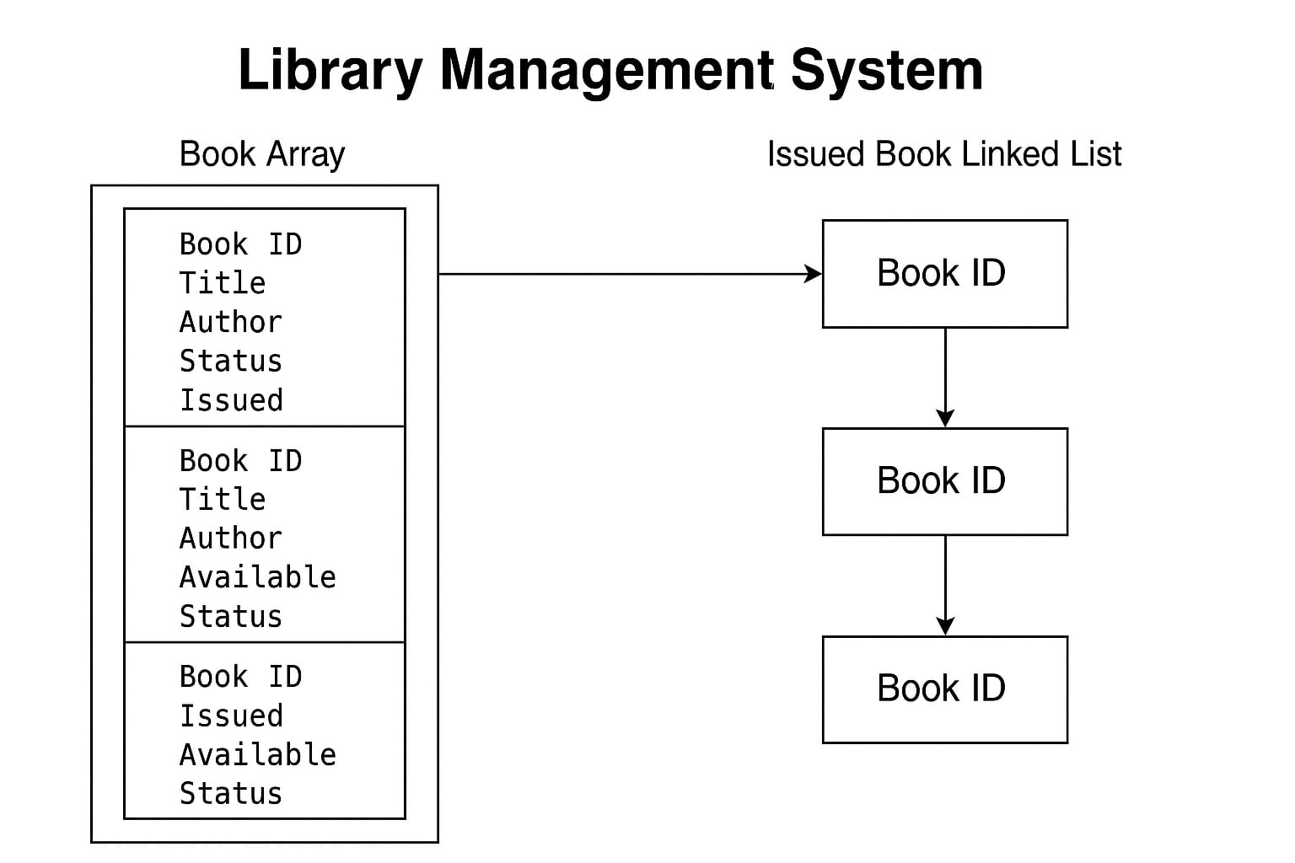
System Architecture
Diagram: Book Array + Issued Linked List
Menu -> Functions (Add, Delete, Issue, etc.)

Slide 9
Key Functions
• addBook()
• deleteBook()
• searchBook()
• displayBooks()
• issueBook()
• returnBook()
• displayIssuedBooks()

Slide 10


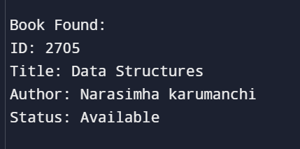
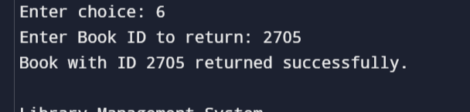
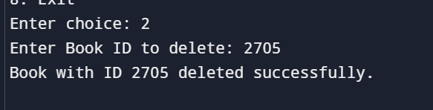
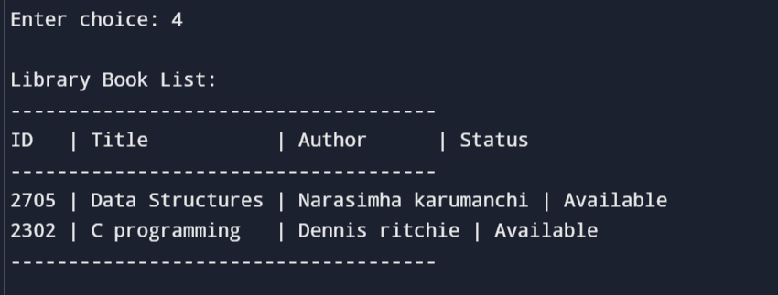
Sample Output

Slide 11
Advantages
• Reduces manual effort
• Accurate tracking
• Easy to use and extend
• Real-time status checking

Slide 12
Limitations & Future Work
• No login system
• No file/database storage
• Future enhancements:file storage,user login.

Slide 13
Conclusion
• Efficient for small libraries
• Demonstrates C programming and data structures
• Basis for more advanced systems

Slide 14
THANK YOU

