Slide 1




RADAR DETECTION SYSTEM
team id: CU_CP_Team_8608
M. Deekshitha
A. Sindhu
K. Rajasruthi
Under the mentorship of,
Kurumurthy Pasupula

Slide 2

Project Objectives
Problem Statement
Project Overview – Introduction
End Users
Wow Factor in Project
Modelling/Block Diagram/Flow of Project
Result/outcomes
Conclusion
Future Perspective

Slide 3
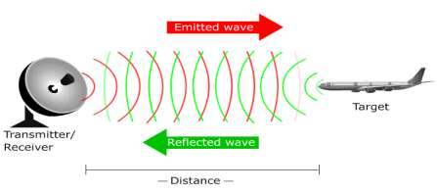
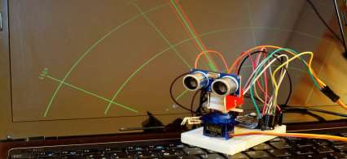
|Problem Statement:
The increasing need for affordable and efficient object detection systems in security, automation, and navigation necessitates a compact, cost-effective radar detection system. Existing systems are either expensive or complex. This project aims to develop a radar detection system using Arduino to provide real-time object detection and tracking capabilities with minimal cost and complexity.

Slide 4
|Project overview - Introduction
This project focuses on designing a radar detection system using an ultrasonic sensor, servo motor, and Arduino. The system will scan the surroundings, detect objects within a defined range, and display the results on a computer interface using Processing software. The main objective is to create a low-cost, efficient, and simple radar system for educational and practical applications

Slide 5
|End User
•Robotics enthusiasts and hobbyists
•Students and researchers in electronics and automation
•Security personnel for surveillance applications
•Developers looking for cost-effective radar solutions
•Industries requiring proximity detection systems

Slide 6
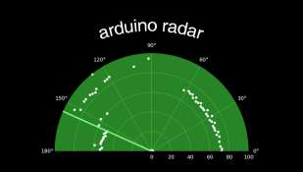
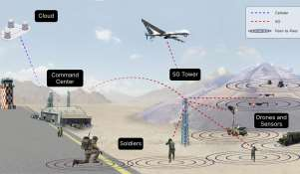
|Wow Factor in Solution
•Real-time object detection and visualization
•180-degree scanning with an ultrasonic sensor
•Graphical user interface (GUI) for live monitoring
•Cost-effective alternative to traditional radar systems
•Can be further integrated with IoT and AI for enhanced functionality

Slide 7
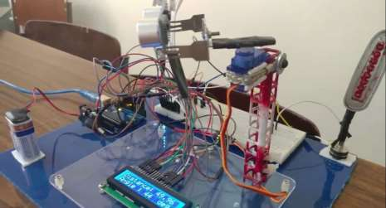
|Modelling
Power Supply → Powers the Arduino and components.
Arduino Board → Controls the ultrasonic sensor and servo motor.
Ultrasonic Sensor (HC-SR04) → Measures distance of objects.
Servo Motor → Rotates the sensor for scanning.
Processing Software → Visualizes detected objects on a computer

Slide 8
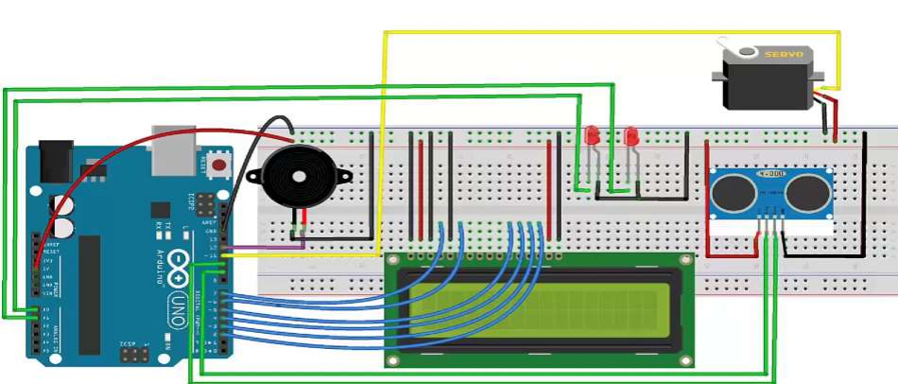
|Circuit Diagram

Slide 9
|Result /Outcomes
Prototype Level Solution
At the prototype level, the radar detection system is constructed on a breadboard using an Arduino Uno, ultrasonic sensor, servo motor, buzzer, LEDs, and an LCD display. The components are wired together to allow real-time object detection and distance measurement. The system is tested in a controlled environment to ensure functionality before moving towards a more robust implementation.

Slide 10
•The system successfully detects objects within a predefined range.
•Real-time data visualization on a computer screen.
•Cost-effective and easy-to-build radar system.
•High accuracy in short-range detection.
•Audible and visual alerts through buzzer and LEDs.
•Potential applications in security and automation

Slide 11
|Conclusion
The Arduino-based radar detection system provides an efficient, affordable, and functional solution for real-time object detection. Its ease of implementation and adaptability make it suitable for various applications. The project demonstrates the capability of using simple electronic components to create a working radar system, making it an excellent learning tool for students and developers

Slide 12
|Future Perspective
•Enhancing accuracy by integrating multiple sensors.
•Implementing machine learning for object classification.
•Extending the range using advanced sensors like LIDAR.
•Integrating wireless communication for remote monitoring.
•Developing an autonomous navigation system using radar feedback.

Slide 13
THANK YOU..!

