Slide 1
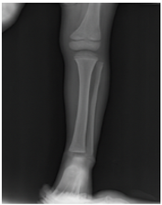
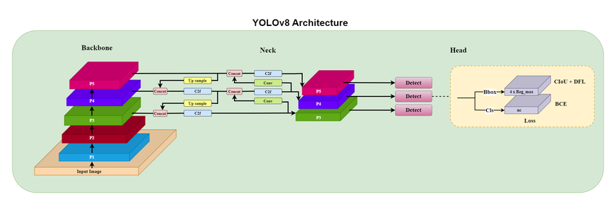
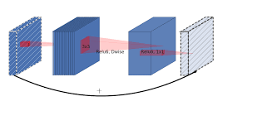

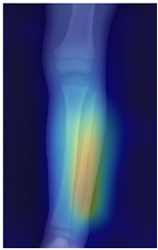
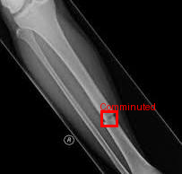
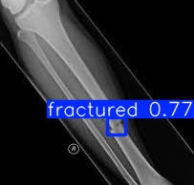
Input X-ray image
YOLOv8
EfficientNET - B0
Full Grad CAM Suite

Slide 2
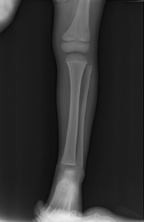
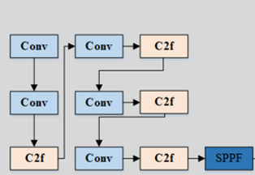
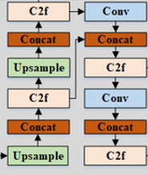
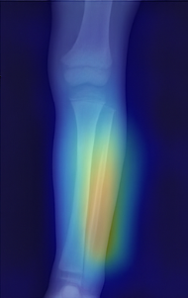

Input
Backbone
Neck
Prediction
Output

Slide 3
Input X-Ray Image
EfficientNET-B0
YOLOv8
Full Grad-CAM
Conv
C2f
Detection Head
Conv2D
MBConv
Max Pool
Grad-CAM
Grad-CAM ++
Score-CAM
Grad CAM output
Cropped Bounding boxes
Classified images

