Slide 1

Project Title - Seasonal Agriculture Performance Analysis
Deekshitha H R
East West College of Engineering
AICTE STU ID: STU6a697faea39e81785298862

Slide 2

PROBLEM STATEMENT
Agricultural activities are influenced by seasonal variations in environmental conditions, farming practices, resource availability and market conditions. As a result, agricultural performance may differ from one season to another. However, raw agricultural data does not clearly explain how agricultural performance changes across seasons or what patterns can be observed in different seasonal conditions.
The problem is to analyze the given agricultural dataset and investigate seasonal differences in agricultural performance by identifying meaningful patterns, trends, relationships and variations within the available data.

Slide 3
Project Description This project looks at how agriculture performs in different seasons. It uses data about crops, farming activities, weather conditions, resource use, and profit to understand what changes from one season to another. By analyzing the data, we identify important patterns and differences in crop performance and use these findings to give useful suggestions for better agricultural planning.

Slide 4

WHO ARE THE END USERS?
Farmers – to understand which seasons and farming conditions give better results.
Agricultural planners – to plan farming activities based on seasonal patterns.
Agricultural officers and decision-makers – to use data-based findings for better agricultural planning.
Researchers and students – to study seasonal trends and relationships in agricultural data.

Slide 5

Technology Used
Python – Used to perform the overall data analysis.
Pandas – Used to load, clean, and organize the dataset.
NumPy – Used for numerical calculations and data processing.
Matplotlib – Used to create graphs and charts.
Seaborn – Used to create clear and attractive visualizations.
SciPy – Used for statistical analysis and testing.

Slide 6
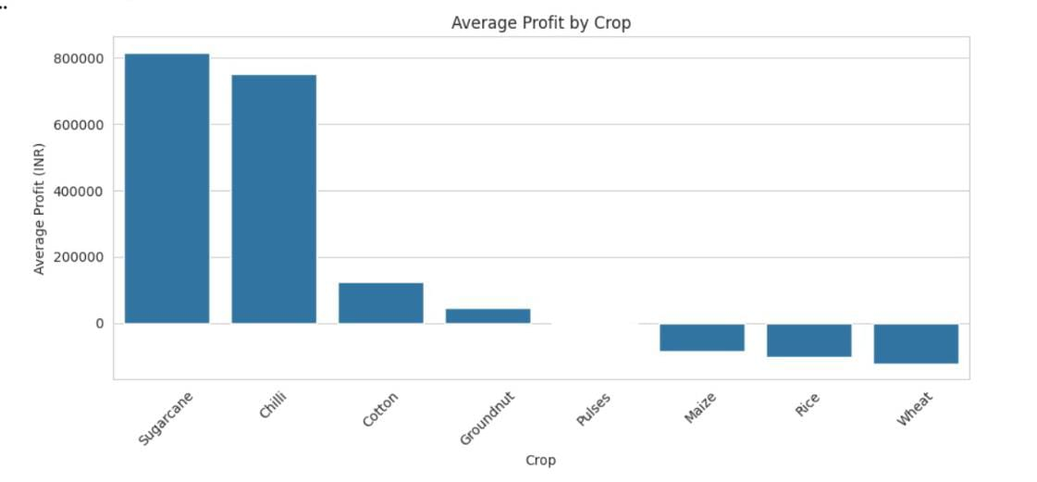
RESULTS
Average Profit by Crop
The graph shows that Sugarcane and Chilli have the highest average profits among the crops. In comparison, Maize, Rice, and Wheat have negative average profits in the dataset.

Slide 7
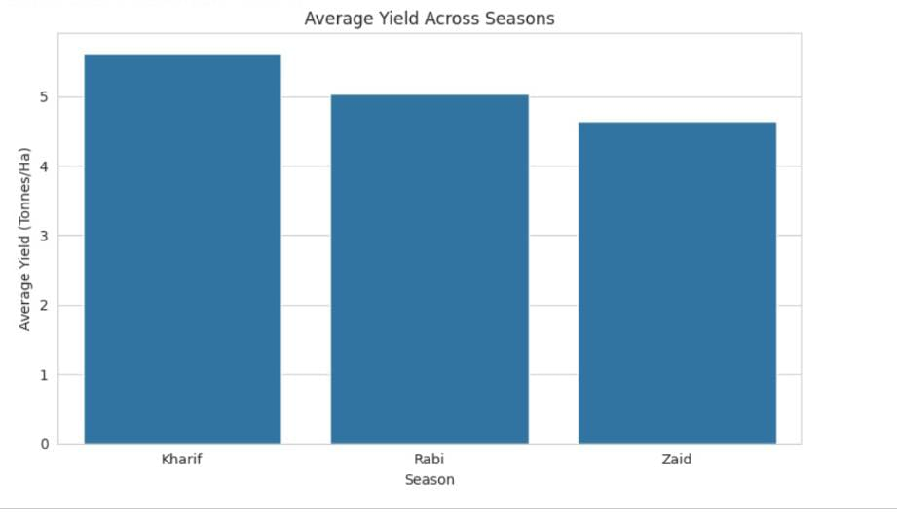
RESULTS
Average Yield Across Seasons
The graph shows that Kharif has the highest average yield, followed by Rabi and Zaid. This indicates that crop production is generally better during the Kharif season.

Slide 8
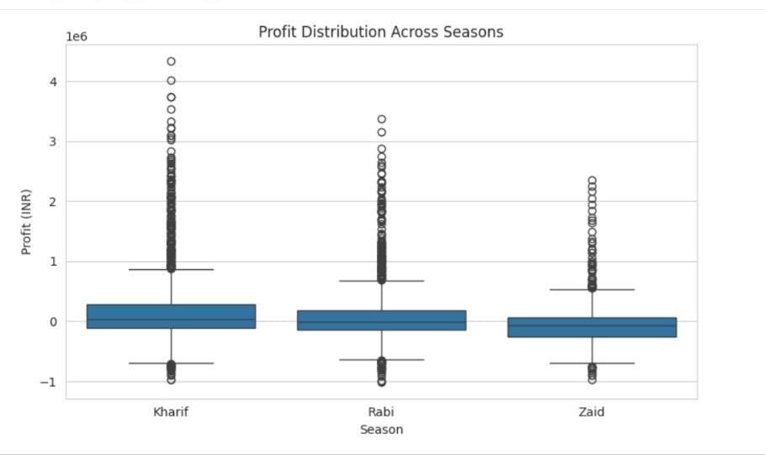
RESULTS
Profit Distribution Across Seasons
The graph shows that Kharif has better profit performance overall, while Zaid has lower profits. It also shows some high and low profit values, indicating variation among farms.

Slide 9
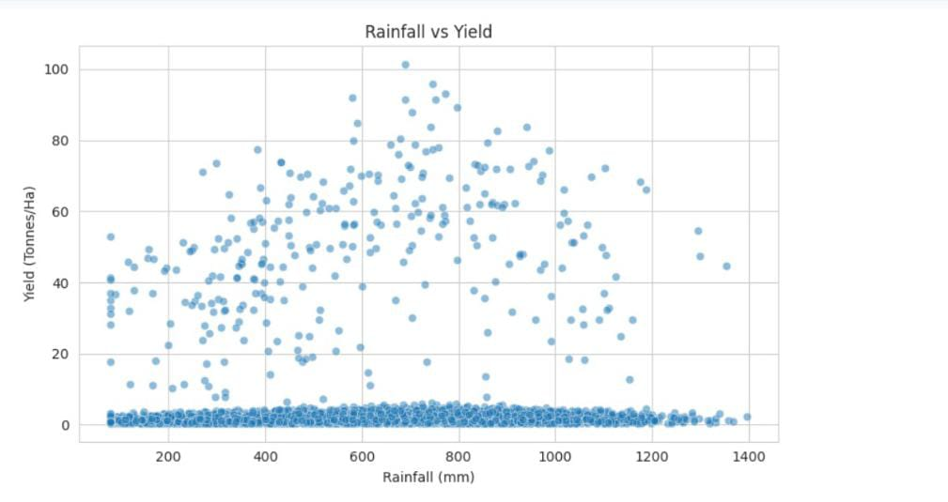
RESULTS
Rainfall vs Yield
The scatter plot shows the relationship between rainfall and crop yield. The points indicate that rainfall alone does not determine yield, as yield varies considerably at different rainfall levels.

Slide 10
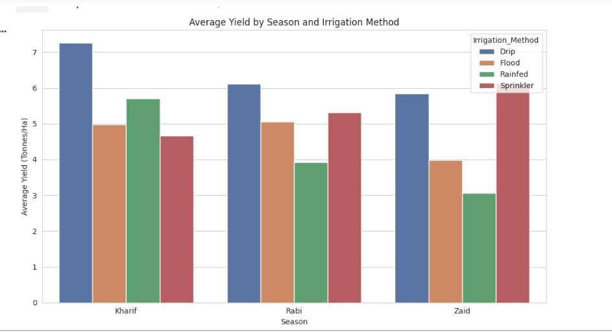
RESULTS
Average Yield by Season and Irrigation Method
The graph compares different irrigation methods across seasons. Drip irrigation generally gives high yields, while the best-performing irrigation method can vary depending on the season.

Slide 11
Future scope
The project can be extended by using more agricultural data from different regions and years.
More environmental factors such as soil quality, weather conditions, and rainfall can be studied.
The analysis can be improved by adding real-time agricultural data.
Future work can include predicting crop yield and profit for different seasons.
A simple dashboard or application can be developed to help farmers understand the results.
The project can be updated regularly to support better seasonal farming decisions.

Slide 12
GitHub Link
https://github.com/BHUVANA-TS/Seasonal-Agriculture-Performance-Analysis.git

Slide 13

VOIS Course completion certificate - Course name- Data Visualization

Slide 14
Thank you
.
.

