Slide 1


Slide 2
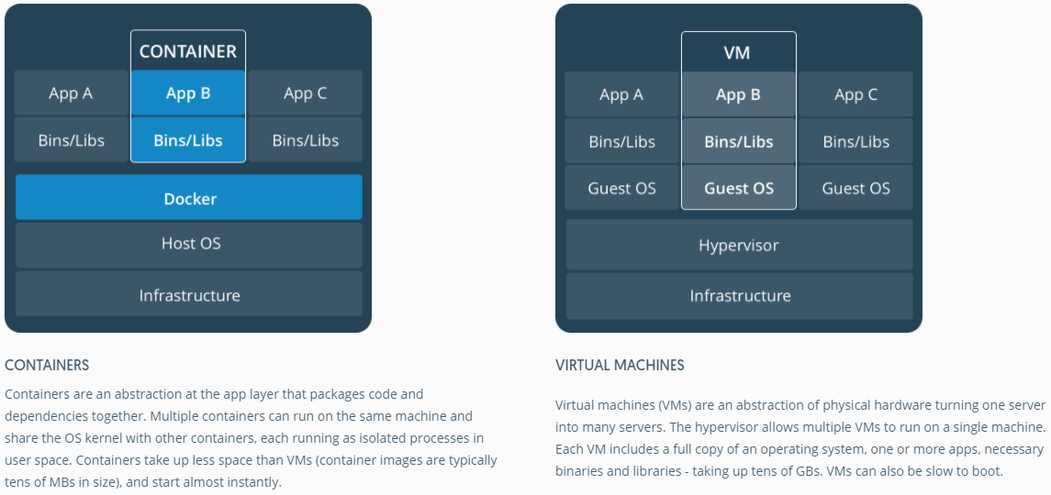
Why Docker ?

Slide 3
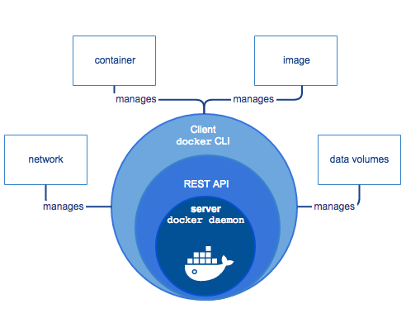
Docker and its Features

Slide 4
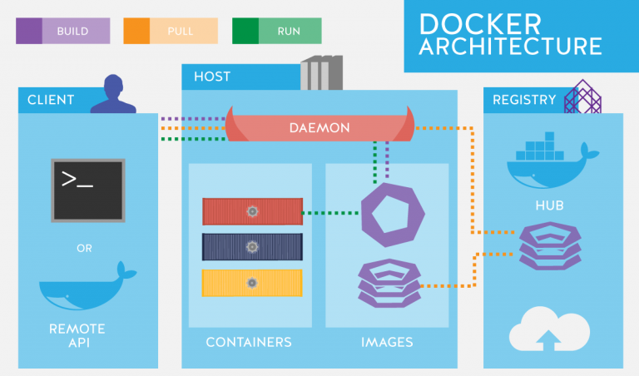
Docker Architecture

Slide 5

Docker Commands Demo
This Photo by Unknown Author is licensed under CC BY-NC-ND

Slide 6
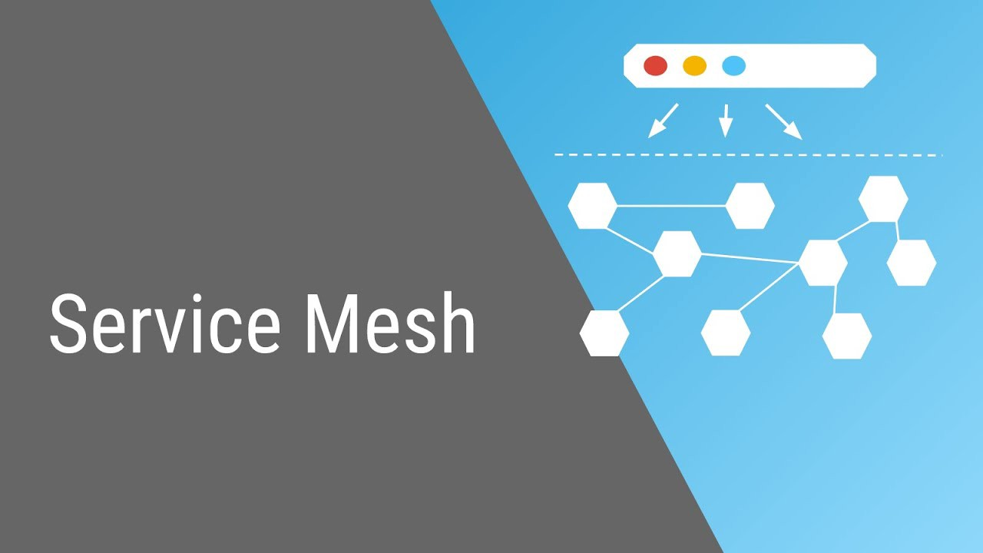

Slide 7
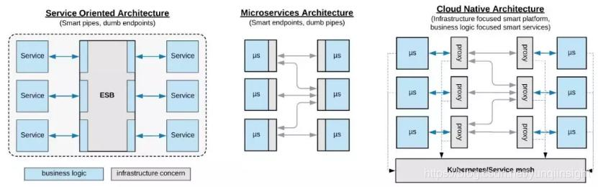
Architectures

Slide 8
Service Mesh
Service Mesh is a dedicated infrastructure layer for making service-to-service communication in safe , fast and reliable way . If you are building a cloud native application , you need service mesh
Service Mesh is mostly focus on East-West traffic(traffic in your services)
Service Mesh consists of data plane and control plane which are dependent on each other
Data Planes: Linkerd, NGINX, HAproxy ,Envoy
Control Planes: Istio , Nelson , SmartStack

Slide 9
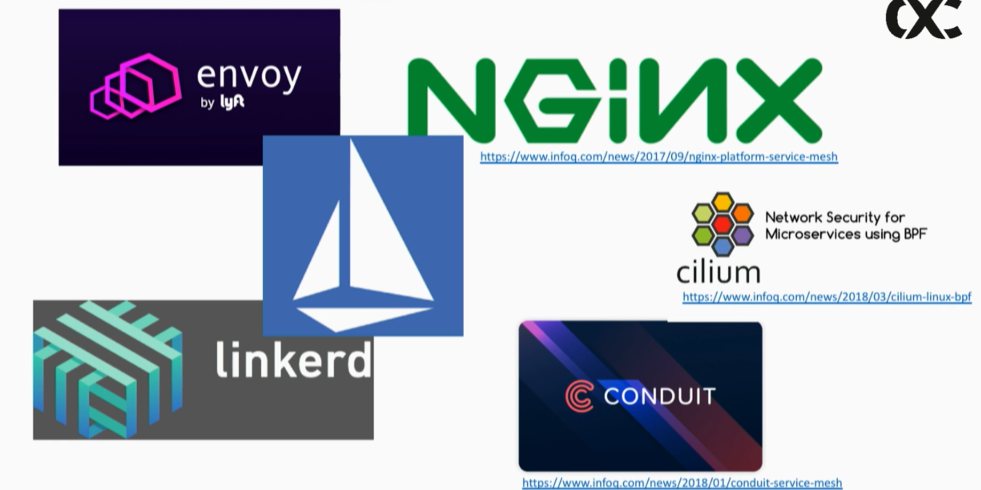
Implementations of service mesh

Slide 10
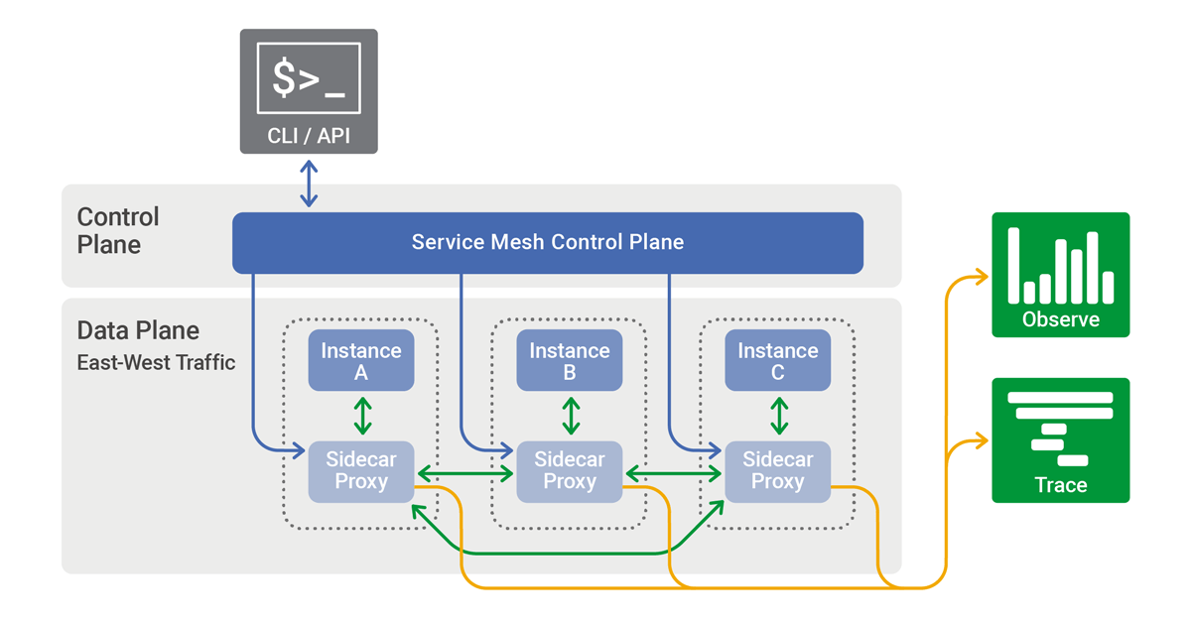
Service Mesh Example

Slide 11
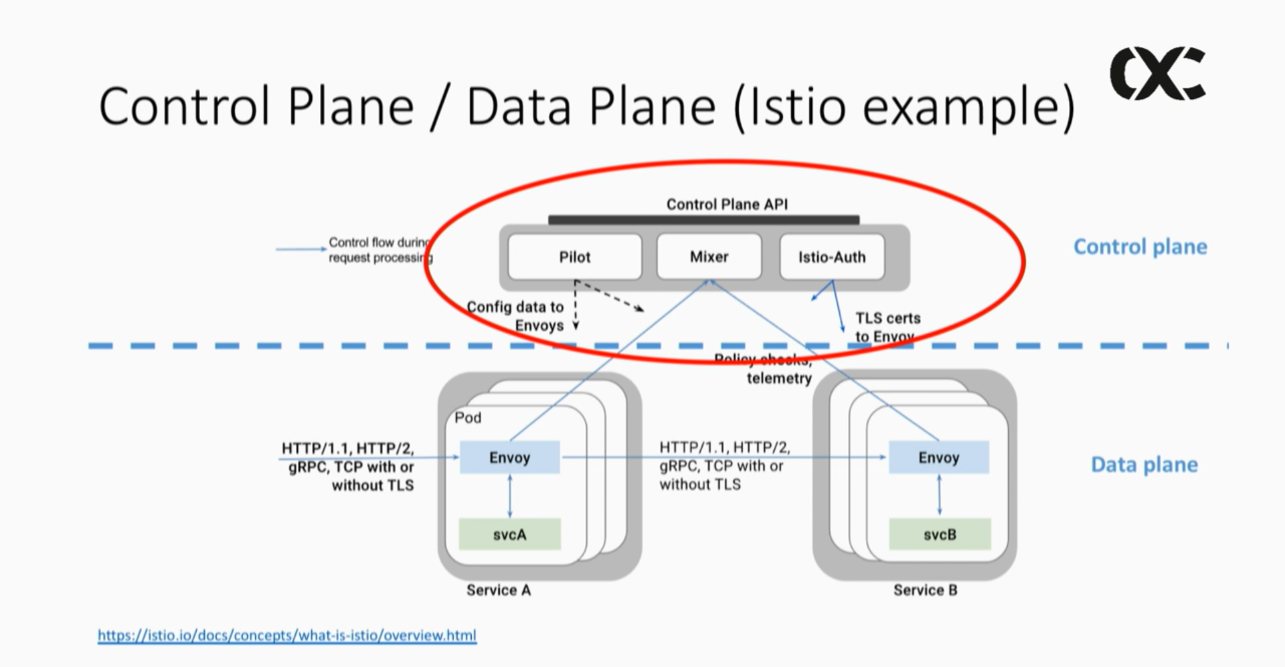
Service Mesh with Envoy

Slide 12

ENVOY PROXY

Slide 13
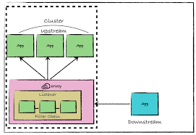
Upstream and Downstream
Downstream: A downstream host connects to Envoy, sends requests, and receives responses.
Upstream: An upstream host receives connections and requests from Envoy and returns responses.

Slide 14


