Slide 1
Presentation

Slide 2

KUBERNETES
What is Kubernetes?
Why do we need Kubernetes?

Slide 3
KUBERNETES
Features of Kubernetes
Automatic scheduling
Service discovery and load balancing
Storage orchestration
Self healing
Automatic rollout and roll backs
Scaling

Slide 4
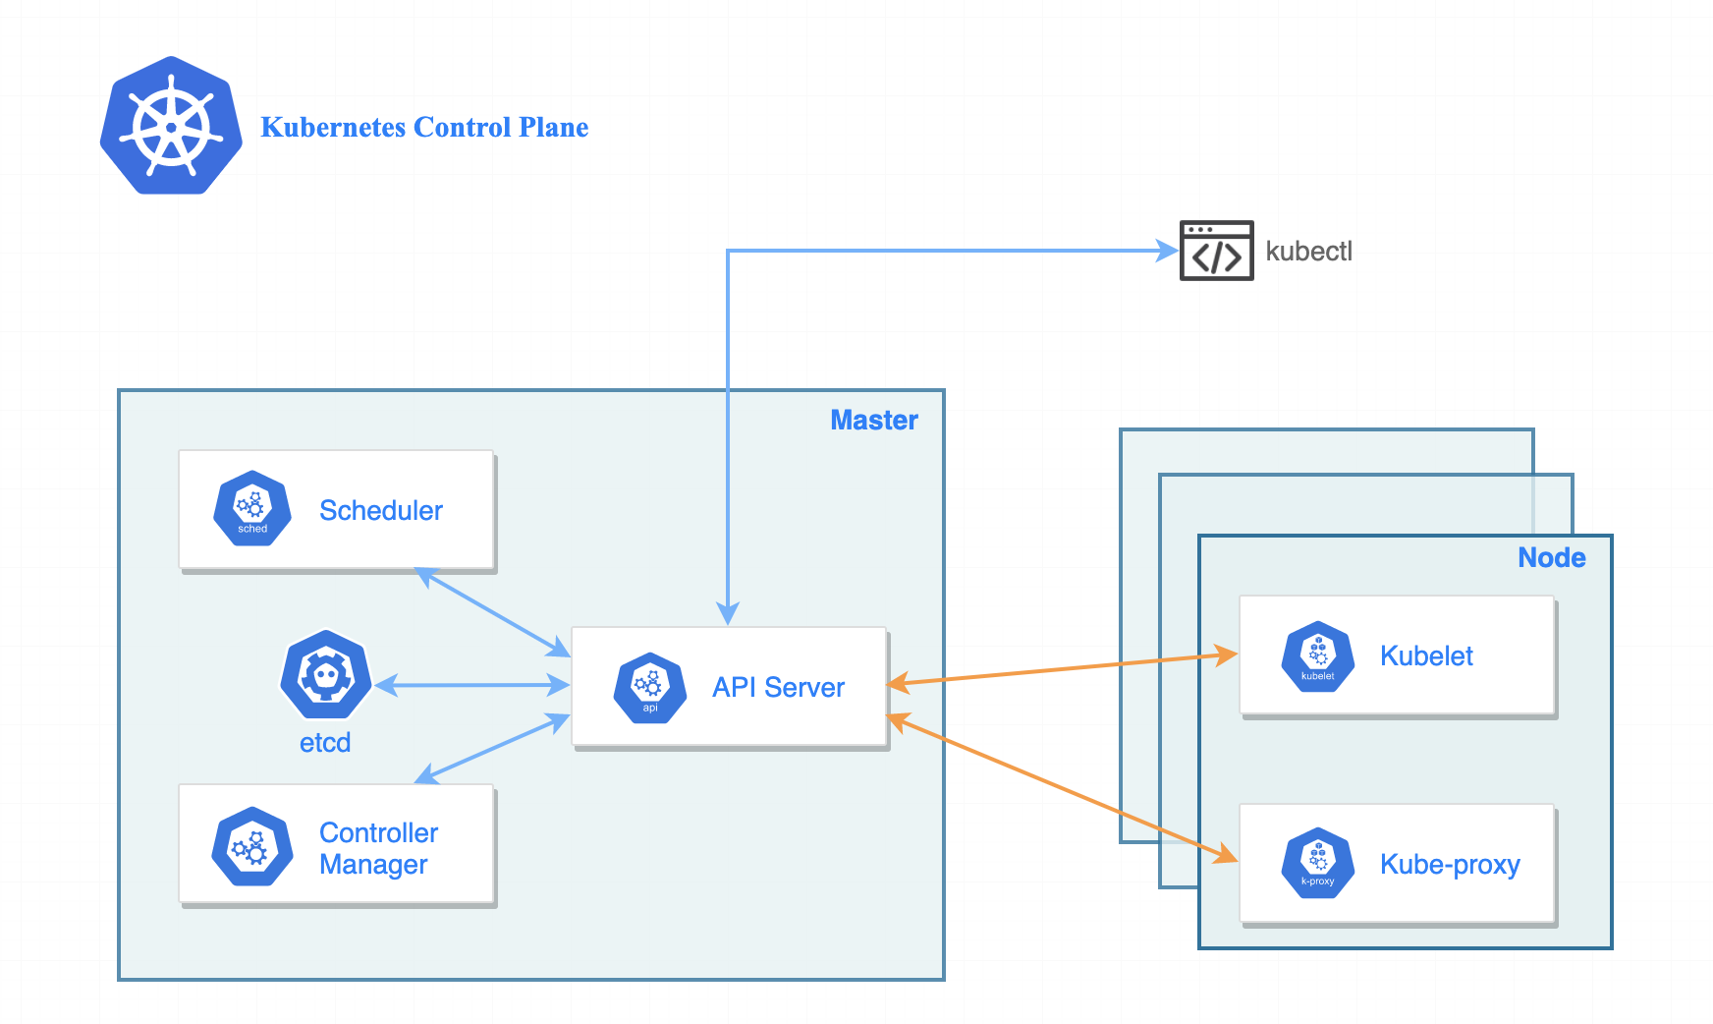
KUBERNETES
Architecture of Kubernetes cluster

Slide 5
Basic Commands in Kubernetes
command | usage
create | Create a resource from a file or from stdin.
delete | Delete resources by filenames, stdin, resources and names.
get | Display one or many resources
apply | Apply a configuration to a resource by filename
describe | Show details of a specific resource or group of resource
expose | Take a replication controller, service, deployment or pod and expose it as a new Kubernetes Service

Slide 6
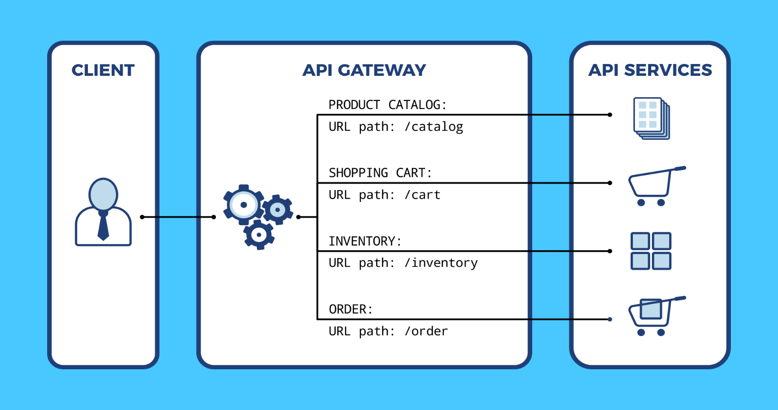
Api Gateway
What is Api Gateway?

Slide 7
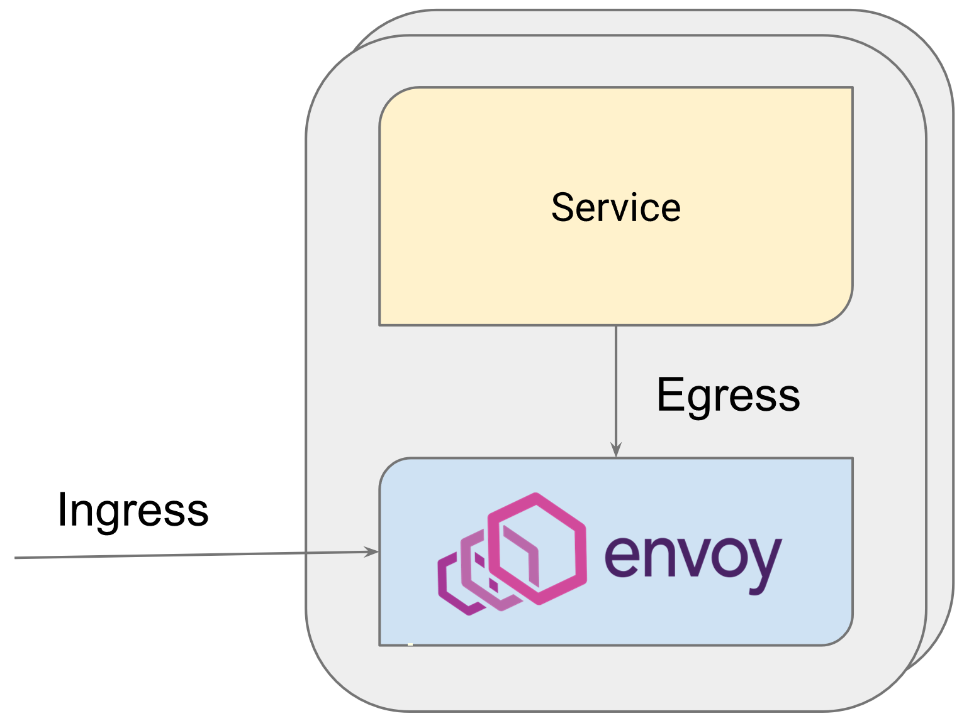
Envoy
Ingress Listeners
Egress Listeners

Slide 8
Thank you!!

