Slide 1


NEXT GEN EMPLOYABILITY PROGRAM
CREATING A FUTURE-READY WORKFORCE
Student Name :
DEEKSHITH KUMAR D NAIK
Student ID :
College Name :
STU6738374b641081731737419
CITY ENGINEERING COLLEGE BENGALURU

Slide 2
CAPSTONE PROJECT SHOWCASE
News Application with User Authentication
Abstract | Problem Statement | Project Overview | Proposed Solution | Technology Used | Modelling & Results | Conclusion | Q&A

Slide 3
Abstract
1
News Web Application: A platform where users can register, log in, and access news articles securely.
2
MERN Stack: The application utilizes MongoDB, Express.js, React.js, and Node.js for both front-end and back-end development.
3
User Authentication: Incorporates authentication to ensure secure user access to news content.
4
API Integration: The application fetches and displays news articles via API calls from the back-end.

Slide 4


Problem Statement
Lack of Secure Authentication: Many news websites don't provide secure authentication for users to access content.
User Accounts: Users need the ability to create accounts and log in securely to access personalized news.
Personalized News: The application allows users to view news tailored to them after authentication.
User-Generated Content: Users can also add their own articles, contributing to the news feed.

Slide 5

Project Overview
User Authentication - Registration and Login using JWT tokens.
News Viewing - Only authenticated users can access and view the latest news articles.
News API -The application uses server-side routes to fetch the latest news. These routes are tested using Postman to ensure they are working correctly..
The front-end is developed with React, styled using Material-UI for a modern UI/UX experience. The back-end is built using Node.js, Express.js, and MongoDB to manage user accounts and store news data.

Slide 6
Proposed Solution
Creating a front-end that allows users to easily register, log in, and view news.
Implementing JWT-based authentication to manage secure login sessions.
Fetching and displaying news articles from a server using API requests.
Ensuring a clean and modern design using Material-UI to improve the user experience.

Slide 7
Technology used
Technology Stack
Frontend: React.js, Material-UI
Backend: Node.js, Express.js
Database: MongoDB
Authentication: JWT (JSON Web Tokens)
Other Tools: Axios (for API requests), React Router (for navigation)
API Testing: Postman

Slide 8
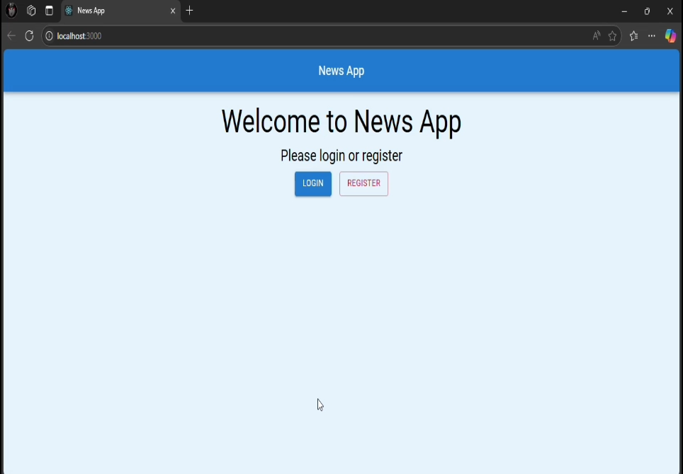
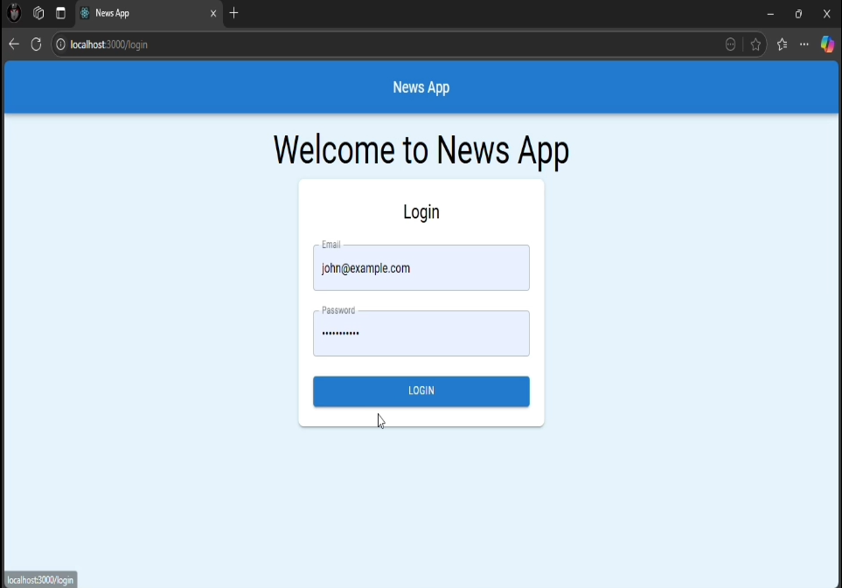
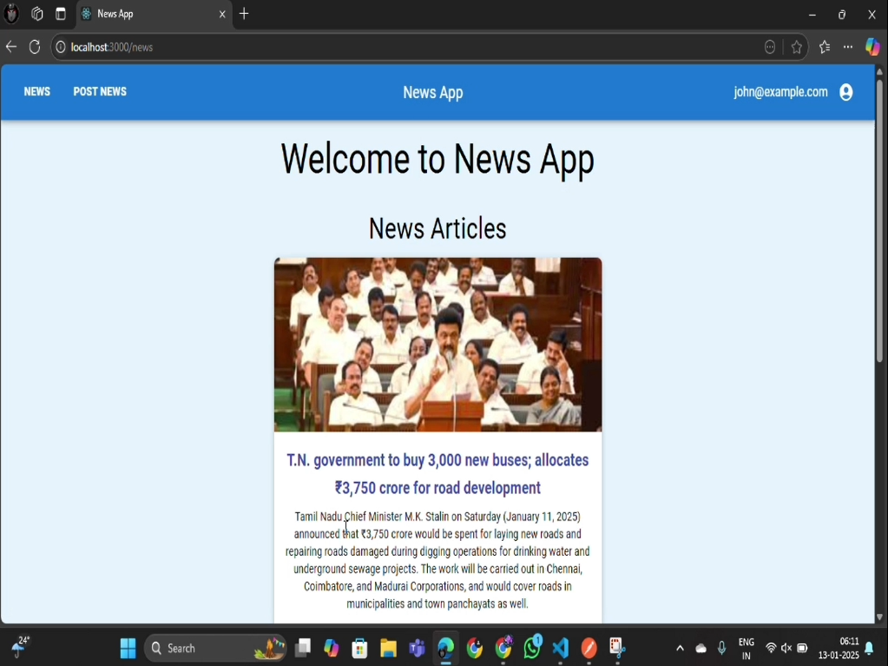
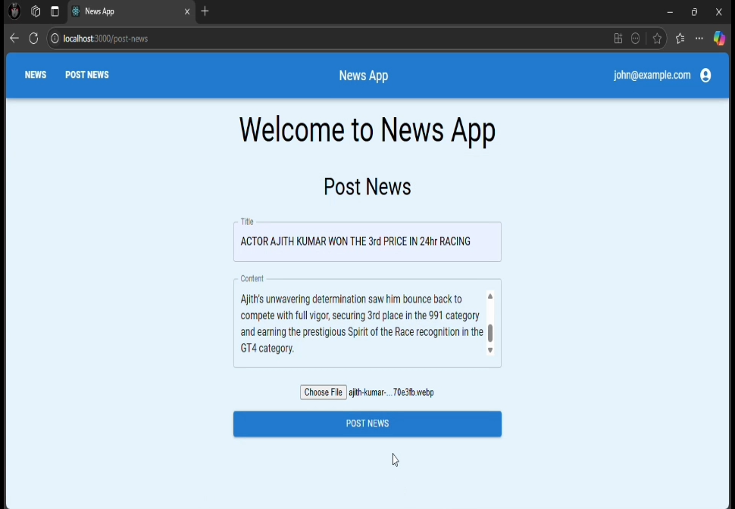
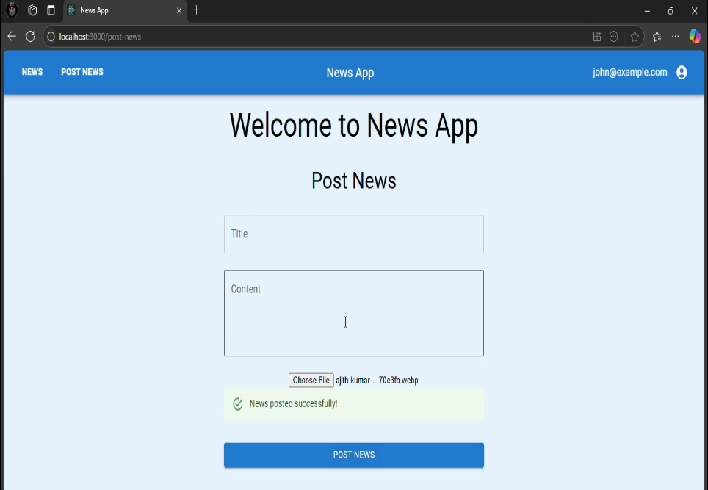
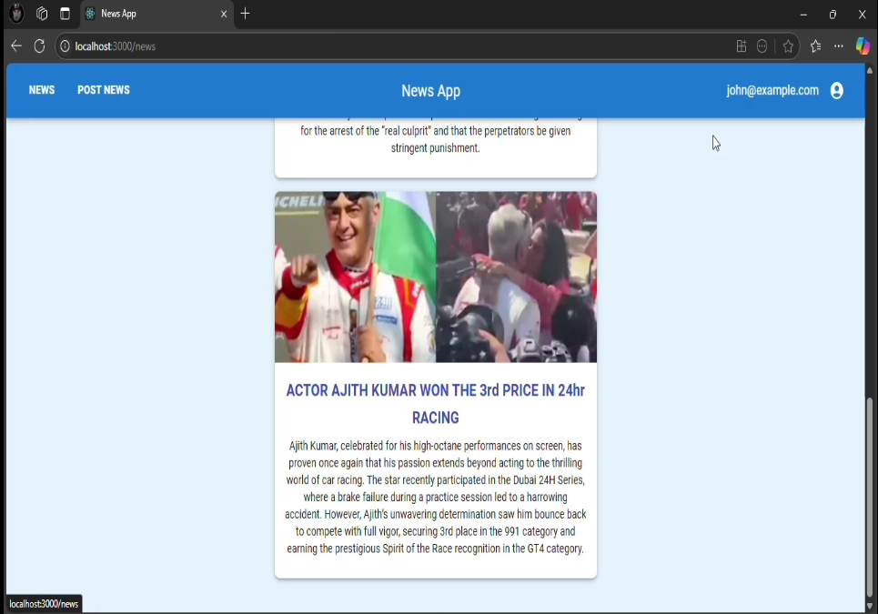
Modelling & Result

Slide 9

Conclusion
This project successfully builds a secure and user-friendly news application where users can register, log in, and view the latest news articles. The use of modern technologies such as MERN stack and JWT-based authentication ensures scalability, security, and a seamless user experience.

Slide 10


Notes:
Thank You !!

