Slide 1
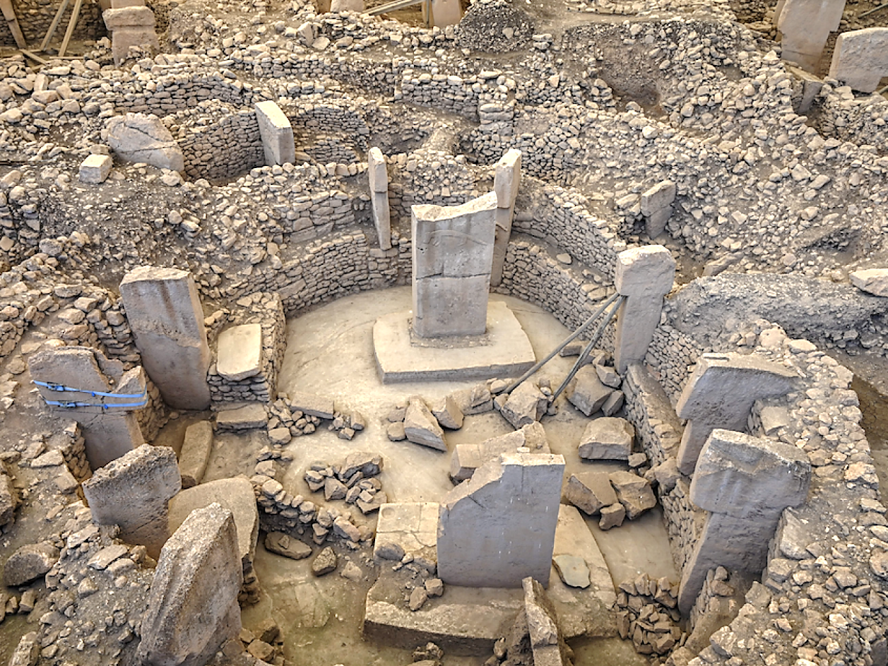
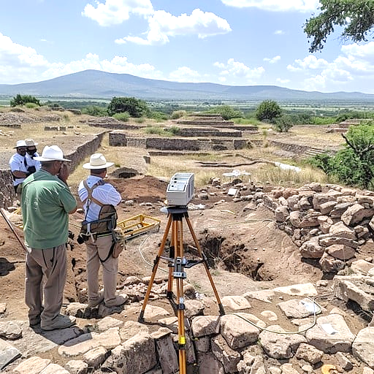
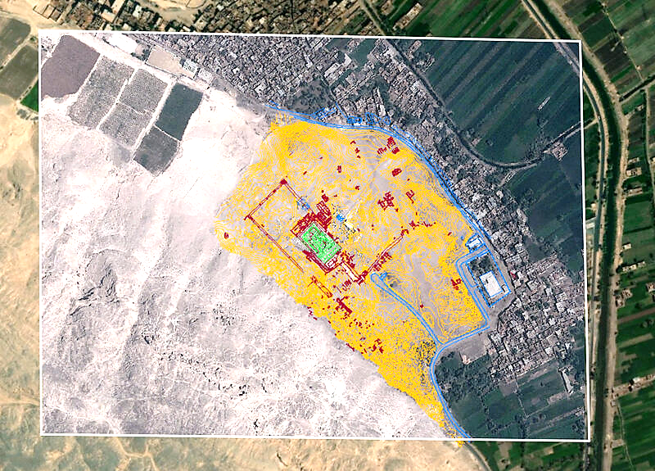


Slide 2

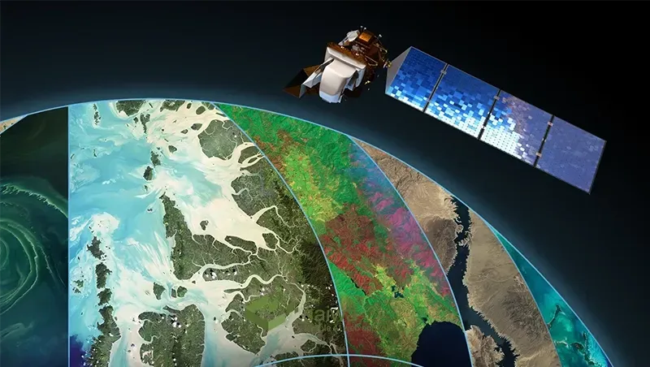

AI-Driven Archaeological Site Mapping
Vegetation & Soil Detection using CNNs
Presented By: Infosys Springboard Virtual Internship 6.0 (Batch 2)

Slide 3
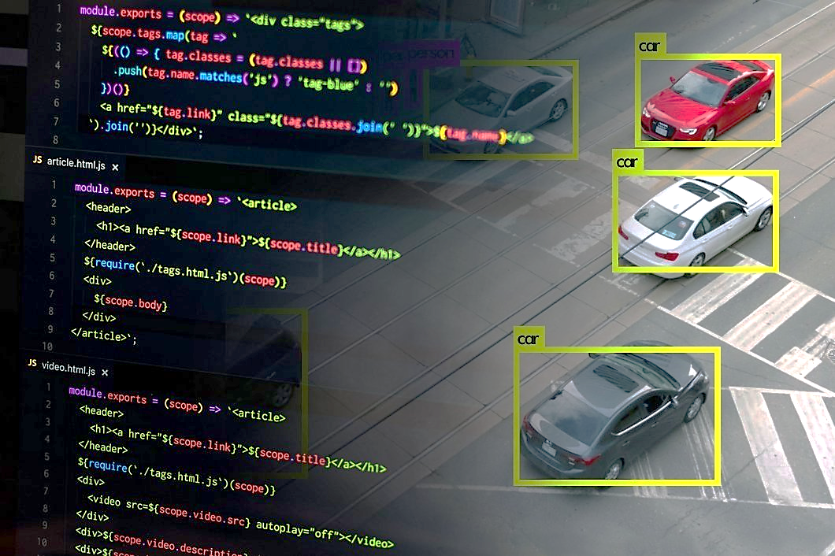

Project Overview
Archaeological site mapping often faces challenges due to vegetation cover and soil diversity.
Traditional methods are time-consuming and rely on manual fieldwork.
This project integrates AI-driven detection models to automate analysis of satellite or drone imagery.

Slide 4
Project Objectives
It Automate vegetation detection using computer vision.
Classify soil types for archaeological terrain understanding.
Design an interactive web dashboard for visualization and analysis also build FastAPI backend for model inference.
Enable faster and data-driven archaeological mapping.

Slide 5
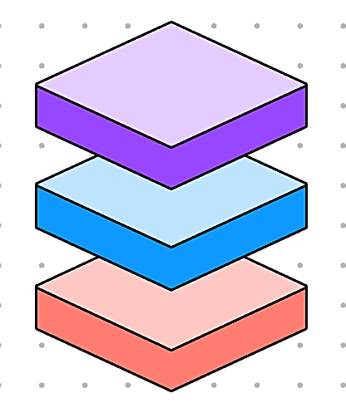
System Architecture
Data
Workflow:
Image Collection (Google Earth Pro, Roboflow)
Data Preprocessing (Resizing to 640 × 640, Labeling)
Model Training (Colab with GPU)
YOLOv8 → Vegetation Detection (1 class)
YOLOv11 → Soil Detection (4 classes)
Model Evaluation (Precision, Recall, F1 Score)
API Integration with FastAPI
Frontend Visualization in React
YOLO Models
FastAPI
React Dashboard

Slide 6
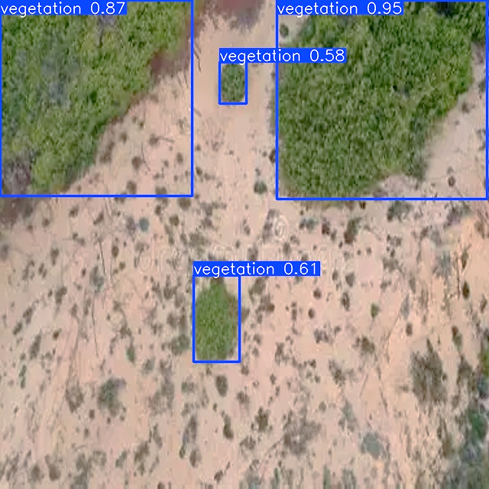
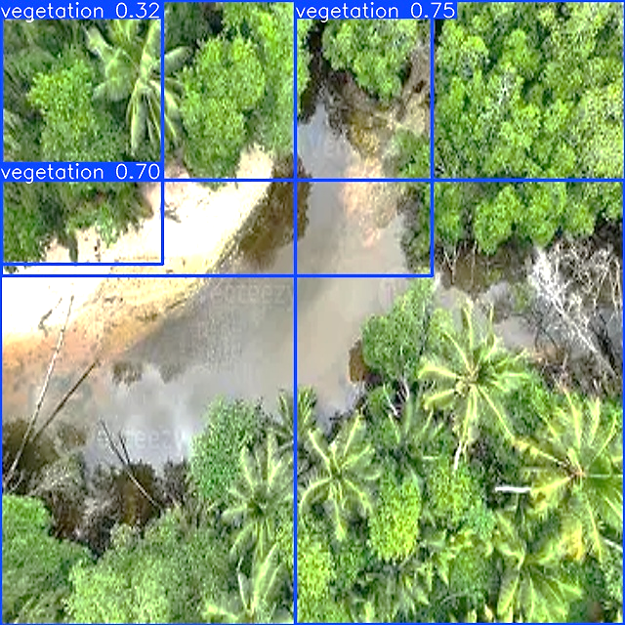
Tech Stack
Frontend
: React (UI for user interaction)
Backend
: FastAPI (API for model serving and data handling)
AI Models
: YOLOv8 for vegetation, YOLOv11 for soil classification
Language
: Python
Development Environment
: Google Colab (for training and experimentation)

Slide 7
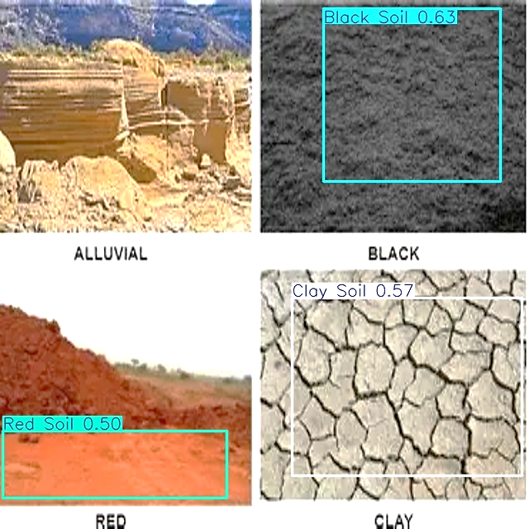
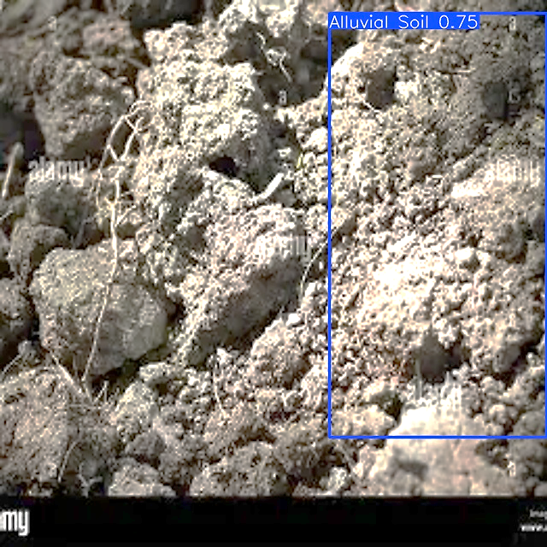
Vegetation Detection (YOLOv8)
Model Used: YOLOv8 (Ultralytics)
Class: 1 (Vegetation)
Features:
Lightweight and fast
Ideal for single-class detection
Output: Bounding boxes showing vegetation coverage
Result: High accuracy and rapid inference time

Slide 8

Soil Detection (YOLOv11)
Model Used: YOLOv11
Classes (4):
1. Red Soil, 2. Clay Soil, 3. Black Soil 4. Alluvial Soil
Training Details:
Image size : 640×640
Custom dataset organized by soil types
Metrics : Precision, Recall, F1 Score, mAP
Output: Bounding boxes identifying different soil regions with color-coded labels (e.g., red, clay, black, alluvial)

Slide 9

Integration
Models deployed on FastAPI backend for inference.
React Dashboard visualizes detection results with map overlays.
Option to upload new images for prediction.
The system supports modular endpoints — one for vegetation detection and another for soil detection.

Slide 10
Evaluation Metrics
Metric | Vegetation (YOLOv8) | Soil (YOLOv11)
Precision | 0.71 | 0.68
Recall | 0.66 | 0.51
F1 Score | 0.68 | 0.58
mAP50 | 0.71 | 0.57

Slide 11


Conclusion
Successfully built an AI pipeline for vegetation and soil detection.
Overview of how YOLOv8 and YOLOv11 contribute to vegetation and soil detection.
Combines AI + Web + Geospatial analysis for real-world archaeological applications.

Slide 12

Acknowledgment
Mentor: Vamshi Krishna Sir
Institution: Infosys Springboard Internship Program
Special Thanks: Open-source contributors (Roboflow, React community)
Thank You

