Slide 1
Health and Safety Monitoring for the Modern Workspace
CSE 572: Data Mining
Deekshith Reddy Kotla 1228003064
Rohith Kumar Reddy Bathula 1225413605
Mogileeswar Reddy Morramreddygari 1226424565
Sathvika Talakanti 1225530644

Slide 2
Problem Description
There are many scenarios in real world where people may face health and safety risks in various situations, such as the modern workspace, driving, and online learning.
There is a need to address these problems such as bad posture, exhaustion, drowsiness, and mental distress to enhance health and safety outcomes.
There are many models that address these issues individually, but there isn't any model that combines all of them..
We propose a unified model that uses CNN for training and Haar cascade
classifiers to develop an application that detects sub-features, such as emotion, heart attack, and eye detection, in a single model to address these health hazards.

Slide 3
Eye Detection
Related Work
Ma et al. [4] proposed BiLRCN for online learning engagement recognition, Mehta et al. [6] developed a real-time driver drowsiness detection system using eye closure ratio and aspect ratio, and Rafid et al. [5] achieved real-time accuracy of 94.5% in detecting driver tiredness using the CenterFace algorithm and Haar-Classifier.
Guo et al. [2] proposed LBP-TOP for micro-expression recognition with 65.83% accuracy, while Wang et al. [3] achieved up to 75.30% accuracy using LBP-TOP features and SVM classifiers with EVM amplification. Ayyalasomayajula et al. [1] achieved high accuracy with CNN for recognizing subtle micro-expressions after detecting and amplifying faces with EVM.
Emotion Detection
Heart Attack Detection
Newell et al. [9] used deep learning to monitor ergonomic posture, while Sung et al. [8] showed the potential of deep learning in detecting human activities. Rojas-Albarracín et al. [7] built on these techniques to develop a system for detecting heart attacks in color images using convolutional neural networks, achieving high accuracy.
Unified Model
To create a unified model for Health and Safety Monitoring, high accuracy can be achieved by referencing Rojas-Albarracín et al. [7], Rafid et al. [5], and Ayyalasomayajula et al. [1], who used convolutional neural networks and color image datasets.

Slide 4
Dataset
Instances
Size
Distribution
4850
24*24 pixels
Closed eye: 2386
Open eye: 2464
Eye Detection
35,887
48*48 pixels
Angry: 4953
Disgust: 547
Fear: 5121
Happy: 8989
Sad: 6077
Surprise: 4002
Neutral: 6198
Emotion Detection
1520
48*48 pixels
Infarct: 760
No infarct: 760
Heart Attack Detection

Slide 5
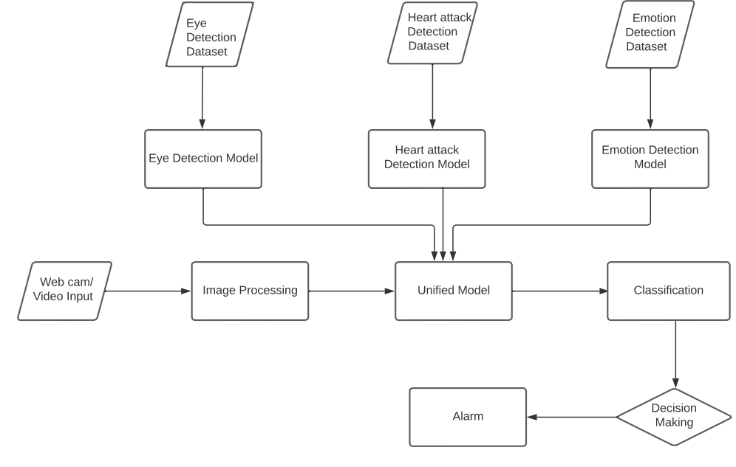
Proposed Architecture

Slide 6

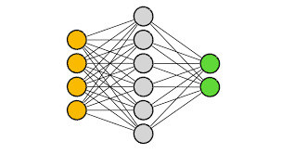

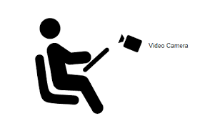
Approach
Data Preprocessing
Individual Models
Data Augmentation
Class balancing
Classification is done using CNN with SGD optimizer
Unified Model
User Application
Haar Cascade Classifier is used to detect faces and eyes in video streams, and pre-trained individual models to classify emotions, monitor drowsiness and infarcts.
Our system classifies video streams, increments the score accordingly, and alerts users with a buzzer.

Slide 7
Application Working Conditions Overview
Our Application increments the eye score when it detects user both left and right are closed by classifying eyes in each data frame from live video and alerts when it crosses 15
Eye score>15
Our Application increments the face score when it doesn't detects any face in each data frame from the live video and alerts when it crosses 20
Face score>20
Our Application increments the emotion score when it detects user is scared by classifying face in each data frame from the live video and alerts when it crosses 3
Emotion score>3
Our Application increments the Infarct score when it classifies the input data frame as infarct and also checks for extra constraints that either user fall’s out of camera focus or closes both eyes and alert
Body score>15 and (If face not found or (right and left eye close are closed))

Slide 8

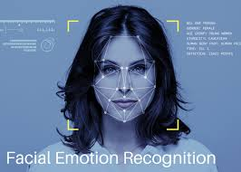
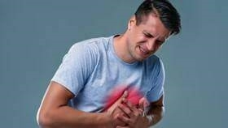
Model’s Accuracies
Train
Val
Test
EM
Eye Detection
94.4%
94.7%
96.8%
97.0%
Our eye detection model performed comparably to all other existing models to our knowledge.
Emotion Detection
75.2%
68.1%
67.8%
66.4%
We achieved better accuracy than other existing models using the same dataset.
Heart Attack Detection
79.3%
78.9%
71.3%
91.8%
We achieved less accuracy than existing work we referred to because of our low computational power
EM = existing model accuracy with same dataset

Slide 9
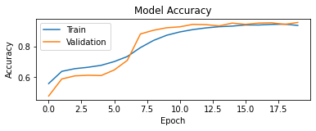
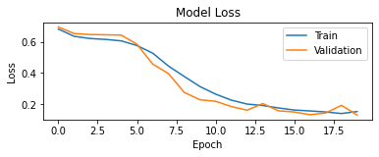
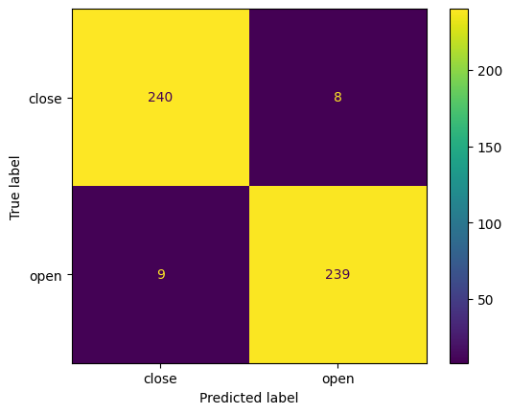
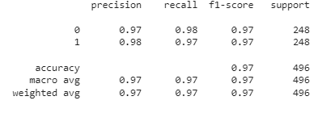
Eye Detection Results

Slide 10
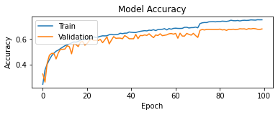
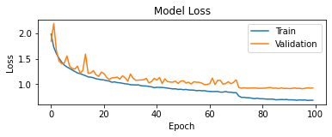
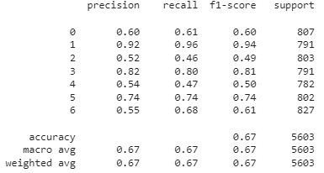
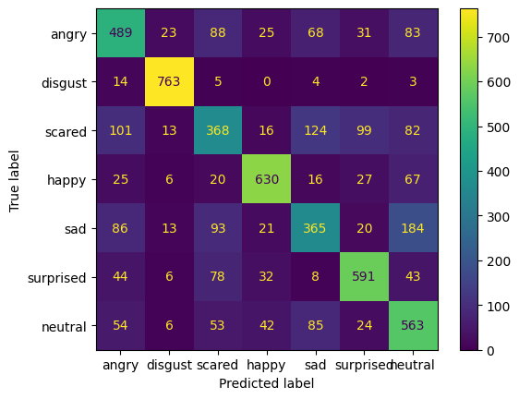
Emotion Detector Results

Slide 11
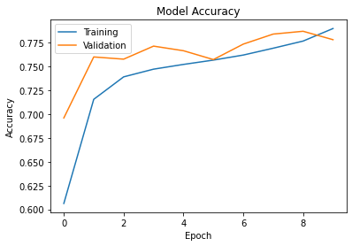
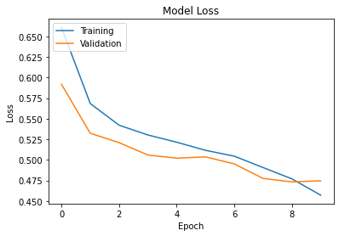
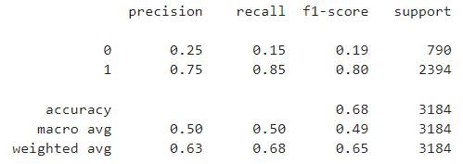
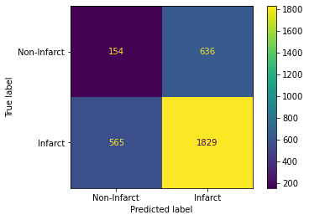
Heart Attack Detector Results

Slide 12
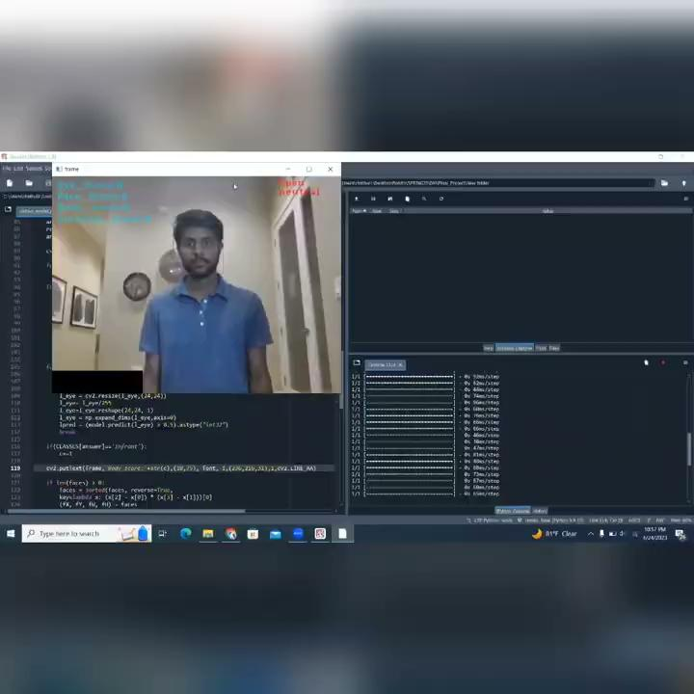
Working Model Demo (link)

Slide 13
Conclusion and Future work
⧪ Proposed real-time monitoring system uses computer vision to detect health and safety risks
⧪ System has shown promising results in accurately detecting eye movements and emotions
⧪ Heart attack detection model needs further improvement
⧪ Need for more extensive and diverse datasets to improve model performance in the future
⧪ Incorporating other health and safety features, such as muscle strain detection or vital sign monitoring, can enhance the system's capabilities.
Conclusion
Future Work

Slide 14
References
[1] S. C. Ayyalasomayajula, B. Ionescu and D. Ionescu, "A CNN Approach to Micro-Expressions Detection," 2021 IEEE 15th International Symposium on Applied Computational Intelligence and Informatics (SACI), Timisoara, Romania, 2021, pp. 345-350, link.
[2] Y. Guo, Y. Tian, X. Gao and X. Zhang, "Micro-expression recognition based on local binary patterns from three orthogonal planes and nearest neighbor method," 2014 International Joint Conference on Neural Networks (IJCNN), Beijing, China, 2014, pp. 3473-3479, doi: 10.1109/IJCNN.2014.6889620, link.
[3] Wang, Y., See, J., Oh, YH. et al. Effective recognition of facial micro-expressions with video motion magnification. Multimed Tools Appl 76, 21665–21690 (2017), link.
[4] Ma, Y.; Wei, Y.; Shi, Y.; Li, X.; Tian, Y.; Zhao, Z. Online Learning Engagement Recognition Using Bidirectional Long-Term Recurrent Convolutional Networks. Sustainability 2023, 15, 198, link
[5] A. -U. -I. Rafid, A. I. Chowdhury, A. R. Niloy and N. Sharmin, "A Deep Learning Based Approach for Real-time Driver Drowsiness Detection," 2021 5th International Conference on Electrical Engineering and Information Communication Technology (ICEEICT), Dhaka, Bangladesh, 2021, pp. 1-5, link.
[6] S. Mehta, S. Dadhich, S. Gumber and A. Jadhav Bhatt, "Real-time driver drowsiness detection system using eye aspect ratio and eye closure ratio", Proceedings of International Conference on Sustainable Computing in Science Technology and Management (SUSCOM), 2019, link.
[7] Rojas-Albarracín, G.; Chaves, M.Á.; Fernández-Caballero, A.; López, M.T. Heart Attack Detection in Colour Images Using Convolutional Neural Networks. Appl. Sci. 2019, 9, 5065, link.
[8] Jaeyong Sung, C. Ponce, B. Selman and A. Saxena, "Unstructured human activity detection from RGBD images" 2012 IEEE International Conference on Robotics and Automation, Saint Paul, MN, USA, 2012, pp. 842-849, doi: 10.1109/ICRA.2012.6224591, link.
[9] Newell, A., Yang, K., Deng, J. (2016). Stacked Hourglass Networks for Human Pose Estimation. In: Leibe, B., Matas, J., Sebe, N., Welling, M. (eds) Computer Vision – ECCV 2016. ECCV 2016. Lecture Notes in Computer Science(), vol 9912. Springer, Cham, link.

Slide 15


