Slide 1
IBM Data Science Capstone Project

Slide 2


Slide 3
BUSINESS PROBLEM
The objective of this capstone project is to find the most suitable
location for the entrepreneur to open a new Indian Restaurant in
New York, USA.
By using data science methods and tools along with
machine learning algorithms such as clustering, this project aims to
provide solutions to answer the business question : In New York, if an
entrepreneur wants to open an Indian Restaurant, where should they
consider opening it?

Slide 4
DATA
To solve this problem, we will need below data:
List of neighbourhoods in New York, USA
Latitude and Longitude of these neighbourhoods
Indian American Population Datatset from wikipedia
Venue data related to Indian restaurants. This will help us find the
neighbourhoods that are more suitable to open an Indian Restaurant
EXTRACTING THE DATA
Neighbourhoods data from Internet.
Getting Latitude and Longitude data of these neighbourhoods via
Geocoder package
Using Foursquare API to get venue data related to these
Neighbourhoods

Slide 5
METHODOLOGY
Tools Used
FourSquare API
GeoCoder
Machine Learning Technique Used
K mean CLustering

Slide 6
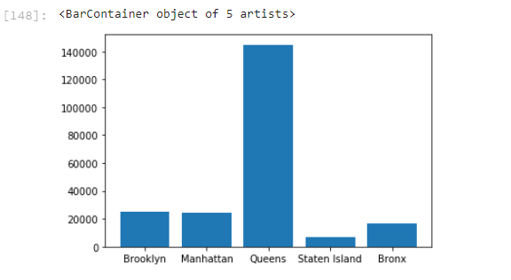
Plot of Borough and population

Slide 7
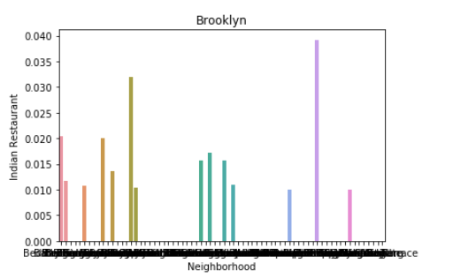
Brooklyn Neighbourhood

Slide 8
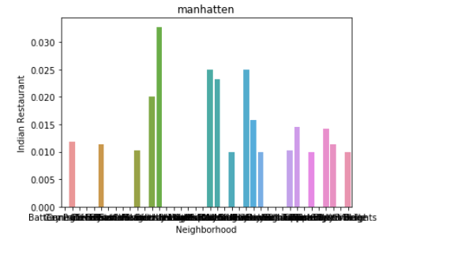
Manhatten Neighbourhood

Slide 9
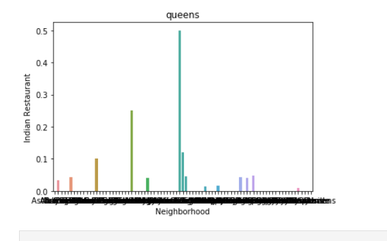
Queens Neighbourhood

Slide 10
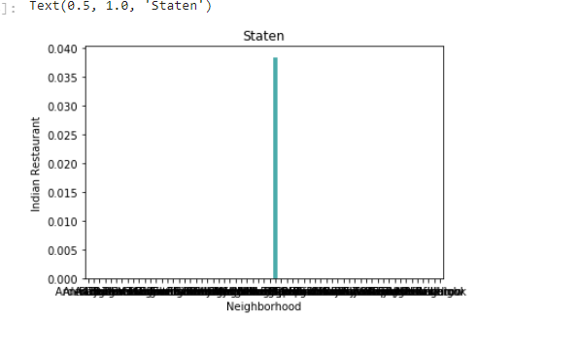
Staten Island Neighbourhood

Slide 11
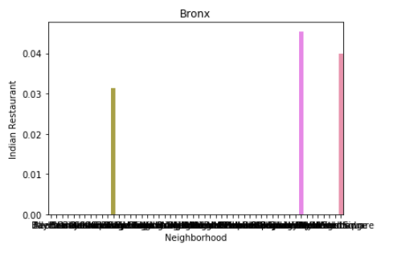
Bronx Neighbourhood

Slide 12
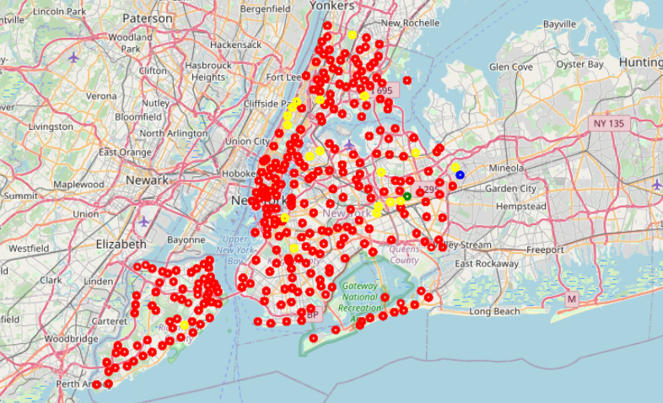
RESULT

Slide 13
The results from k-means clustering show that we can categorize New York neighbourhoods into 4 clusters based on how many Indian restaurants are in each neighbourhood:
● Cluster 0: Neighbourhoods with the More number of Indian
restaurants.
● Cluster 1: Neighbourhoods with less Indian restaurants.
● Cluster 2: Neighbourhoods with a small number of Indian restaurants
● Cluster 3: Neighbourhoods with a small number of Indian restaurants but greater than cluster2

Slide 14
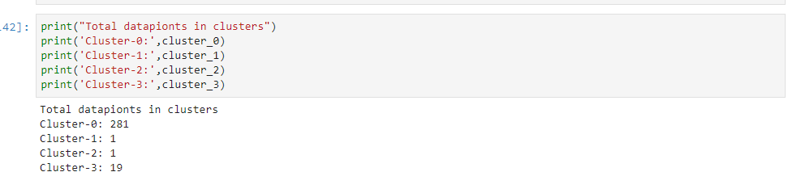

Slide 15
Conclusion
Above clustering was done by using only 100 venues nearby to each city, this number of venues can be increased to get more precise result.
Also we can collect data about citizens origin and use it to get good result.

