Slide 1
YI13N for iOS apps Example
Lawrence Tseng

Slide 2
Agenda
Architecture Overview
Xcode project Setup
Configuration
Instrumentation methods
View Result

Slide 3
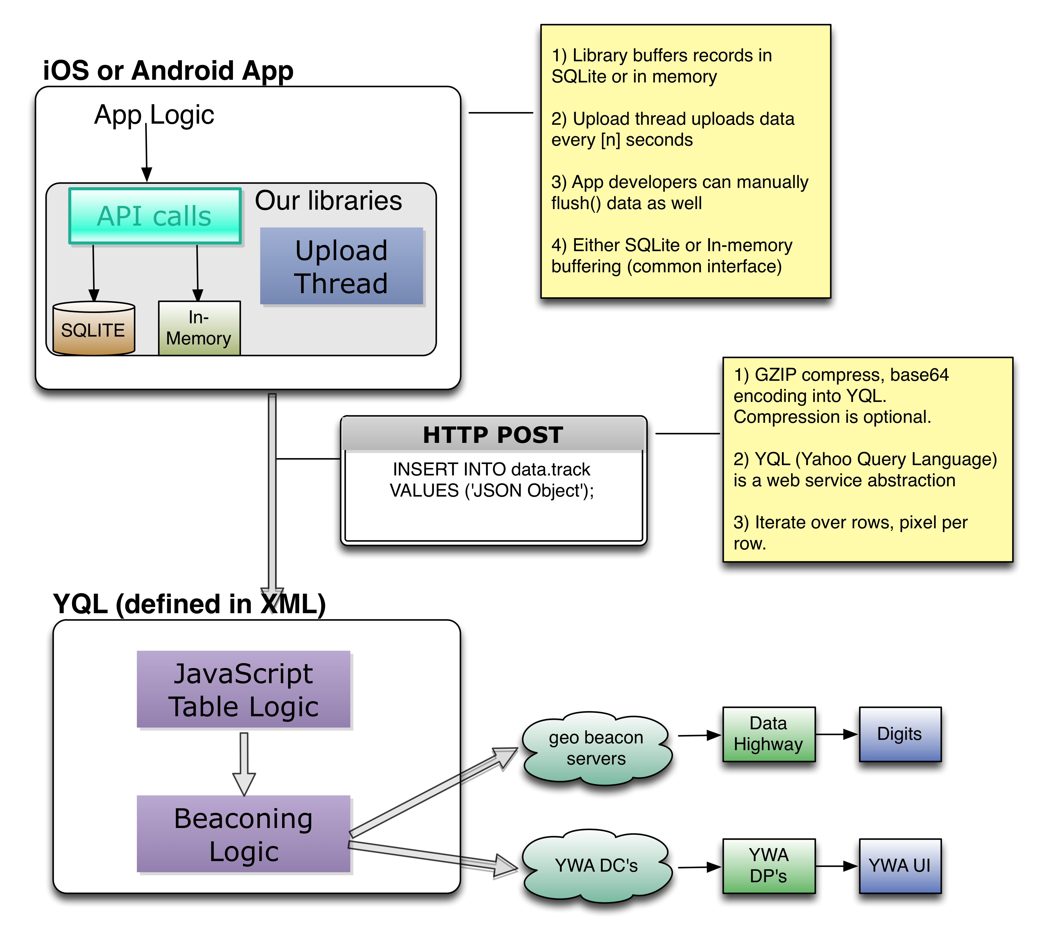
Architecture Overview

Slide 4
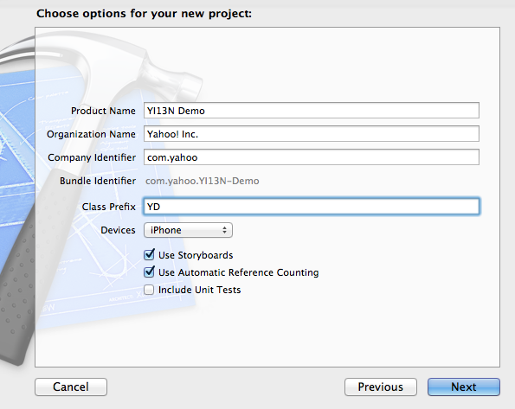
Xcode project Setup
1. Create new Xcode project

Slide 5
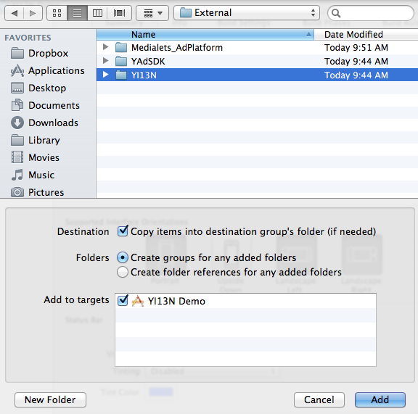
Xcode project Setup
2. Add YI13N folder
Download YI13N.h and libymobile_instrumentation.a from here:
http://twiki.corp.yahoo.com/view/UDA/MobInstLibReleases
and put them into YI13N folder

Slide 6
Xcode project Setup
3. Add SBJSON
Minimum version required: 2.3.2
Install with 2 ways:
Github:
https://github.com/stig/json-framework
Download and install by readme instructions
SVN external:
svn ps svn:externals svn+ssh://svn.corp.yahoo.com/yahoo/mobile/iphone/libJSON/trunk/

Slide 7
Xcode project Setup
3-a. Install from github
Add SBJson.xcodeproj into project
In Build Phases => Target Dependencies, add sbjson-ios
In Build Phases => Link Binary with Libraries, add libsbjson-ios.a

Slide 8
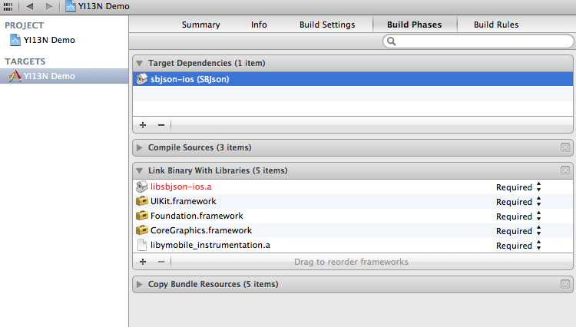
Xcode project Setup

Slide 9
Xcode project Setup
4. Add the following libraries and frameworks from iOS SDK:
libsqlite3.dylib (or libsqlite3.0.dylib)
SystemConfiguration.framework
libz.dylib
CoreTelephony.framework

Slide 10
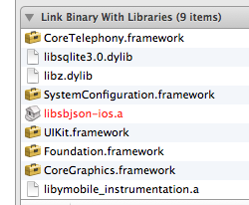
Xcode project Setup

Slide 11
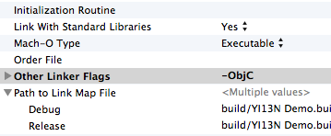
Xcode project Setup
In build settings, add “ –ObjC “ flag in “other linker flags”
What does “ –ObjC “ do?
Link all the objective-C classes in a static library into the project
Reference

Slide 12
Configuration
In Prefix.pch:
So all .h and .m files don’t need to import YI13N.h
Better practice: import YI13N.h in another common.h and import common.h in prefix.pch
#ifdef __OBJC__
#import <UIKit/UIKit.h>
#import <Foundation/Foundation.h>
#import "YI13N.h"
#endif

Slide 13
Configuration
In AppDelegate, application:didFinishLaunchingWithOptions:
YI13N *yi13n = [YI13N sharedInstance];
[yi13n startWithBufferType:YI13NEventBufferTypeInMemory andConfig:@{
YI13NConfigOptionYWAProjectID: @"557313379",
YI13NConfigOptionAppSpaceid: @"985574831”,
YI13NConfigOptionEnableConsoleLogging: @YES,
YI13NConfigOptionYQLMode: YI13NConfigValueYQLModeStaging
}];

Slide 14
Instrumentation Methods
Get YI13N instance:
Log “user views the screen” event:
Log custom name event:
YI13N *yi13n = [YI13N sharedInstance];
[yi13n logScreenview:@”FirstView” withSpaceid:985574831];
[yi13n logEventWithSpaceid:985574831 withName:@"YI13N test on 985574831"];

Slide 15
Instrumentation Methods
Log exception event:
YI13N delegate method:
(void) exceptionHandler(NSException *exception) {
YI13N *yi13n = [YI13N sharedInstance];
[yi13n logException: exception];
}
....
NSSetUncaughtExceptionHandler(&exceptionHandler);
#pragma mark – YI13N delegate
-(void) dataUploaded: (NSString *) msg {
NSLog(@”data uploaded!”);
NSLog(@”%@”, msg);
}

Slide 16
View Results
ULT Log Viewer
http://beacon.staging.yahoo.com/ult/logview/index.php
YWA Console
https://reports.web.analytics.yahoo.com/InternalLogin.vm

Slide 17
Reference
Detailed documentation:
http://fixsingle.corp.yahoo.com/yi13n/3/sdk.php
http://fixsingle.corp.yahoo.com/yi13n/3/api_docs/ios/Classes/YI13N.html
Latest library release:
http://twiki.corp.yahoo.com/view/UDA/MobInstLibReleases
Sample code:
https://git.corp.yahoo.com/tailun/YI13N-Demo

