Slide 1
Brand Logo Detection: Unmasking the Counterfeits

Slide 2
Content
Problem Statement
Analytical tools
Dataset
Method of Analysis
ETL
Result
Conclusion
Future Scope
References

Slide 3
Problem Statement
Problem
Retailers face significant challenge in their effort to overcome counterfeit products with fake brand logos.
Solution
Retailers need a robust system to automatically detect fake brand logos, protecting consumers from fraudulent products and ensuring authenticity on their platforms.

Slide 4
Analytical Goals
Build
Develop a machine learning model capable of accurately recognizing and classifying genuine brand logos from fake ones. This involves collecting and organizing a diverse dataset of authentic and counterfeit brand logos to train the model effectively.
Achieve
Achieve high precision and recall in detecting fake brand logos on various products. The goal is to minimize false positives (incorrectly flagging genuine logos as fake) and false negatives (failing to identify actual fake logos).
Evaluate
Conduct effective evaluation metrics, such as precision, recall and F1 score, to assess the performance of the detection model. Regularly validate the model against a test dataset to ensure its effectiveness.

Slide 5
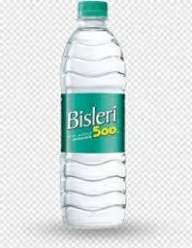
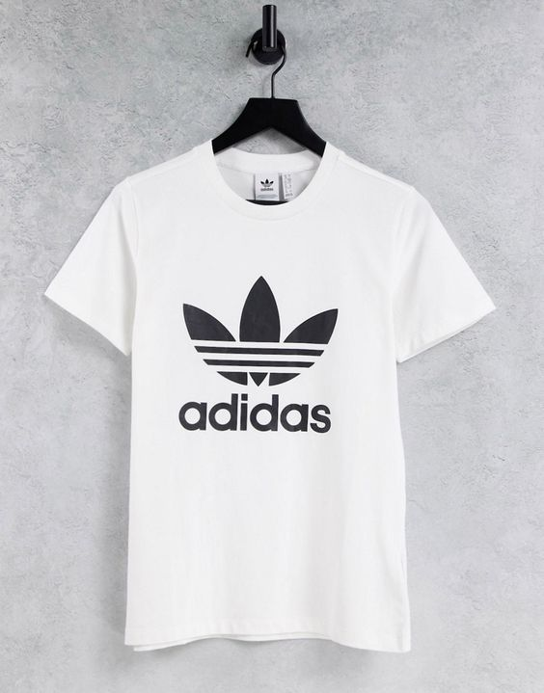
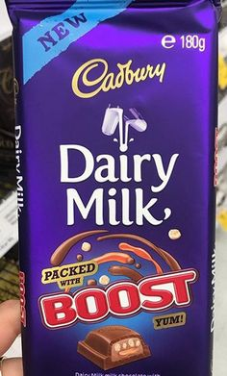
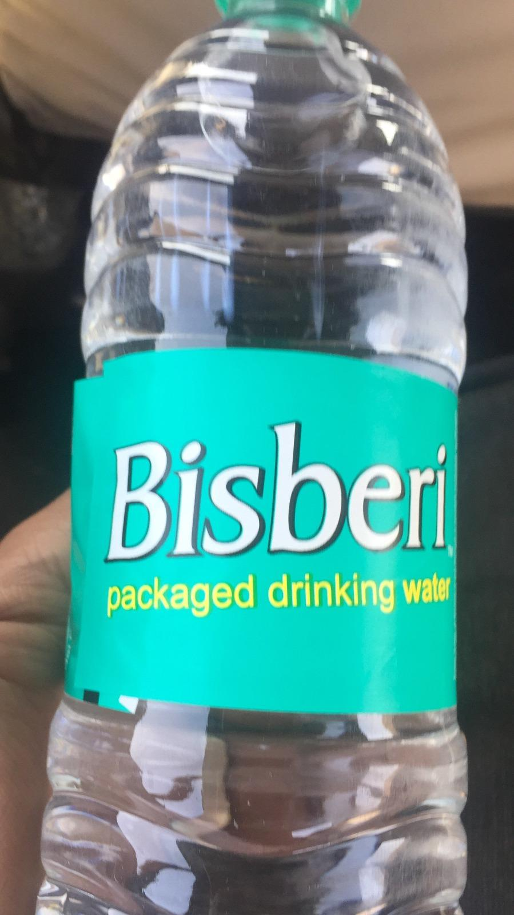
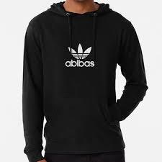
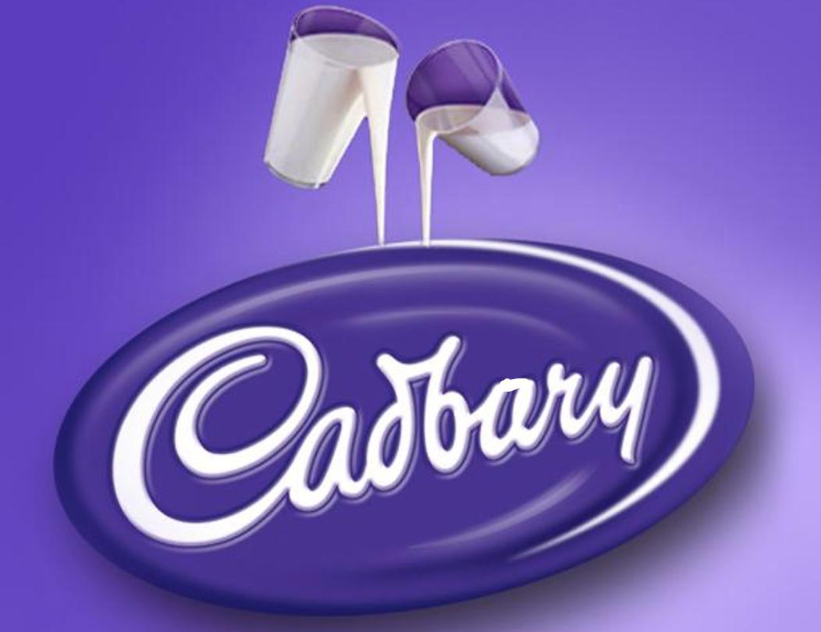
Dataset

Slide 6
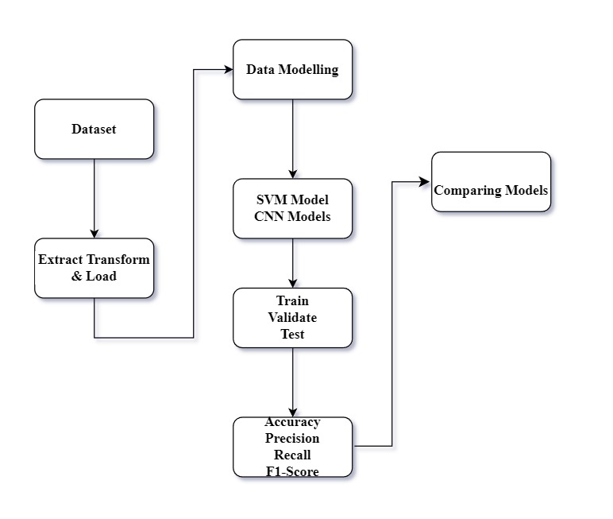
Method Of Analysis

Slide 7

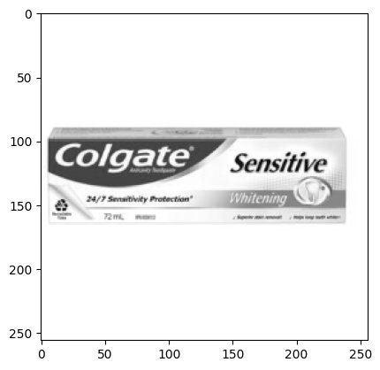
ETL (Extract Transform Load)
Original Image
Grayscale &Resized Image

Slide 8
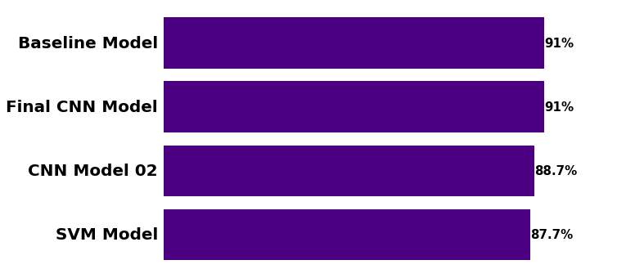
Accuracy of Models

Slide 9
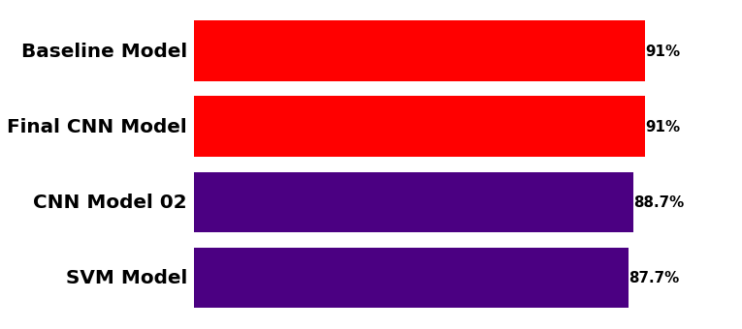

Slide 10
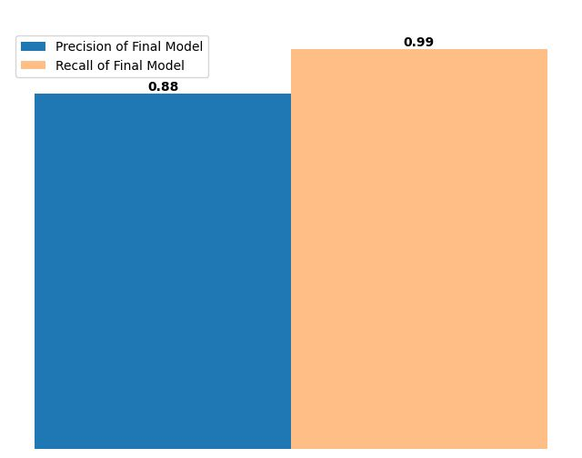
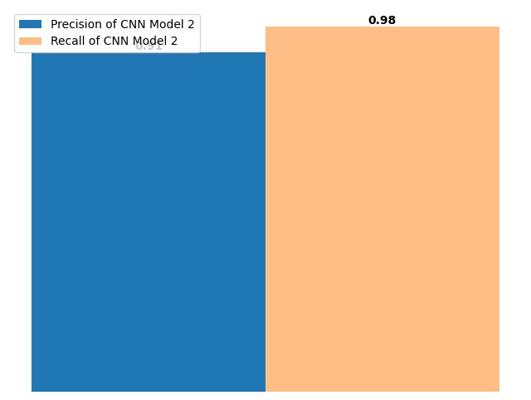
Precision and Recall for Original Class
CNN Model2
Final Model

Slide 11
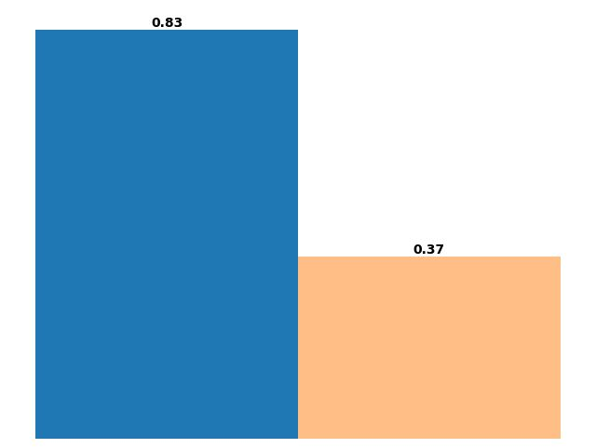
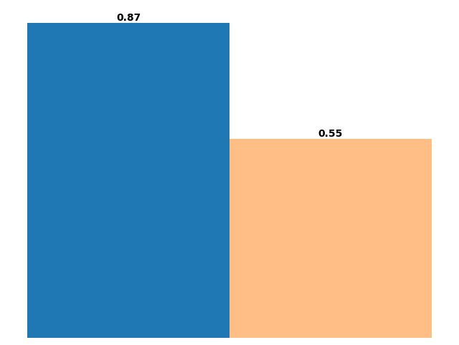
CNN Model2
Precision and Recall for Fake Class
Final Model

Slide 12
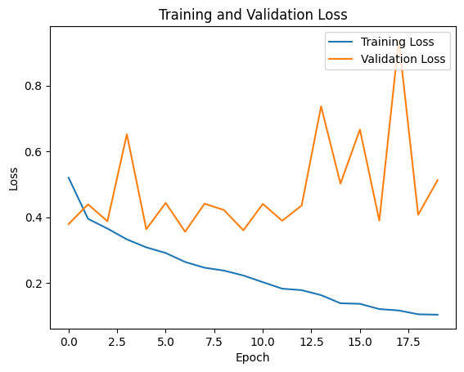
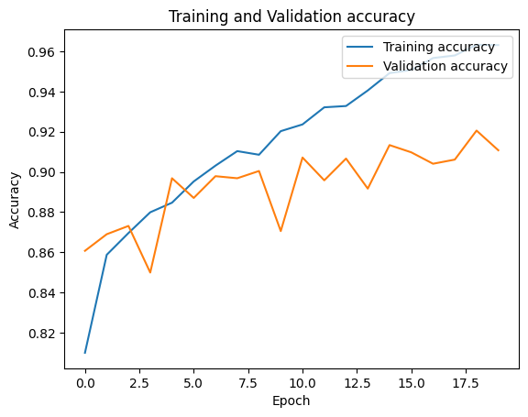
Line graphs of Loss and Accuracy of final model

Slide 13
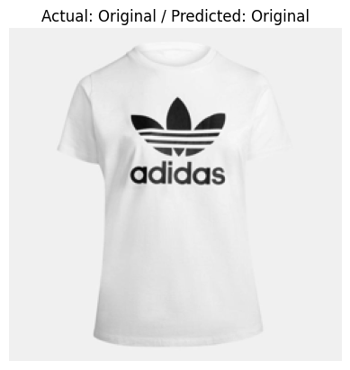
A pre-trained CNN model has predicted the image based on whether it belongs to the ”ORIGINAL" or ”FAKE" class.

Slide 14
Conclusion
The model has achieved an accuracy rate of 91%, signifying its effectiveness in classifying Fake and Original logos.
The developed model exhibits substantial promise for deployment in diverse real-world applications

Slide 15
Future Scope
Working on dataset consisting of same number of images for both classes.
Trying different architectures and other techniques to further enhance performance.
Enhancing Precision and Recall for Fake class so that model is able to accurately detect fake logos same as it is detecting Original logos.
Deploying the model.

Slide 16
References
https://www.researchgate.net/publication/354507140_Logo_Infringement_Detection_using_Machine_Learning
https://www.researchgate.net/publication/312194349_Deep_Learning_for_Logo_Recognition
https://scikit-learn.org/stable/modules/svm.html#classification
https://www.tensorflow.org/tutorials/images/cnn
https://keras.io/api/layers/convolution_layers/convolution2d/
https://scikit-learn.org/stable/auto_examples/model_selection/plot_precision_recall.html
Github: https://github.com/Delphina08/Fake-brand-logo-detection

Slide 17


Thank You

