Slide 1
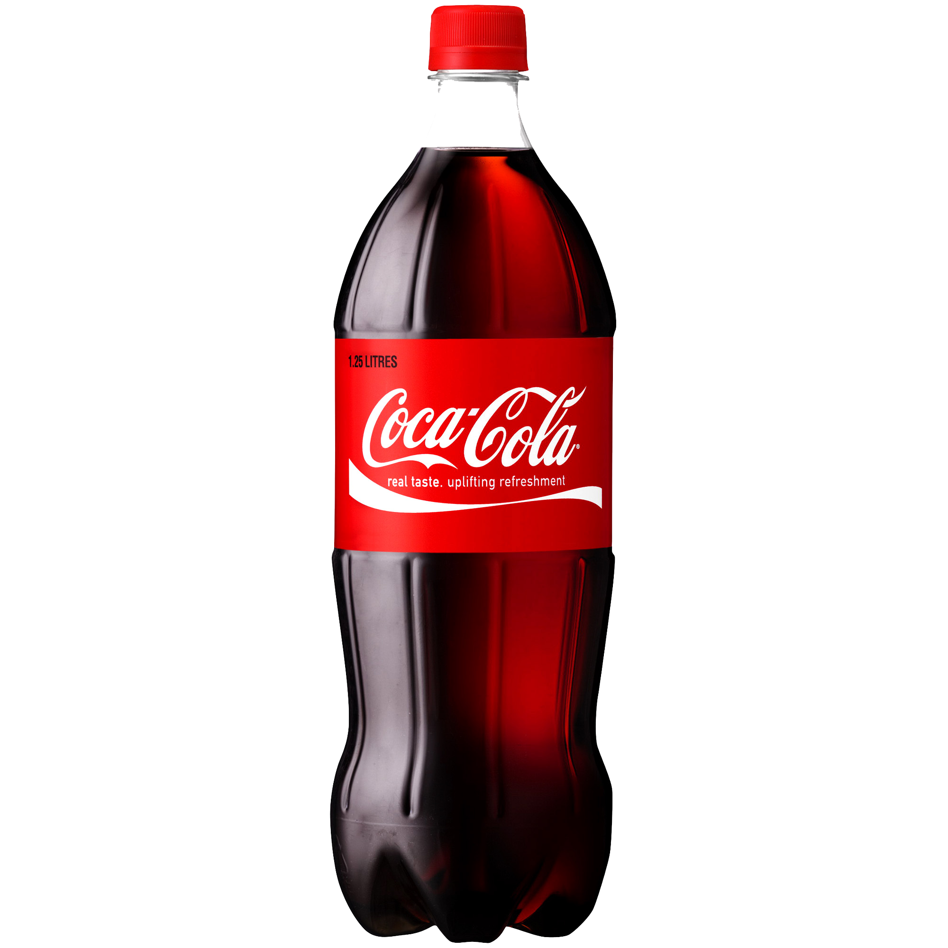
Coca –Cola
This Photo by Unknown Author is licensed under CC BY-NC

Slide 2
Content
Introduction
Competitors
Ratio Analysis
DCF
CAPM
WACC
Monte Carlo Simulations
Recommendation

Slide 3
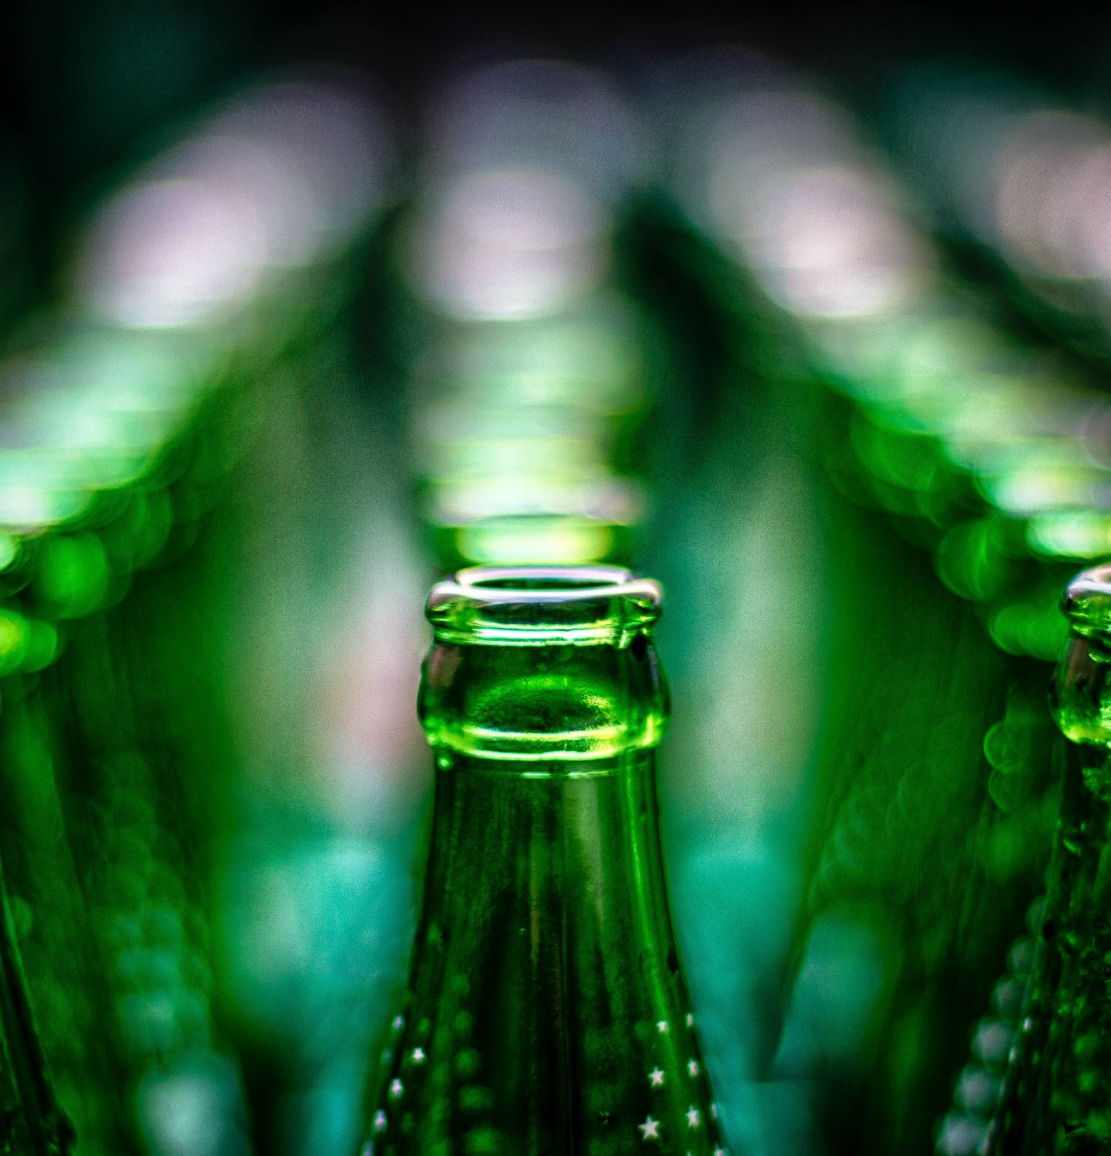
Introduction
Dr. John S. Pemberton founded the Coca-Cola company in 1886, and now it ranks among the top beverage manufacturers in the world. The business has expanded its product offering throughout the years to include a range of non-alcoholic beverages, such as sparkling drinks, juices, and sports drinks.
In 2022 the company made a revenue of $43.00 B an increase over the year 2021 revenue that was of $38.65. Economic growth, inflation, interest rates, and consumer preferences have an impact on the sales and profitability of the company. The company adapts to changes in these factors for improving revenue.
Currently, the Coca-Cola company operates in more than 200 countries and territories. The company is spending a lot of money on marketing and advertising for strengthening its brand visibility. In order to adapt to shifting consumer expectations, the company also places a strong emphasis on product development and innovation, as evidenced by the launch of sugar-free and healthier beverage options. Coca-Cola has also been focusing on environmental measures like water stewardship, attempts to combat climate change, and reduction of packaging and waste.

Slide 4

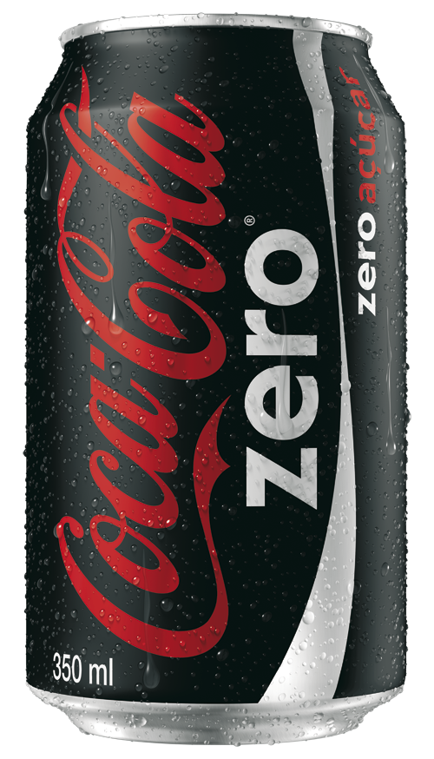
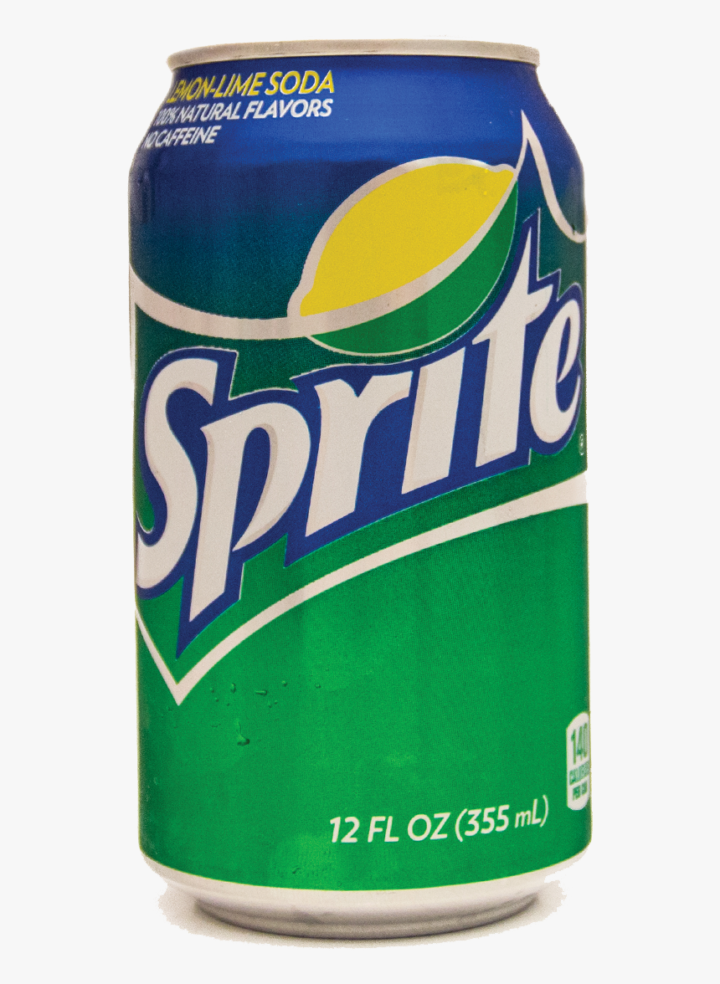
Products
In recent years, the company has launched several new products, including Coca-Cola Zero Sugar, Coca-Cola Energy, and Topo Chico Hard Seltzer. Additionally, Coca-Cola has made a significant investment in sustainability initiatives, with a goal of becoming a net-zero company by 2040.

Slide 5
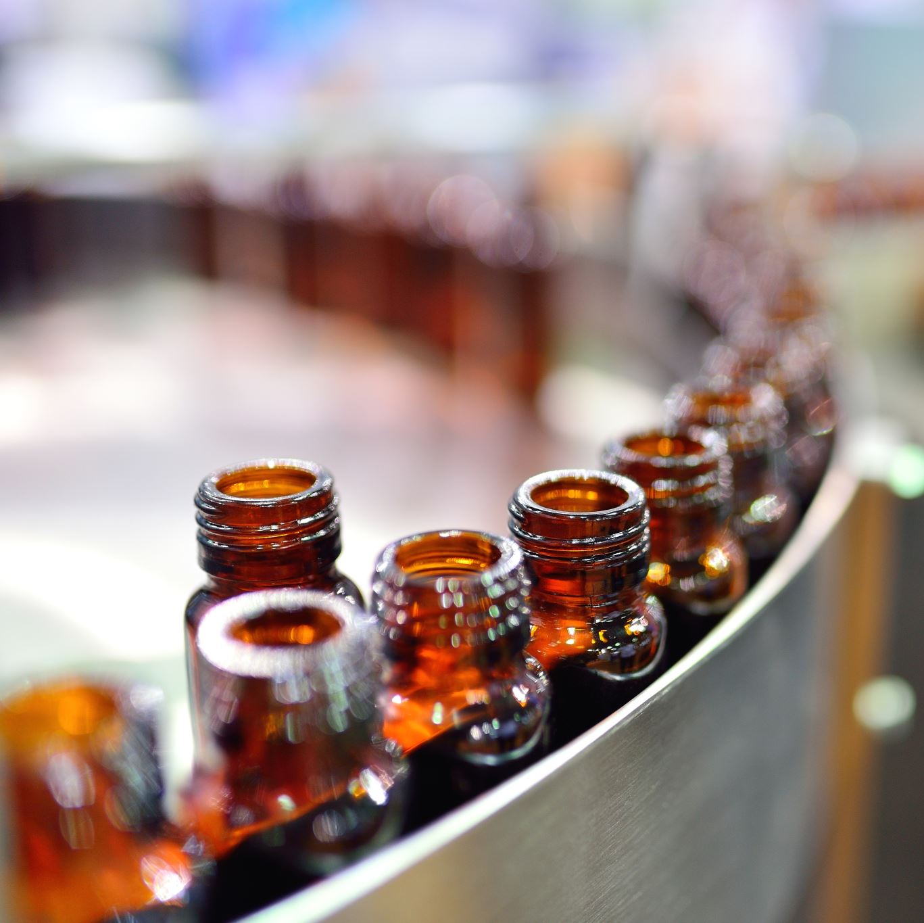
Competitors
The Coca-Cola Company confronts fierce competition from significant rivals like PepsiCo, known for brands including Pepsi, Mountain Dew, and Gatorade, in the beverage business. Through brands like Dr Pepper and Snapple, the Dr Pepper Snapple Group competes with Coca-Cola. As rivals in the beverage market, Nestlé offers Nescafé coffee, Nestea, and Nesquik. The broad beverage lineup from Keurig Dr. Pepper and Unilever's Lipton tea also add to the level of competition.

Slide 6

Ratio Analysis
The current ratio indicates that the company's current assets are 1.38 times its current liabilities, suggesting good short-term liquidity, while the quick ratio of 0.99 suggests slightly lower liquidity due to less liquid current assets, and the cash ratio of 0.21 indicates relatively low cash reserves compared to current liabilities.
The company has a healthy gross profit margin of 36.74%, indicating efficient cost management, while the operating profit margin of 10.34% suggests effective operational performance, and the return on assets of 11.60% signifies the company's ability to generate profits from its total assets. Additionally, the high return on equity of 38.57% indicates strong profitability relative to shareholders' equity

Slide 7

The solvency ratio of 23.20% indicates the company's ability to meet its long-term obligations and indicates a relatively healthy financial position, while the high debt to equity ratio of 232.58% suggests a significant reliance on debt financing compared to equity, potentially increasing financial risk.
The high inventory turnover ratio of 12.06 indicates efficient management of inventory and quick sales, while the accounts receivable turnover ratio of 12.77 suggests effective collection of receivables, and the low payable turnover ratio of 0.34 indicates a longer payment period to suppliers, potentially impacting cash flow.
The P/E ratio of 13.72 suggests that the stock is valued at a moderate multiple of its earnings.

Slide 8
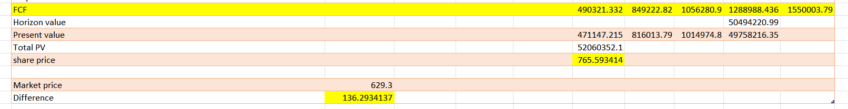
The calculated stock price of Coke is $765.59 whereas the actual price is $629.3.

Slide 9
CAPM
The Capital Asset Pricing Model (CAPM) is a financial model that describes the relationship between risk and expected return for an asset. The model is widely used by investors and analysts to estimate the expected return on an investment, given the level of risk associated with that investment.
The CAPM formula is:
Ra = Rf + βa (Rm – Rf)
Where:
Ra = the required/expected return for the asset/Investment
Rf = the risk-free rate
βa = the beta of the asset/Investment
Rm = the expected market return(market risk premium)

Slide 10
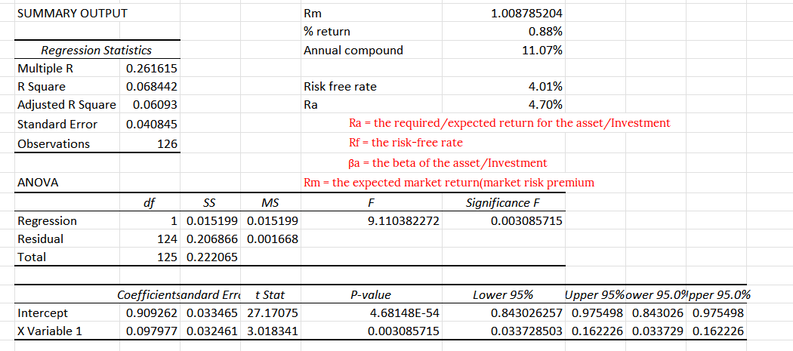
Expected return (Ra) = 4.70%

Slide 11
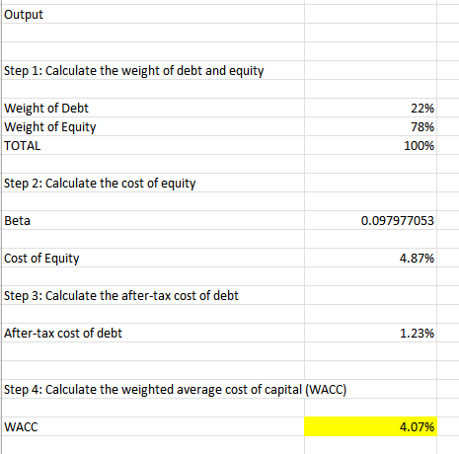
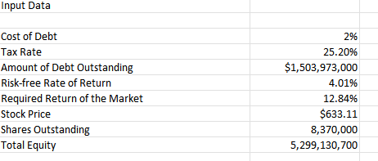
WACC
The WACC is Weighted average of the cost of debt and the cost of equity to determine the overall cost of capital for a company.
Coca-Cola's WACC is 4.07% it means the weighted average cost of the company's debt and equity is 4.07%.
WACC of 4.07% suggests that the company's cost of capital is relatively low. Any investment that yields a rate of return greater than 4.07% would be considered financially attractive.

Slide 12
Monte Carlo Simulations
A Monte Carlo simulation is a model used to predict the probability of different outcomes when the intervention of random variables is present.
Monte Carlo simulations help to explain the impact of risk and uncertainty in prediction and forecasting models.
A variety of fields utilize Monte Carlo simulations, including finance, engineering, supply chain, and science.

Slide 13
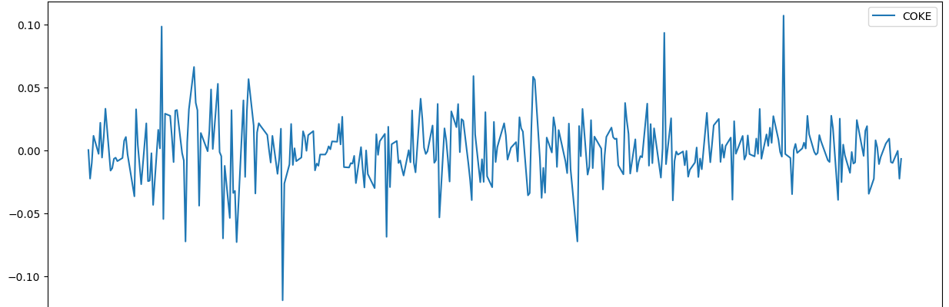
The graph shows the adjusted closing price from 2022-03 to 2023-07.

Slide 14
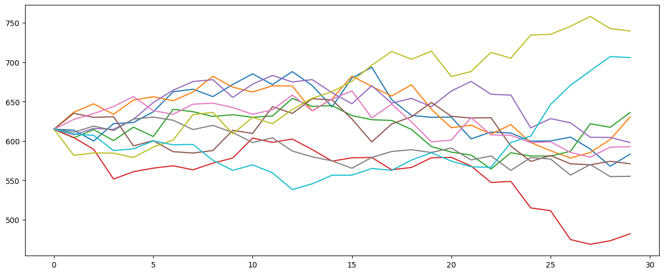
The Monte Carlo simulation of 30 days of Coca-Cola stock price, starting at $620, demonstrates multiple fluctuations throughout the period.
These fluctuations indicate a volatile nature of the stock price, with potential changes occurring over time.
However, the simulation suggests an overall downward trend, implying a higher probability of the stock price decreasing rather than increasing over the 30-day period.

Slide 15

Recommendation
Coca-Cola is a promising investment option. Investors comfortable with its risk profile and potential return prospects may find it a worthwhile investment.
Coke’s beta value is 0.09 means that the stock is not strongly influenced by the ups and downs of the overall market. It suggests that the stock's price tends to move less compared to the general market movements.For people who prefer investments that are less risky and don't want the value of their investment to fluctuate too much with changes in the overall market, this stock could be a good choice. It may offer more stability and potentially lower volatility.
Coca-Cola is a promising investment option. Investors comfortable with its risk profile and potential return prospects may find it a worthwhile investment. Investing in Coca-Cola offers the opportunity for higher returns, but it comes with an elevated level of risk, as indicated by the various ratios and findings from the CAPM and Monte Carlo simulations. However, the company has consistently shown growth in sales, gross profit, and valuation over time. Consequently, the financial analysis highlights Coca-Cola as a robust company with significant revenue.

Slide 16

Thank you

