Slide 1







STACK OVERFLOW DEVELOPER SURVEY
Deelip Solanki,
2025

Slide 2



OUTLINE
Executive Summary
Introduction
Methodology
Results
  Visualization – Charts
  Dashboard
Discussion
  Findings & Implications
Conclusion
Appendix

Slide 3

EXECUTIVE SUMMARY
Data contextualization and analysis goal
Methodology description
  Data gathering
  Data analysis
  Data visualization
Results shows the graphs and trend supported by various graphs
Discussion of overall findings and implications regarding the results previously exposed
Final conclusions of the findings in Dataset.

Slide 4

INTRODUCTION
Stack Overflow’s annual Developer Survey is the largest and most comprehensive survey of developers around the world.
Results don’t represent everyone in the developer community evenly
Nearly 90,000 developers responded
Trends
  Technology worked with
  Future technology to work

Slide 5

METHODOLOGY
Collect survey data
  Web scraping
  APIs
  Request library
Data wrangling
Exploratory Data Analysis (EDA)
  Distribution
  Outlier Handling
  Correlation
Visualization
  Distribution of data
  Relationship
  Comparison
  Composition
Dashboards

Slide 6

RESULTS

Slide 7
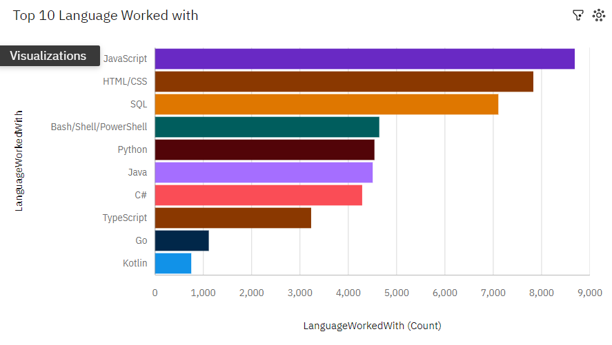
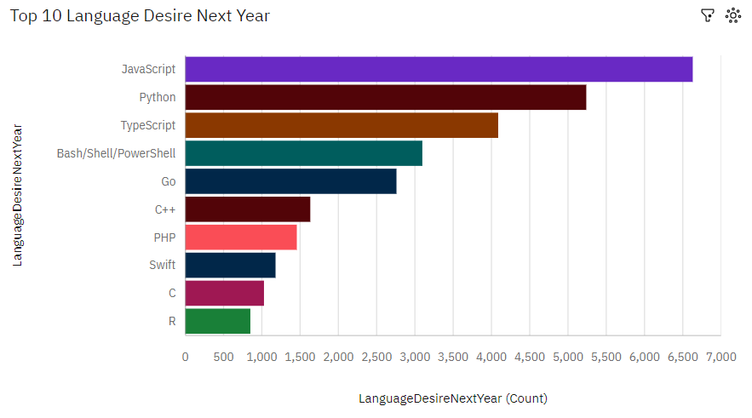
PROGRAMMING LANGUAGE TRENDS

Slide 8
PROGRAMMING LANGUAGE TRENDS - FINDINGS & IMPLICATIONS
Findings
Java Script is currently most popular language
TypeScript, Go, Kotlin least popular now
Python and TypeScript seem to be the next popular languages as they are emerging to top
Implications
Possibility of learning New language among the developers and the future technology will work on that language

Slide 9
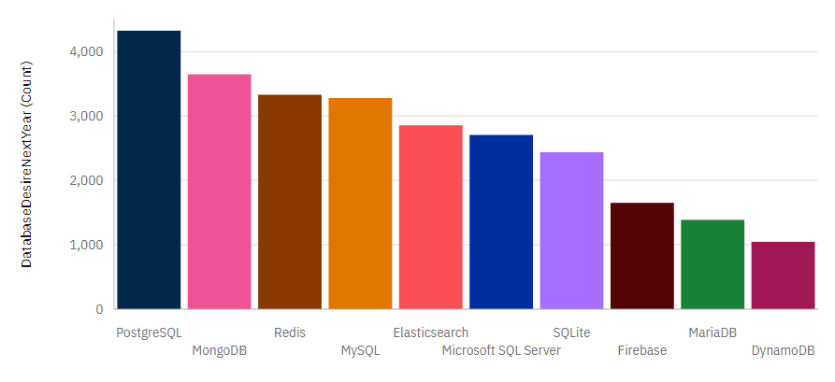
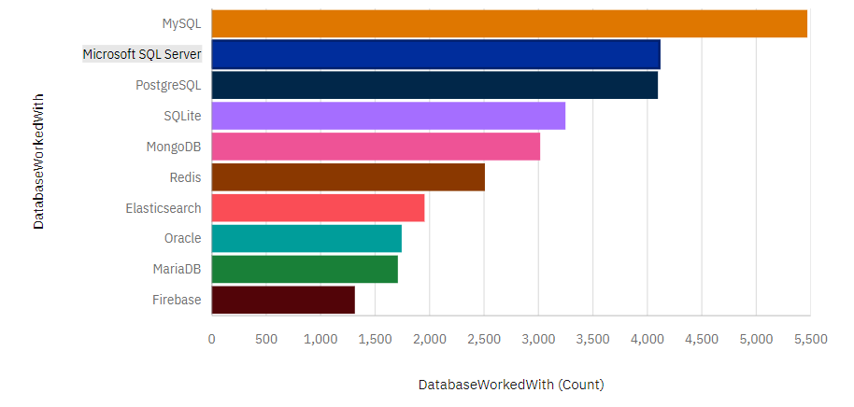
DATABASE TRENDS
Current Year
Next Year

Slide 10
DATABASE TRENDS - FINDINGS & IMPLICATIONS
Findings
MySQL is the most used database, followed by Microsoft SQL
Lack of interest in Oracle, MariaDB, firebase
Increasing interest in PostgreSQL and MongoDB
Implications
Microsoft SQL Server and SQLite losing ground in the market
PostgreSQL and MongoDB establishment in the market

Slide 11

DASHBOARD

Slide 12
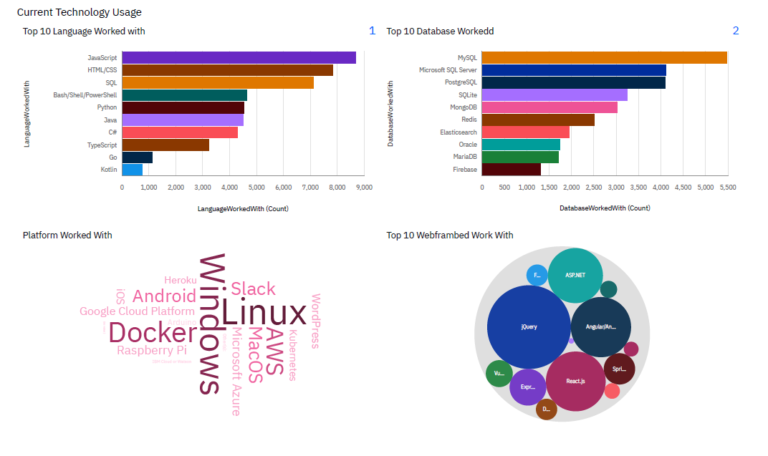
DASHBOARD TAB 1

Slide 13
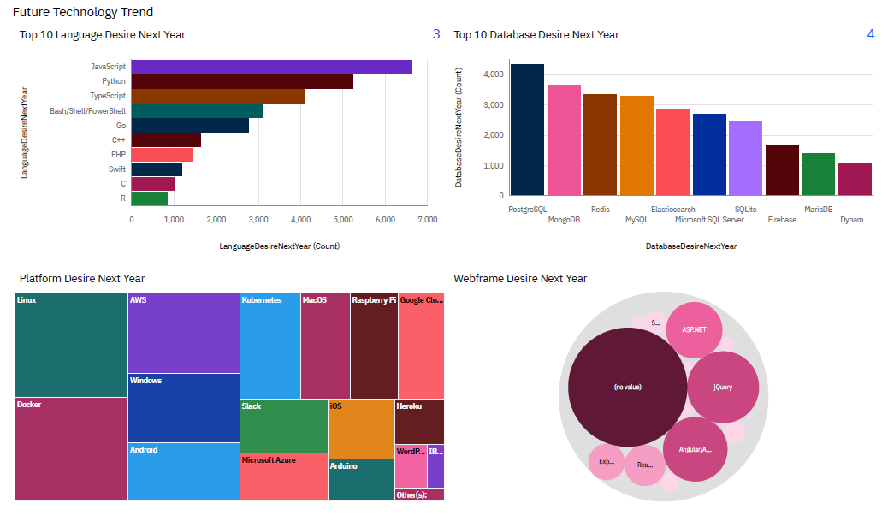
DASHBOARD TAB 2

Slide 14
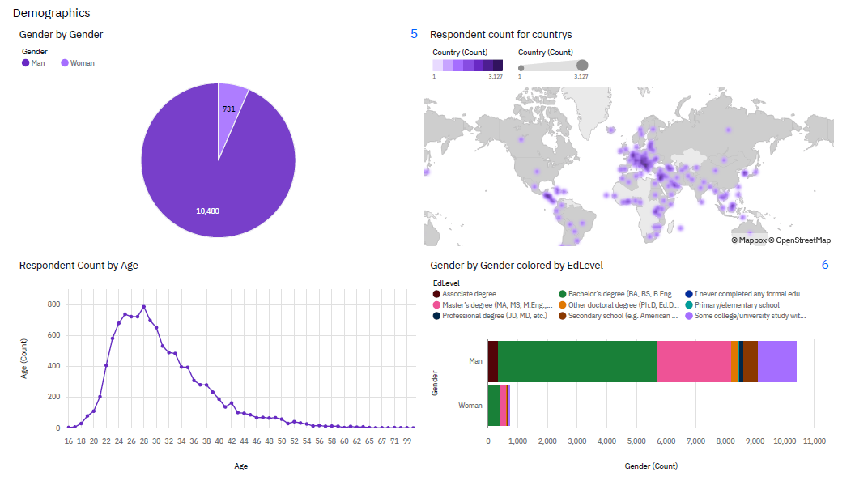
DASHBOARD TAB 3

Slide 15

DISCUSSION

Slide 16
OVERALL FINDINGS & IMPLICATIONS
Findings
JavaScript widely used and TypeScript getting popular.
Over 90% young male developers.
Developers mostly located in developed countries.
Implications
JavaScript and TypeScript web frames gaining followers.
Global polarization of developers location and gender.
Young developers without postgrad studies are a majority.

Slide 17

CONCLUSION
Developers are people who work with digital platforms and technology, to create products and services
The popular trends of different tools, platforms and languages can be obtained from this stack overflow survey
There is less involvement of female developers in this survey

Slide 18
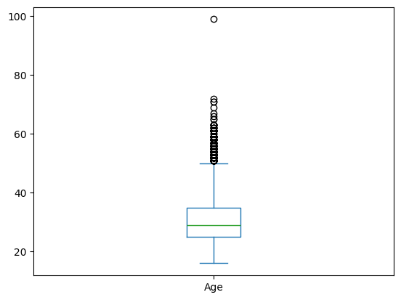

APPENDIX
Box plot of Age groups of Developer

Slide 19
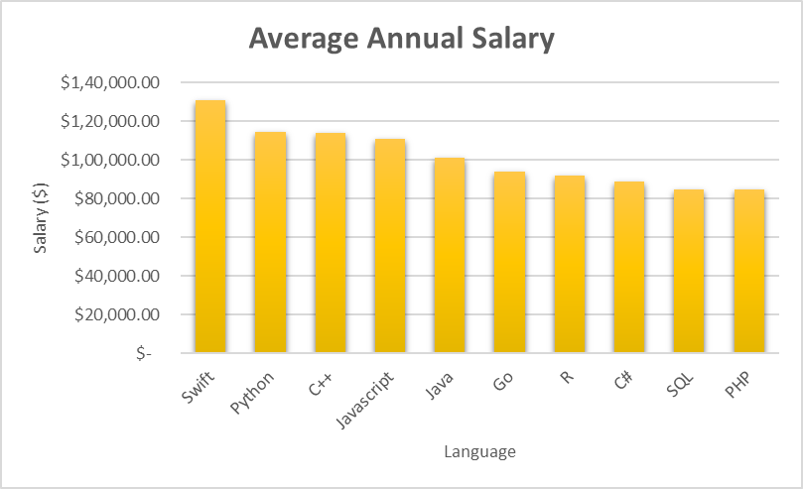
POPULAR LANGUAGES by Salary

