Slide 1
FLASHING LED BIKE LIGHTS

Slide 2
OUTLINE
Introduction
Components list
555 timer ic
Circuit connection

Slide 3
INTRODUCTION
Light emitting diodes are used as indicator lamps for several electronic devices due to the following features:
lower power consumption
smaller size
longer lifetime
In this study, the LED serves as a form of reflector by providing light flashes at regular intervals. Its use as a flashing bike light allows cyclist to be visible to other road users to prevent accidents.

Slide 4
LIST OF COMPONENTS
1 555 timer IC (IC1)
12 LED: D1 to D12: common red Or white LEDs
1 10K resistor (R1)
1 100K resistor (R2)
12 1K resistors (R3 to R14)
1 10 uF Electrolytic Capacitor (C1)
1 9 volt battery

Slide 5
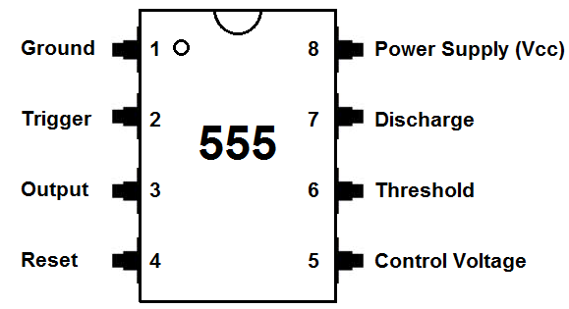
555 TIMER IC
The 555 timer IC is usually used in timing circuits
Has three modes of operation based on how its pins are connected:
-bistable
-monostable
-astable
The astable mode of operation is utilised in this project.
In this mode of operation, a multivibrator circuit has no stable states i.e. it alternates between two states.
Thus the flashing of the two groups of LEDs at regular intervals clearly exhibits the astable mode of operation.

Slide 6
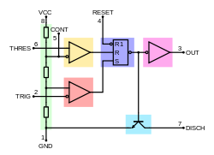
555 TIMER…….Cont.

Slide 7
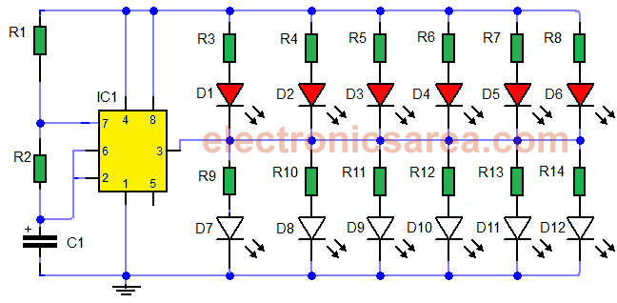
CIRCUIT CONNECTON
The top group will light if the output of the 555 is low.
The bottom group will light if the output of the 555 is high.

Slide 8
THANK YOU FOR YOUR TIME!!!!

