Slide 1
Software Requirements Specification
Mass-Mass Stoichiometry Problem
Deemah Alomair
CAS 741
Presentation 1

Slide 2
Presentation outline
Introduction.
Goal statement.
Specific system description.
Requirements.
Changes.

Slide 3

Introduction
Stoichiometry.
Mass-Mass Stoichiometry.

Slide 4
Goal Statement
Given unbalanced chemical reaction with sets of reactants and products , the goal statement is:
GS1: Get the mass of one of unknown reactant.

Slide 5
Specific System Description
Problem Description
Terminology and Definitions
Physical System Description
Assumptions
Theoretical model.
General definition.
Instance model.
Data definition.

Slide 6
Problem Description
SMMP is intended to solve the Mass-Mass Stoichiometry problem in any chemical reaction consists of two reactants.

Slide 7
Terminology and Definitions
Stoichiometry.
Chemical reaction.
Reactant.
Product.
Coefficients.
Mole ratio.
Molecular weight (Molar mass).

Slide 8
Assumptions
Two reactants.
Unbalanced reaction.
Known mass.
Mass unit.
Positive amount.
Known molecular weight.

Slide 9
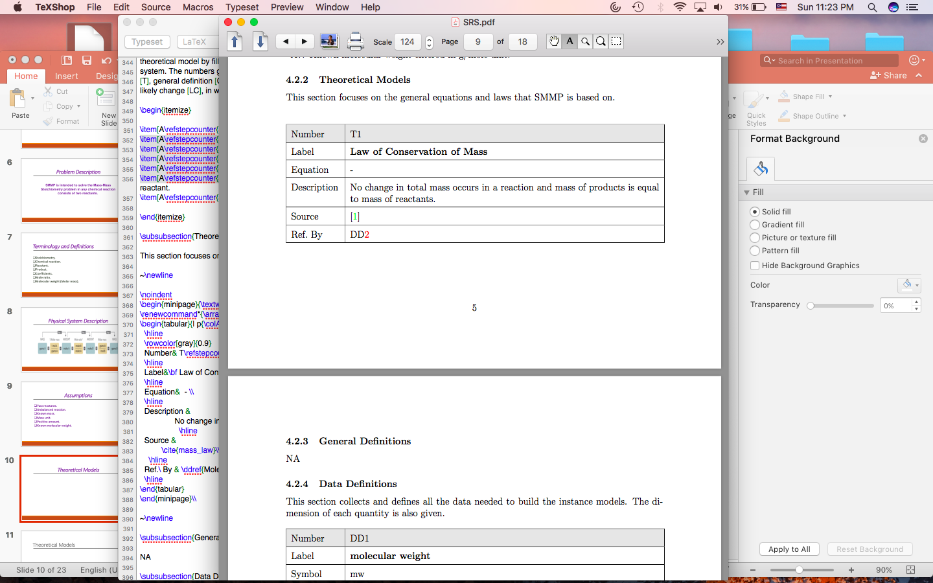
Theoretical Model

Slide 10
General Definition
I do not need general definition.

Slide 11
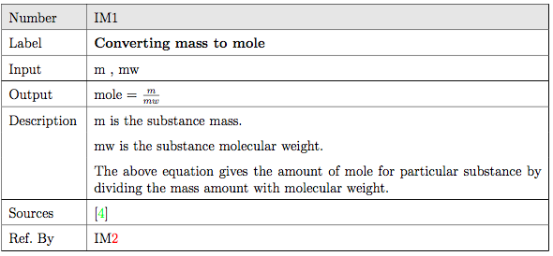
Instance Model (1)

Slide 12
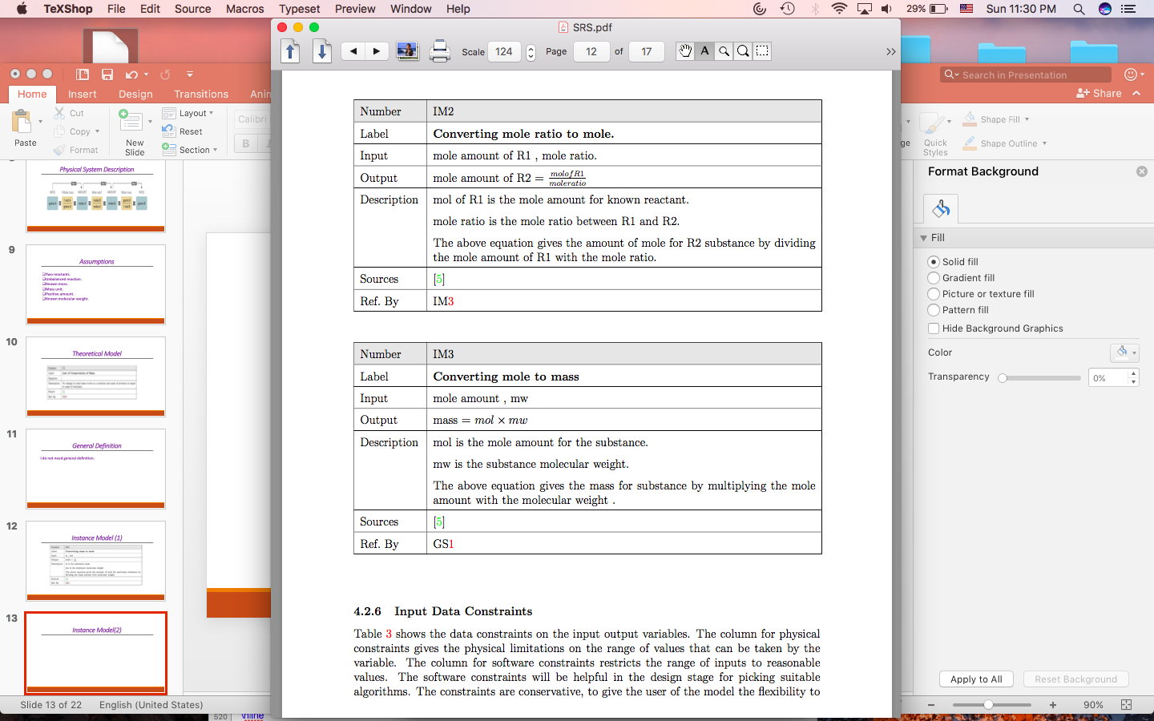
Instance Model(2)

Slide 13
Instance Model(3)

Slide 14
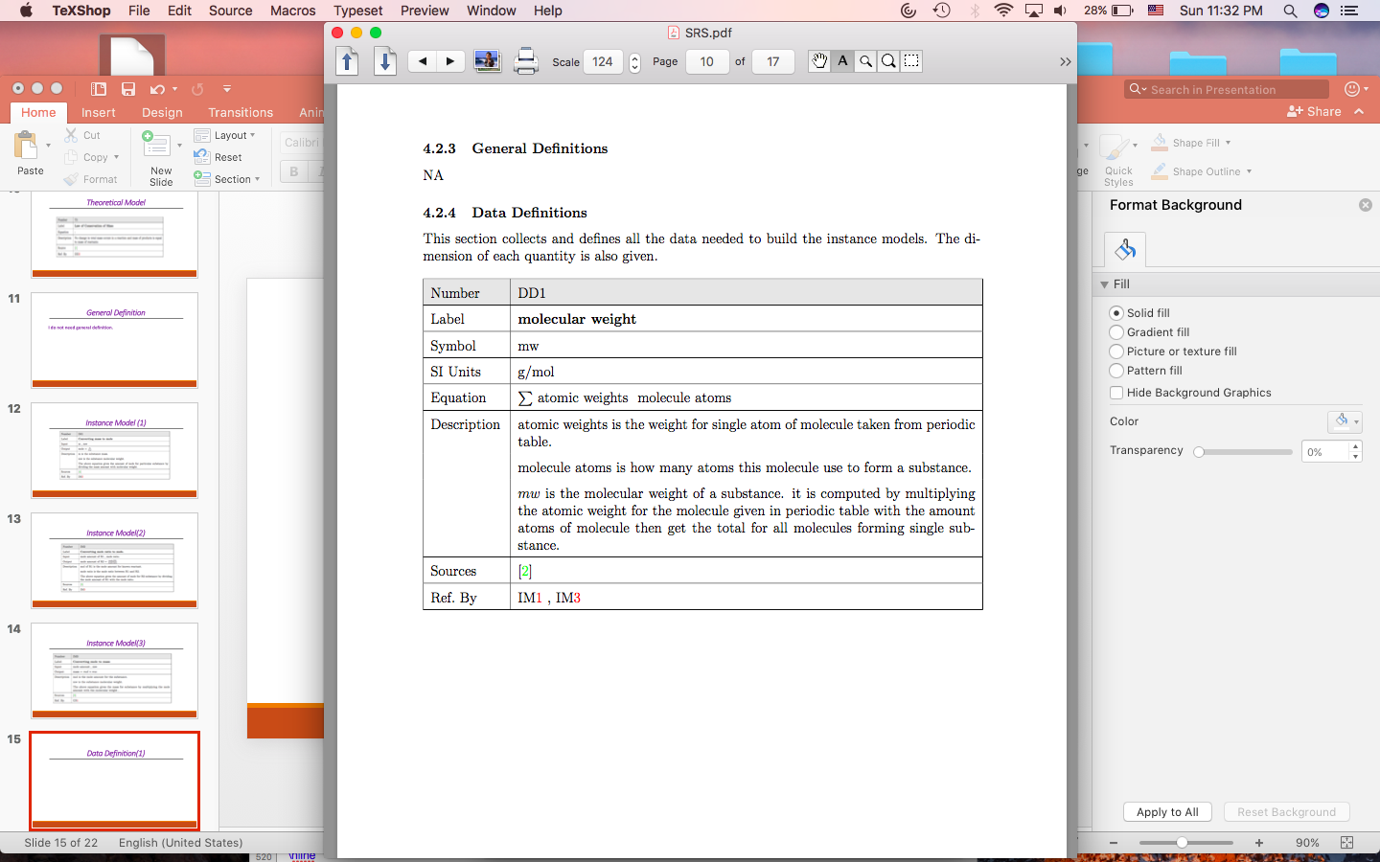
Data Definition(1)

Slide 15
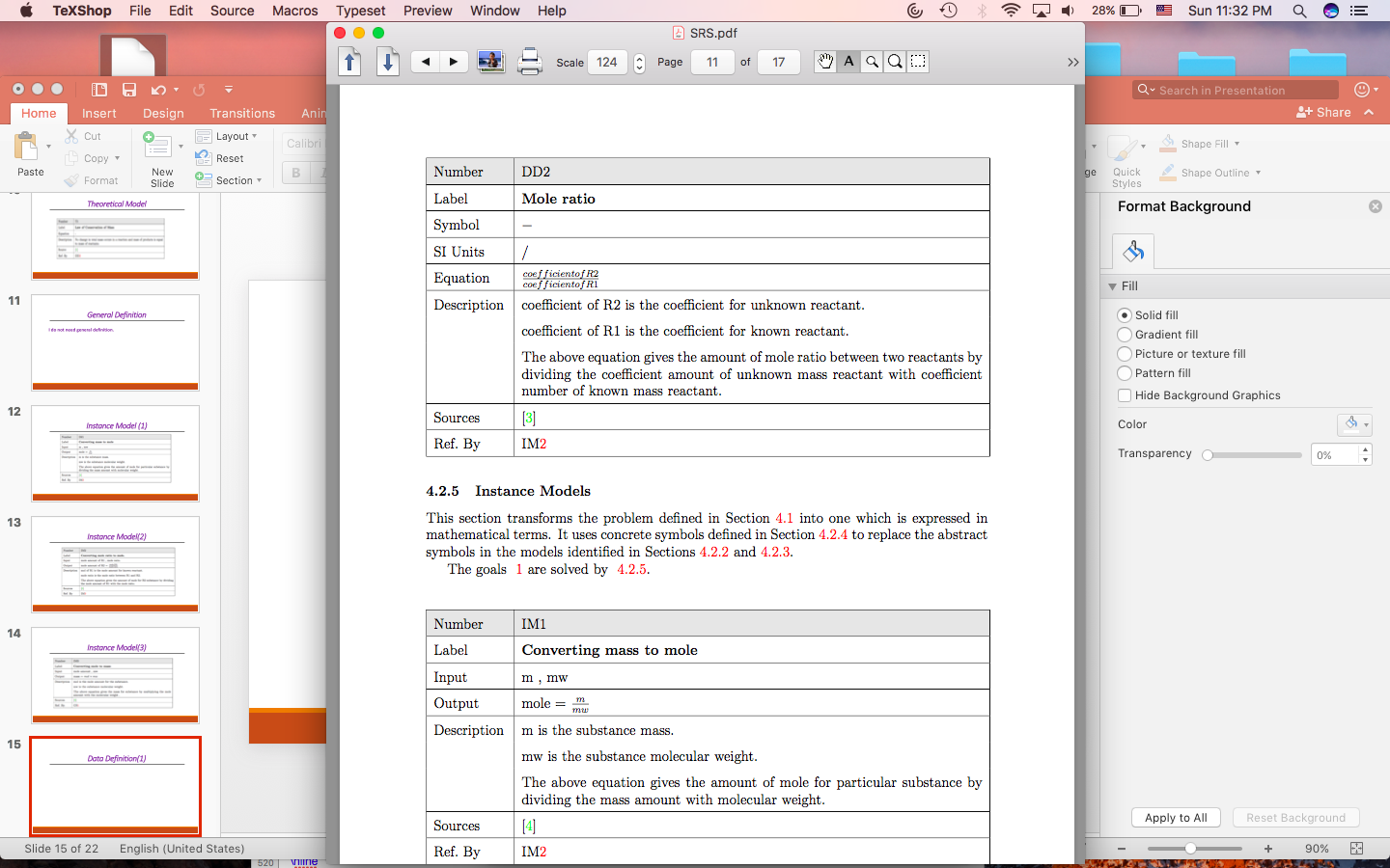
Data Definition(2)

Slide 16
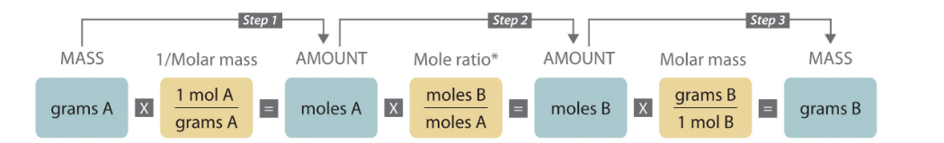
Physical System Description

Slide 17
Input Data Constraints
Mass > 0.
Molecular weight > 0.

Slide 18
Output Data Constraints
Mass > 0.
Balanced chemical reaction.

Slide 19
Requirements
Functional requirements.
Non-functional requirements.

Slide 20
Functional Requirements
Input : The system will use the following inputs:
1- Unbalanced chemical reaction. 2- Mass of R1.
3- Molecular weight for R1 , R2.
Output : The system will produce the mass amount for R2.

Slide 21
Functional Requirements
Calculation : The system needs to calculate the followings: 1- Coefficients needed.
2- Mole amount for R1.
3- Mole ratio between R1 and R2. 4- Mole amount for R2.

Slide 22
Functional Requirements
verify: The system will verify the followings: 1- Output is correct. 2- Input is correct. 3- Mass Conservation Low applied.
4- No integer overflow.
Output: The system output must satisfy the following:
1- Mass is not negative number.

Slide 23
Nonfunctional Requirements
SMMP provides a correct Solution.
The ability to test and verify the system.
The system is understandable for novel users without any ambiguities.
The system could be used for different applications and modified easily.

Slide 24
Likely Changes
Mass amount will change depending on the reactants entered.
Coefficients amount will change depending on the chemical reaction.
Mole amount will change depending on the reactants entered.

Slide 25
Unlikely Changes
The calculation formulas will not be change what ever amount entered.
The units used in the system will not likely to be change.
The system will not likely to calculate the molecular weight of the

Slide 26
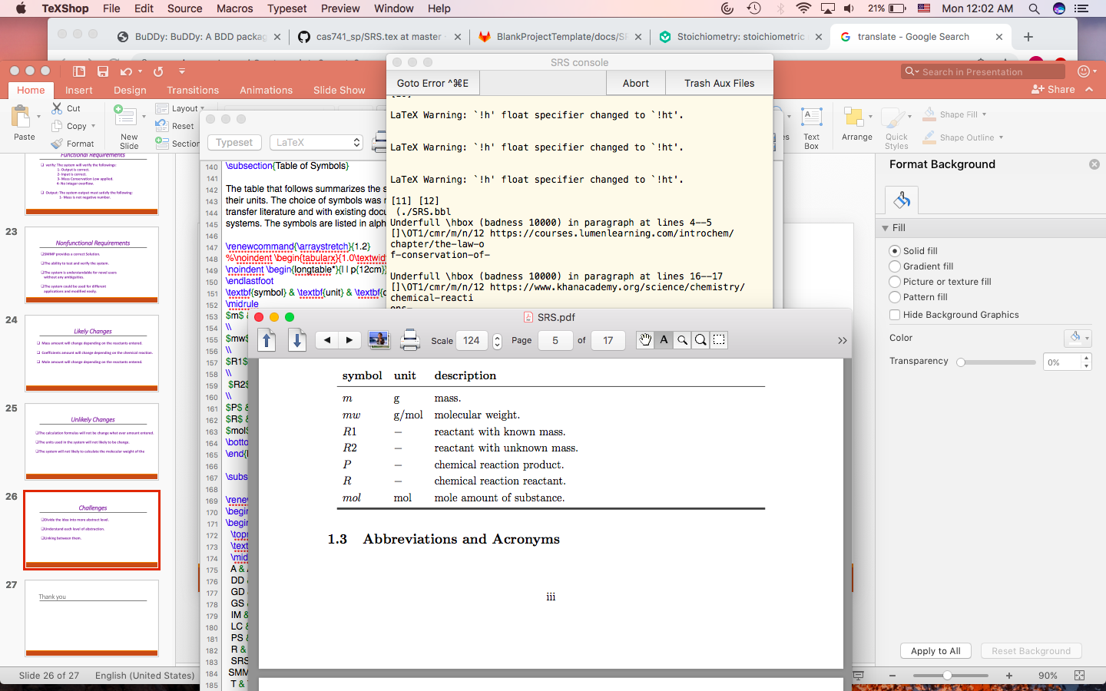
Table of symbols

Slide 27
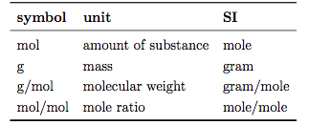
Table of units

Slide 28
Challenges
Divide the idea into more abstract level.
Understand each level of abstraction.
Linking between them.

Slide 29
References
[1] https://courses.lumenlearning.com/introchem/chapter/the-law-of-conservation-of- mass/.
[2] https://www.thoughtco.com/definition-of-molecular-weight-605369.
[3] https://www.thoughtco.com/definition-of-mole-ratio-and-examples-605365.
[4] https://www.britannica.com/science/mole-chemistry.
[5] https://www.khanacademy.org/science/chemistry/chemical-reactions- stoichiome/stoichiometry-ideal/a/stoichiometry

Slide 30

Thank you

