Slide 1
RAHAL
Biometric Authentication

Slide 2
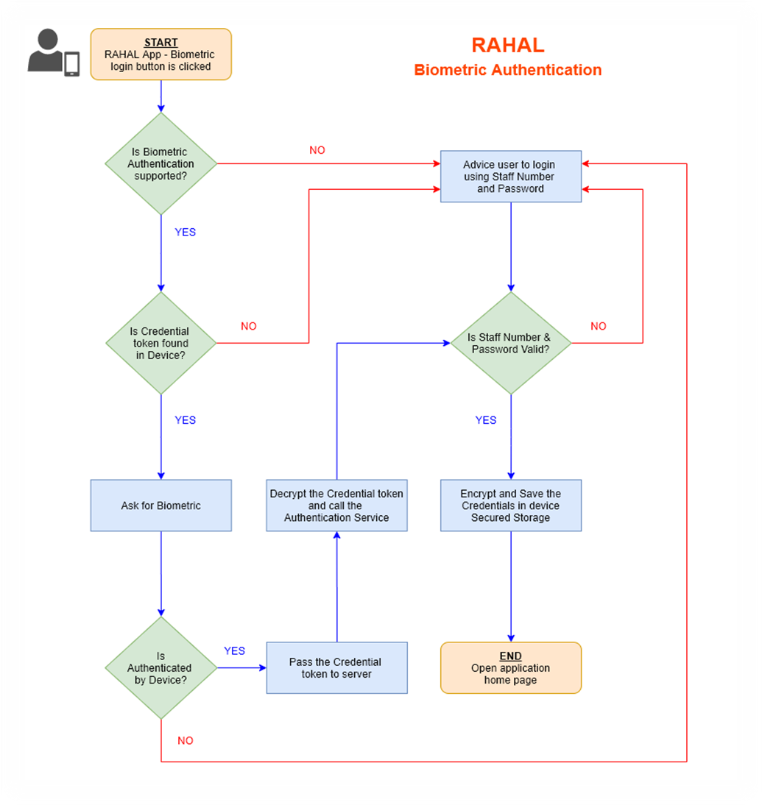

Slide 3
Default ASP.NET form authentication encryption (AES256 with MAC) is used to encrypt/decrypt the login credentials
Encrypted credential token is stored in device “Secure Storage”
Encryption/Decryption is done only on the server
Similar encryption is already used securing RAHAL booking flow API’s against data tampering

