Slide 1
TEAM MEMBERS
M.Dinesh(TL)
M.Deenadayalan
S.Harish
N.T.Keerthimurugan
S.Muralidhara

Slide 2
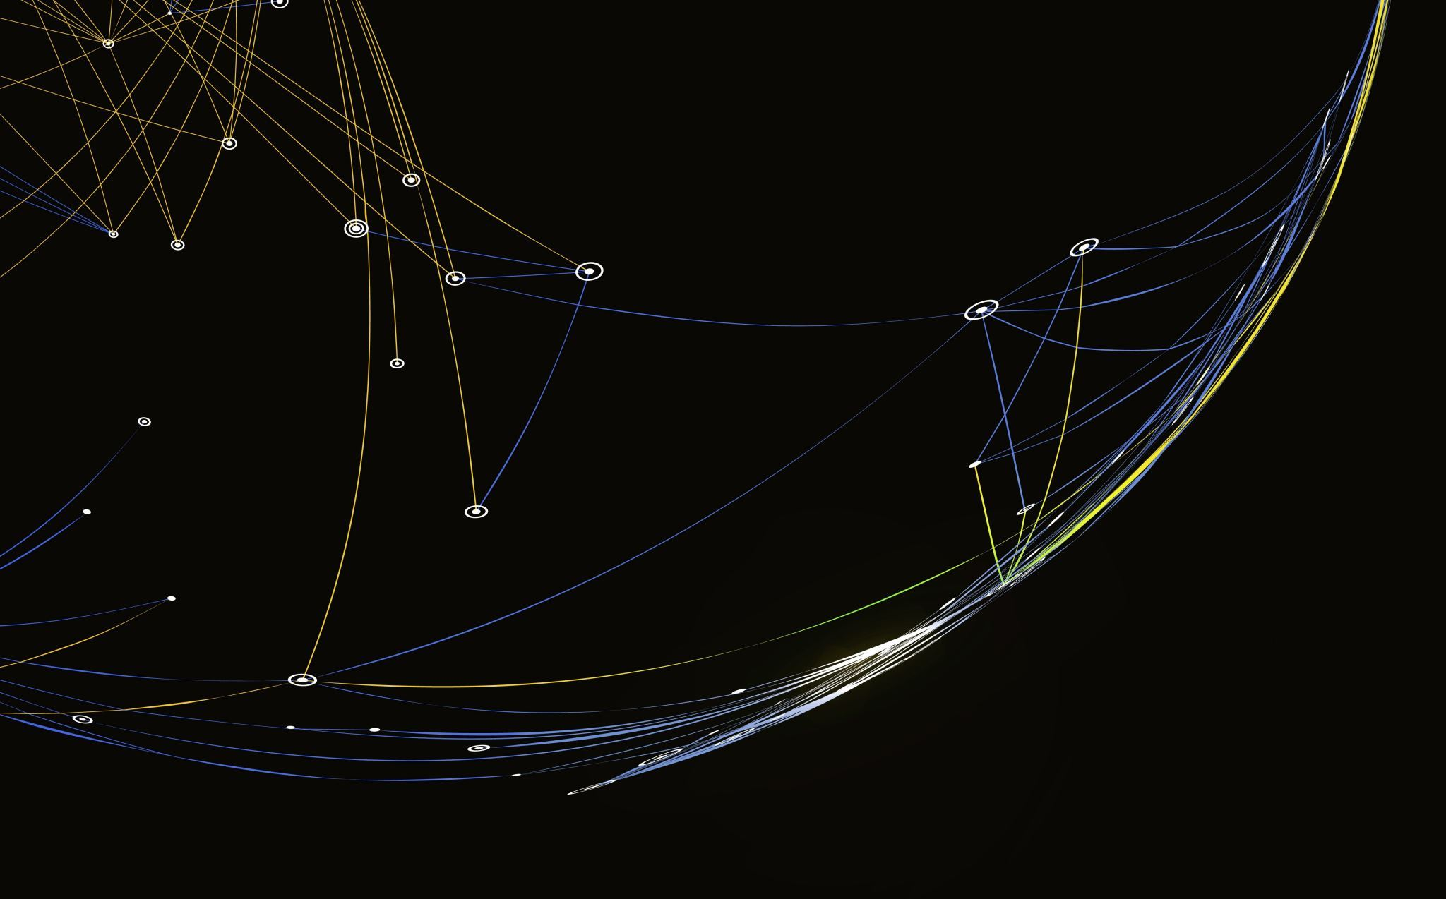
Title "Optimizing Electricity Bill Prediction"

Slide 3

Introduction
Welcome to the seminar on "Electricity Bill Prediction."
This is the introductory slide that sets the tone for the seminar and welcomes the audience
Stress the importance of accurate electricity bill prediction for consumers and utility companies
Accurate bill prediction ensures that consumers can plan their budgets effectively, while utility companies can allocate resources efficiently, ultimately leading to better customer satisfaction
Provide an overview of the presentation structure
Mention that the presentation will cover various aspects of electricity bill prediction, from challenges and benefits to smart meters, data analytics, and machine learning models

Slide 4

Electricity Bill Components
Explain the key components of an electricity bill
Usage charges: Charges based on the amount of electricity consumed
Fixed charges: Charges that remain constant regardless of usage
Taxes: Additional taxes imposed by the government
Emphasize that predicting each component accurately is essential for overall bill accuracy
Accurate predictions of each component ensure that consumers are billed correctly and can budget effectively

Slide 5
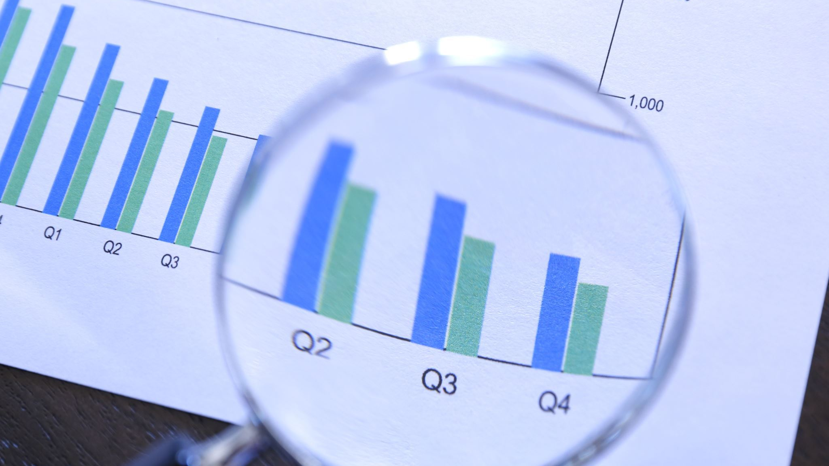
Challenges in Electricity Bill Prediction
Highlight common challenges in predicting electricity bills
Challenges can include variations in consumption, weather influences, and data accuracy issues
Explain how these challenges can impact consumers and utility companies, including billing disputes and inefficiencies
Inaccurate predictions can lead to billing disputes, financial strain on consumers, and operational inefficiencies for utility companies

Slide 6
Benefits of Accurate Predictions
Discuss the advantages of accurate electricity bill predictions
Improved budgeting for consumers: Accurate predictions help consumers plan their finances better
Better resource planning for utility companies: Accurate predictions enable utility companies to allocate resources efficiently
Reduced disputes and complaints: Accurate bills lead to fewer billing disputes and customer complaints

Slide 7

Traditional Billing Methods
Explore traditional methods of calculating electricity bills, including manual meter reading
Manual meter reading involves physically reading the electricity meter at regular intervals
Emphasize the limitations and inefficiencies of these methods
Manual meter reading can be error-prone, time-consuming, and may not provide real-time data, leading to billing inaccuracies

Slide 8
Introduction to Smart Meters
Define smart meters and their role in modern billing systems
Smart meters are digital devices that measure electricity consumption and communicate this data in real-time to utility companies
Explain how smart meters automate data collection, providing real-time consumption information
Smart meters eliminate the need for manual readings and enable utility companies to access consumption data instantly

Slide 9
Data Collection with Smart Meters
Describe how smart meters collect real-time data on electricity consumption
Smart meters continuously record electricity usage and transmit this data wirelessly
Highlight the benefits of having access to continuous consumption data
Real-time data allows for better monitoring, immediate response to anomalies, and enhanced billing accuracy

Slide 10
Data Analytics in Bill Prediction
Introduce data analytics as a solution for processing smart meter data
Data analytics involves using algorithms and statistical methods to process and analyze large datasets
Explain how data analytics enhances the accuracy of electricity bill prediction through pattern recognition
Data analytics can identify consumption patterns and factors influencing electricity usage, leading to more precise predictions

Slide 11

Machine Learning Models
Define machine learning and its application in electricity bill prediction
Machine learning is a subset of artificial intelligence that involves training models to make predictions based on data
Mention different types of machine learning models used for prediction tasks
Examples include linear regression, decision trees, and neural networks

Slide 12
Data Preprocessing
Explain the importance of data preprocessing in electricity bill prediction
Data preprocessing involves cleaning, transforming, and preparing data for analysis
Detail the steps involved, including data cleaning, transformation, and handling missing data
These steps ensure that the data used for prediction is accurate and complete

Slide 13
Feature Selection
Describe the significance of selecting relevant features for prediction
Feature selection involves choosing the most important variables or factors that influence electricity consumption
Emphasize the benefits of reducing dimensionality to improve model efficiency
Reducing the number of features can improve the speed and accuracy of machine learning models

Slide 14
Model Training
Explain the process of training machine learning models using historical consumption data
Historical data on electricity consumption and other relevant factors are used to train the model
Highlight how training enables models to learn patterns and relationships
During training, models learn from past data to make accurate predictions for future electricity bills

Slide 15
Model Evaluation
Describe the evaluation of machine learning models using metrics such as RMSE and MAE
RMSE and MAE measure the accuracy of predictions compared to actual consumption data
Stress the importance of assessing model performance
Model evaluation ensures that the machine learning model is making accurate predictions, which is crucial for billing accuracy

Slide 16
Model Deployment
Detail the integration of machine learning models into billing systems for real-time predictions
After successful training and evaluation, models are deployed to make real-time predictions
Ensure real-time updates based on the latest smart meter data
Models continually update their predictions based on the most recent consumption data from smart meters

Slide 17
Case Studies
Present real-world case studies showcasing utility companies benefiting from accurate bill prediction
Share success stories to illustrate practical applications

Slide 18
Customer Empowerment
Explain how accurate predictions empower consumers to manage their electricity consumption
Discuss how it encourages energy-efficient behavior and cost savings

Slide 19

Challenges in Implementation
Identify potential challenges in implementing smart meter systems and machine learning models
Address issues such as infrastructure upgrades and cost considerations

Slide 20

Regulatory Considerations
Discuss regulations governing electricity billing and data privacy
Emphasize the importance of compliance with legal and privacy standards

Slide 21

Future Trends
Predict future trends in electricity bill prediction technology, including AI advancements and blockchain integration
Explore sustainability and green energy integration

Slide 22
Security and Privacy
Address concerns related to data security and consumer privacy in smart meter systems
Explain measures taken to protect sensitive data

Slide 23

Consumer Education
Emphasize the importance of educating consumers about electricity bill prediction and smart meters
Highlight the role of transparent communication

Slide 24
Conclusion
Summarize key takeaways from the presentation
Reiterate the benefits of accurate electricity bill prediction for all stakeholders

