Slide 1
SMScape
Hack for Humanity project by Stefan Zier, Deen Aariff, Mickey Hoang, Sai Panneerselvam, Sean Romero, Nathan Hutchison

Slide 2
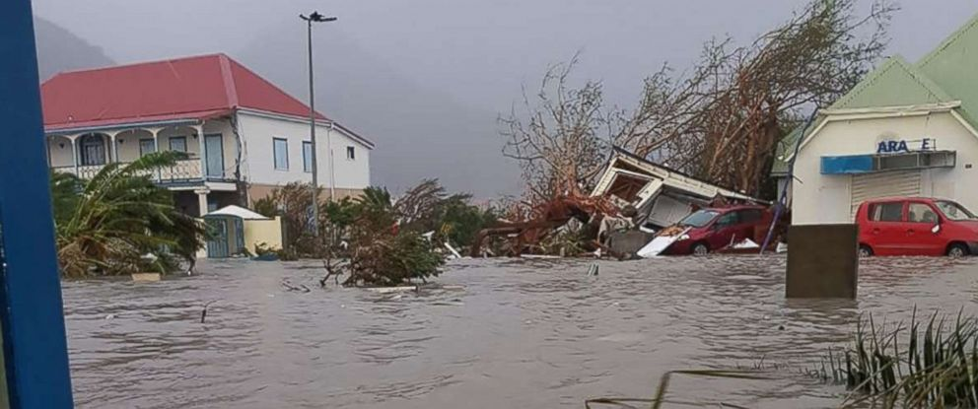
Problem
<50% people evacuated mandatory order for Hurricane Matthew
Those who stay are often poor, vulnerable
Instead of fixing the problem, we wanted to allow people to prepare to mitigate the damage
Notes:
We all know hurricane damage can be catastrophic. Generally evacuation rates remain low<=50% . We want to help increase that number and allow people a resource when the disaster does strike.

Slide 3
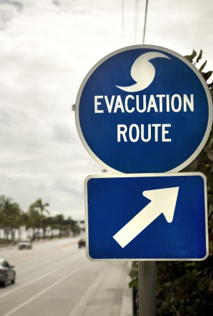
Prevention vs. Treatment
We aimed to address fixing the problem before disaster strikes in order to limit the total harm to individuals

Slide 4
Our Idea
Create a service to serve as an all purpose guide to provide personalized information to the individual, pre and post disaster.

Slide 5
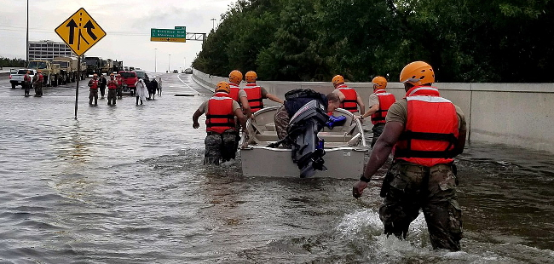
What we do
Before a major Hurricane, send a text to those at risk
Work as a dynamic chat bot to find localized info
Shelters
Evacuation routes
Medical facilities
Use just a zip code
Notes:
Use just a zip to minimize personal information/intrusion. It will encourage more to sign up and have less risk

Slide 6
How?
Use our database of zip code/phone numbers to send automated text
Our website uploads the phone/zip to our database!
Directed graph to represent our data
Can dynamically add nodes/edges that could easily be expanded for different disasters
Notes:
Add Deens js visual link to the bottom of the slide, show what we have

Slide 7
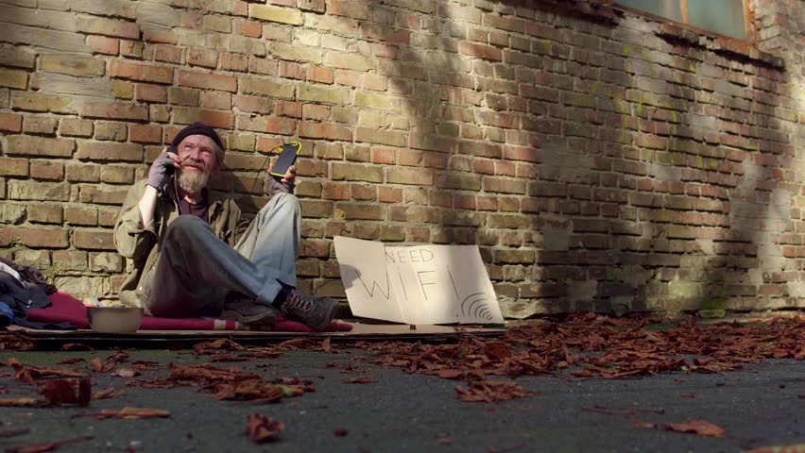
Why Text?
If power goes out, can still send sms
Does not require a smartphone to subscribe to service
One before the storm hits to help preparation, and one to receive immediate help during the crisis
Notes:
In 2011 50% of homeless had phones, number will only have increased. No major studies have been don since, but a smaller study in massachusets says around 89% of homeless now have a smart device. 90% of the whole population have smartphones, but even more have some phone. We want to make sure everyone has an opportunity to hear the evacuation order and be able to get information about how to evacuate/stay safe

Slide 8
Demonstration

Slide 9
Future Ideas
Ride sharing opportunity-Google Direction Services API
Natural Disaster API to detect other natural disasters
Automate the text service to detect natural disasters
Connect to Facebook, let others know you are safe with just an SMS

Slide 10
Thank You!

