Slide 1
Introduction to Processing: Part I
Tech Focus III: Caring for Software Based Art
September 26, 2015

Slide 2
Processing
Software is the best way I’ve found to express myself. When I work in other media, the results somehow always seem worse in reality than in my head. The software I create, however, has a magical quality: it ends up being better than what I originally imagined.
– Martin Wattenberg
From: Processing (Reas & Fry, 2007)

Slide 3
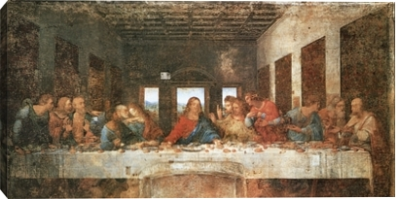
Art History and Intellectual History
There is a school of thought … that claims that mathematical and scientific discoveries … were previously seen in the visual arts.
The most commonly cited example is perspective: artists figured it out well before the mathematicians did!
Another example is a comparison between Pointillism and Post Expressionism with 20th century development of display technologies.
Art & Physics: Parallel Visions in Space, Time, and Light
By Leonard Shlain (William Morrow Paperbacks, 2007)

Slide 4
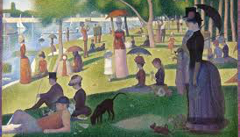
Pointillism …
A Sunday on La Grande Jatte, Georges Seurat, 1884 Art Institute of Chicago

Slide 5
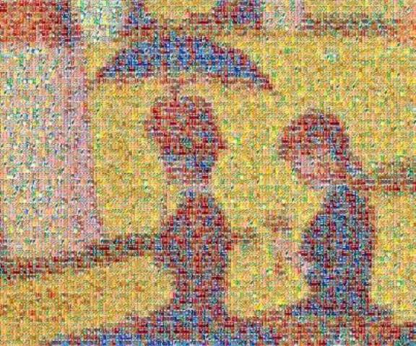
Pointillism … Magnified
A Sunday on La Grande Jatte, Georges Seurat, 1884 Art Institute of Chicago

Slide 6

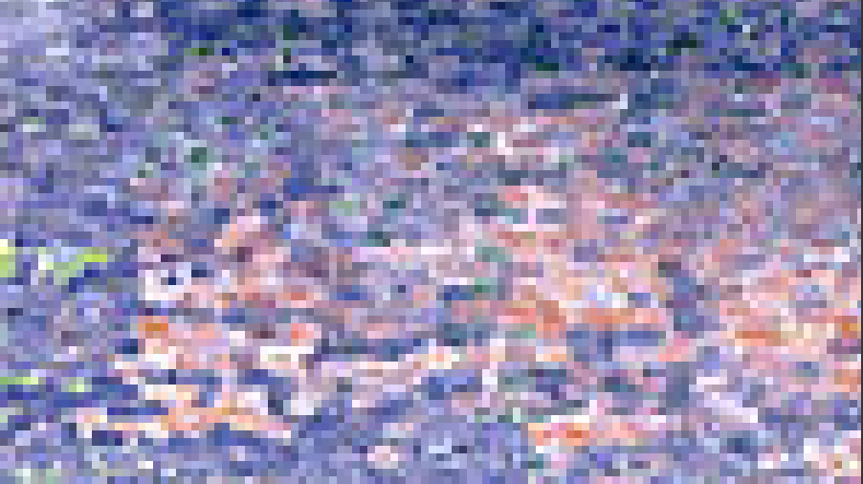
… and pixelated:
Detail at 1600%: A Sunday on La Grande Jatte, Georges Seurat, 1884 Art Institute of Chicago

Slide 7
Processing: Addressing Pixels on a Grid
Every pixel has an x-coordinate, a y-coordinate and a color.
x-axis
(0,0)
y-axis

Slide 8
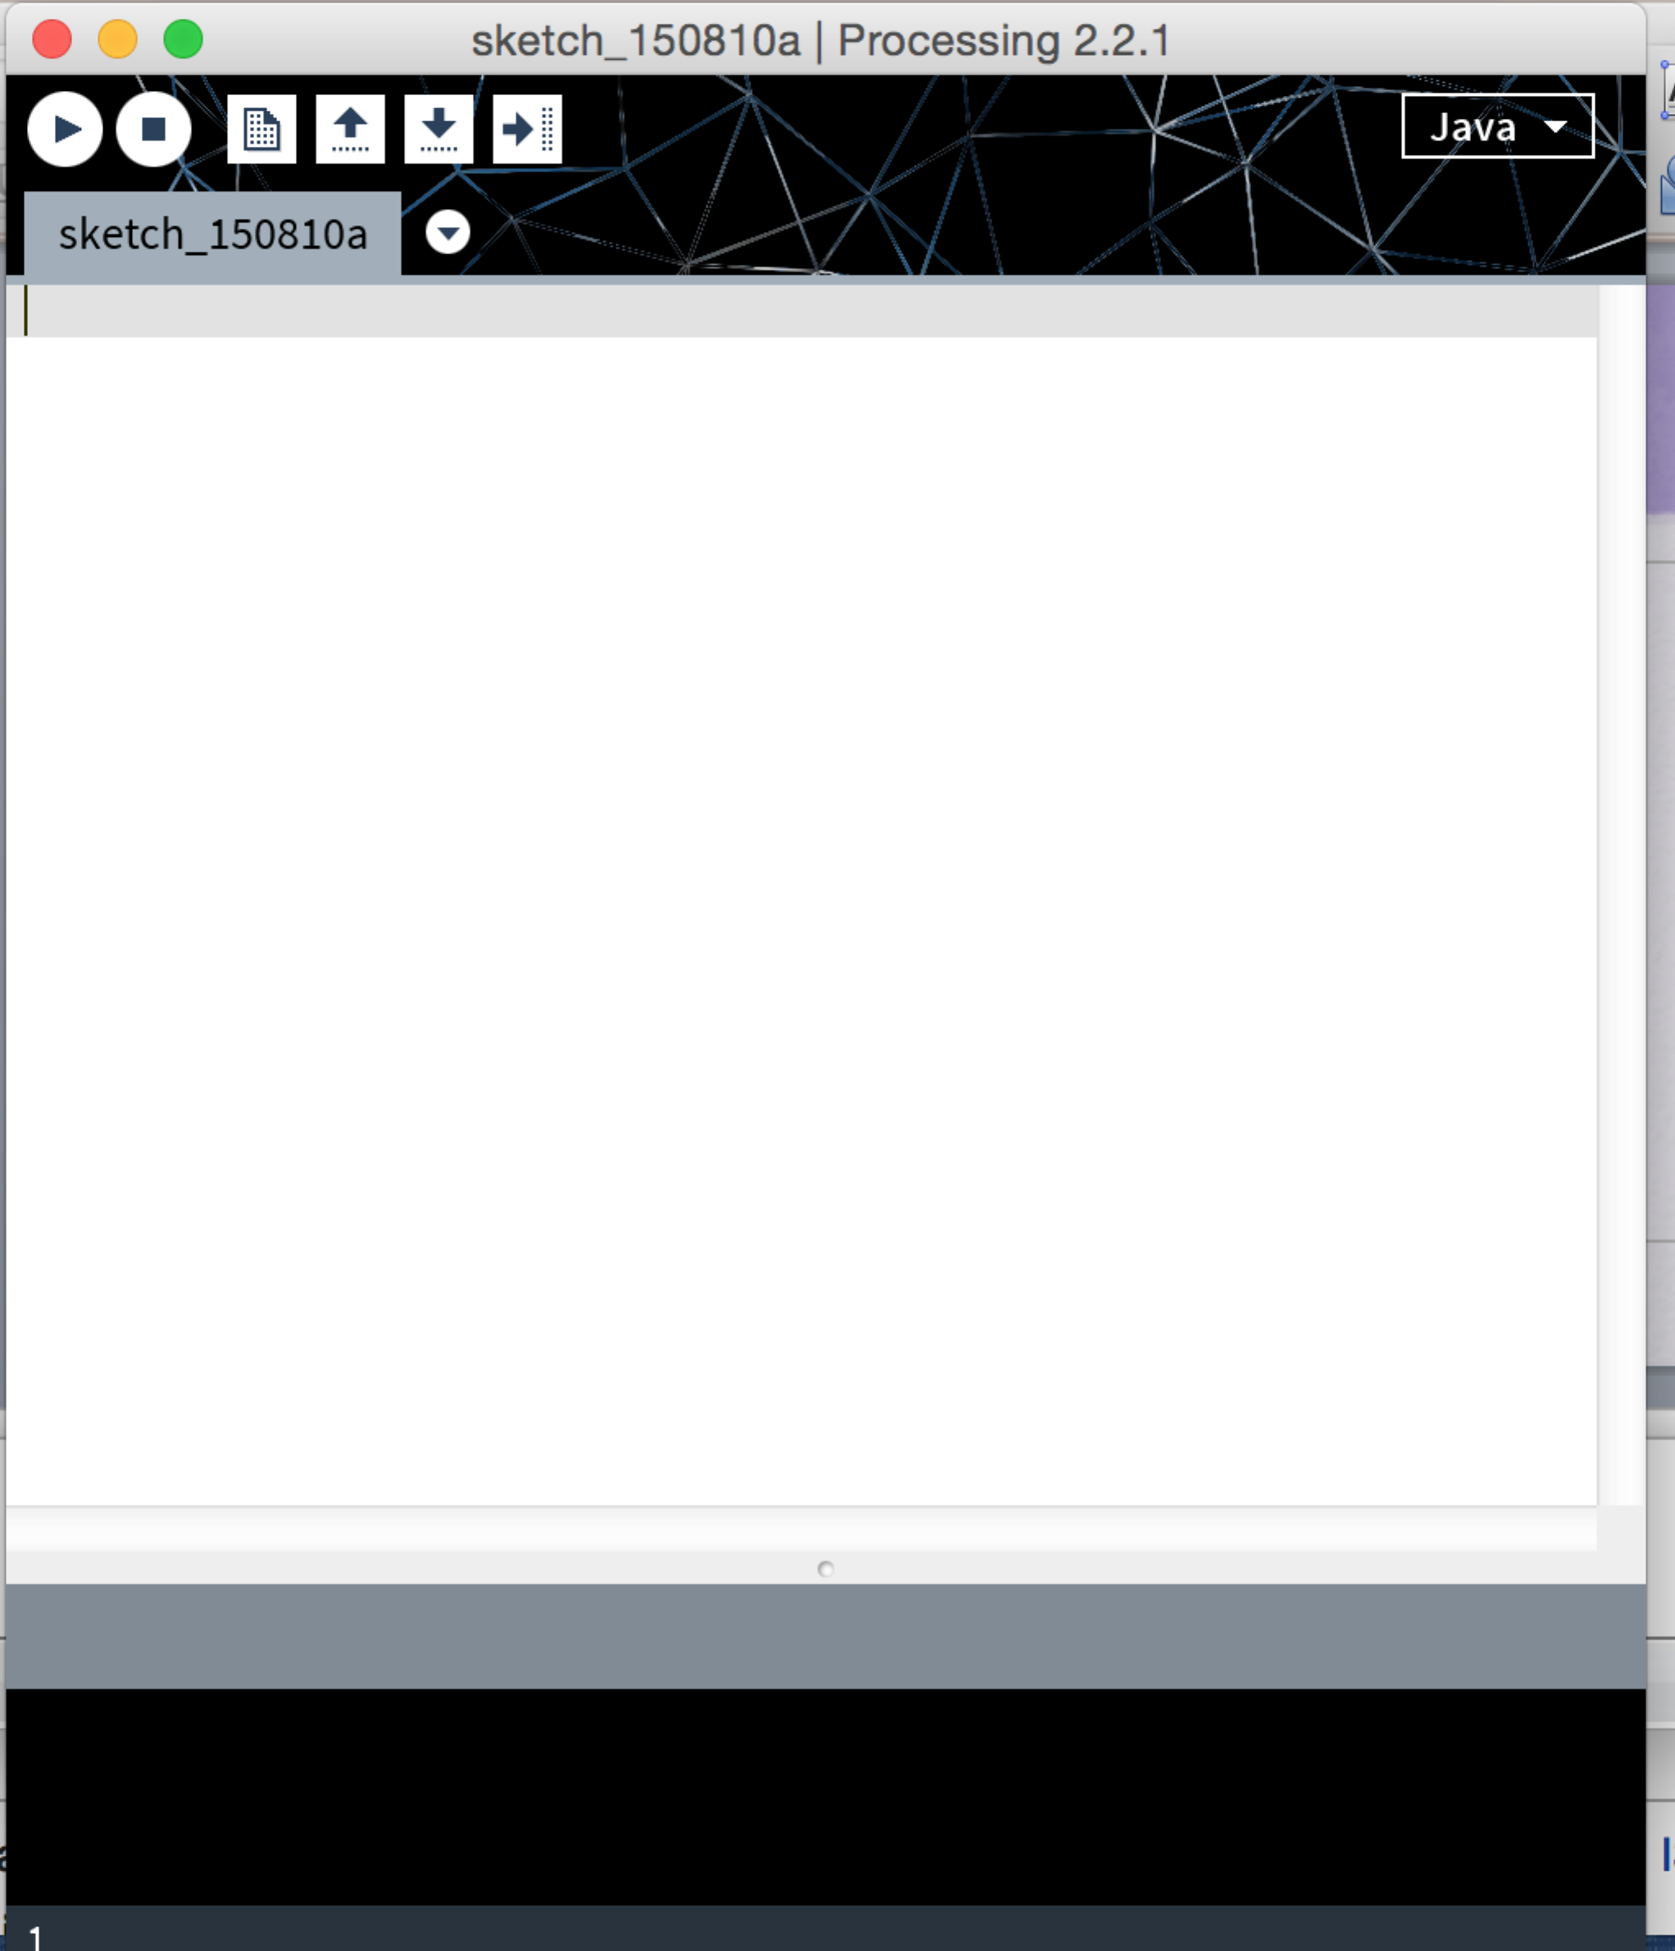
Processing
Open Processing with a blank sketch

Slide 9
Processing
Processing is widely used to teach programming skills.
Processing was initially written to use Java but it also now supports python and there is a JavaScript version available as well.
Our focus today will be on using Processing as an artist, so that you can see how it feels to be a digital artist.
I would be happy to answer specific programming questions and provide additional materials as well during our discussion and work periods for anyone who is interested!

Slide 10
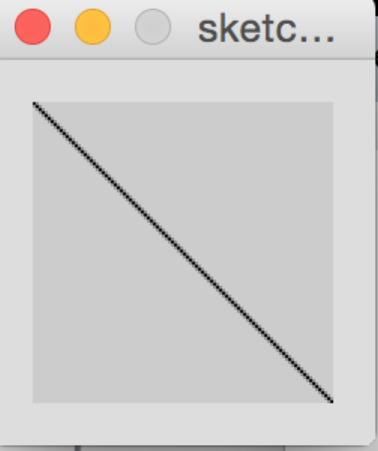
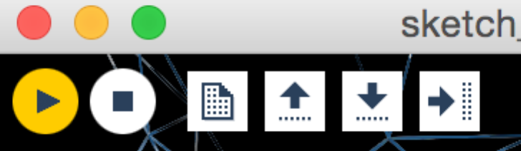
Drawing a line: Type this code into your Sketch
line(0,0,200,200);
Then click on the yellow “play” button:
Use the square “stop” button before playing a second time.
Notice that every statement in Processing ends with a semi-colon (and not a period … or a question mark!)

Slide 11
Drawing a line: Let’s look at the code.
line(0,0,200,200);
Here is how a line is defined in Processing:
line (a,b,c,d) is defined where (a,b) are the (x,y) coordinates of the first point on our grid of pixels and and (c,d) are the (x,y) coordinates of the second point on our grid.
See https://processing.org/reference/line_.html

Slide 12
Drawing a line
line(0,0,200,200);
In programming terms, line is a function and 0,0, 200 and 200 are the parameters.
In other words, anytime you want to draw a line, you can call the line function and spell out the (x,y) coordinates for the two points that define your line.
The processing environment offers many functions. You can also write your own!
See https://processing.org/reference/line_.html

Slide 13
Adding to your sketch
When you create a sketch, it is saved in a folder along with a .pde file of the same name. For example, the above drawing is stored in a folder called sketch_1_line and named sketch_1_line.pde on your drive.
Next let’s add the following code and call it sketch_2_line:
The size of the drawing in pixels
More lines and other shapes
Color
Comments into your code

Slide 14
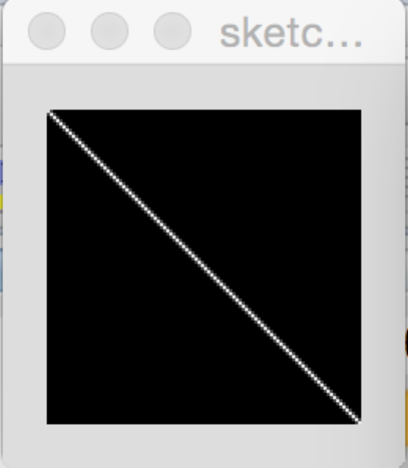
Let’s render your line in white on a black background …
If you add the first two lines above your code:
background(0);
stroke(255);
line(0,0,200,200);
… here is your new sketch:

Slide 15
A Word About Color
We will be using color today in RGB mode (red, green, and blue) and we will measure each of the three colors in a range of 0-255.
Color can be defined for stroke (lines and/or outlines) and/or fill (contents of a shape)
(Hint: use nofill() to leave a shape with only an outline!)
Black can be expressed as (0) and white can be expressed as (255).
Note there is a Processing tutorial on color posted to https://www.processing.org/tutorials/color/

Slide 16
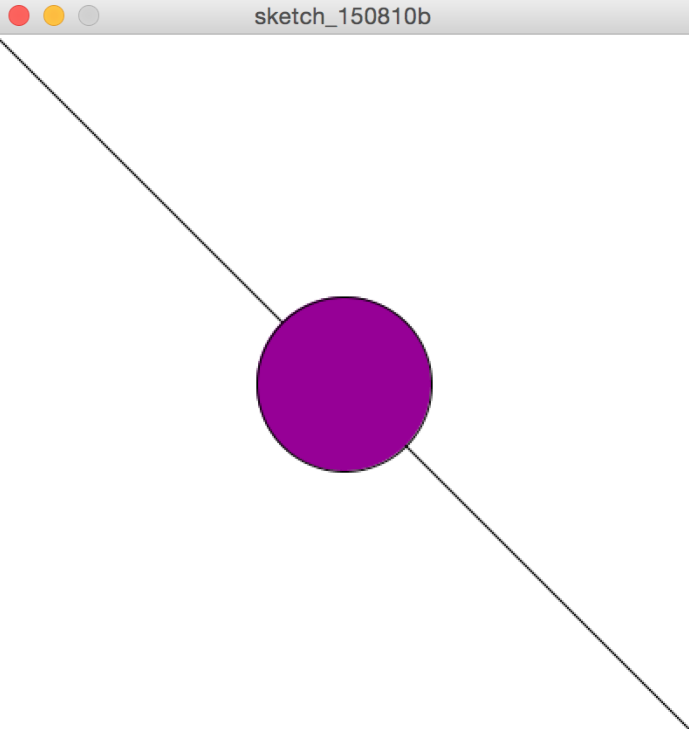
We can also change the colors …and add another shape:
The following code (saved on your drive as sketch_3_circle ) renders:
size(400,400);
background(255);
stroke(0);
fill(150,0,150);
line(0,0,400,400);
ellipse(200,200,100,100);

Slide 17
Notice that we can annotate the code using comments.
Here is the same code … annotated:
size(400,400); // set up the size of the window
background(255); // the background is white
stroke(0); // lines and outlines are in black
fill(150,0,150); // fill shapes in purple
line(0,0,400,400); // draw a diagonal in black
ellipse(200,200,100,100); //draw a purple circle
Comments are for human readers only … the computer ignores them!

Slide 18
We will now give you time to do a sketch of your own!
How do these shapes look … in different colors?
Line: line (a,b,c,d) where (a,b) is the first point and (c,d) is the second point.
Rectangle: rect(a,b,c,d) where (a,b) is the upper left corner; c is the width in pixels and d is the height in pixels.
Ellipse: ellipse(a,b,c,d) where (a,b) is the center point; c is the width in pixels and d is the height in pixels. Note that if c is equal to d, ellipse draws a circle.
Triangle: triangle(a,b,c,d,e,f) where (a,b), (c,d) and (e,f) represent the three points that create the triangle.

Slide 19
Notes for your sketch:
Shapes:
Line: line (a,b,c,d) where (a,b) is the first point and (c,d) is the second point.
Rectangle: rect(a,b,c,d) where (a,b) is the upper left corner; c is the width in pixels and d is the height in pixels.
Ellipse: ellipse(a,b,c,d) where (a,b) is the center point; c is the width in pixels and d is the height in pixels. Note that if c is equal to d, ellipse draws a circle.
Triangle: triangle(a,b,c,d,e,f) where (a,b), (c,d) and (e,f) represent the three points that create the triangle.
Colors:
Red (255,0,0)
Green (0,255,0)
Blue (0,0,255)
White (255)
Black (0)
Reddish Violet (255,0,255)
Olive green (100, 150, 0)
Navy blue (50, 75,150)
Online color picker: http://www.w3schools.com/tags/ref_colorpicker.asp

Slide 20
Introduction to Processing: Part 2
Tech Focus III: Caring for Software Based Art
September 26, 2015

Slide 21
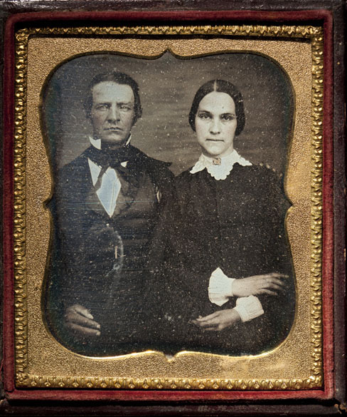
Art and New Technologies
Early photographs were reportedly used to capture images that might otherwise have been rendered in paintings or drawings.
Source: http://www.si.edu/MCI/EarlyPhotography/about.html

Slide 22
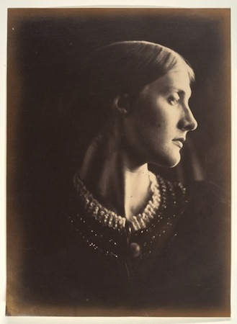
Early Photography
With time and advances in technology, photography grew into a medium for art in its own right.
Julia Margaret Cameron, Mrs. Herbert Duckworth, 1867, albumen silver print from glass negative (Metropolitan Museum of Art) https://www.khanacademy.org/humanities/becoming-modern/early-photography/a/julia-margaret-cameron-mrs-herbert-duckworth

Slide 23
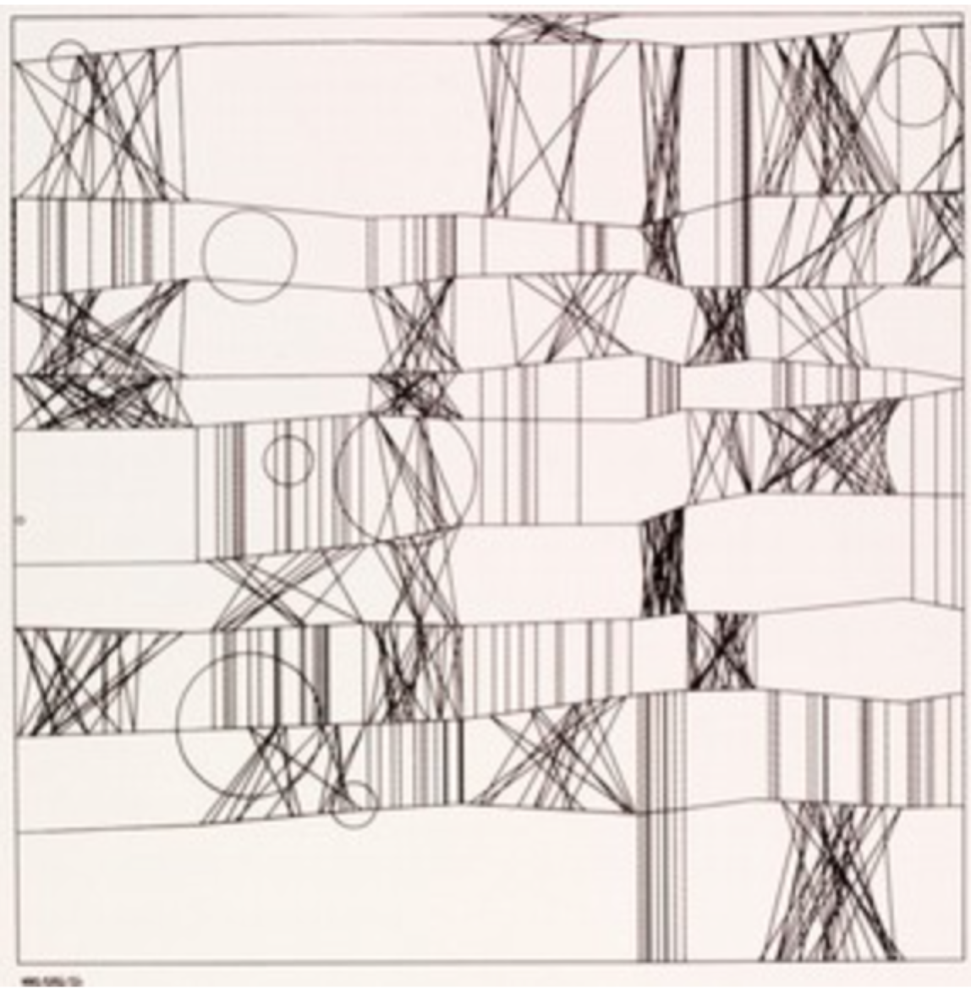
Early software art
So, too, software art and digital-born art have evolved as artists continue to work in new technologies.
'Hommage à Paul Klee 13/9/65 Nr.2', a screenprint of a plotter drawing created by Frieder Nake in 1965 (Victoria and Albert Museum: http://www.vam.ac.uk/content/articles/a/computer-art-history/ )

Slide 24
Processing Class, Part 2
In the first part of today’s class, you experimented with drawings that you could have created with physical media such as crayons, paints, or ink.
In the second part of today’s class, I would like for you to take this opportunity to explore facets of drawing in Processing that you cannot replicate with familiar physical drawing materials.

Slide 25
Exploring Software Based Art
What are facets of software art that have gone beyond the realm of traditional media?
Algorithmic art: regular and repetitive drawing ideas that create or render a work which would be difficult or impossible or extremely time-consuming to create by hand.
Animation: drawings that shift and move
Interactive art: drawings that respond to the user (e.g. through a mouse)
And more ...

Slide 26
Algorithmic Art: using repetition with change
Iteration (repetition) is widely used in computer programming. Computers are quite good at doing the same task over and over again.
In algorithmic art, one can vary the parameters (either dramatically or subtly or anywhere in between) to render a drawing that results from such a “theme and variations” approach.

Slide 27
Simple Algorithmic Design: What does the following code produce?
size(400,400);
background(255);
stroke(0);
line(0,0,400,400);
fill(150,0,150);
ellipse(200,200,100,100);
/* setting up the ellipse parameters as integer variables: */
int x = 200;
int y = 200;
int w = 100;
int h = 100;
/* Using repetition and change: */
for (int i=1; i<6; i++) {
x = x+25;
y = y-25;
w = w-20;
h = h-20;
ellipse(x,y,w,h);
}
This is stored on your drive as sketch_4_repetition.

Slide 28
Programming Interlude
In programming terms, iteration is handled by loops. There are typically at least two kinds of loops in programming languages:
for loops for counted repetitions
while loops for conditional repetitions
Conditions can be set using if statements or if … else statements so that the program is response to a condition.
You will see these keywords used throughout programming and therefore throughout software-based art.

Slide 29
Drawing
In order to move shapes and lines around a sketch, we will need to introduce two new functions to set the scene, so to speak:
setup() will allow us to define the starting condition for the work
draw()is used to render the work
We will also use curly braces { … } to define blocks of code within each function*.
Here is the previous drawing, rendered with these functions and saved as sketch_4_usingFunctions.
* Note that our for loop earlier also used braces to define that block of code.

Slide 30
Using the setup() and draw() functions
void setup() {
size(400,400);
background(255);
}
void draw() {
stroke(0);
line(0,0,400,400);
fill(150,0,150);
ellipse(200,200,100,100);
/* setting up the ellipse parameters as integer variables: */
int x = 200;
int y = 200;
int w = 100;
int h = 100;
/* Using repetition and change: */
for (int i=1; i<6; i++) {
x = x+25;
y = y-25;
w = w-20;
h = h-20;
ellipse(x,y,w,h);
}
}

Slide 31
The “draw()” function handles some of the iteration for us!
Sketch 5 (sketch_5_movingLine) yields a moving line. Here are questions for you:
What color is the line?
Is it horizontal or vertical now?
How would you change its direction?
Why does the line appear to move as a single line (rather than producing a drawing with many lines?)
Does the line go all the way across the window or just partway? How do you know?

Slide 32
Sketch 5: A Moving Line
int i = 0;
void setup() {
size(400,400);
stroke(0,0,255);
}
void draw() {
background(255);
line(0,i,400,i);
i = i+2;
if (i>400) {
i=0;
}
}

Slide 33
Sketch 5: A Moving Line (Annotated view)
int i = 0; // set up integer i
void setup() { // open setup()
size(400,400); // window size
stroke(0,0,255); // use blue
}
void draw() { // open draw()
background(255); // white background
line(0,i,400,i); // draw a line
i = i+2; // increment i by 2
if (i>400) { // if i has reached
// the bottom …
i=0; // reset i to zero
}
}

Slide 34
Still images and animation
Look closely at this line of code and where it is placed in the animated sketch:
background(255);
In animation, one can reset the background to give the illusion of a moving shape or object.
Therefore the placement of the code to set the background color (whether in the setup() function or in the draw()function) is one way to render the illusion of animation (which is actually a rapidly changing drawing.)

Slide 35
Interactive Images
In order to build an interactive image (i.e. an image that the user can render or influence in some way), the program must accept input from a user or the environment.
This can be done in many ways such as through a user manipulating a mouse or typing on the keyboard; or various peripherals to detect sound, motion, or environmental information.

Slide 36
Processing and your mouse
Processing offers a number of functions to detect whether your user is manipulating her mouse.
For example, mouseX and mouseY will detect the current (x,y) coordinates of a mouse and mousepressed will indicate if the user is currently clicking or pressing the mouse.
You, as the artist/programmer, can make things happen where the user “tells” you to!

Slide 37
Responding to a mouse:
In this program (sketch_6_mouse), the user “draws” with a purple circle:
void setup() {
size(400,400);
background(255);
fill(150,0,150);
}
void draw() {
ellipse(mouseX,mouseY,50,50);
}

Slide 38
Responding to a mouse:
Annotated version:
void setup() { // setup
size(400,400); // window size
background(255); // white background
fill(150,0,150); // purple color
}
void draw() {
// draw a circle at the (x,y)
// coordinates designated by the mouse
ellipse(mouseX,mouseY,50,50);
}

Slide 39
One can change colors as well using an “if” clause:
void setup() {
size(400,400);
background(255);
}
void draw() {
// change color … depending on whether
// the mouse is pressed or not!
if (mousePressed) {
fill(150 ,0,150); }
else {
fill(0,0,255); }
ellipse(mouseX,mouseY,50,50);
}

Slide 40
Now its your turn!
Render your earlier drawing (or start a new one) with the addition of animation or user interactivity.
Be sure to ask me or any of our talented teaching assistants any questions that you might have.
Above all, have fun!

Slide 41
Bibliography
The Processing Site
Opening Page https://processing.org
Tutorials https://processing.org/tutorials/
Examples https://processing.org/examples/ or … open Processing and naviage to FILE / EXAMPLES.
Exhibition https://processing.org/exhibition/

Slide 42
Bibliography
Exhibitions and Inspiration
OpenProcessing http://www.openprocessing.org
OpenProcessing Data Visualizations http://www.openprocessing.org/collection/1122
Ben Fry’s Project Page http://benfry.com/projects/

Slide 43
Bibliography
Processing and Programming Languages
Processing in Java https://processing.org
Python mode for Processing http://py.processing.org
Processing and JavaScript http://processingjs.org

Slide 44
Prof. Deena Engel
Clinical Professor
Associate Director of Undergraduate Studies for the
Computer Science Minors programs
Department of Computer Science
Courant Institute of Mathematical Sciences
New York University
deena.engel@nyu.edu

