Slide 1
Introduction to Processing: Part I
Tech Focus III: Caring for Software Based Art
September 26, 2015

Slide 2
Processing
Software is the best way I’ve found to express myself. When I work in other media, the results somehow always seem worse in reality than in my head. The software I create, however, has a magical quality: it ends up being better than what I originally imagined.
– Martin Wattenberg
From: Processing (Reas & Fry, 2007)

Slide 3
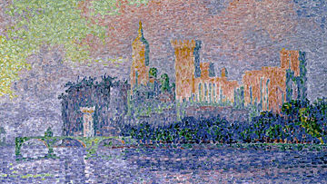
Pointillism …
Paul Signac: The Papal Palace, Avignon, oil on canvas, 1909, Musée d'Orsay, Paris

Slide 4
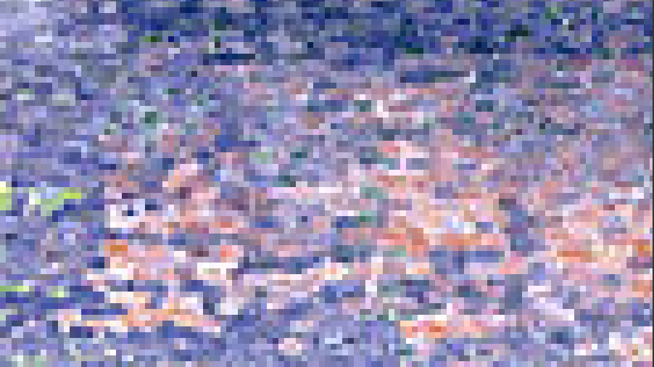
… and pixels
Detail at 800%: Paul Signac: The Papal Palace, Avignon, oil on canvas, 1909, Musée d'Orsay, Paris

Slide 5
The Grid
Every pixel has an x-coordinate, a y-coordinate and a color.
x-axis
(0,0)
y-axis

Slide 6
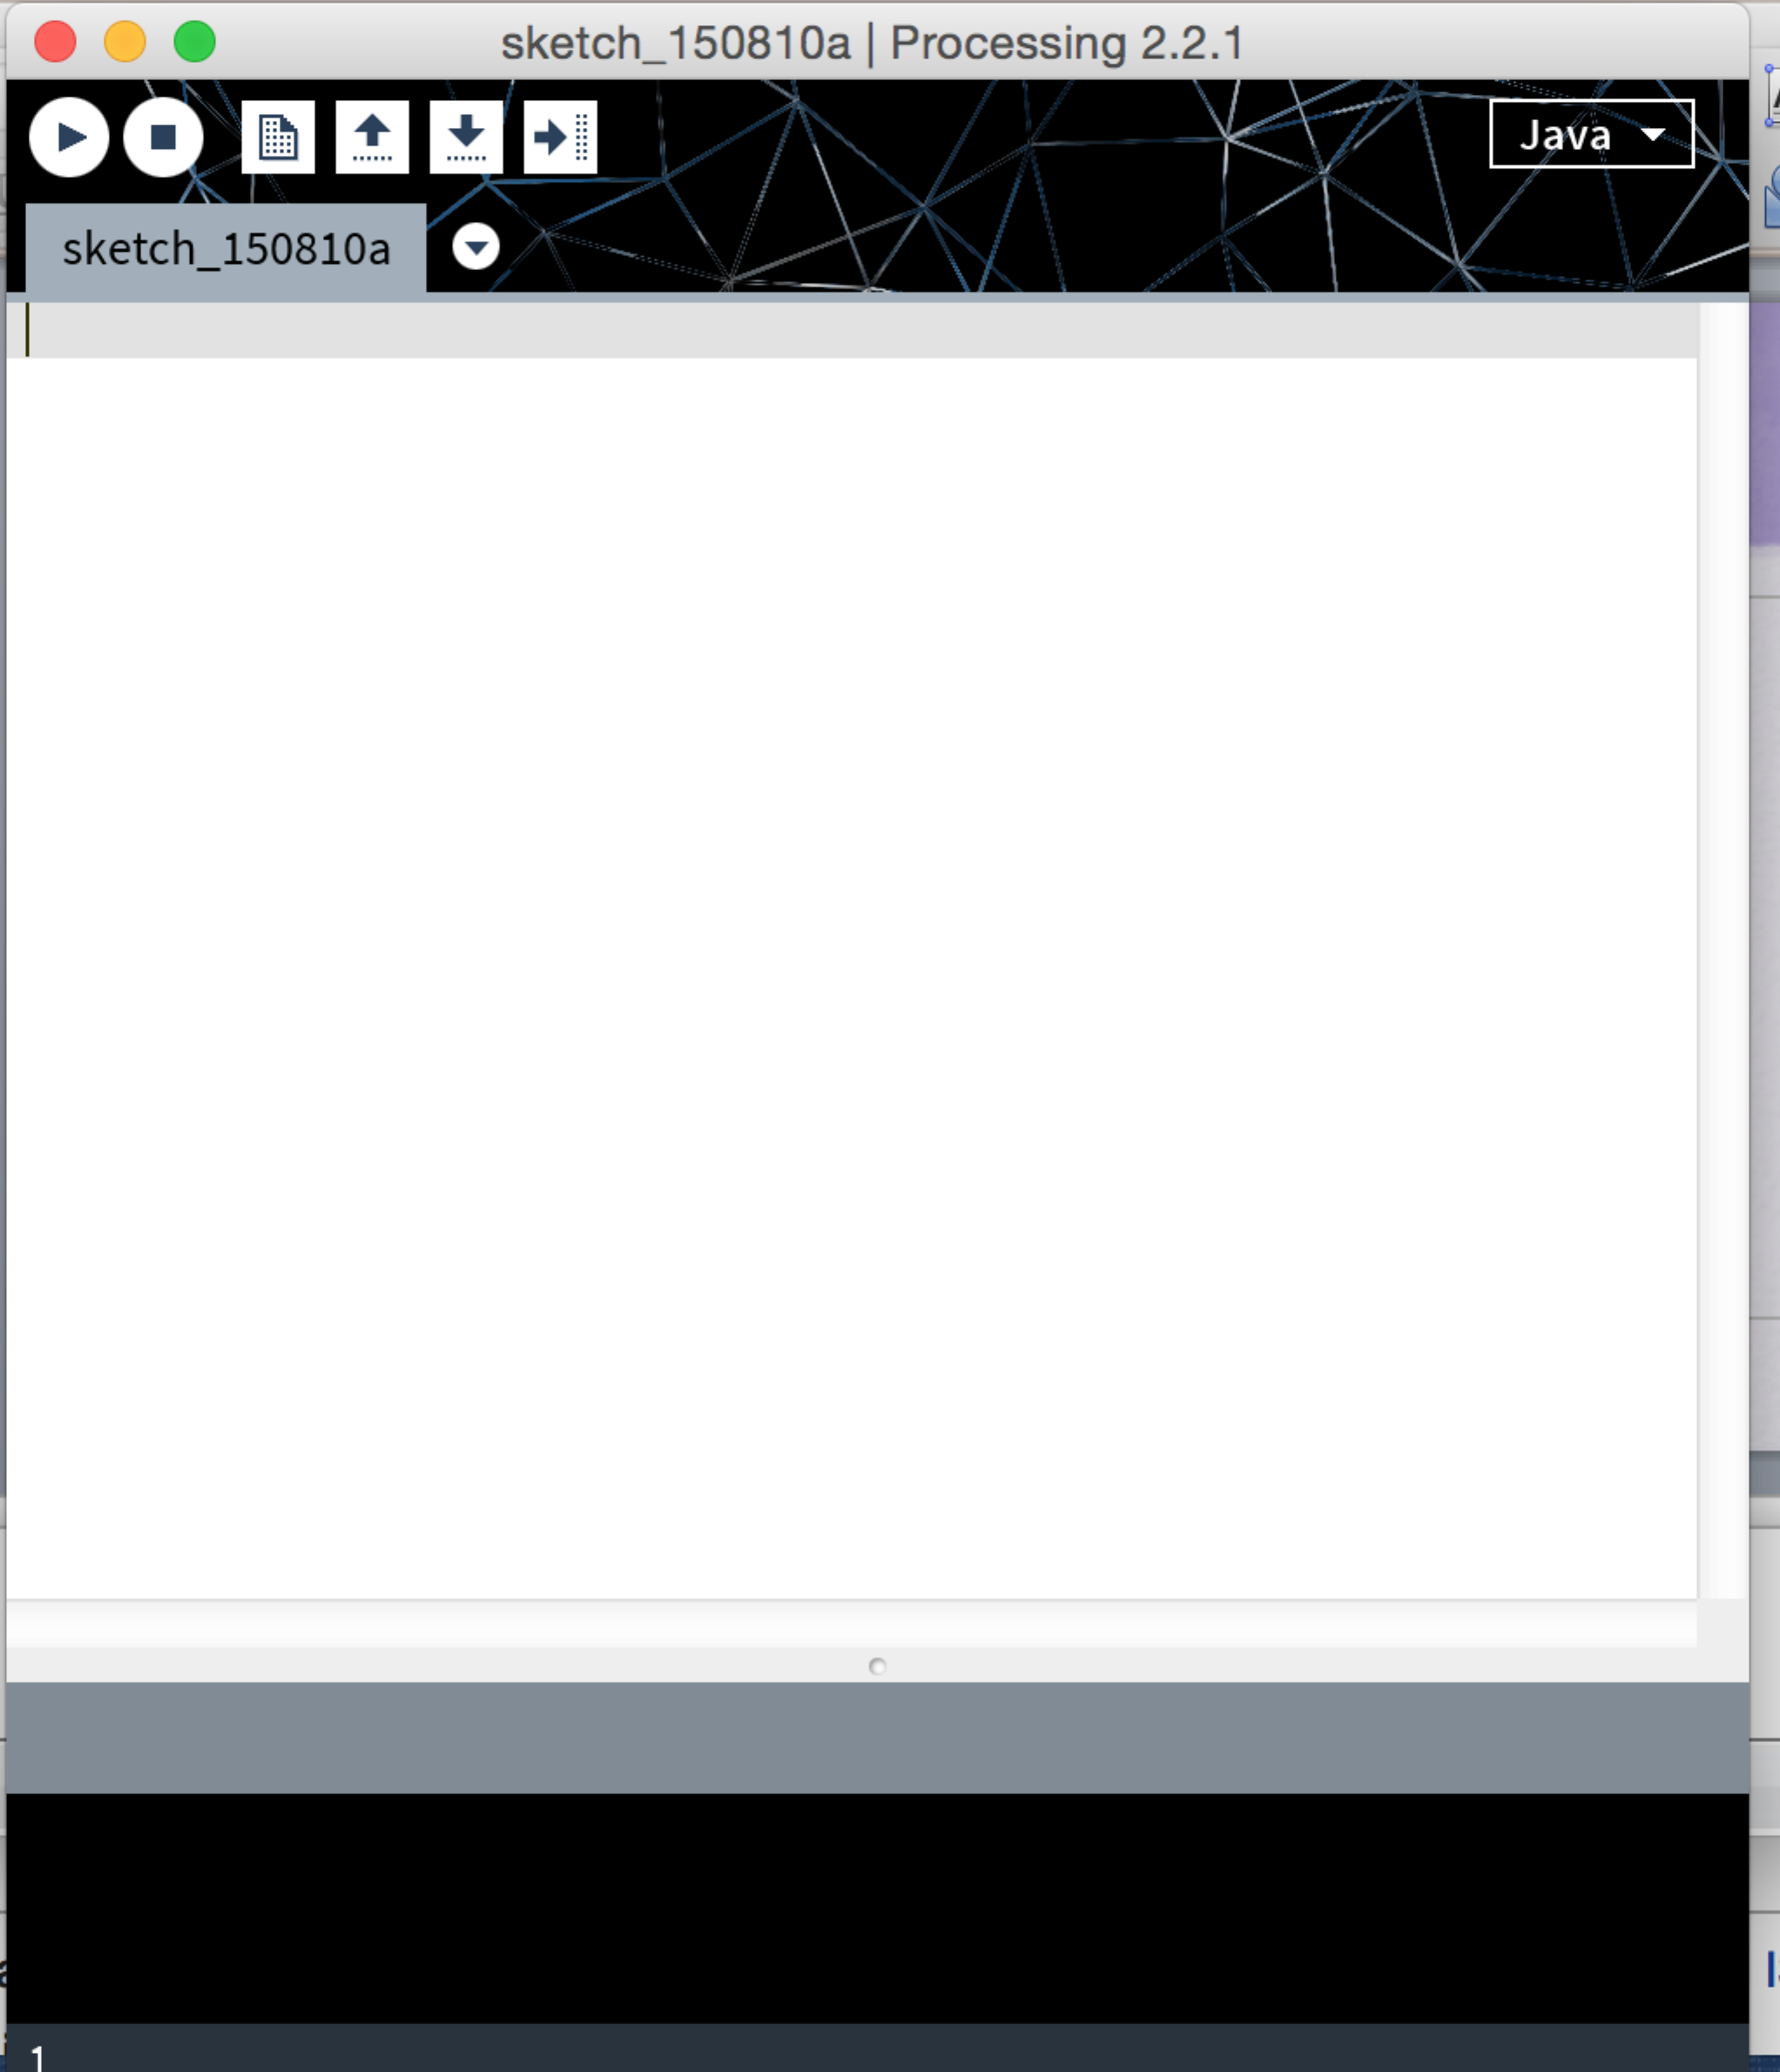
Processing
Open Processing

Slide 7
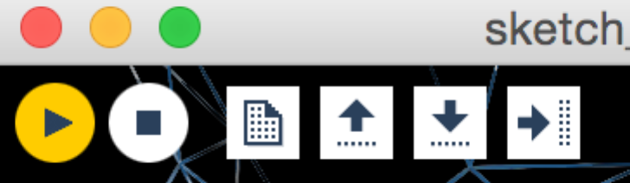
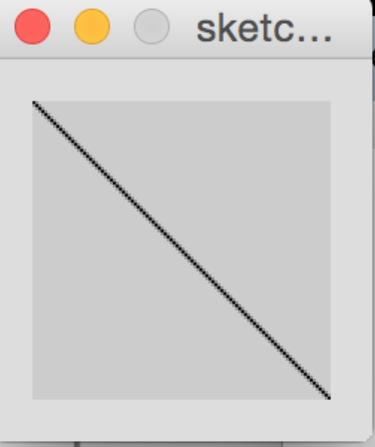
Drawing a line: Type this code into your Sketch
line(0,0,200,200);
Then click on the “play” button in yellow:
… and here is your sketch:
Notice that every statement in Processing ends with a semi-colon (and not a period … or a question mark!)

Slide 8
Drawing a line: Let’s look at the code.
line(0,0,200,200);
Here is how a line is defined in Processing:
line (a,b,c,d) is defined where (a,b) are the (x,y) coordinates of the first point and (c,d) are the (x,y) coordinates of the second point.
See https://processing.org/reference/line_.html

Slide 9
Drawing a line
line(0,0,200,200);
In programming terms, line is a function and 0,0, 200 and 200 are the parameters.
The processing environment offers many functions. You can also write your own!
See https://processing.org/reference/line_.html

Slide 10
Adding to your sketch
Next let’s add:
The size of the drawing in pixels
More lines and other shapes
Color
Comments into your code

Slide 11
A Word About Color
We will be using color today in RGB mode (red, green, and blue) and we will measure each of the three colors in a range of 0-255. (Why??)
Color is defined for both the stroke (lines and/or outlines) and fill (contents of a shape)
(Hint: use nofill() to leave a shape with only an outline!)
Black can be expressed as (0) and white can be expressed as (255).
Note there is a Processing tutorial on color posted to https://www.processing.org/tutorials/color/

Slide 12
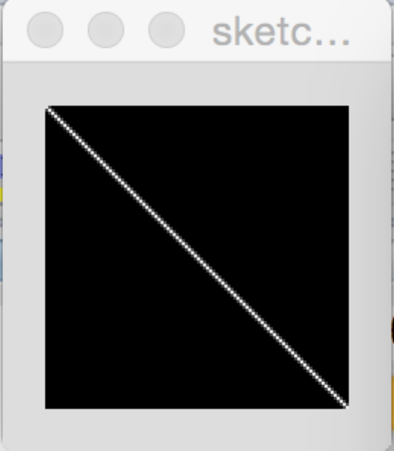
Let’s render your line in white on a black background …
If you add the first two lines above your code:
background(0);
stroke(255);
line(0,0,200,200);
… here is your new sketch:

Slide 13
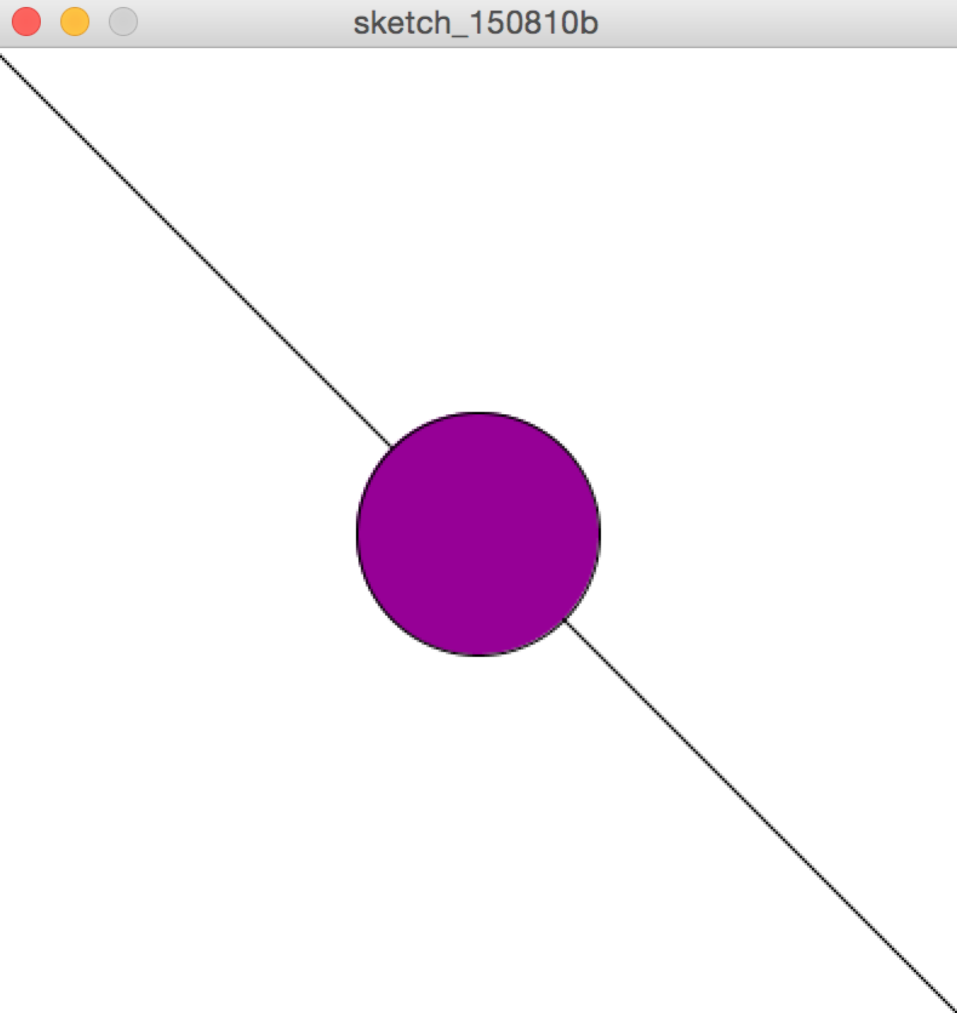
We can also change the colors …and add another shape:
The following code gives you:
size(400,400);
background(255);
stroke(0);
fill(150,0,150);
line(0,0,400,400);
ellipse(200,200,100,100);

Slide 14
Notice that we can annotate the code using comments.
Here is the same code … annotated:
size(400,400); // set up the size of the window
background(255); // the background is white
stroke(0); // lines and outlines are in black
fill(150,0,150); // fill shapes in purple
line(0,0,400,400); // draw a diagonal in black
ellipse(200,200,100,100); //draw a purple circle
Comments are for human readers only … the computer ignores them!

Slide 15
We will now give you time to do a sketch of your own!
How do these shapes look … in different colors?
Line: line (a,b,c,d) where (a,b) is the first point and (c,d) is the second point.
Rectangle: rect(a,b,c,d) where (a,b) is the upper left corner; c is the width in pixels and d is the height in pixels.
Ellipse: ellipse(a,b,c,d) where (a,b) is the center point; c is the width in pixels and d is the height in pixels. Note that if c is equal to d, ellipse draws a circle.
Triangle: triangle(a,b,c,d,e,f) where (a,b), (c,d) and (e,f) represent the three points that create the triangle.

Slide 16
Introduction to Processing: Part 2
Tech Focus 3
September 26, 2015

Slide 20
Bibliography
The Processing Site:
Opening Page https://processing.org
Tutorials https://processing.org/tutorials/
Examples https://processing.org/examples/ or … open Processing and naviage to FILE / EXAMPLES.
Exhibition https://processing.org/exhibition/

Slide 21
Bibliography
Exhibitions and Inspiration
OpenProcessing http://www.openprocessing.org
OpenProcessing Data Visualizations http://www.openprocessing.org/collection/1122
Ben Fry’s Project Page http://benfry.com/projects/

