Slide 1

SIR CR REDDY COLLEGE OF ENGINEERING
DEPARTMENT OF COMPUTER SCIENCE AND ENGINEERING
Title : Energy Consumption Forecasting and Visualization for
Smart Homes Using Data Analytics and Machine Learning
Project Guide : Dr. G. Nirmala , M.Tech.Ph.D Professor
Presented by : (Batch - 4)
B. Deenaja – 22B81A0516
B. Trilok – 22B81A0517
B. Bala Bandhavi – 22B81A0518
B. Praveen – 22B81A0519
B. Rama Jyothi – 22B81A0520
Project Co-ordinator : Dr. B. Madhav Rao, Professor
HOD Dept. Of CSE : Dr. A. Yesu Babu

Slide 2
Table of Content
1.Abstract
2.Introduction
3. Problem Statement
4. Existing System
5.Proposed System
6.Techonologies Used
7.Architecture
8.Result
9.Conclusion
10.Future Scope

Slide 3
Abstract
Energy Consumption Forecasting and Visualization for Smart Homes using Data Analytics and Machine Learning focuses on analyzing historical electricity consumption data to understand usage patterns and predict future demand. The system uses Random Forest and LSTM models, which are trained separately and compared for performance. LSTM provides better accuracy by capturing time-based patterns. The results support efficient energy planning in smart homes and smart grid systems.

Slide 4
Introduction
Energy Consumption Forecasting and Visualization for Smart Homes using Data Analytics and Machine Learning focuses on addressing the increasing demand for efficient energy management. Electricity consumption patterns are complex and vary over time, making traditional methods less effective. By using machine learning and deep learning techniques, historical energy data can be analyzed to identify patterns and predict future consumption. This helps in improving energy planning and supports smarter decision-making in smart home and smart grid environments.

Slide 5
Problem Statement
Increasing electricity demand and dynamic usage patterns make accurate energy forecasting difficult. Traditional methods fail to capture complex and time-based variations, leading to inefficient energy planning and possible power shortages or wastage. Therefore, a data-driven approach is needed to improve prediction accuracy and support better energy management.

Slide 6
Existing System
Existing systems use traditional statistical methods and basic machine learning models to predict electricity consumption. These methods can handle simple patterns but fail to capture complex and time-dependent variations in energy usage. As a result, their prediction accuracy is limited.
Advantages | Disadvantages
Simple system | No energy forecasting
Low cost | Manual data analysis
Basic energy monitoring | No interactive visualization

Slide 7
Proposed System
The proposed system uses a combination of Random Forest and LSTM models to forecast electricity consumption. It analyzes historical data, captures both nonlinear and time-based patterns, and provides more accurate predictions. This approach improves energy planning and supports efficient management in smart systems.
Feature | Benefits
Automated data preprocessing. | Improved forecasting accuracy.
Accurate ML-based forecasting. | Reduced energy wastage.
Clear visualization. | Enhanced decision-making for smart home users.

Slide 8
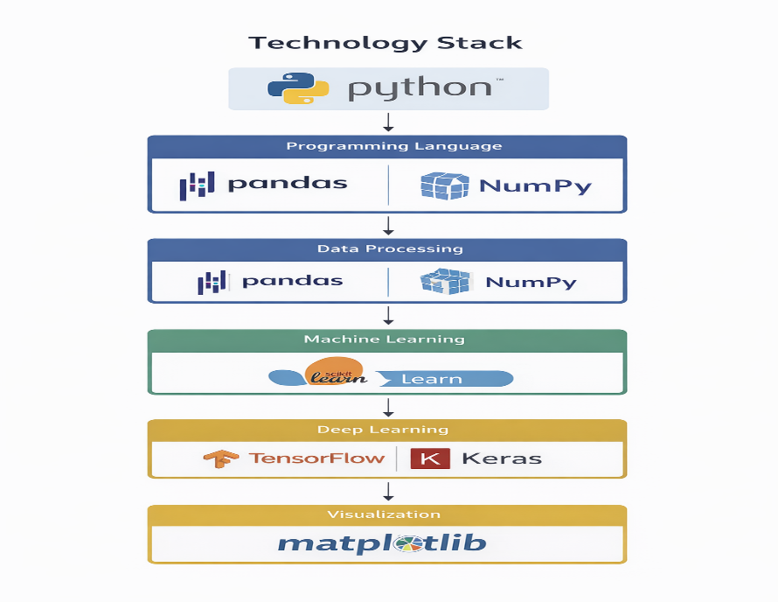
Technologies Used

Slide 9
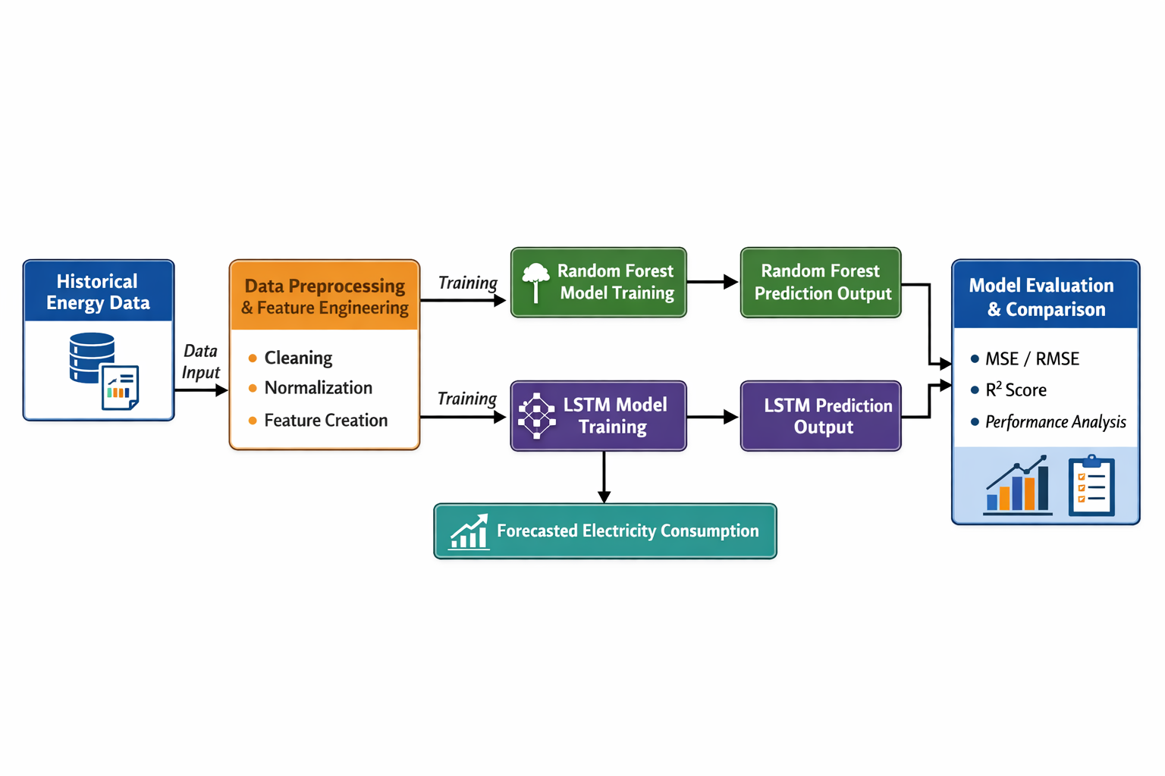
System Architecture

Slide 10
System Design (Algorithms)
Data Collection - Collect historical electricity consumption data from a reliable source.
Data Preprocessing - Clean the data, handle missing values, and convert timestamps into proper format.
Feature Engineering - Extract time-based features (day, month, weekday) and create lag features.
Data Splitting - Divide the dataset into training and testing sets.
Model Training - Train Random Forest and LSTM models using the training data.
Prediction - Generate future electricity consumption predictions using trained models.
Evaluation - Evaluate model performance using MSE, RMSE, and R² score.

Slide 11
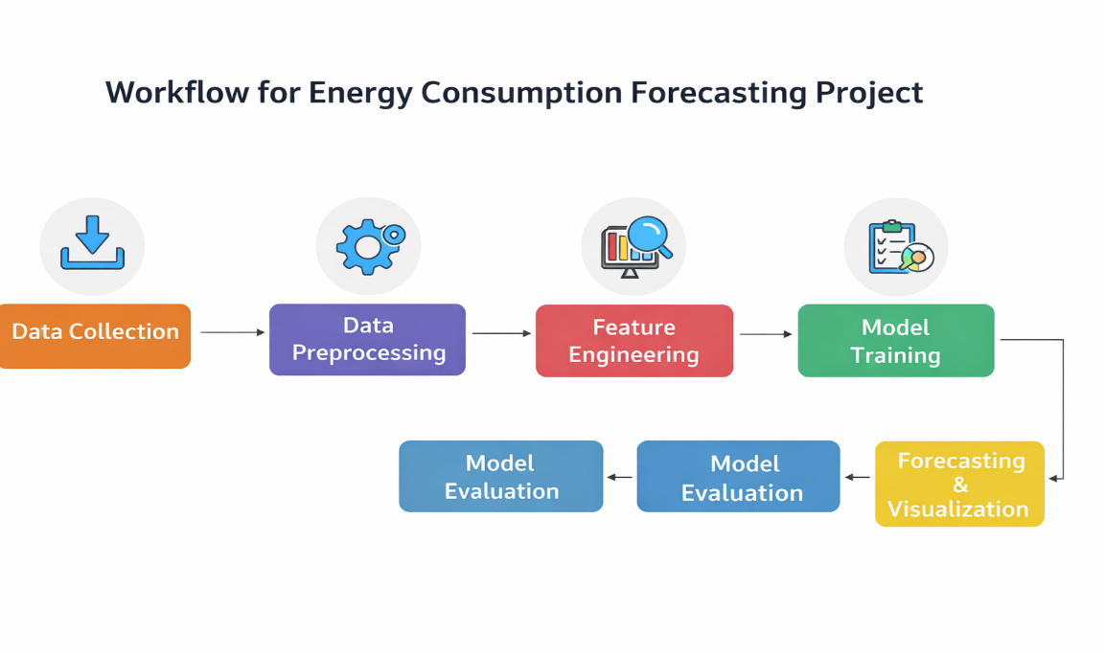
Model Flow

Slide 12
Dataset Description
Dataset contains historical electricity consumption data
Source: Fingrid (Finland electricity dataset)
Time range: 2016 – 2021
Total records: ~52,000+ entries
Data collected at hourly intervals
Main features: Timestamp and Consumption (MWh)
Type: Univariate time-series dataset

Slide 13
Data Preprocessing
Steps:
Load the dataset and understand its structure
Convert timestamp column into proper datetime format
Sort data in chronological order (time-series format)
Handle missing or null values (remove or fill)
Remove duplicates and inconsistent entries
Resample data if needed (hourly/daily format)
Normalize or scale data (for LSTM model)

Slide 14
Model Used
LSTM (Long Short-Term Memory)
Deep learning model for time-series data
Captures temporal (time-based) patterns
Provides higher accuracy in predictions
Random Forest
Machine learning algorithm
Handles nonlinear relationships
Provides stable and reliable predictions

Slide 15
Model Evaluation
Performance Metrics:
Mean Squared Error (MSE) - Measures average squared difference between actual and predicted values
Root Mean Squared Error (RMSE) - Square root of MSE, shows error in actual units
R² Score (Coefficient of Determination) - Measures how well the model fits the data (closer to 1 is better)

Slide 16
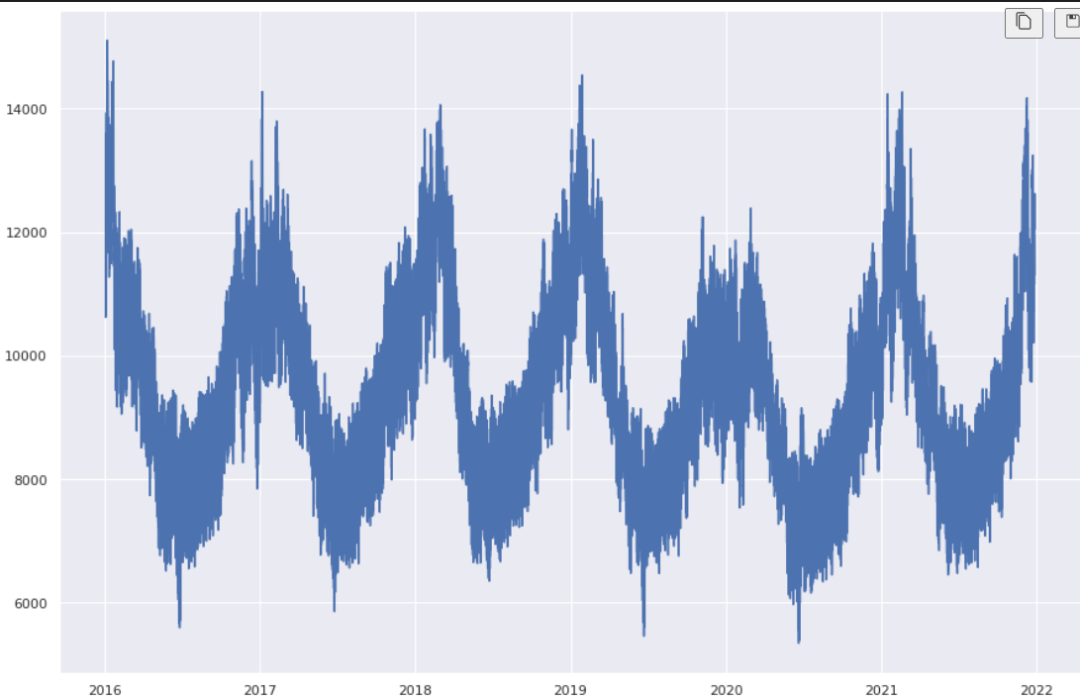
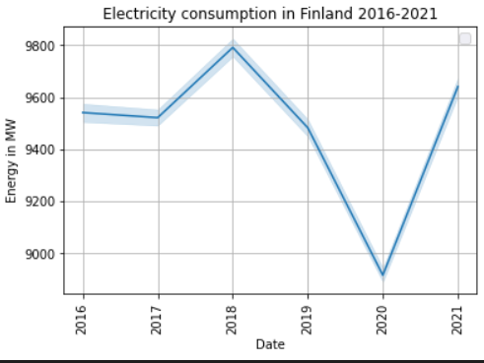
Visualization
Electricity Consumption Over Time (2016–2021)
Year-wise Average Electricity Consumption

Slide 17
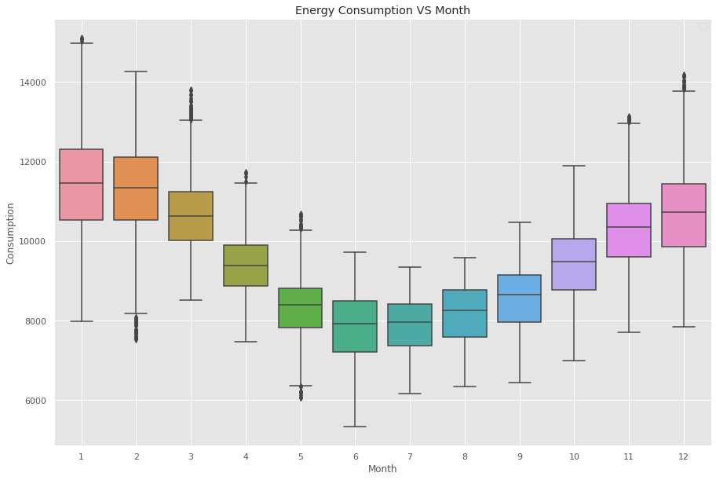
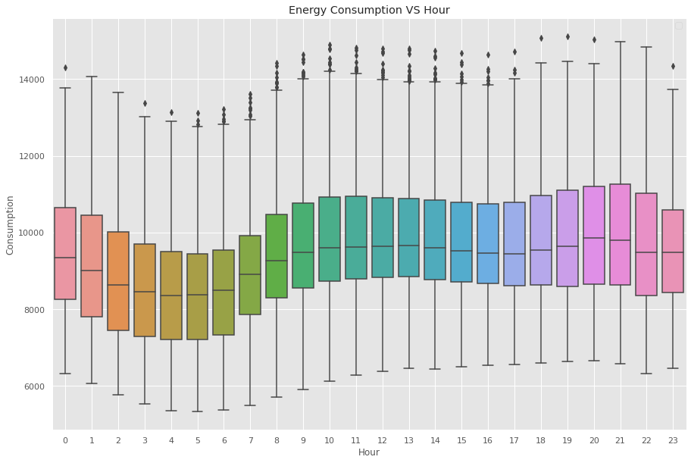
Visualization
Energy Consumption vs Month (Box Plot)
Energy Consumption vs Hour (Box Plot)

Slide 18
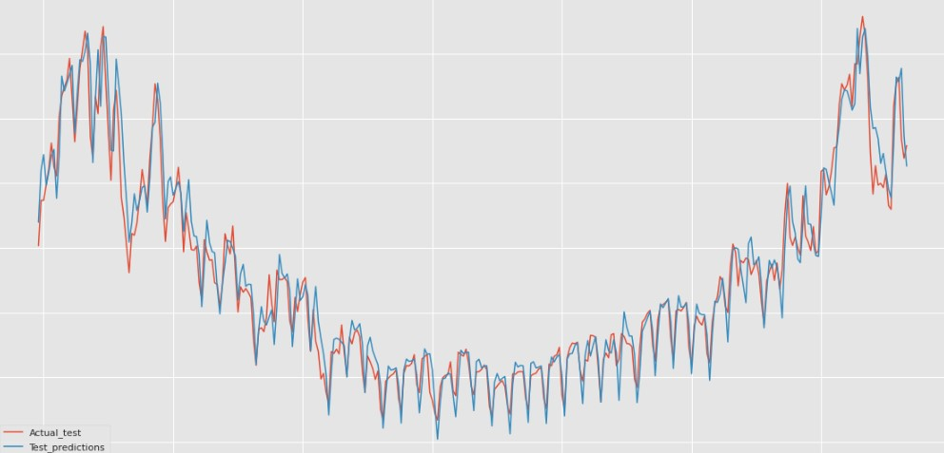
Results
The proposed ML and DL-based forecasting system shows improved performance over traditional methods
Random Forest R² ≈ 0.91 (good at capturing nonlinear patterns)
LSTM RMSE ≈ 0.08 (high accuracy in time-series prediction)
LSTM performs better in capturing temporal dependencies
Predictions closely match actual electricity consumption
Actual vs Predicted Electricity Consumption

Slide 19
Conclusion
Developed a forecasting system using Random Forest and LSTM
Successfully analyzed historical electricity consumption data
LSTM provided better accuracy by capturing time-based patterns
System helps in efficient energy planning and management

Slide 20
Future Scope
Integrate real-time data using IoT/smart meters
Include additional features like weather and user behavior
Use advanced models like Transformers
Develop a web/mobile dashboard for real-time monitoring

Slide 21
Thank You

