Slide 1
Synergy Raw Foods
Marketing Audit Presentation Deirdre Norgrove- 15343481

Slide 2



= Possible Recommendation
= Warning, needs improvement
= Done well

Slide 3
External ANALYSIS

Slide 4
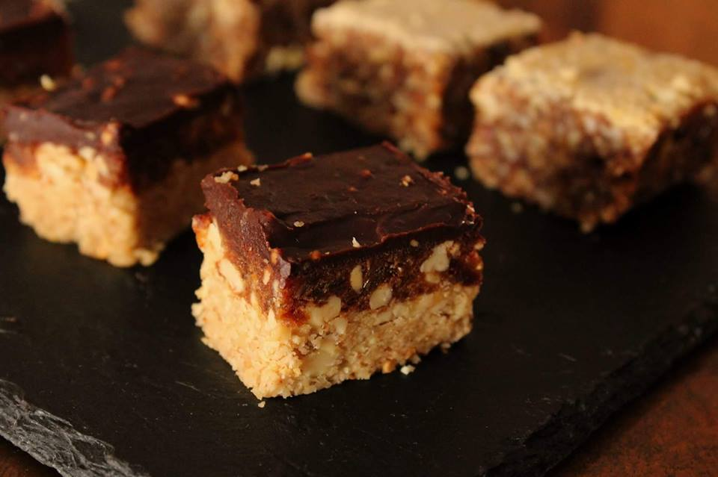
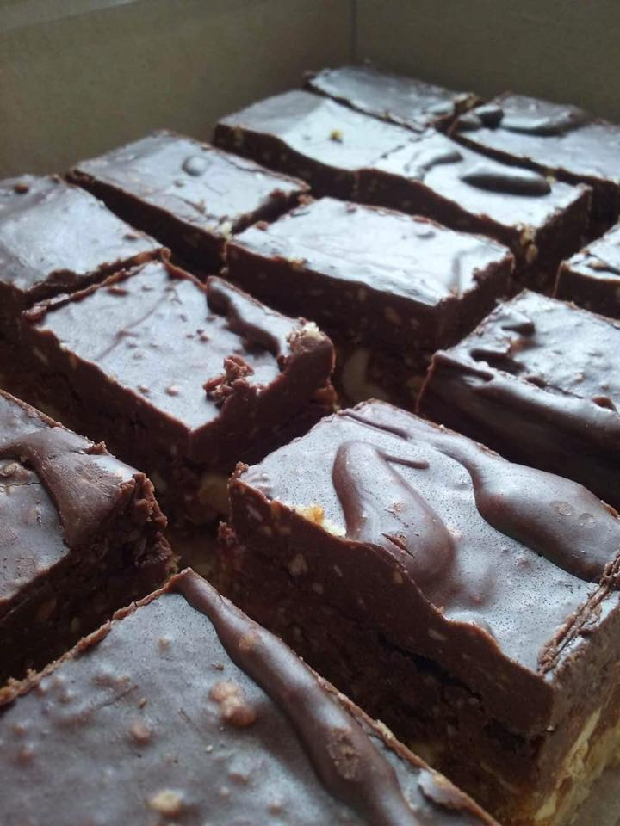
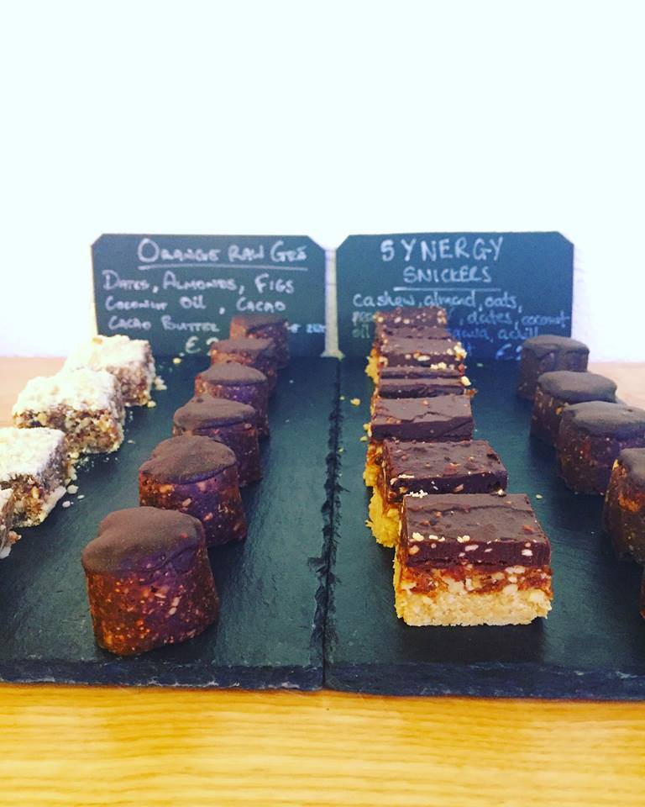
Introduction
“A local family run business making nutritious raw snacks and treats.”
RAW
Uncooked Unprocessed Organic
VEGAN
Plants
Plant-Based Products

Slide 5
PEST Analysis
P
S
T
Rise of subscription models and 3rd party delivery services (e.g. Deliveroo) in the industry (The Spoon, 2019)
Growing importance of health products in the snack/treat category (Bord Bia, 2018 )
E
Implementation of sugar tax will encourage consumers to go for healthier options (Safe Food, 2018 )
Irish Consumer Sentiment Index increase to 98.8, consumers more likely to purchase ‘luxuries’ (ESRI, 2019 )
Notes:
Sugar sweetened drinks tax comes into effect in the Republic of Ireland (2018). Available at: https://www.safefood.eu/Professional/Nutrition/Nutrition-News/Nutrition-News/May-2018/Sugar-sweetened-drinks-tax-comes-into-effect-in-th.aspx (Accessed: 26 February 2019).
ERSI (2019) Ireland Consumer Confidence | 2019 | Data | Chart | Calendar | Forecast. Available at: https://tradingeconomics.com/ireland/consumer-confidence (Accessed: 26 February 2019).
Bord Bia (2018) Snackification and healthy snacking trends gather momentum, Bord Bia. Irish Food Board. Available at: https://www.bordbia.ie/industry/manufacturers/insight/alerts/pages/snackificationandhealthysnackingtrendsgathermomentum.aspx (Accessed: 2 March 2019).
The Spoon (2019) Subscription Models Are the Future of Third-Party Food Delivery | The Spoon. Available at: https://thespoon.tech/subscription-models-are-the-future-of-third-party-food-delivery/ (Accessed: 2 March 2019).

Slide 6

Growing Market
“In the US sales of plant-based food went up by 8.1% in 2017 to $3.1 billion.” (Forbes, 2017)
“In Ireland 9 in 10 consumers note that they snack at least once per day.”
(Mintel, 2018)
“Plant-based dairy alternatives are expected to represent 40% of the combined total of dairy and dairy alternative beverages in the next few years.”
(Forbes, 2017)
“The number of people choosing a plant-based or vegan diet continues to grow exponentially. ” (Irish Examiner, 2019)
Notes:
Forbes (2017) Here’s Why You Should Turn Your Business Vegan In 2018. Available at: https://www.forbes.com/sites/katrinafox/2017/12/27/heres-why-you-should-turn-your-business-vegan-in-2018/#7f6d28ae2144 (Accessed: 2 March 2019).
Mintel (2018) Ireland Consumer Snacking Habits Market Report (Updated 2018) | Mintel.com. Available at: https://store.mintel.com/ireland-consumer-snacking-habits-market-report (Accessed: 2 March 2019).
Irish Examiner (2019) Darina Allen’s top food trends for 2019. Available at: https://www.irishexaminer.com/breakingnews/lifestyle/foodanddrink/darina-allens-top-food-trends-for-2019-896785.html (Accessed: 2 March 2019).

Slide 7
Competitor Strength Analysis
Company | Cost of Unit | Stockists | Strategic Focus | Advertising & Promotion
Synergy Raw Foods | €2.55 | Artisan Cafés Gyms | Unclear | Social Media
Jo’s Absolute Nutrition | €2.75 | Supermarkets Online Cafés Gyms Avoca | “We're big on taste and we promise to satisfy your sweet tooth 'the natural way' whilst fueling your body.” (Absolute Nutrition, 2019) | Website Social Media In-store
Natasha’s Living Foods | €1.80 | Supermarkets Online Cafés Food Markets | Powered by Plants | Social Media
Notes:
Absolute Nutrition | Protein Snacks | Superfoods (2019). Available at: https://www.absolutenutrition.ie (Accessed: 2 March 2019).

Slide 8

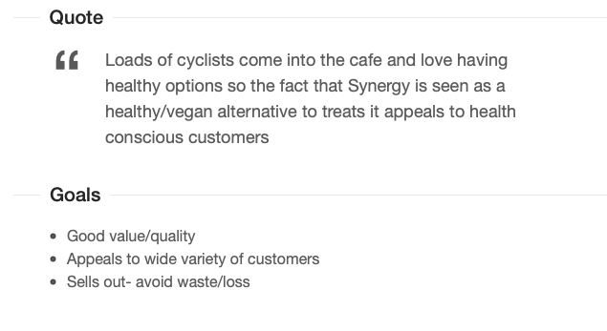
Café Buyer
Currently stocking Synergy
Age: 30
Occupation: Café Owner
Location: Skerries, Co. Dublin
Income: Full-time

Slide 9
Internal ANALYSIS

Slide 10

RESOURCES
FINANCIAL
HUMAN
INFORMATION
SUPPLY
€0 Marketing Budget | One Part-Time employee | No CRM system | Expensive ingredients imported
Profitable | Customer loyalty (local/family ran business) | No Website/Database | Bio-degradable packaging sourced from Cork
Funded through company profits | Contacts within Target Market (Founder also works in a gym) | Good relationship with buyers (receive information from them)
Distribution and Merchandising costs €105.00 per week (1 day’s work) | Need additional team member in order to grow business
Costly to
Imitate

Slide 11
Marketing AUDIT
Marketing Strategy | No Value Proposition | No Mission Statement | No Website where Mission, Values, Products etc. can be displayed | Social media (Instagram and Facebook) currently under utilised
Marketing Systems | No formal customer research | No CRM system in place | No Marketing Objectives
Marketing Organisation | Nobody on team with Marketing expertise | Marketing is seen as an ‘unessential’ task | Business doesn’t have capacity to facilitate demand that Marketing could generate
Marketing Productivity | Interactive followers on Facebook (positive reviews and comments)

Slide 12
Marketing Mix Effectiveness
Product | Price | Place | Promotion
Wide selection of loose bites, tray bakes, cakes e.g. wedding on request | Price reflects luxury product made with premium ingredients | Minimal Facebook & Instagram posting | No clear promotional strategy
Innovation in form of seasonal products (Christmas puddings) | Same price ran across all outlets | No major investment into any form of marketing or advertising | Trade Shows attended but of no success
Attention paid to serving size and nutritional value |  |  | Promotions could damage ‘premium’ image
Ethical product with Fairtrade ingredients, bio-degradable packing & handmade

Slide 13
Brand Report Card
Is the brand…
Delivering benefits customers desire? | Growing demand for Vegan/Raw products. Ahead of curve.
Relevant? | Raw/Vegan option for those following diet or just health conscious consumers
Priced correctly based on the consumer’s perception of the brand? |  | Labour time/cost not taken into account (yet emphasises hand-made)
Properly Positioned? | Luxury product in Artisan Cafés and established Gyms.
Consistent? |  | Social Media consistency could be improved. No website currently.

Slide 14
SWOT
Strengths | Weaknesses
Premium Product- High Margins Competitively Priced Health benefits of product; Protein, Sugar Free Beautifully packaged emphasises hand-made Ethical company (ingredients, packaging) | High Cost Premium ingredients Small team limits growth Chilled product – logistical weakness in transporting, storage and stocking product Educating people on the product
Opportunities | Threats
Growth in health snacks & food industries in the global market One of few in Irish Market | ‘Own-shop’ Products Competition from several other established Raw manufacturers

Slide 15

KEY ISSUES
Not taking advantage of huge market potential
Small team limits possibility of growth
Most time spent preparing and distributing product, marketing neglected
Not showcasing the unique qualities of product to full potential
Notes:
“did really good job of highlighting”

Slide 16
Bibliography
Absolute Nutrition | Protein Snacks | Superfoods (2019). Available at: https://www.absolutenutrition.ie (Accessed: 2 March 2019).
Bord Bia (2018) Snackification and healthy snacking trends gather momentum, Bord Bia. Irish Food Board. Available at: https://www.bordbia.ie/industry/manufacturers/insight/alerts/pages/snackificationandhealthysnackingtrendsgathermomentum.aspx (Accessed: 2 March 2019).
ERSI (2019) Ireland Consumer Confidence | 2019 | Data | Chart | Calendar | Forecast. Available at: https://tradingeconomics.com/Ireland/consumer-confidence (Accessed: 26 February 2019).
Forbes (2017) Here’s Why You Should Turn Your Business Vegan In 2018. Available at: https://www.forbes.com/sites/katrinafox/2017/12/27/heres-why-you-should-turn-your-business-vegan-in-2018/#7f6d28ae2144 (Accessed: 2 March 2019).
Irish Examiner (2019) Darina Allen’s top food trends for 2019. Available at: https://www.irishexaminer.com/breakingnews/lifestyle/foodanddrink/darina-allens-top-food-trends-for-2019-896785.html (Accessed: 2 March 2019).
Mintel (2018) Ireland Consumer Snacking Habits Market Report (Updated 2018) | Mintel.com. Available at: https://store.mintel.com/ireland-consumer-snacking-habits-market-report (Accessed: 2 March 2019).
Safe Food (2018) Sugar sweetened drinks tax comes into effect in the Republic of Ireland. Available at: https://www.safefood.eu/Professional/Nutrition/Nutrition-News/Nutrition-News/May-2018/Sugar-sweetened-drinks-tax-comes-into-effect-in-th.aspx (Accessed: 26 February 2019).
The Spoon (2019) Subscription Models Are the Future of Third-Party Food Delivery | The Spoon. Available at: https://thespoon.tech/subscription-models-are-the-future-of-third-party-food-delivery/ (Accessed: 2 March 2019).

