Slide 1
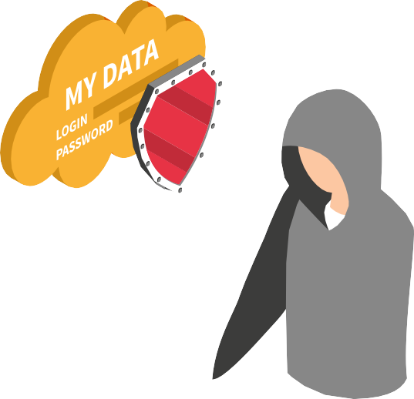
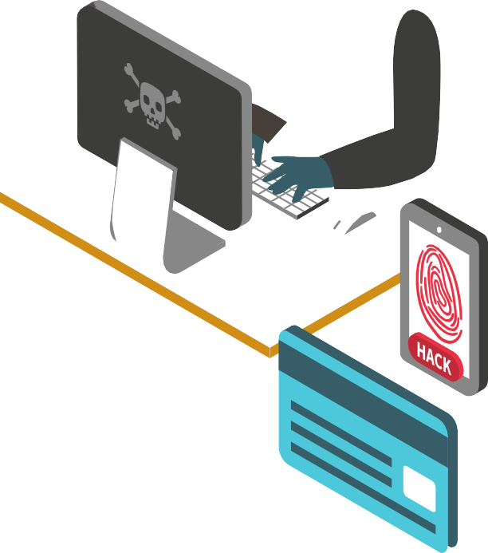
Vulnerability
Report
Security Evaluation on the project of Team3 by Team2(SHEILD)

Slide 2
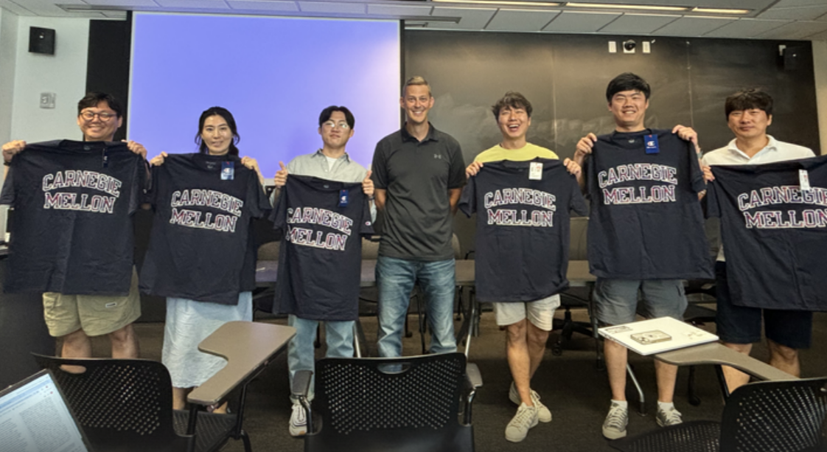
Team members and evaluation plan

Slide 3
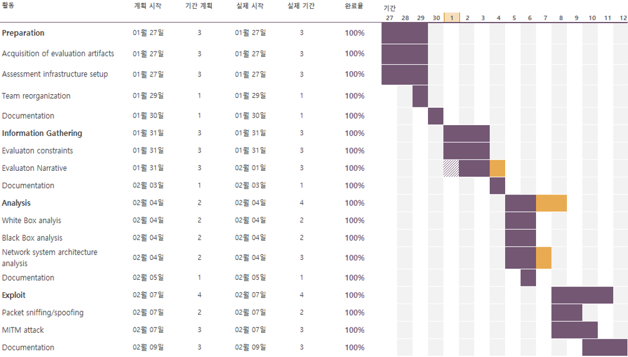
Team members and evaluation plan
Team Member | Role | Schedule
Jin Woo Kim | Project Management, Network system architecture analysis
Nam Il Lee | White Box Analysis (Static Analysis)
Se Han Yoon | Black Box Analysis (Fuzzing Test)
Jang Hyun Ko | System & Security architecture analysis
Hoon Min Lee | Network system architecture analysis
Ji Hyun Jang | Network system architecture analysis
David Belasco | Mentor

Slide 4

Contents
GATHERING
INFORMATION
EXPLOIT
Q&A
1
2
3
4
5
ANALYSIS
CONCLUSIONS

Slide 5



1.Gathering Information
System Configuration
Simple System diagram
This is a simple diagram to understand the relationship between components.
The 2FA part for Admin authentication is omitted.(etc. Google OTP)
After Admin authentication, user account management is possible through the Cockpit Webpage.
The supplied OpenVPN, PAM, and Cockpit SW are widely used open sources.
App.
(client)
OpenVPN
Network
User
RSA Keys
WiFi
Network
PC
Rasp.
WiFi
Network
PAM
DemoCannon
(server)
OpenVPN
Network
Robot

Slide 6
1.Gathering Information
Evaluation Constraints
1. Secure Communication
Using OpenVPN's strong encryption and secure protocol, Sniffing and spoofing from external access is significantly prevented:
Provides a secure network environment for the IP (server IP) requesting connection
Strong Encryption: Supports TLS 1.3 protocol to apply RSA-2048 and AES-256 encryption
Secure protocol: Prevent Replay attacks with a protocol using sequence numbers
App.
(client)
OpenVPN
Network
IP Address
User
RSA Keys
WiFi
Network
PC
Rasp.
WiFi
Network
PAM
DemoCannon
(server)
OpenVPN
Network
Robot

Slide 7

1.Gathering Information
Evaluation Constraints
2. User Authentication and Management
A strong authentication mechanism by PAM make difficult to takeover account or unauthorized access
PAM allows for multiple user authentication methods, locking accounts based on number of failed attempts, and enforcing strong password policies.
App.
(client)
OpenVPN
Network
ID/PW
User
Untrusted
RSA Keys
WiFi
Network
PC
Rasp.
WiFi
Network
PAM
With these two constraints, we focused on only
server and client applications,
key management,
and, network configurations
Pass/Reject
DemoCannon
(server)
OpenVPN
Network
Robot

Slide 8
Evaluation Narrative
1.Gathering Information
Decide which elements to evaluate
Static Code Analysis and Fuzzing to find issues not discovered due to SonarQube(team3 used) rule coverage limitations
Secure data transmission of the client or server application
Secure storing certificate and private key for TLS connection
Network configurations for OpenVPN
Select security evaluation techniques
Wireshark, tcpdump : Network Traffic Analysis
Boofuzz : Network Fuzzer Testing
Zmap : network scanning tool that scans port -> No open ports found
clang-tidy : Static Code Analysis
ZAP : Web application(Cockpit) security testing tool

Slide 9
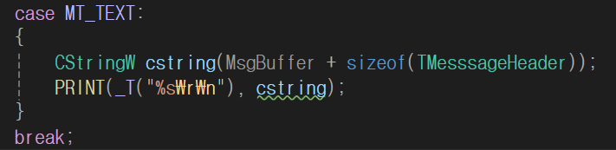
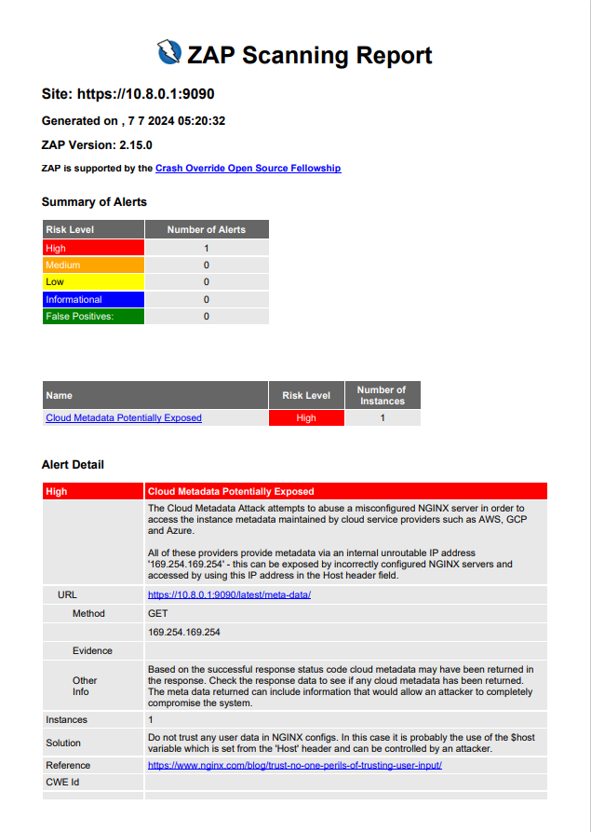
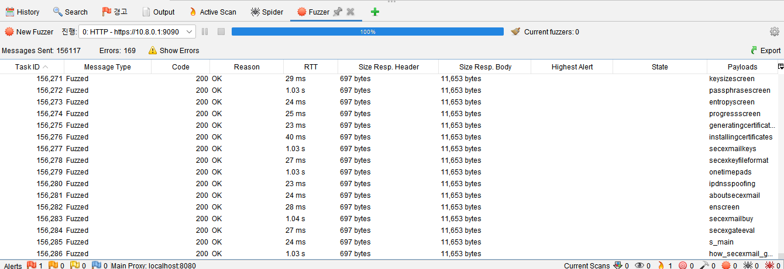
Tool Analysis
2.Analysis
1.Static Analysis(with clang_tidy)
3 errors were found.
Client.cpp 395 lines : Format string vulnerability
The other two are not critical but recommended for improvement.
It is possible to print internal stack memory using
MT_TEXT message.
2.OWASP ZAP Scanning Attack
ZAP scan reported 1 high level risk, but it was a misdetection of tool.
Web application(Cockpit)
3.OWASP ZAP Fuzzing Test
ZAP fuzzer tried 156,117 fuzzing test,
but there was no crash and no successful injection attack.
Web application(Cockpit)

Slide 10

Data transmission
2.Analysis
Insecure data transmission at the client side
As seen with the constraints, the connection between the server-side OpenVPN and client-side OpenVPN is highly secured. But..
App.
(client)
OpenVPN
Network
Trusted User
Communication between the client application and the OpenVPN network is in plaintext and lack of mutual authentication.
Sniffer
WiFi
Network
Untrusted
PC
Rasp.
WiFi
Network
-> Anyone can sniff the data or send commands by packet spoofing.
Conditions :
1. Trusted user is connected to VPN
2. Untrusted user can access PC
DemoCannon
(server)
OpenVPN
Network
Robot

Slide 11
Storing certificate and key
2.Analysis
Insecure storing certificate and private key
App.
(client)
OpenVPN
Network
OpenVPN uses TLS to perform authentication of the server and client in order to establish a secure channel.
However, the client certificate and private key used for TLS authentication are exposed.
User
Copy,replace
WiFi
Network
Untrusted
PC
-> Anyone can perform a man-in-the-middle (MITM) attack using a fake CA certificate.
Conditions :
1. Trusted user is connected to VPN
2. Untrusted user can access client PC
Rasp.
WiFi
Network
PAM
DemoCannon
(server)
OpenVPN
Network
Robot

Slide 12

Storing certificate and key
2.Analysis
Insecure storing certificate and private key
App.
(client)
OpenVPN
Network
OpenVPN uses TLS to perform authentication of the server and client in order to establish a secure channel.
However, the client certificate and private key used for TLS authentication are exposed.
User
WiFi
Network
PC
-> Anyone can perform a man-in-the-middle (MITM) attack using a fake CA certificate.
Man in the Middle
Rasp.
Untrusted
Conditions :
1. Trusted user is connected to VPN
2. Untrusted user can access client PC
WiFi
Network
PAM
DemoCannon
(server)
OpenVPN
Network
Robot

Slide 13
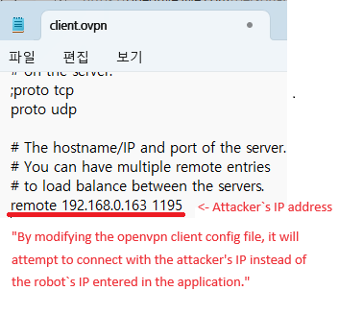
Network configuration
2.Analysis
IP Tables
1.Insecure server authentication
target prot opt source destination
--------------------------------------------------------------------------------------
ACCEPT tcp -- 10.8.0.0/24 anywhere tcp dpt:5000
User authentication is simply replaced with an IP table(OpenVpn IP band). There are No user authentication in server application
-> Anyone can connect to the server and transmit packets by IP spoofing
Client
Server
Can't Connect
eth0 interface:
- ip: 192.168.0.224
eth0 interface:
- ip: 192.168.0.248
vpn interface:
- ip: 10.8.0.5
vpn interface:
- ip: 10.8.0.1
Conditions :
1. Untrusted user already known VPN IP address
Connect
2.Exposed OpenVPN configuration
The file for OpenVPN configuration is exposed.
-> Anyone can forcefully change the target network
IP and port of the Open VPN connection.

Slide 14


3.EXPLOIT
Vulnerabilities
Packet sniffing/spoofing
Sniffing transmitted data and sending a fire command by untrusted user
MITM attack
Intercepting the communication between two parties and sending commands by untrusted user.
Client IP spoofing
Establishing a TCP connection with an untrusted user

Slide 15
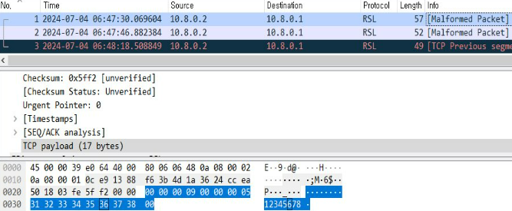
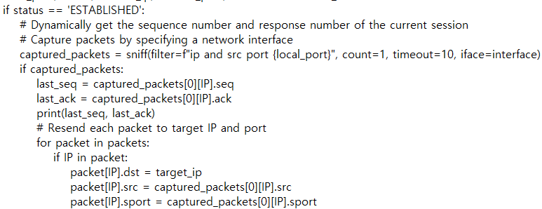
3.Exploit
Exploit via Packet sniffing/spoofing
1.Sniffing transmitted data
Transmitted data in plaintext on the client PC using Wireshark.
And, also you can see the addresses and ports for the TCP connection.
#1. Pre-Arm
#2. Armed Manual
#3. Fire
#1. Pre-Arm packet payload
Wireshark in client PC
2.Sending these 3 packets to fire
Real-time sniffing of seq_num and ack_num of the TCP connection and sending of captured messages is possible.
Python code for sending packets

Slide 16
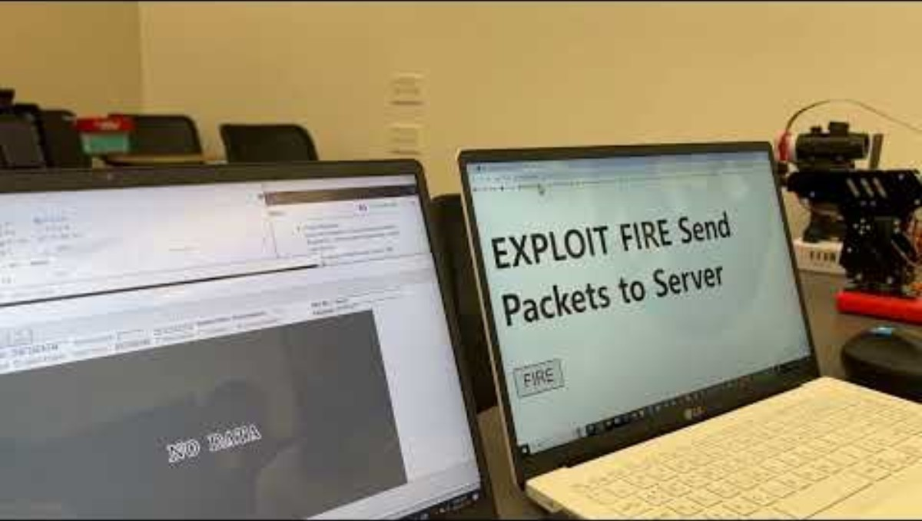
Exploit via Packet sniffing/spoofing
3.Exploit
https://youtu.be/oly2VFk9DJY

Slide 17
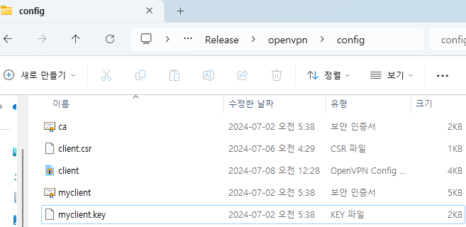
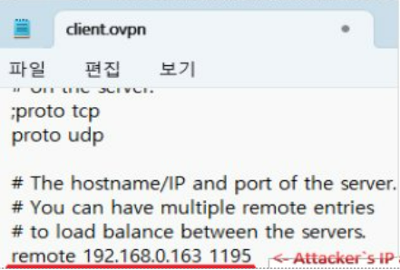
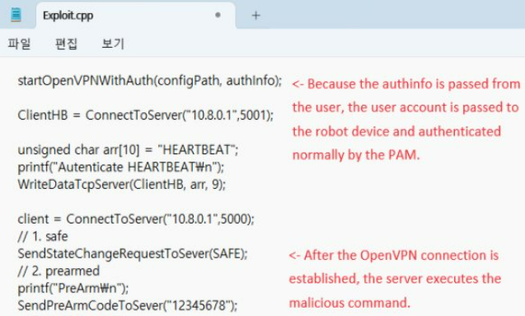
Exploit via MITM attack
3.Exploit
1.Replacing certificates and key on client
Copy the certificate and key on the client, and replace them with others.
It makes the client to spoof authentication with the middle server.
2.Modifing OpenVPN configuration file in client.
Modify the OpenVPN configuration file on the client.
This allows ignoring the user's IP input and connecting to the middle server's IP.
3.Forwarding user login to establish OpenVPN connection
By forwarding the user ID and password, the connection can be established.
After that, the middle server can intercept all communications or send any messages.

Slide 18
Exploit via MITM attack
3.Exploit
User Device : 192.168.0.123
Robot Device : 192.168.0.248
PAM
Robot
Input:
192.168.0.248
id : trust
pw : trust123!@#
Application
Fake key
Fake key
Exploit
Program
Connect Request
192.168.0.248
id : trust​
pw : trust123!@#
Pass
OpenVPN Network(C)
OpenVPN Network(S)
OpenVPN Network(C)
OpenVPN Network(S)
Connect Request
192.168.0.163:1195
Attacker Device : 192.168.0.163
Connect Request
192.168.0.248:1194
Config. file

Slide 19
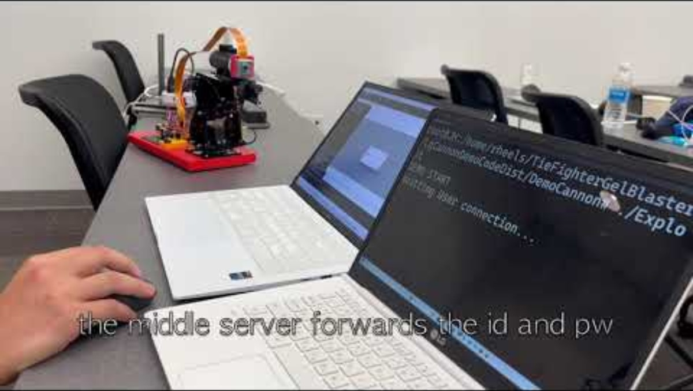
Exploit via MITM attack
3.Exploit
https://youtu.be/5gz9pafMpxQ

Slide 20
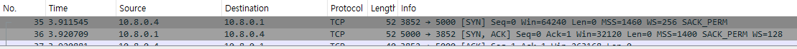
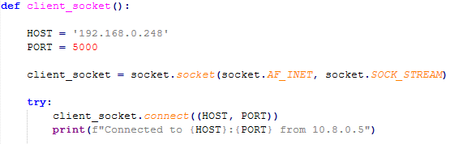

Exploit via IP Spoofing
3.Exploit
Establishing a TCP connection with an untrusted user
1. Check the server connection port on the client.
2. Change the attacker's address to the IP band used by OpenVPN.
3. Create a new client and try to connect to the server.
※ Connected to the address assigned by AP using the 10.8.0.X IP

Slide 21
Conclusions and Recommendations
4. Conclusions
Vulnerability | Mitigation Strategy
Lack of encryption and authentication between endpoints | Use TLS to communicate securely between the client application and server application.
Exposed certificates and keys | Store keys in secure Storage rather than a regular filesystem
Insecure configuration files | Ensure the integrity of some configuration files using hash

Slide 22
Lessons Learned
4. Conclusions
Although the effective use of open source is impressive, vulnerabilities still exist.
Sharing other people's opinions and various opinions is effective in improvement of security.
It is important to have experience with a variety of analysis tools.
Key protection is always important.
With importance of secure software training, the need for a security mindset has been highlighted.

Slide 23

THANKS
DO YOU HAVE ANY QUESTIONS?

Slide 24
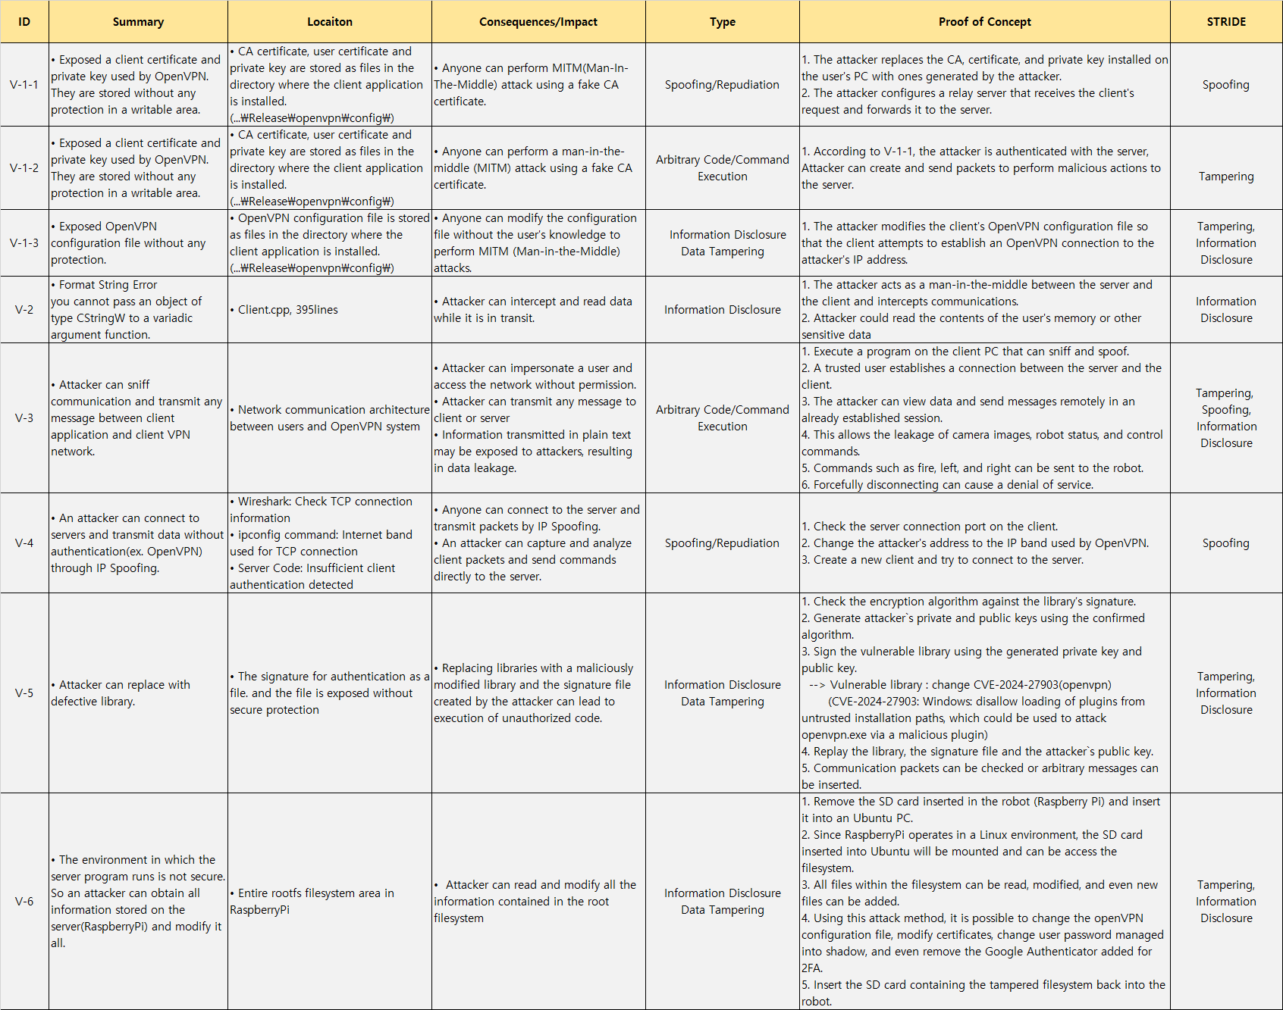
VULNERABILITY REPORT
Appendix

Slide 25
OWASP ZAP ATTACK
Appendix
Information Gathering
Vulnerability Detection
ZAP intercepts and analyzes requests and responses to gather information about the target web application's structure and vulnerabilities.
ZAP identiﬁes various security vulnerabilities such as SQL injection, cross-site scripting (XSS), cross-site
request forgery (CSRF), authentication and session management ﬂaws.
Scanning
Attack Simulation​
ZAP offers automated scanning capabilities to search for vulnerabilities in the target web application using different attack techniques.
ZAP simulates various attack techniques to test the security strength of the web application, helping developers and security teams identify and address weaknesses.
Alert type | Risk | Count
Cloud Metadata Potentially Exposed | High | 1(100%)
ZAP scan reported 1 high level risk, but it was a misdetection of tool.
Because https://10.8.0.1:9090/latest/meta-data/ responds 200 OK even if it is not an exist page.

Slide 26
OWASP ZAP FUZZING TEST
Appendix
Automation
Random
Crash
Injection
ZAP automates the process of sending various inputs to the target application, systematically testing different scenarios to discover vulnerabilities automatically.
ZAP generates random inputs and sends them to the target application, aiming to uncover unexpected behavior or vulnerabilities caused by unexpected data.
In the context of FUZZING TEST, ZAP attempts to identify input combinations that can cause the target application to crash, hang, or become unresponsive, revealing potential stability or robustness issues.
ZAP injects malicious or unexpected input values into user inputs, headers, or other parts of the request, aiming to identify vulnerabilities like SQL injection, command injection, or other
injection-related ﬂaws in the target application's handling of user input.
ZAP fuzzer tried 156,117 fuzzing test, but there was no crash or successful injection attack.

Slide 27
ZMAP – Port scan
Appendix
Zmap Command
$> sudo zmap -p 0-65535 -w target.txt --output-module=csv -o port_scan_result.csv --output-fields=saddr,daddr,sport,dport,success --output-filter="success=1 && repeat=0"
Result
port_scan_result.txt
saddr,daddr,sport,dport,success
Can't find any open ports via zmap.

