Slide 1
Superstore Sales:
A Customer Segment Analysis
April 20, 2020
CSDA 1050 Group 2

Slide 2
Agenda
Introduction
Stakeholders
Problem Statement
Value Proposition
Deliverables
Data Understanding
Customer Segment
Insights and Recommendations

Slide 3
Introduction
AnalytIQ is a consulting firm hired by the Superstore to deliver actionable insights to assist the organization in optimizing their promotional, planning and overall supply chain management to increase competitiveness in the marketplace.

Slide 4
Stakeholders
Stakeholder | Value of Analysis
Supply Chain | Develop concise, strategic plans and goals based on sound metrics
Marketing | Employ marketing tactics based on metrics, analysis of past performance and strategy
Logistics | Streamline logistics & warehouse operation, reduce cost & errors, and achieve a higher perfect order rate
Merchandise Financial Planning & Procurement | Increase profit with better planning and buying; set sales, margin and inventory targets based on analysis
eCommerce | Better understanding of trends and market segments, ability to cross-promote products

Slide 5
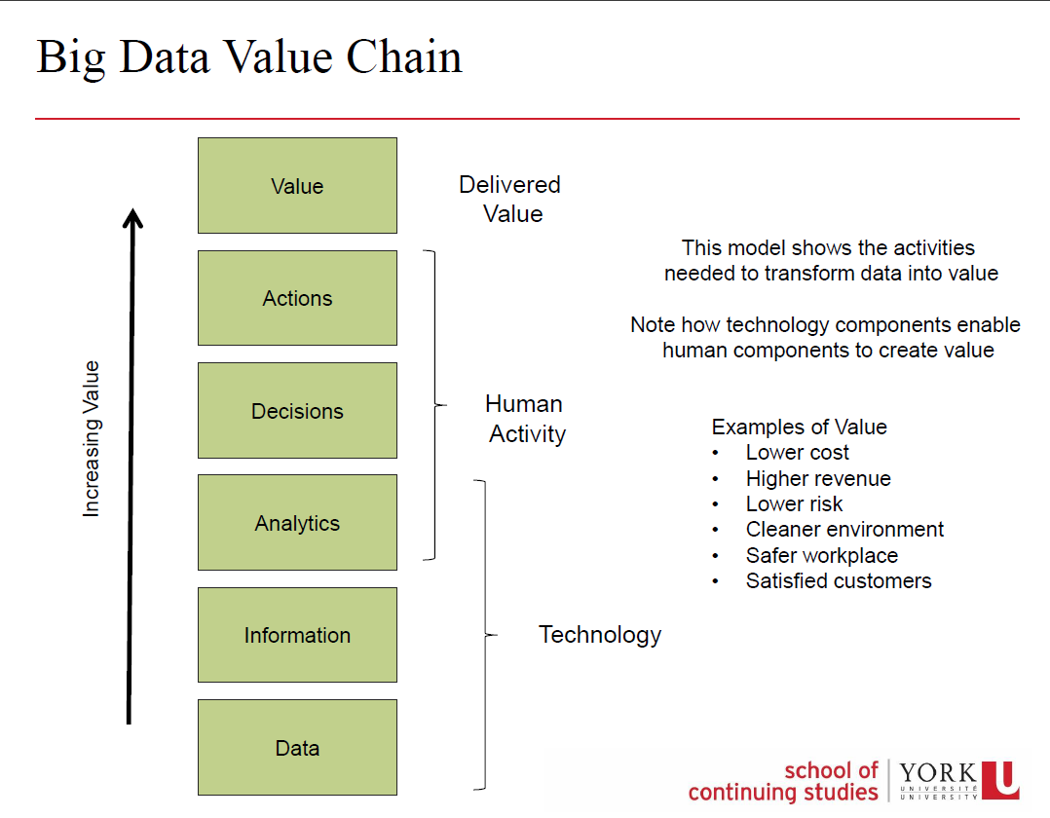
Problem Statement
How can the data provided be broken down by customer segments that will yield value?

Slide 6
Value Proposition:
Transform data into value based insights, in order to increase revenues, offer new products and services, better balance supply and demand, optimize marketing offerings and increase customer engagement.

Slide 7
Data Understanding
Dashboard & Recommender System
Data Exploration
Data Modelling
Data cleaning, manipulation and visualization
Creation of new variables depending on the need
Giving shape to the data for Modelling
Association Rule Mining using Apriori Algorithm for Recommender System
Dashboard to be utilized by all departments to eliminate plan discrepancies and organizational silos
Recommender system will provide insights to customer preferences
Notes:
Hello everyone. Let’s now discuss the data. Our Data Understanding journey began with Data Exploration, Data Modelling which lead to the creation of the Dashboard and Recommender System Tools being delivered today.
Data Exploration typically consisted of cleaning the data, creation of new variables to find more insights into the data by creating visualisations. We also transformed the data to make it ready for the recommender system.
Our goal was to create a Recommender System that would help all the stakeholders to find products that are usually sold together so that procurement of those products is made optimal. The dashboard that we aimed to create is a tool for all the relevant departments to collaborate for understanding the business better and take actions and make decisions that help improve the revenue.

Slide 8
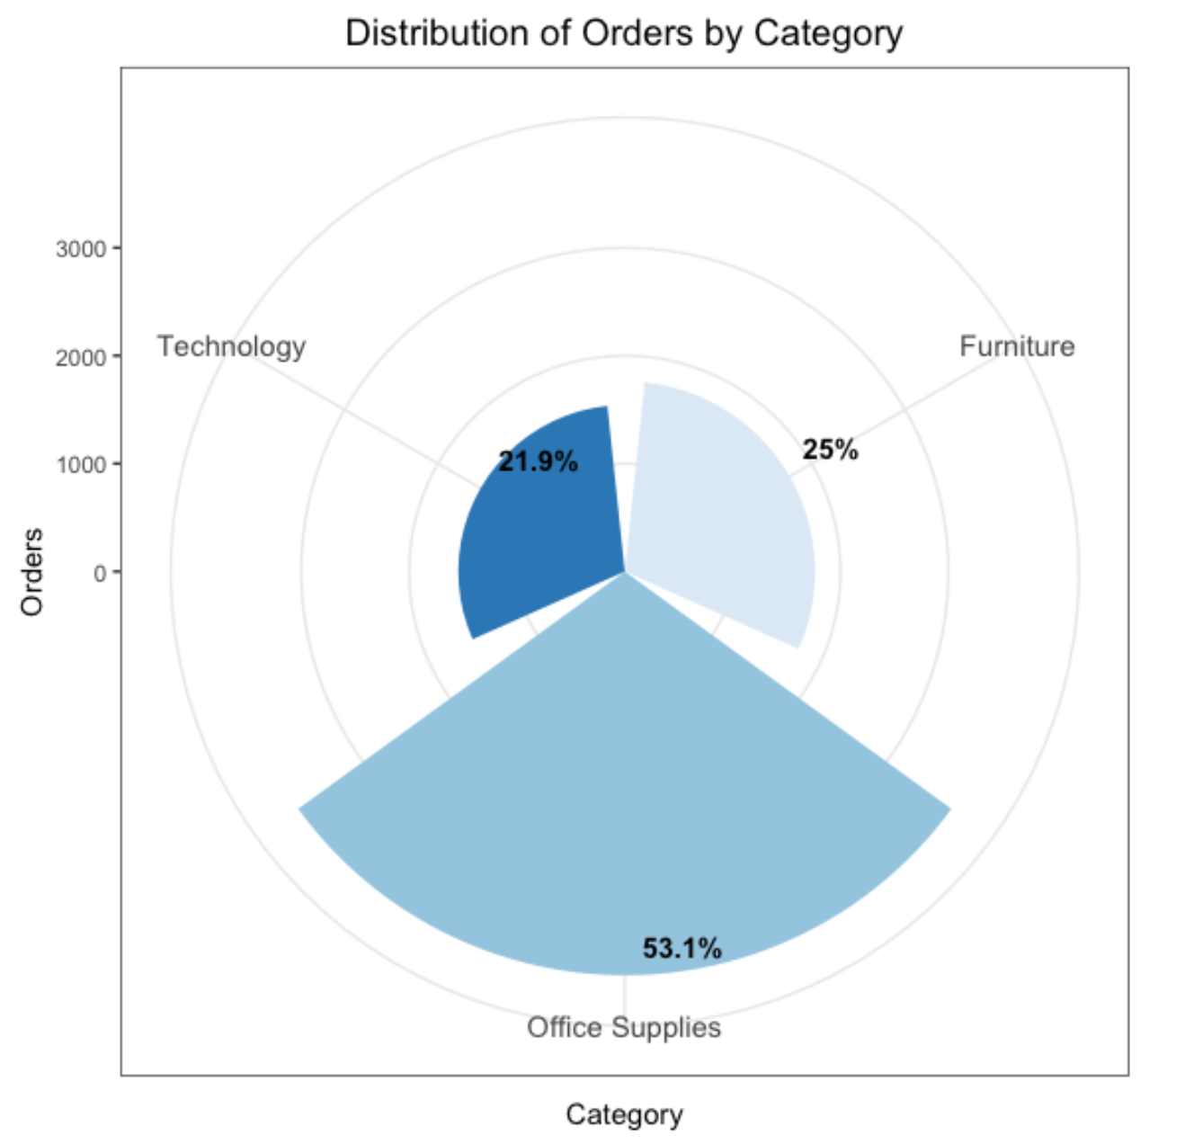
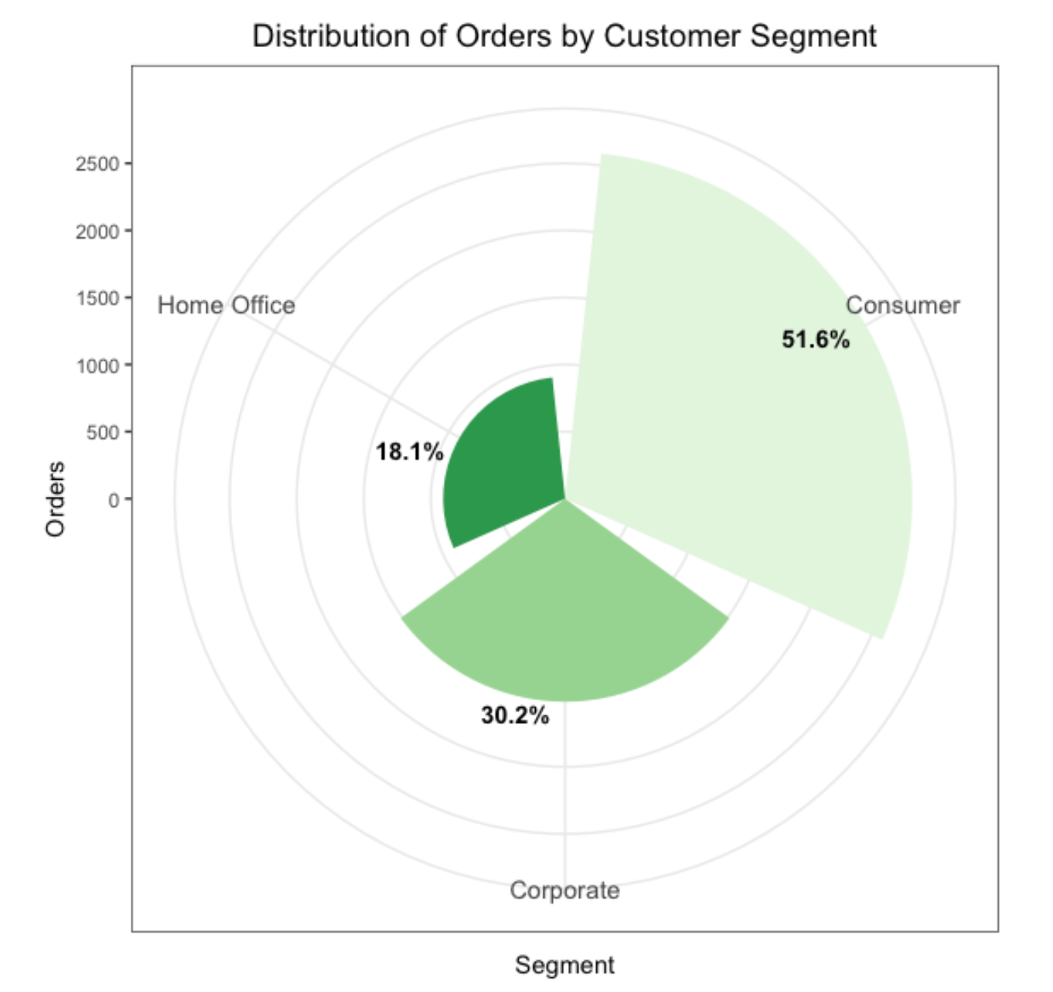
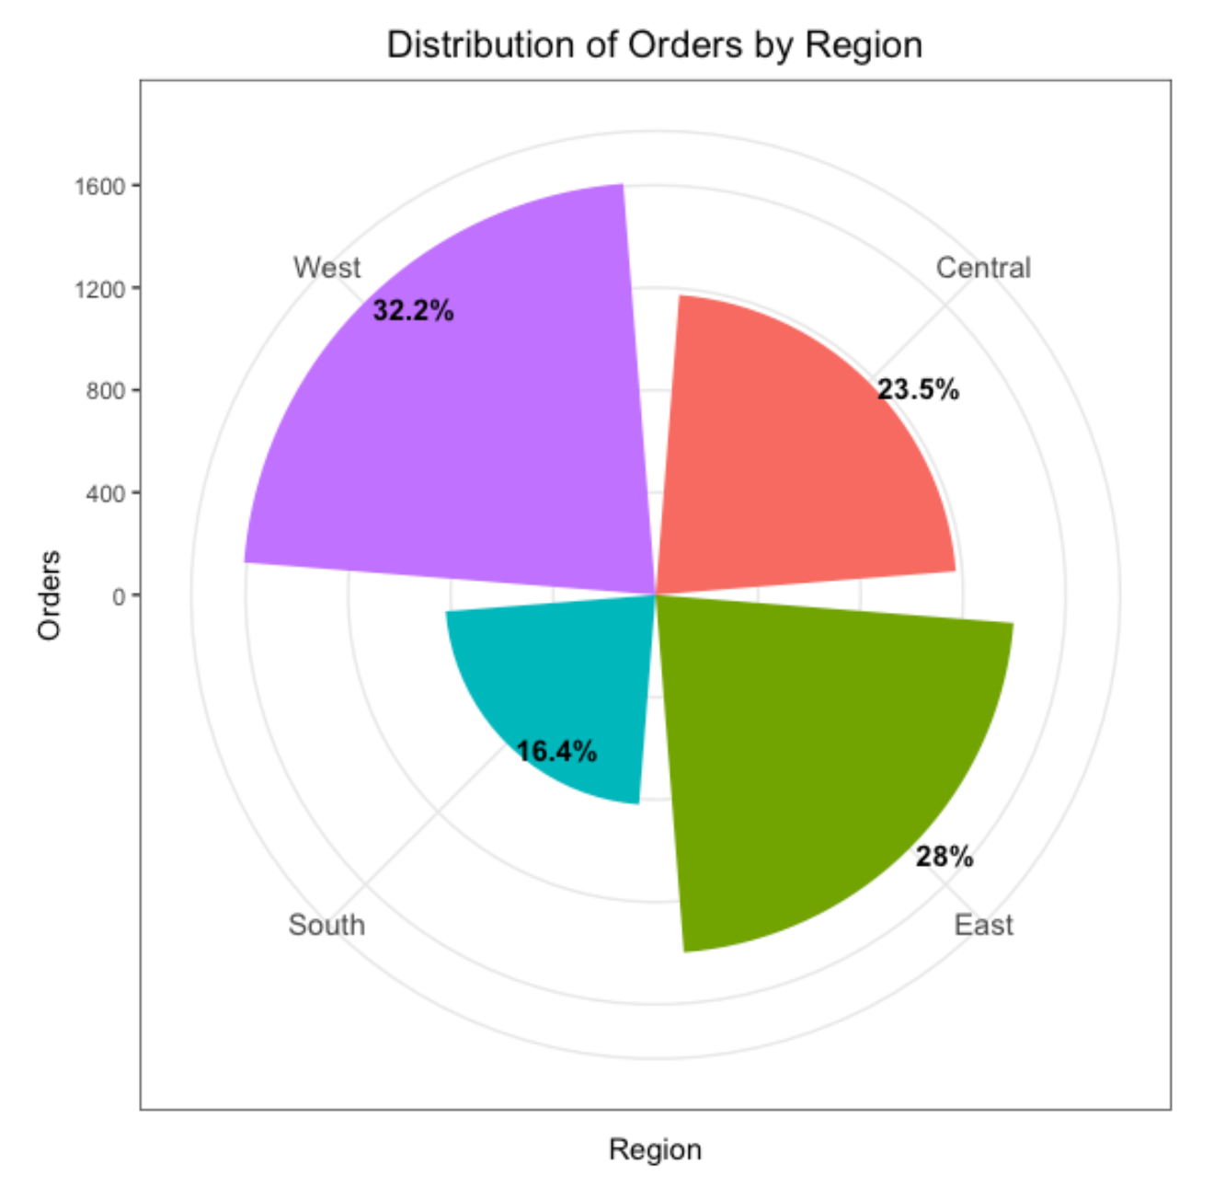
Customer Segments
Notes:
Another important part of our analysis was creation of the customer segments. We visualized the distribution of the orders according to different variables like Category, Segment and Region. We could see that Office Supplies had the largest share of all the orders with more than 50% orders, followed by Furniture and Technology.
While looking at the distribution of the orders according to the customer segment, we found that about half of the orders were from consumers followed by corporate orders and home office owners. When we looked at the distribution by region, the West and the East region not surprisingly contributed the most to the number of orders with smaller percentages from the Central and the South region of the United States.
Now, over to Deenu to talk about the Dashboard and the Recommender System...

Slide 9
Interactive Dashboard
To empower the marketing, product planning, and procurement teams in their decision making, we have developed an interactive dashboard which ingests the data near real-time, and display the live charts
Dashboard is designed to meet two purposes.
A descriptive dashboard to simulate the performance of various segments
A recommender system to show the consumer preference in buying products together
Dashboard is hosted on a secured Shiny (cloud platform) to simplify integration, improve agility, and ease the burden of implementation for Superstore IT resources.
Continue the product demo…
Notes:
Based on the data exploration and descriptive analysis, we were able to identify different segments and key variables that gave insight into how the organization is performing in each segment. The data provided had a great number of categorical variables. The inferences of modeling is derived from associative type algorithms which on one hand can predict a consumer behavior in buying the products together and on the other hand, allow buyers and planners to understand which items are purchased together to ensure they are also bought and stocked together.
Therefore, to empower the organization, we have developed an interactive dashboard which ingests the data near real-time, and display the live charts
The Dashboard serves two functions:
A descriptive dashboard to simulate the performance of various segments
A recommender system to show the consumer preferences and purchasing behaviours
Dashboard is hosted on a secured Shiny (cloud platform) to simplify integration, improve agility, and ease the burden of implementation for Superstore IT resources.
Continue the product demo…

Slide 10
Insights and Recommendations
In summary, the tools being delivered will facilitate the management of items that are key to achieving the value proposition AnalytIQ set out to deliver in this project:
Transform Superstore’s data into value based insights with the end goal:
to increase revenues
offer new products and services
better balance supply and demand,
optimize marketing offerings and,
increase customer engagement.
value value based insights, in order to increase revenues, offer new products and services, better balance supply and demand, optimize marketing offerings and increase customer engagement.
based insights, in order to increase revenues, offer new products and services, better balance supply and demand, optimize marketing offerings and increase customer engagement.
Notes:
-

Slide 11




The Team
Kaustubh Mulay
Deenu Yadav
Fanny Gauvera
Dave Delva

Slide 12
Deliverables
Deliverable 1
Cleansed and transformed data with automated scripts; ingest real-time data.
Deliverable 2
Detailed descriptive analysis on market segments to explore new potential opportunities.
Deliverable 3
Product recommender system to predict consumer behavior in buying products.
Deliverable 4
Self-serving dashboard to see real-time segment trends, performance and consumer preferences.

