Slide 1

BTech Integrated Final Presentation (Sem X) 2021-2022 Project Title: Panacea
Presented by :
-Pannag Shah, C066,
-Deep Shah, C070,
-Samit Shah,C072,
-Dev Dhawan, C088
Under the guidance of :
Prof. Sofia Francis

Slide 2
Introduction
Panacea, is a Greek word that means to cure all diseases and prolong life indefinitely.
Electronic healthcare technology is widespread worldwide and offers enormous potential for improving clinical outcomes and transforming care delivery.
Our project is an Advanced and secured AI-Blockchain powered EHR system aimed to enhance the existing healthcare system helping the medical professionals to cure patients.

Slide 3

Problem definition
Many medical institutions and hospitals communicate through existing electronic health records (EHRs) to obtain observations, diagnosis, and treatment information. Despite advances in technology, most health facilities in some countries rely on out-of-date systems in various healthcare areas. Additionally, most health-sensitive data is stored and sent via centralized architectures. Due to its centralized nature, interoperability across different health systems presents an additional challenge and a security issue.

Slide 4
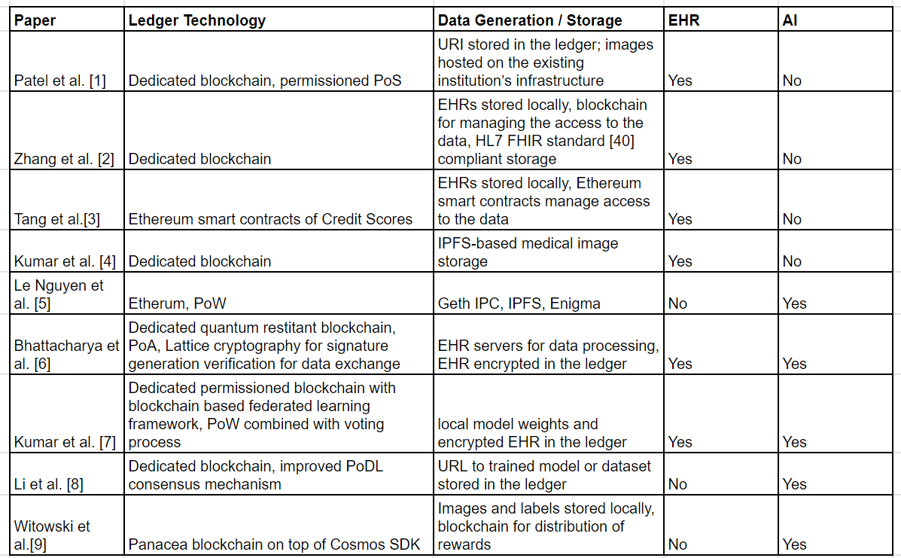
Literature Review

Slide 5
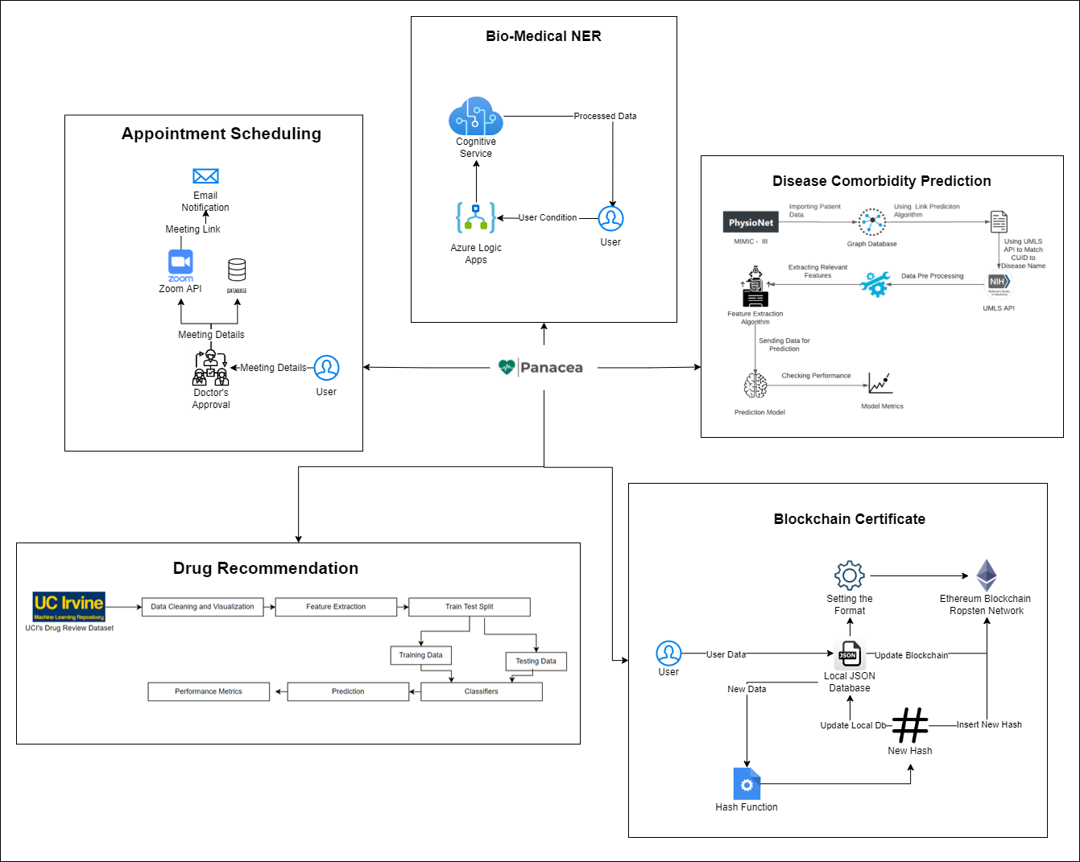
Architecture Diagram

Slide 6
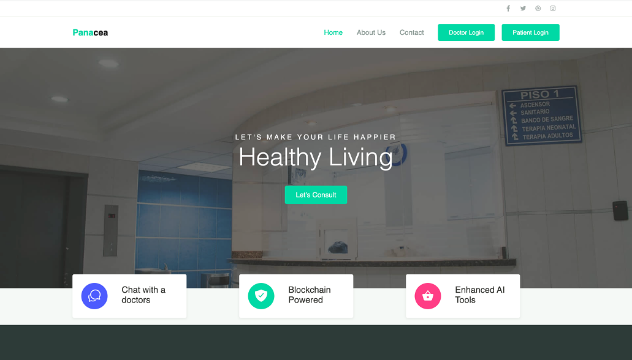
Implementation and Result Discussion

Slide 7
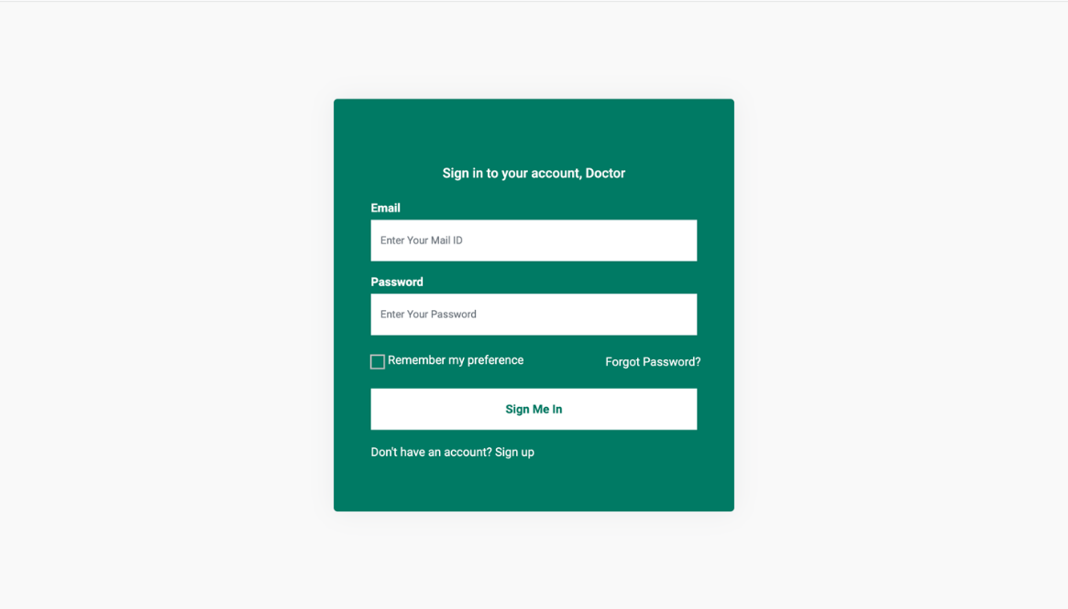
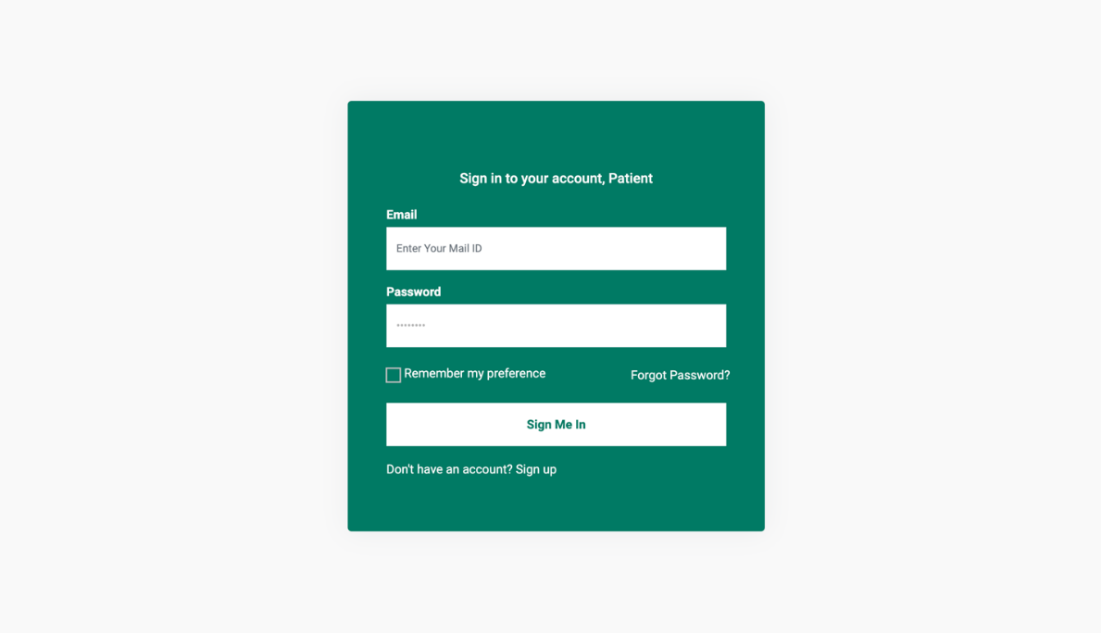
Implementation and Result Discussion

Slide 8
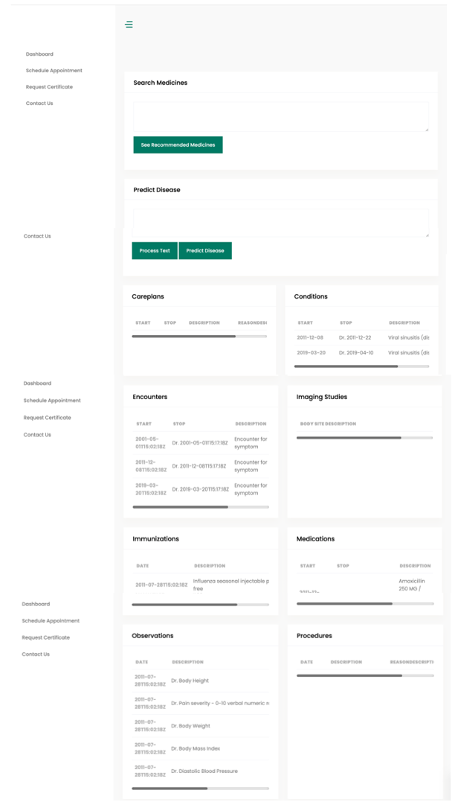
Implementation and Result Discussion

Slide 9
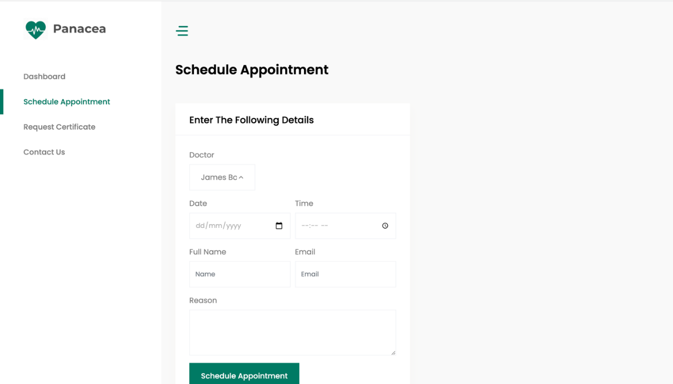

Implementation and Result Discussion

Slide 10
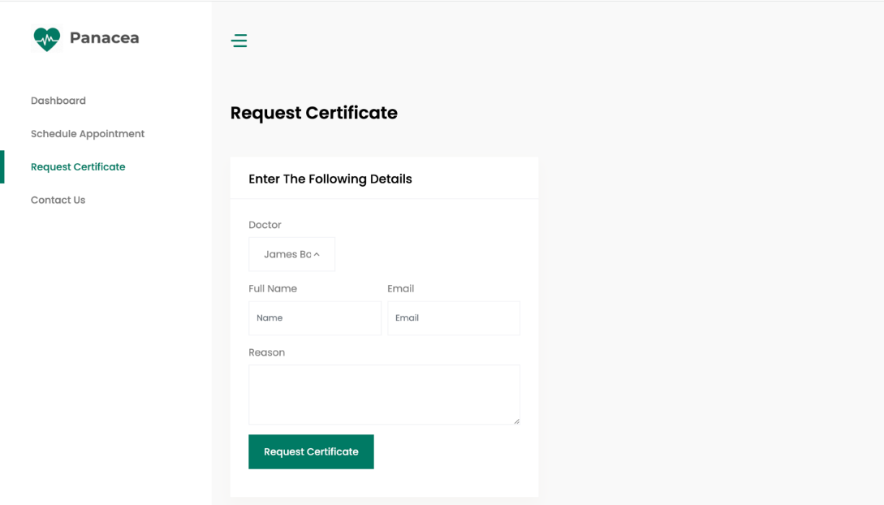
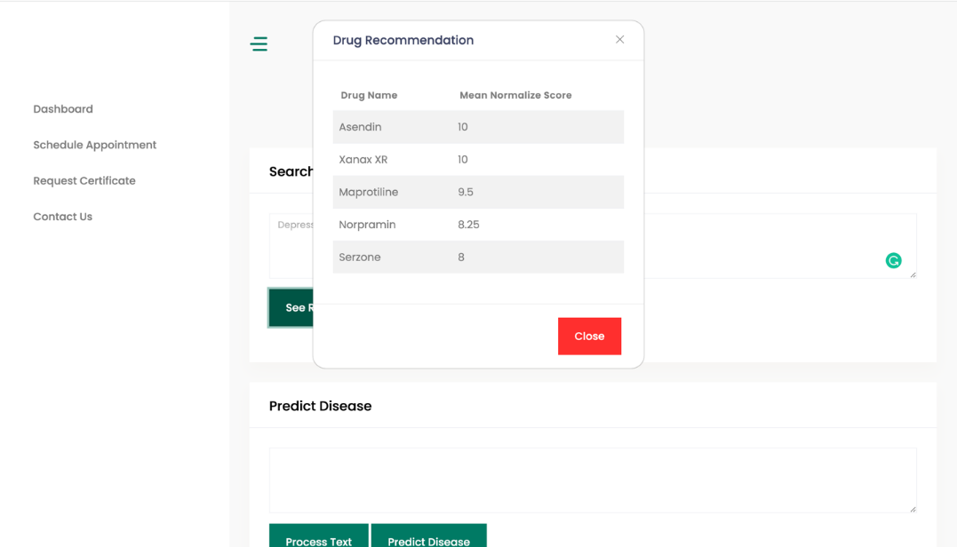
Implementation and Result Discussion

Slide 11
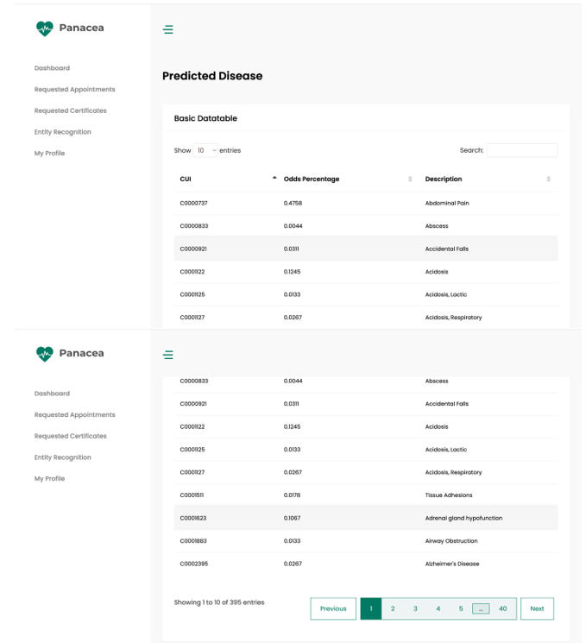
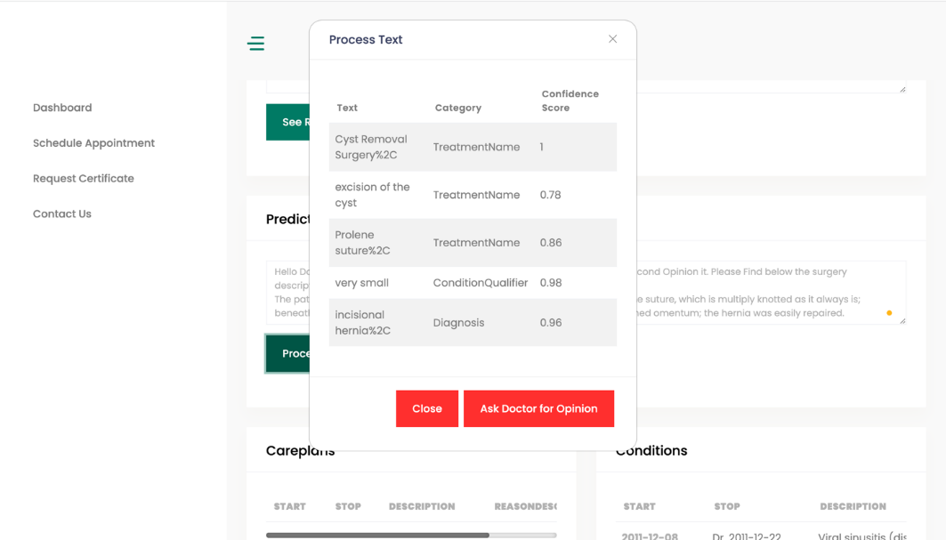
Implementation and Result Discussion

Slide 12
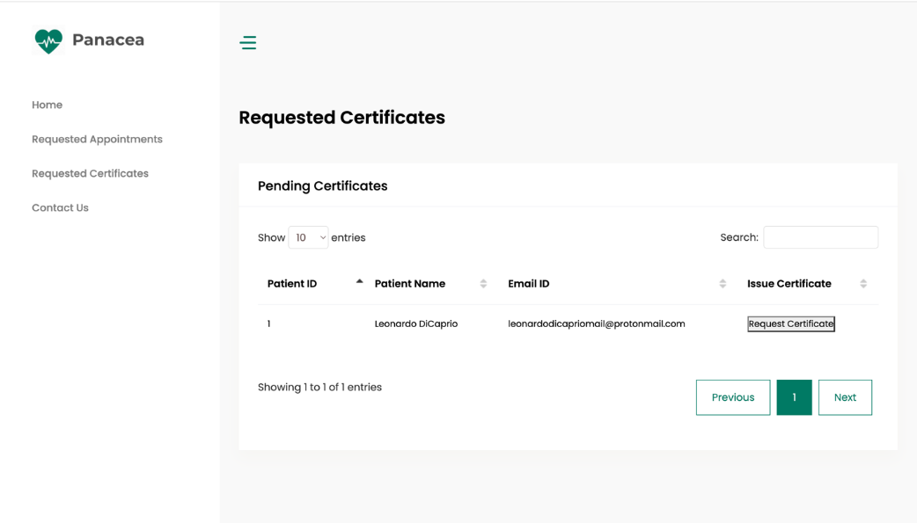
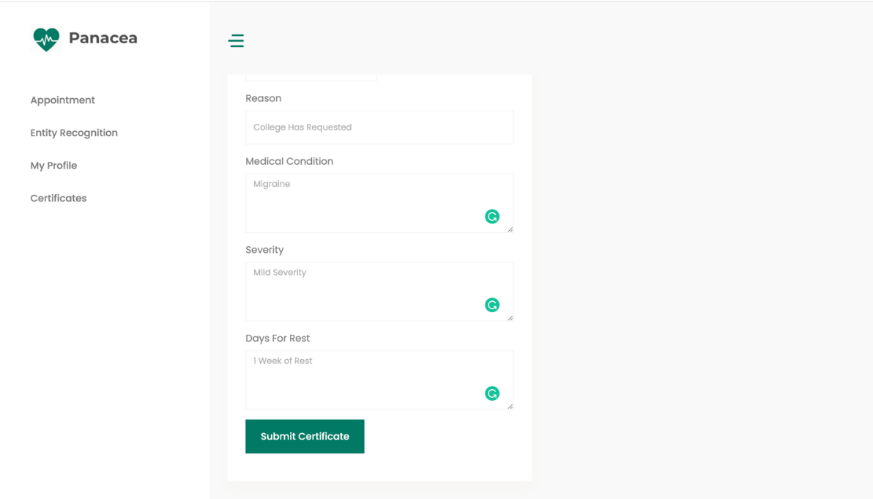
Implementation and Result Discussion

Slide 13
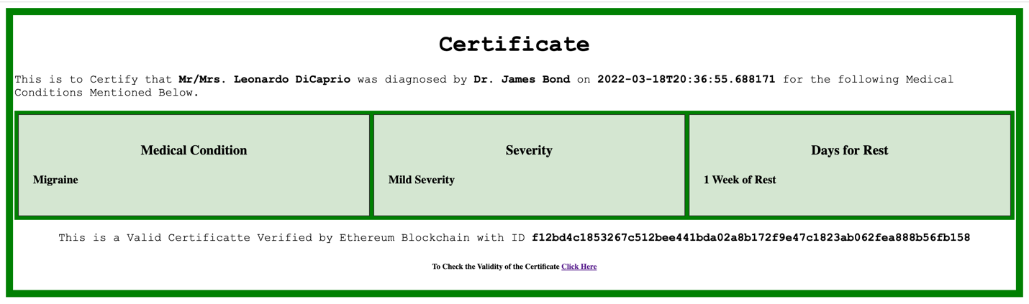
Implementation and Result Discussion

Slide 14
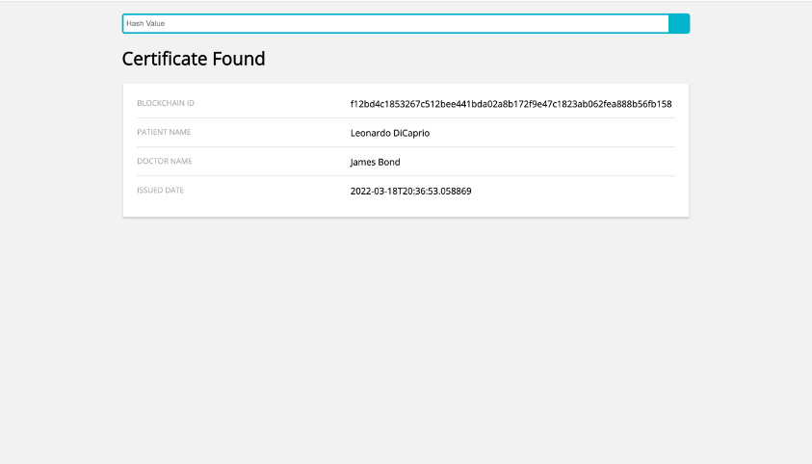
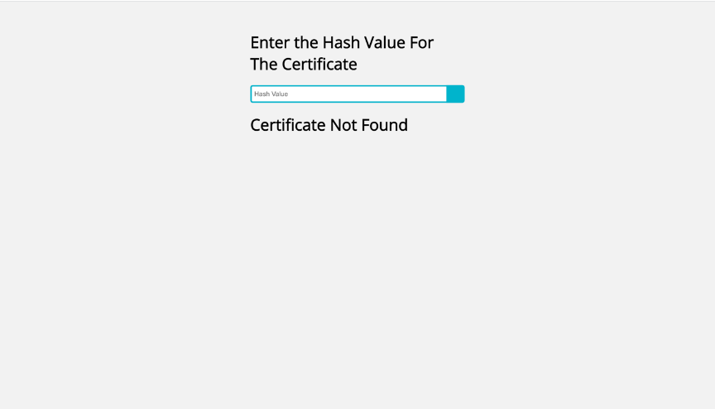
Implementation and Result Discussion

Slide 15
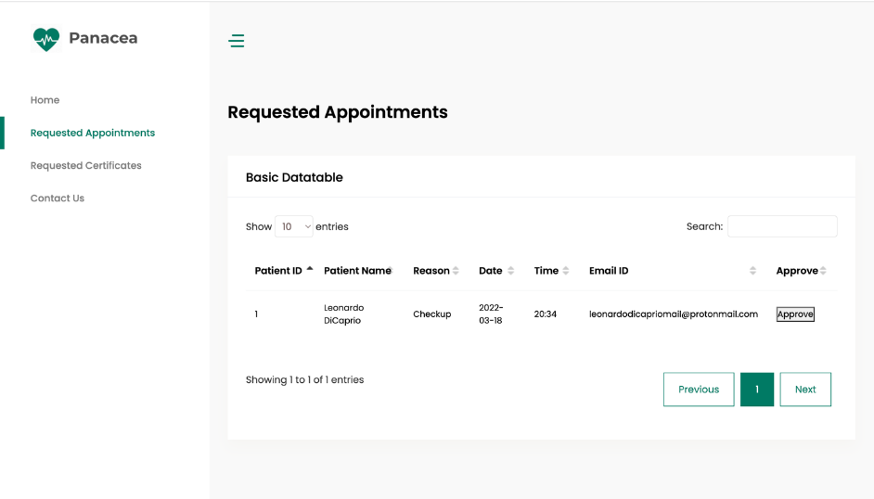
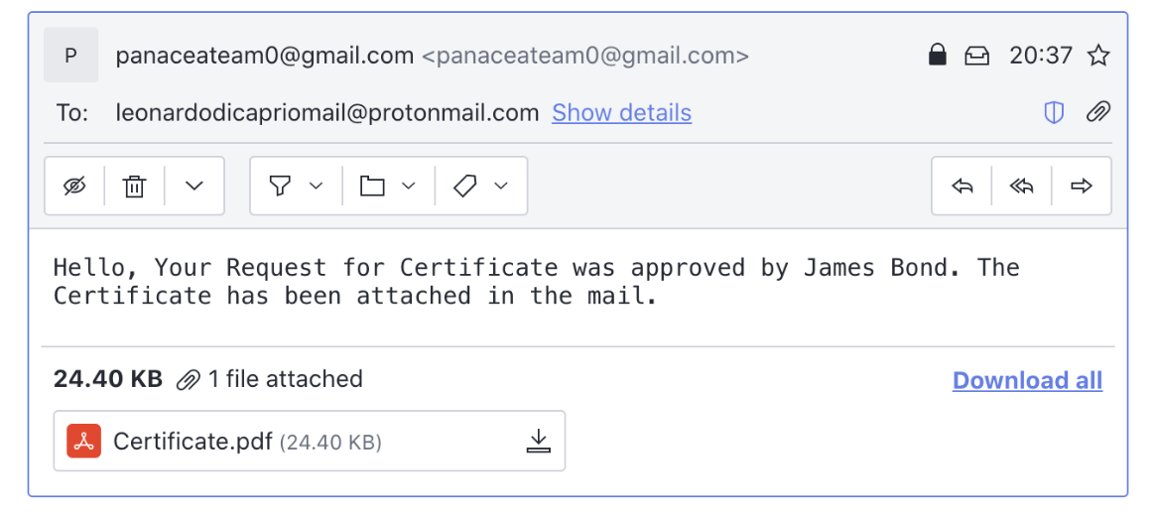
Implementation and Result Discussion

Slide 16
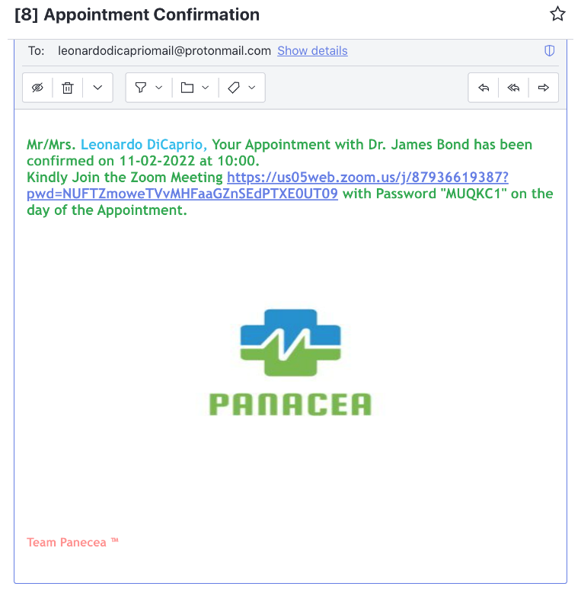
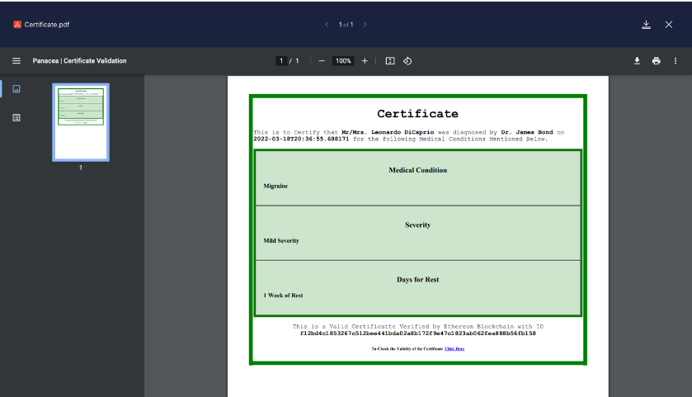
Implementation and Result Discussion

Slide 17
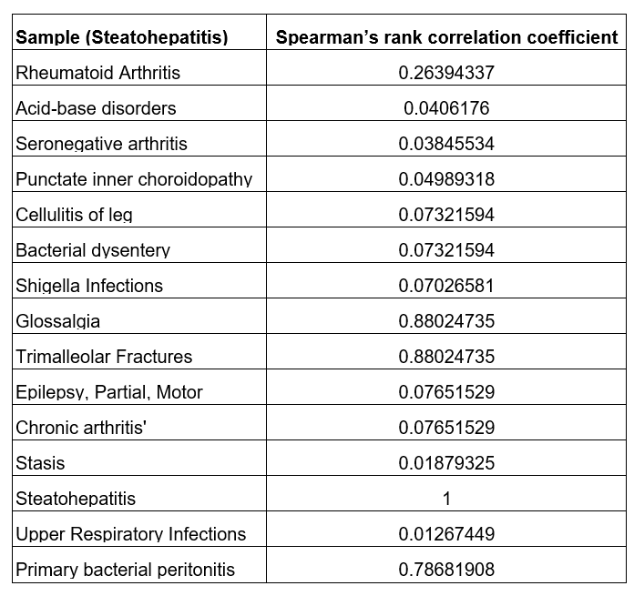
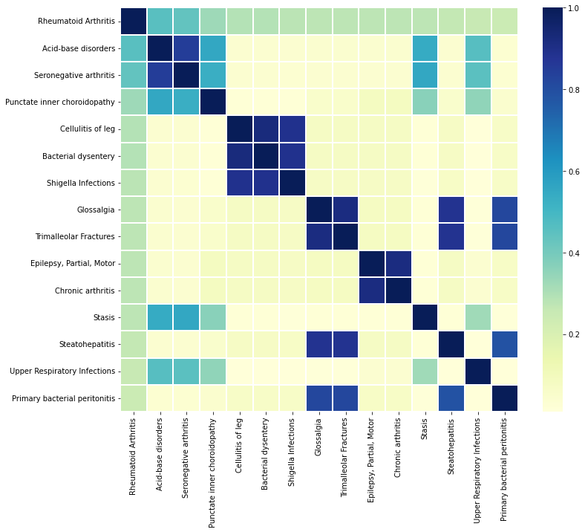
Implementation and Result Discussion
Post Recovery Comorbidity Prediction:
Using Spearman’s Rank Correlation Coefficient [23] as Performance Metrics.
Sample with Steatohepatitis and its comorbidities.
Correlation Matrix for Rheumatoid Arthritis with K = 15

Slide 18
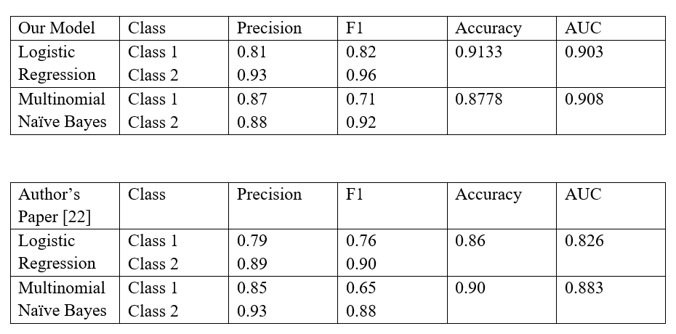
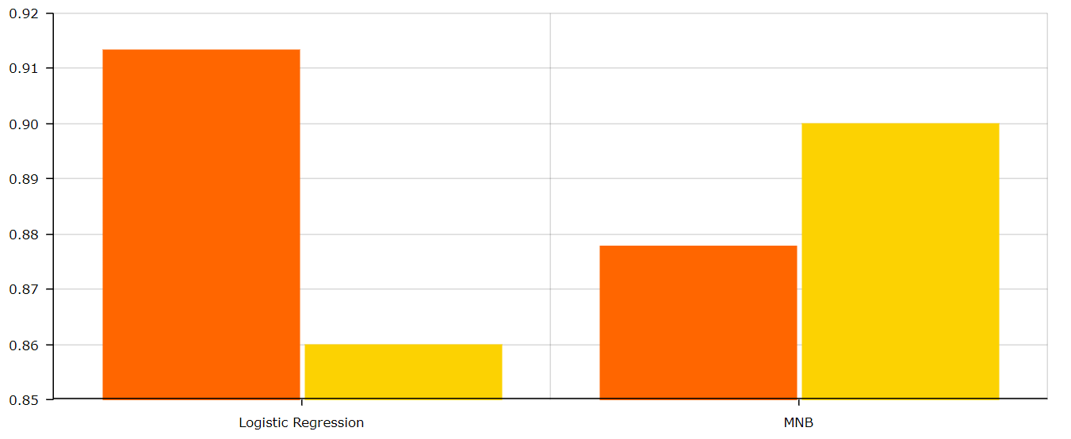
Implementation and Result Discussion
Drug Recommendation:
Model Metrics Comparison
Comparison of Accuracy between our model
( orange ) and author’s model ( yellow )

Slide 19
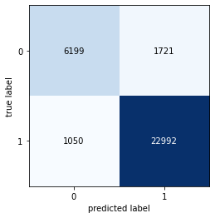
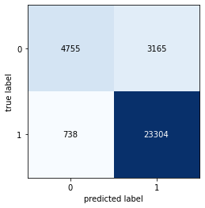
Implementation and Result Discussion
Drug Recommendation:
Logistic Regression Confusion Matrix
Multinomial Naïve Bayes Confusion Matrix

Slide 20
Implementation and Result Discussion
Medical NER:
Model | Accuracy
Spacy | 66%
Data Spacy | < 50%
Our Model | 73%

Slide 21
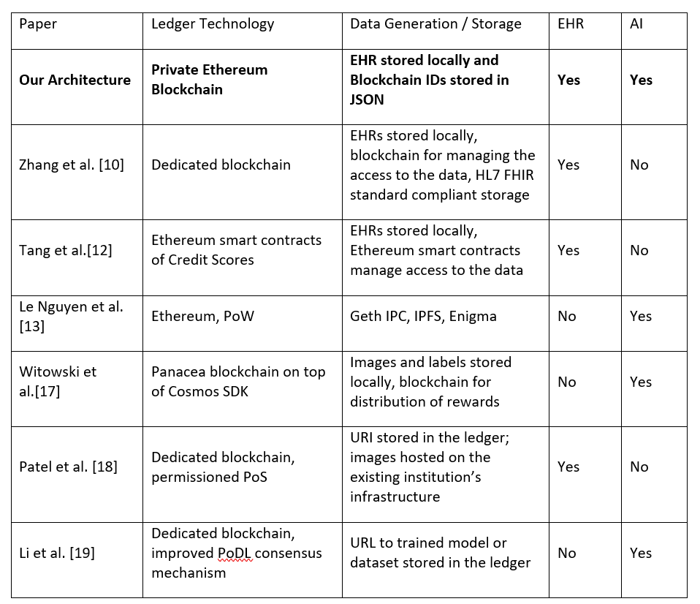
Implementation and Result Discussion
Blockchain EHR:
Comparison between our Architecture and Existing One

Slide 22
Implementation and Result Discussion
Review Paper: “A Survey on Applications of Machine Learning Algorithms in Healthcare”, Springer Lecture Notes in Networks and Systems,6Th International Conference on Advanced Computing and Intelligent Engineering( ICACIE 2021 ).
Final Implementation Paper: In Process for Approval at 7th International Conference Information, Communication & Computing Technology (ICICCT-2022)

Slide 23
Conclusion and Future Work
Conclusion:
In conclusion, an Advanced and secured AI-Blockchain powered EHR system aimed to enhance the existing healthcare system aiding the medical professionals to cure patients.
Future Work:
Since we have applied for and received the UMLS (Unified Medical Language System) license, the use of the knowledge rich data from UMLS dataset as backend would enhance the accuracy as well as increase the potential for additional medical functionalities in our application.
Learning graph database using neo4j during development of the project, the project can be further improved by using the graph database for creating and storing relationships between entities.

Slide 24
References
H. Cheng, C. Rong, K. Hwang, et al, “Secure big data storage and sharing scheme for cloud tenants,” China Communications, 2015, vol. 12, no. 6, pp. 106-115.
M. Shen, B. Ma, L. Zhu, et al, “Cloud-Based Approximate Constrained Shortest Distance Queries Over Encrypted Graphs With Privacy Protection,” IEEE Transactions on Information Forensics & Security, 2018, vol. 13, no. 4, pp. 940-953.
G. Zyskind, O. Nathan, A. Pentland, “Decentralizing Privacy: Using Blockchain to Protect Personal Data,” IEEE Security and Privacy Workshops. IEEE Computer Society, 2015, pp. 180-184.
A. Azaria, A. Ekblaw, T. Vieira, et al, “Med Rec: Using Blockchain for Medical Data Access and Permission Management,” International Conference on Open and Big Data. IEEE, 2016, pp. 25-30.
Q. Xia, E. Sifah, A. Smahi, et al, “BBDS: Blockchain-Based Data Sharing for Electronic Medical Records in Cloud Environments,” Information, 2017, vol. 8, no. 2, pp. 44-44.
K. Peterson, R. Deeduvanu, P. Kanjamala, et al. “A blockchain-based approach to health information exchange networks,” Proc. NIST Workshop Blockchain Healthcare, 2016, pp. 1-10.
A. Ekblaw, A. Azaria, J. D. Halamka, et al, “A Case Study for Blockchain in Healthcare: “Med Rec” prototype for electronic health records and medical research data,” Proceedings of IEEE Open & Big Data Conference. 2016, pp. 13: 13.
24

Slide 25
References
8. D. Fu, L. Fang, “Blockchain-based trusted computing in social network,” IEEE International Conference on Computer and Communications. IEEE, 2017, pp. 19-22.
9. Z. Liu, J. Weng, J. Li, J. Yang, C. Fu, C. Jia, “Cloud-based electronic health record system supporting fuzzy keyword search, “Soft Comput. 2016, vol. 20, no. 8, pp. 3243–3255.
10. P. Zhang, J. White, D. C. Schmidt, G. Lenz, and S. T. Rosenbloom, “FHIRChain: Applying Blockchain to Securely and Scalably Share Clinical Data,” Computational and Structural Biotechnology Journal, vol. 16, pp. 267–278, Jan. 2018.
11. D. Bender and K. Sartipi, “HL7 FHIR: An Agile and RESTful approach to healthcare information exchange,” in Proceedings of the 26th IEEE International Symposium on Computer-Based Medical Systems, pp. 326– 331, June 2013.
12. H. Tang, N. Tong, and J. Ouyang, “Medical Images Sharing System Based on Blockchain and Smart Contract of Credit Scores,” in 2018 1st IEEE International Conference on Hot Information-Centric Networking (HotICN), pp. 240–241, Aug. 2018.
13. T. Le Nguyen and T. T. H. Do, “Artificial Intelligence in Healthcare: A New Technology Benefit for Both Patients and Doctors,” in 2019 Portland International Conference on Management of Engineering and Technology (PICMET), (Portland, OR, USA), pp. 1–15, IEEE, Aug. 2019.
25

Slide 26
References
14. P. Bhattacharya, S. Tanwar, U. Bodke, S. Tyagi, and N. Kumar, “BinDaaS: Blockchain-Based Deep-Learning as-a-Service in Healthcare 4.0 Applications,” IEEE Transactions on Network Science and Engineering, pp. 1–1, 2020.
15. R. Kumar, A. A. Khan, J. Kumar, A. Zakria, N. A. Golilarz, S. Zhang, Y. Ting, C. Zheng, and W. Wang, “Blockchain-Federated-Learning and Deep Learning Models for COVID-19 detection using CT Imaging,” IEEE Sensors Journal, pp. 1–1, 2021.
16. W. Zheng, K. Wang, and F.-Y. Wang, “GAN-Based Key Secret-Sharing Scheme in Blockchain,” IEEE Transactions on Cybernetics, vol. 51, pp. 393–404, Jan. 2021.
17. J. Witowski, J. Choi, S. Jeon, D. Kim, J. Chung, J. Conklin, M. G. F. Longo, M. D. Succi, and S. Do, “MarkIt: A Collaborative Artificial Intelligence Annotation Platform Leveraging Blockchain For Medical Imaging Research,” BHTY, May 2021.
18. V. Patel, “A framework for secure and decentralized sharing of medical imaging data via blockchain consensus,” Health Informatics J, vol. 25, pp. 1398–1411, Dec. 2019.
19. B. Li, C. Chen, X. Xu, T. Jung, and Y. Shi, “Exploiting Computation Power of Blockchain for Biomedical Image Segmentation,” in 2019 IEEE/CVF Conference on Computer Vision and Pattern Recognition Workshops (CVPRW), (Long Beach, CA, USA), pp. 2802–2811, IEEE, June 2019
26

Slide 27
References
20. R. Kumar and R. Tripathi, “Building an IPFS and Blockchain-Based Decentralized Storage Model for Medical Imaging,” in Advancements in Security and Privacy Initiatives for Multimedia Images, pp. 19–40, IGI Global, 2021.
21. H. Wu, L. Li, H. -y. Paik and S. S. Kanhere, "MB-EHR: A Multilayer Blockchain-based EHR," 2021 IEEE International Conference on Blockchain and Cryptocurrency (ICBC), 2021, pp. 1-3, DOI: 10.1109/ICBC51069.2021.9461075.
22. S. Garg, "Drug Recommendation System based on Sentiment Analysis of Drug Reviews using Machine Learning," 2021 11th International Conference on Cloud Computing, Data Science & Engineering (Confluence), 2021, pp. 175-181, DOI: 10.1109/Confluence51648.2021.9377188.
23. Mukaka M. M. (2012). Statistics corner: A guide to the appropriate use of correlation coefficient in medical research. Malawi medical journal: the journal of Medical Associa-tion of Malawi, 24(3), 69–71
27

