Slide 1
Levenshtein Transformer s NeurIPS 2019
Chang Liu, Yunchang Yang

Slide 2
Overview
A novel sequence generation paradigm which is the first to facilitate not only parallel generation but also iterative sequence refinement using two iterative operations: deletion and insertion.
It is 3-4 times faster during inference (in MT) while keeping the performance almost matched with autoregressive methods.

Slide 3
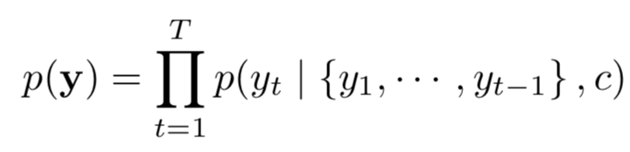
Autoregressive vs Non-autoregressive
Autoregressive
Training: parallel
Inference: step by step, time complexity: O(n)
Non-autoregressive
Training: parallel
Inference: parallel: time complexity: O(1), O(log(n)), O(C)…

Slide 4
Autoregressive vs Non-autoregressive
The trade-off between latency and quality.
Pure autoregressive generation methods generate texts with good quality but at a low speed. O(n)
Pure parallel generation methods (one pass decoding) dramatically speed up inference, but at a huge cost of performance degradation. O(1)
The sweet spot ⭐️: O(C)/O(log(n)) methods.
Where the inference latency and the generation quality can be balanced.
Here comes Levenshtein Transformer !

Slide 5
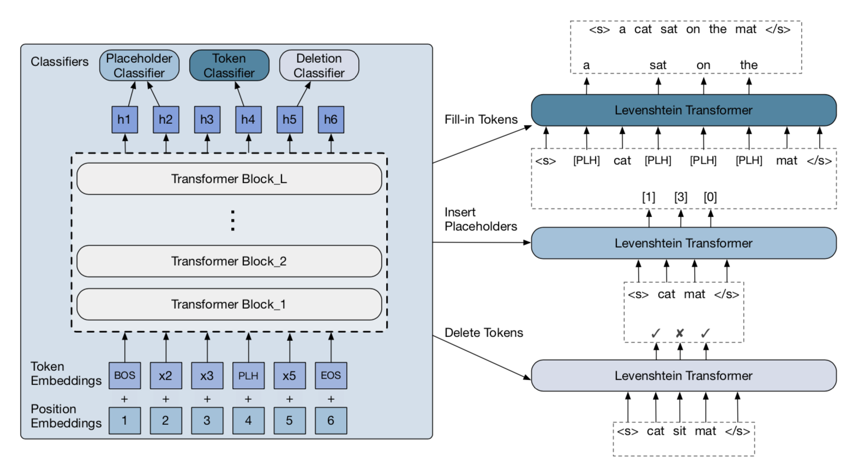
Model
Method: three steps in one iteration
Delete tokens
Insert placeholders
Fill-in tokens
In each step, the
predicting process
runs in parallel.

Slide 6
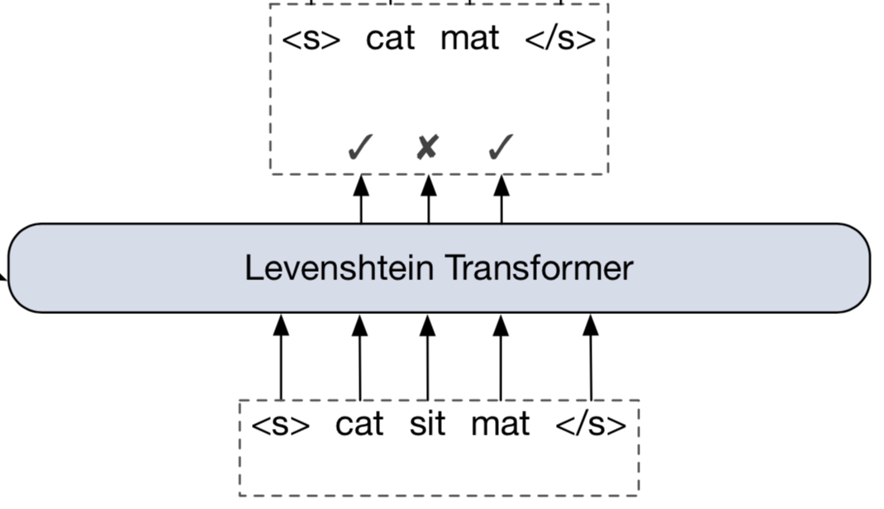

Model
Method: three steps in one iteration (1/3)
Delete tokens using a Deletion Classifier
This operation results in a new sequence, denoted as .

Slide 7
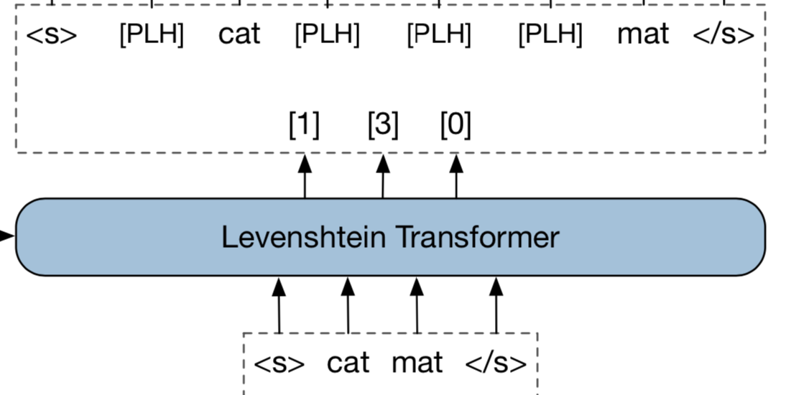

Model
Method: three steps in one iteration (2/3)
Insert placeholders using Placeholder Classifier
This operation results in a new sequence, denoted as .

Slide 8
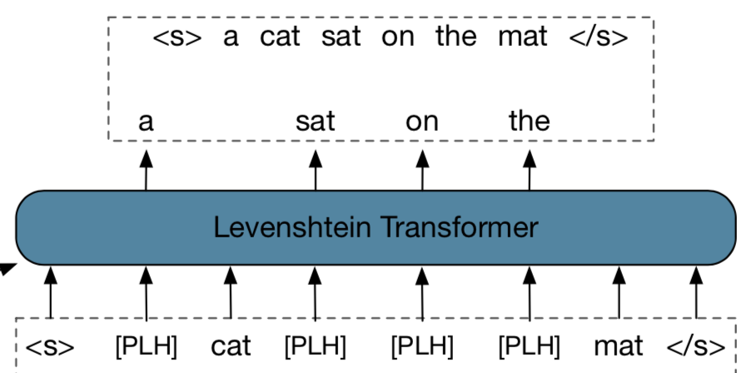
Model
Method: three steps in one iteration (3/3)
Fill-in tokens using Token Classifier
This operation results in a final sequence.

Slide 9
Miscellaneous
Weight sharing is in default. However, separated blocks for each classifiers can be leveraged.
"Early Exit" which attaches the classifiers to an intermediate block instead of the last to save computation.

Slide 10
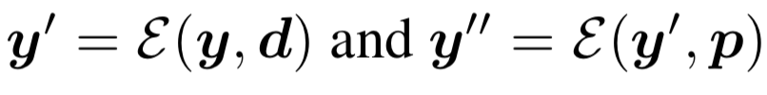

Training
Imitation learning learn from the expert policy $π^{∗}$
The policy for one iteration:
where

Slide 11
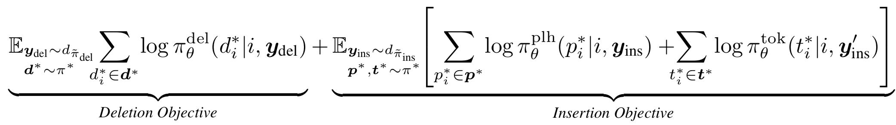
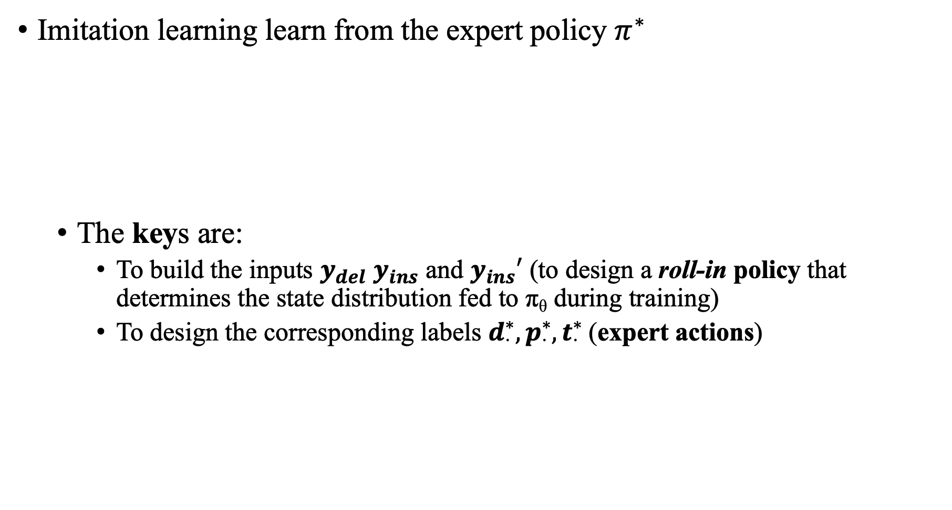
Training
Imitation learning learn from the expert policy $π^{∗}$
The keys are:
To build the inputs $y_{del}$ $y_{ins}$ and $y_{ins}′$ (to design a roll-in policy that determines the state distribution fed to π_{θ} during training)
To design the corresponding labels $d_{⋅}^{∗}, p_{⋅}^{∗}, t_{⋅}^{∗}$ (expert actions)

Slide 12
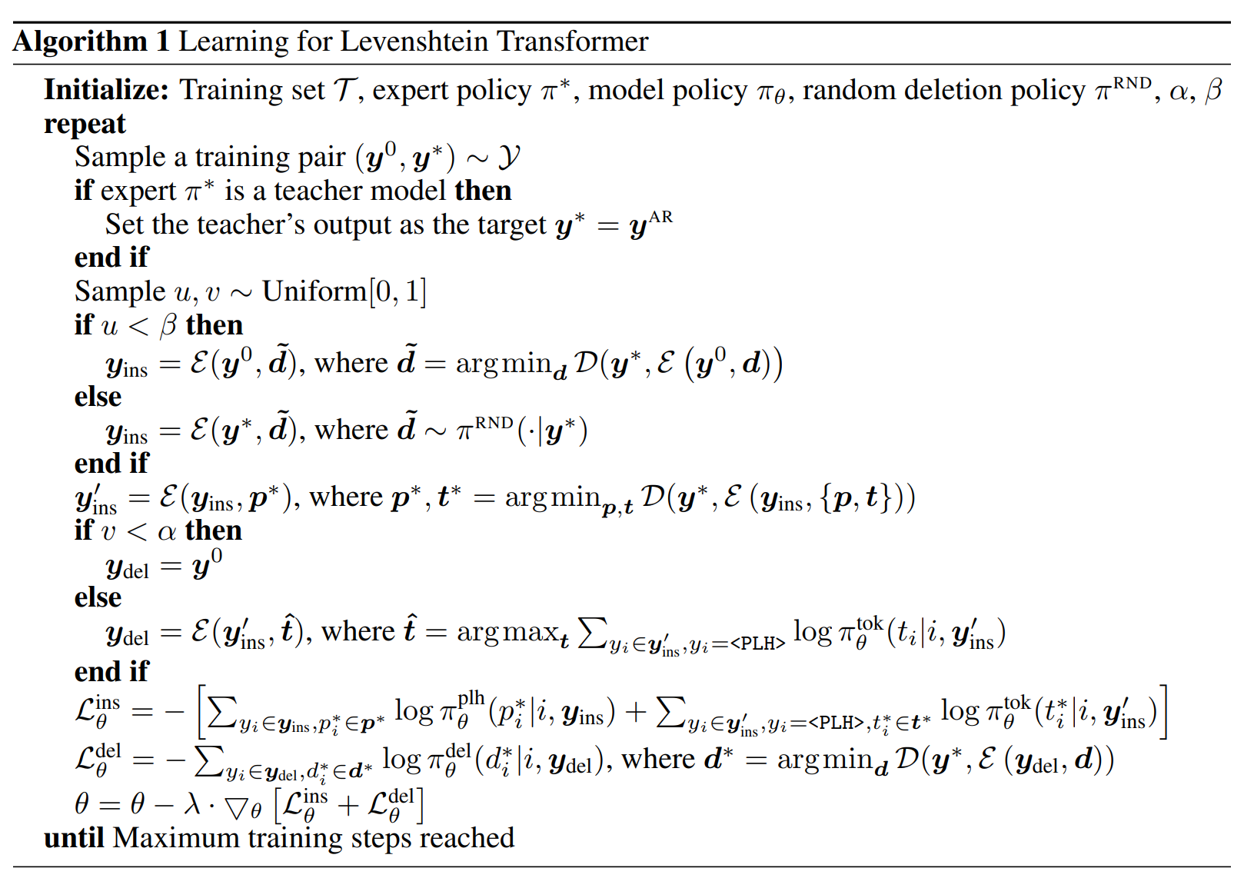
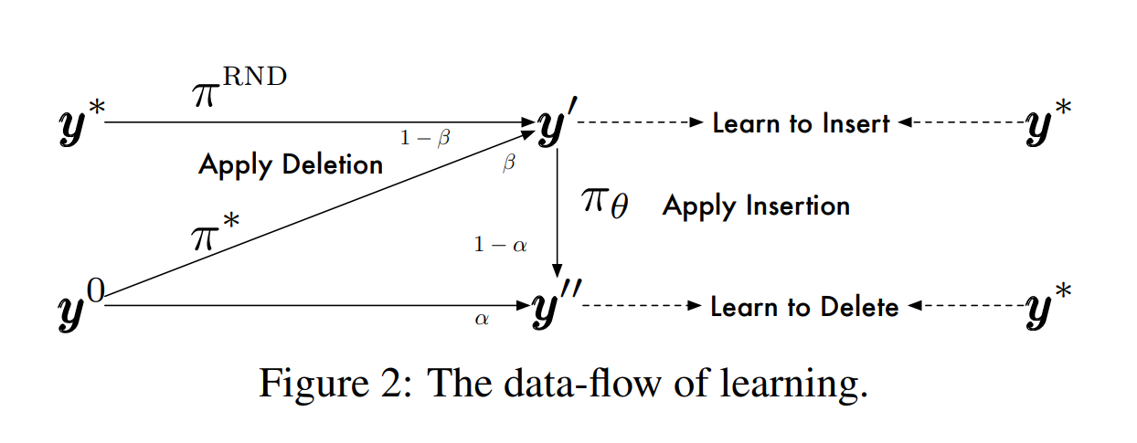


Training: the roll-in policy
placeholder
replace
delete
3
1
2
1
2
$${y^{′}=y}_{ins}$$
3
$${y^{′′}=y}_{ins}^{′}$$
Notes:
对于Insertion ph： 输入为y_ins。 beta概率用y_0 delete到y_*的结果，1-beta概率用y_*随机删除一些token。
对于token replacement： 输入为y_ins’。 为y_ins插入ground truth placeholder的情况。
对于deletion： 输入为y_del。 alpla概率用y_0，1-alpha概率用y_ins’由模型为所有ph位置sample一个token后的。

Slide 13
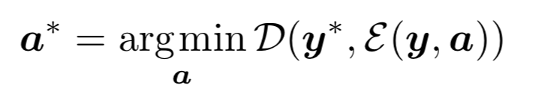
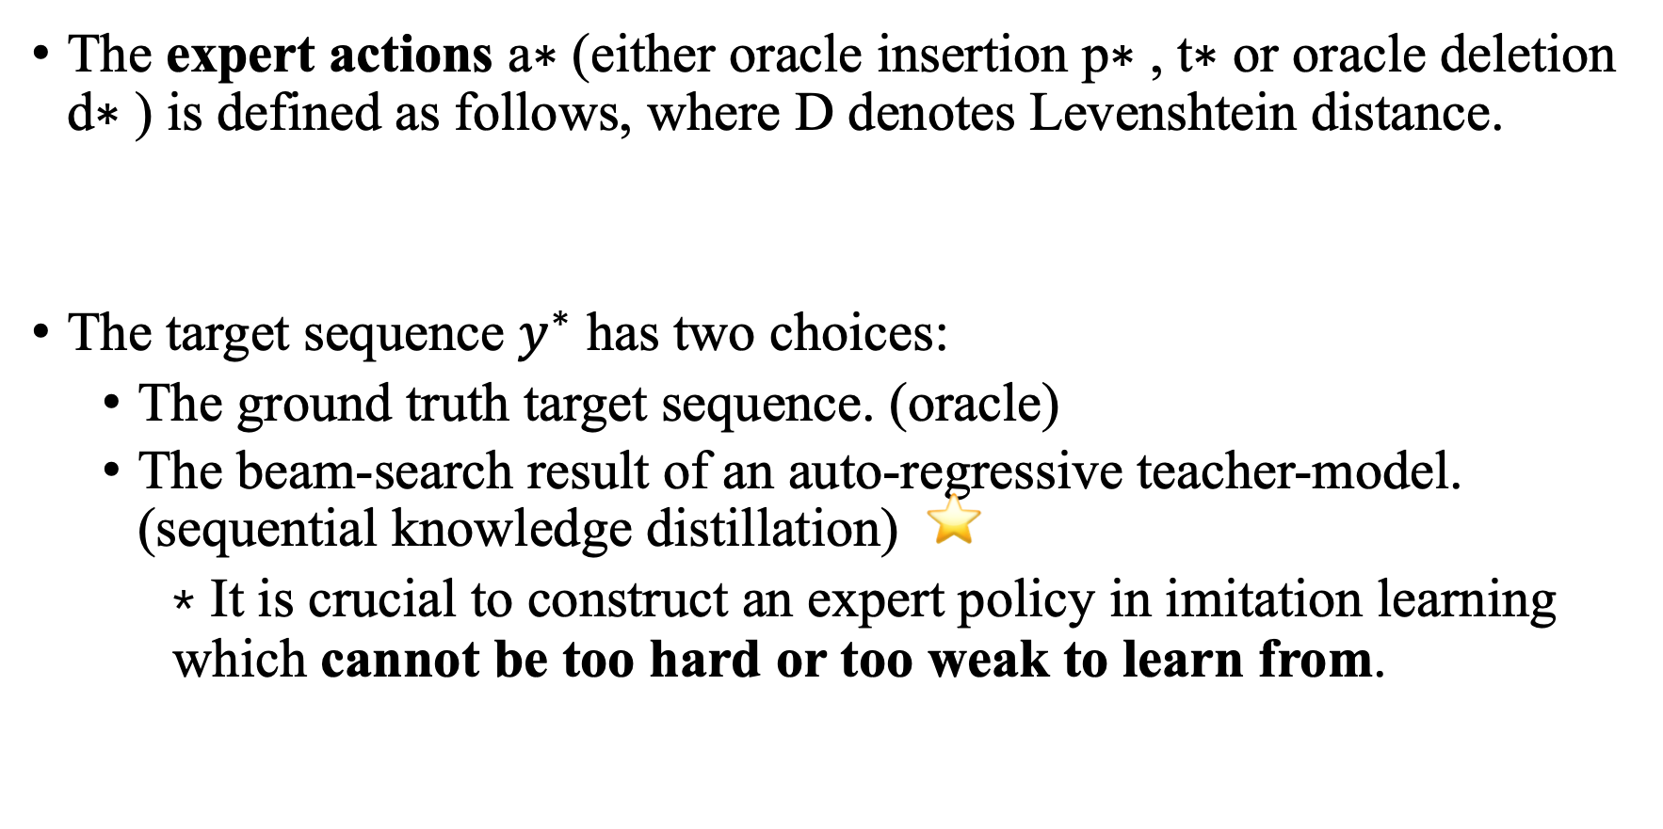
Training: the expert action
The expert actions a∗ (either oracle insertion p∗ , t∗ or oracle deletion d∗ ) is defined as follows, where D denotes Levenshtein distance.
The target sequence $y^{∗}$ has two choices:
The ground truth target sequence. (oracle)
The beam-search result of an auto-regressive teacher-model. (sequential knowledge distillation) ⭐️
* It is crucial to construct an expert policy in imitation learning which cannot be too hard or too weak to learn from.

Slide 14
Inference
Greedy decoding:
Greedily pick up the actions associated with the highest probabilities in all the three classifiers.
Termination condition:
Looping: if two consecutive refinement iterations return the same output.
Timeout: when reaches the maximum number of iterations.

Slide 15
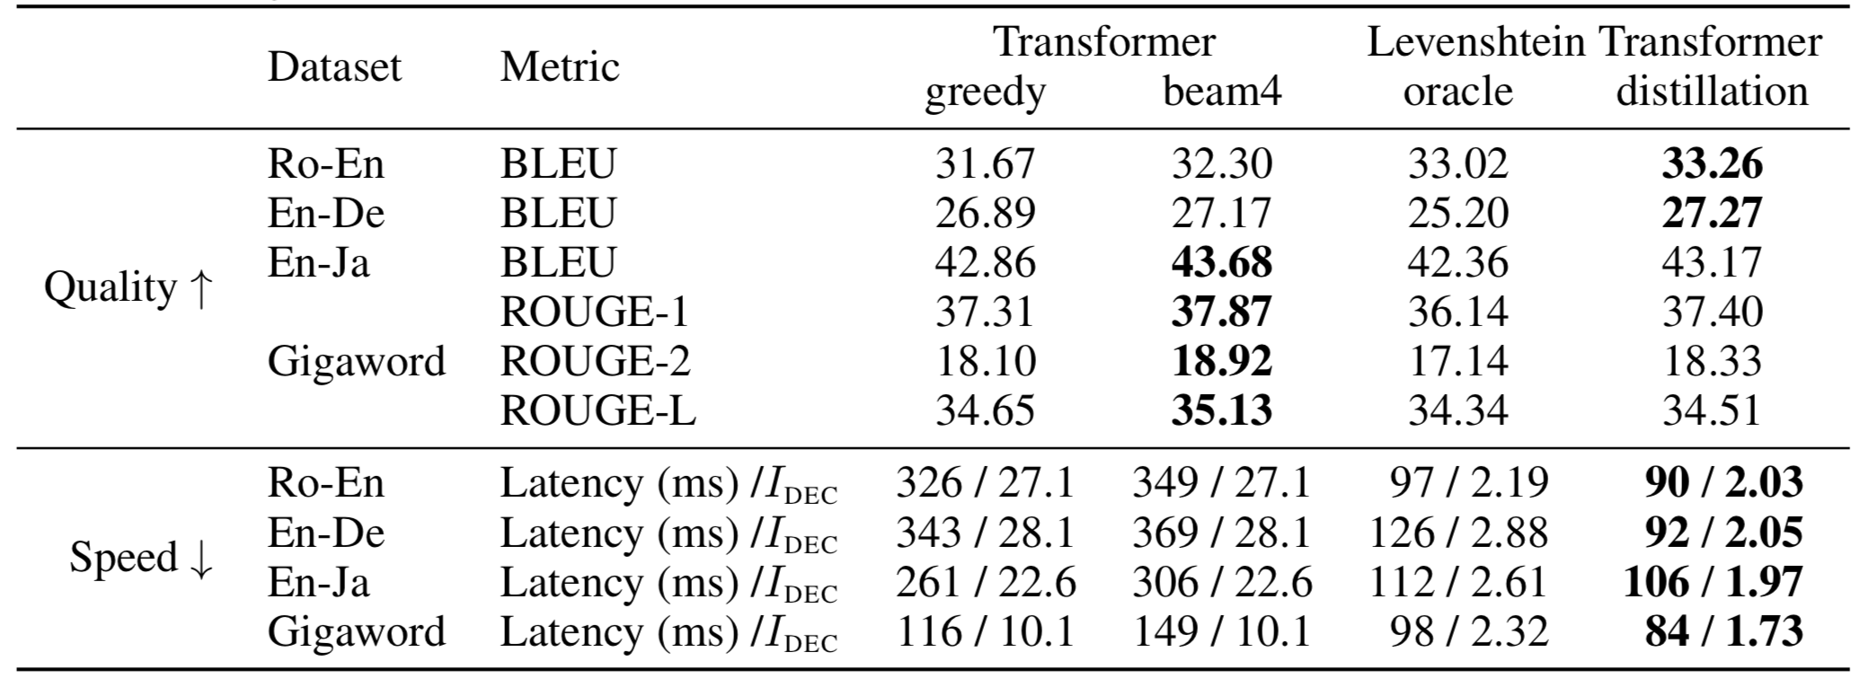
Experiments
Generation (machine translation / summarization)

Slide 16
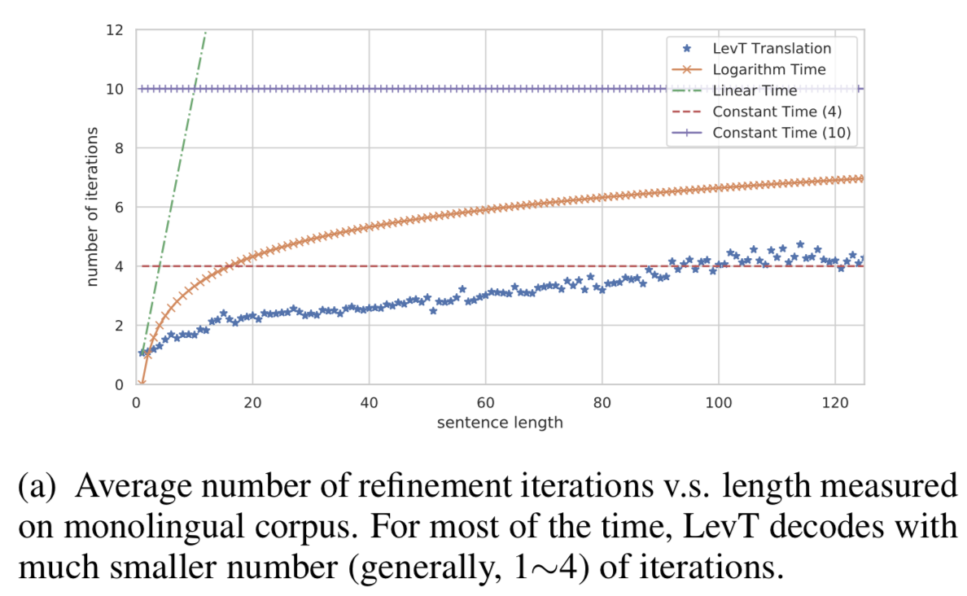
Experiments
Generation (machine translation / summarization)
Analysis of decoding speed

Slide 17
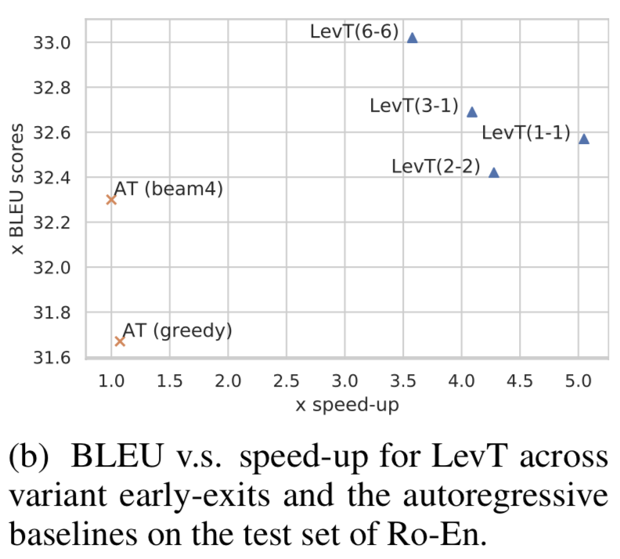
Experiments
Generation (machine translation / summarization)
Trade-off between performance and speed in terms of early exiting strategies.
recall: Early Exiting:
which attaches the classifiers
to an intermediate block instead
of the last to save computation.
LevT(m-n): m block for deletion;
n for placeholder prediction

Slide 18
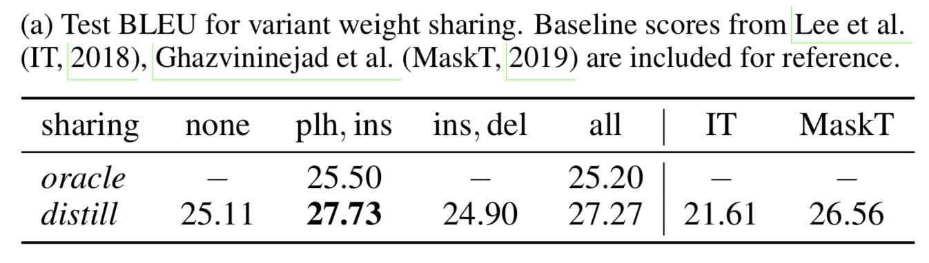
Experiments
Generation (machine translation / summarization)
Analysis of weight sharing
recall: Weight sharing is in default. However, separated blocks for each classifiers can be leveraged.

Slide 19
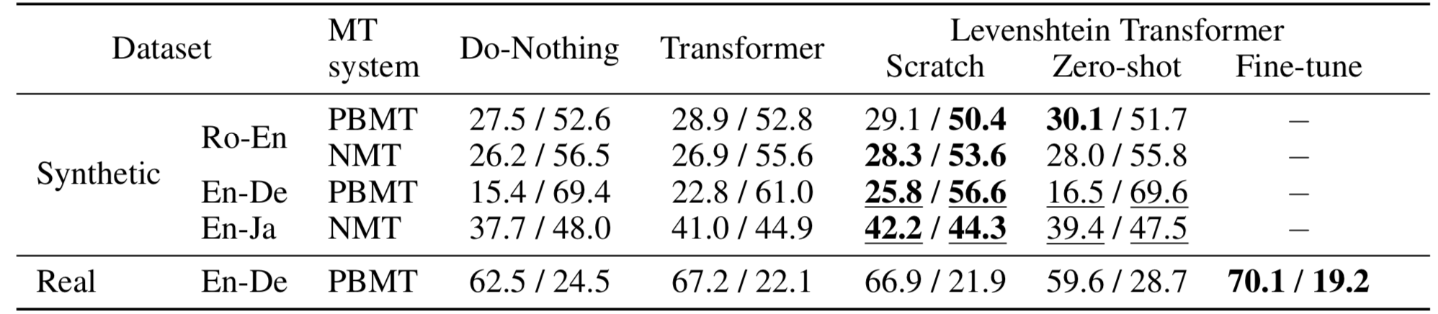
Experiments
Sequence refinement (automatic post editing)

Slide 20
Thanks for listening!

