Slide 1
Neural Machine Translation with Permutation Language Modeling
Chang Liu, Yunchang Yang

Slide 2
Outline
Perliminaries
Permutation language modeling: generalized autoregressive objective.
Two Stream Attention (TSA).
Our model: NMT-PLM
Motivation.
Incorporating two stream attention in to Seq2Seq Transformer.
Training with random and forward factorization.
Curriculum switching from random factorization to forward factorization.
Permutation language modeling as auxiliary task. (Multitasking)
Self-reranking with sampled factorization order.
Conclusion and Future work

Slide 3
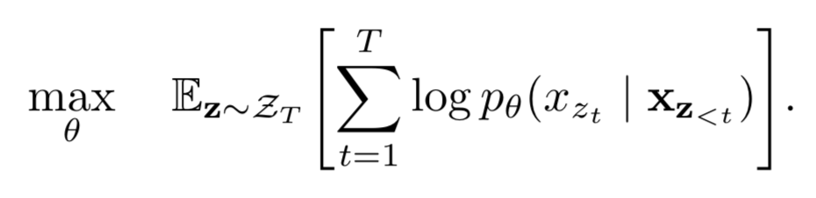
Perliminaries
Permutation language modeling
Generalized autoregressive language modeling objective.
Let Z_{T} be the set of all possible permutations of the length-T index sequence [1, 2, . . . , T ]. We use z_{t} and z_{<t} to denote the t-th element and the first t−1 elements of a permutation z ∈ Z_{T} .
Essentially, for a text sequence x, we sample a factorization order z at a time and decompose the likelihood p_{θ} (x) according to factorization order.
Note that we only permutes the factorization order, not the sequence order.

Slide 4
Perliminaries
Traditional autoregressive decoder
Using the previous generated tokens as the input query to predict the next token.
This paradigm only works on fixed factorization order.
For random factorization order, we need to use the positional information (and not token information) of the predicted position as query to perform attention. To fulfill this constraint and enable parallel training, we use Two Stream Attention (TSA) mechanism.

Slide 5
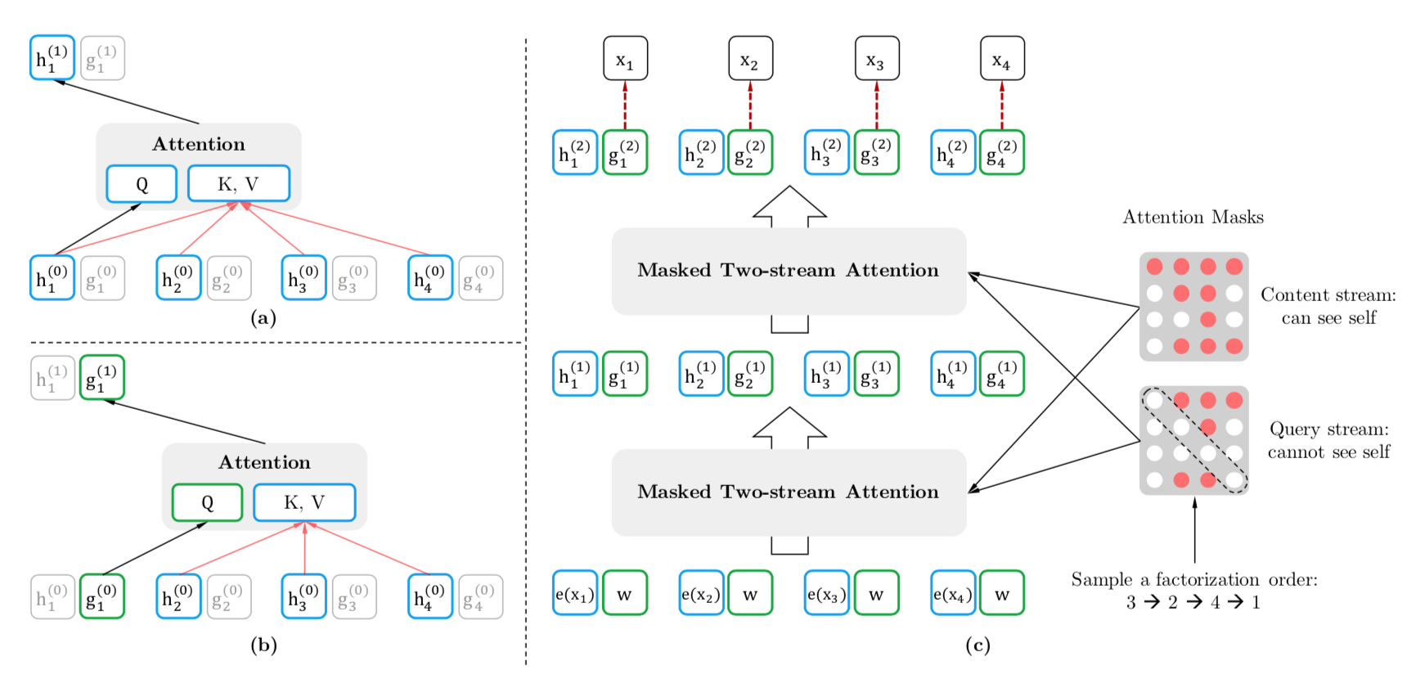
Perliminaries
Two stream attention

Slide 6
NMT-PLM
Motivation
XLNet, which adopts permutation language modeling for pretraining, shows remarkable performance in NLU tasks. Considering its autoregressive nature, we wonder if this objective can be useful in text generation tasks. It has the following advantages:
Given a target sentence with length n, we can sample n! permutation orders for training, which shares the same spirits with data augmentation.
Self-reranking by sampling multiple permutation orders. (which cannot be done by forward LM.)
Generation with arbitrary orders. (non-left-to-right generation) *
So we begin with the neural machine translation task. (IWSLT14 De-En)

Slide 7
NMT-PLM
Implementation: Transformer with two stream attention and permutation
Encoder unchanged.
Decoder: replace traditional transformer decoder attention with two stream cross-attention.
For the permutation objective:
Instead of manipulating the attention mask matrix as the original XLNet paper suggests, we do permutation in the following steps:
Given a target sentence, randomly sample a permutation order.
Jointly permutate the target sentence as well as its original positions (positional encoding).
Feed the permutated tokens as well as its permutated positions to the decoder modified using two stream cross-attention.

Slide 8
NMT-PLM
Training with random and forward factorization, and generating with forward factorization.
Two stream attention is comparable with traditional transformer decoder attention.
Training with random factorization order result in performance degradation. It needs more epochs to converge. We wonder if the model learns more powerful features in this stage through observing much more “data”, so we test whether it would perform better when finetuned to forward training.
Model | BLEU
Transformer-Fairseq | 34.75
Transformer-TSA-Random | 33.75(-1.00)
Transformer-TSA-Forward | 34.84 (+0.09)

Slide 9
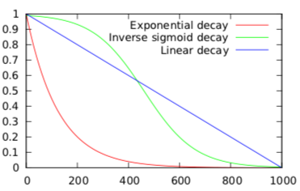
NMT-PLM
Curriculum finetuning from random factorization to forward factorization.
Inverse sigmoid decay: α = k/(k+exp(i/k)) (the green curve)
α proportion of tokens in a sentence (denoted as Curriculum-Sent) or
α proportion of sentences in a batch (denoted as Curriculum-Batch)
are randomly permutated while the remains (tokens/sentences) left unchanged.
Model | BLEU
Transformer-Original | 34.75
Transformer-TSA-Random | 33.75 (-1.00)
Transformer-TSA-Forward (baseline) | 34.84 (+0.09)
Transformer-TSA-Random-Ft-Forward | 35.13 (+0.38)
Transformer-TSA-Curriculum-Batch | 35.30 (+0.55)
Transformer-TSA-Curriculum-Sent | 35.43 (+0.68)

Slide 10

NMT-PLM
Permutation language modeling as auxiliary task.
Using permutation language modeling as auxiliary objective to perform multitasking. $L=Lforward+ \text{λ} Lrandom$
(Here we sample one random factorization order for each target sentence for the calculation of the second term. More factorization orders might boost further.)
Model | BLEU
Transformer-Original | 34.75
Transformer-TSA-Random | 33.75 (-1.00)
Transformer-TSA-Forward (baseline) | 34.84 (+0.09)
Transformer-TSA-Random-ft-Forward | 35.13 (+0.38)
Transformer-TSA-Curriculum-Batch | 35.30 (+0.55)
Transformer-TSA-Curriculum-Sent | 35.43 (+0.68)
Transformer-TSA-Multitask | 35.66 (+0.91)

Slide 11
NMT-PLM
Self-reranking with sampled factorization order.
After beam search, we randomly sample n (n=10 here) factorization orders and calculate the averaged log probabilities (score) of all candidates in the beam using our model itself, and select the one with the highest score.
Model | BLEU
Transformer-Original | 34.75
Transformer-TSA-Random | 33.75 (-1.00)
Transformer-TSA-Forward (baseline) | 34.84 (+0.09)
Transformer-TSA-Random-ft-Forward | 35.13 (+0.38)
Transformer-TSA-Curriculum-Batch | 35.30 (+0.55)
Transformer-TSA-Curriculum-Sent | 35.43 (+0.68)
Transformer-TSA-Multitask | 35.66 (+0.91)
Transformer-TSA-Multitask-self_reranking | 35.86 (+1.11)

Slide 12
Discussion and Future work
Why does it work?
It works as a kind of implicit data (mode) augmentation, compared with EDA, this method doesn’t introduce any noise.
Unfixed factorization order is much harder than a fixed order to learn, thus incorporating PLM objective enforces a more powerful encoder.
What will we do next
To experiment on larger datasets such as WMT14De-En.
To test whether the encoder learns better representations through downstream tasks.
To try generation with non-left-to-right orders.
Using XLNet to initialize the decoder.

Slide 13
Thanks for listening!

