Slide 1
IM-Net¹ and Sampling Optimization
Hongda Jiang
1. Chen Z, Zhang H. Learning implicit fields for generative shape modeling[C]//Proceedings of the IEEE Conference on Computer Vision and Pattern Recognition. 2019: 5939-5948.

Slide 2
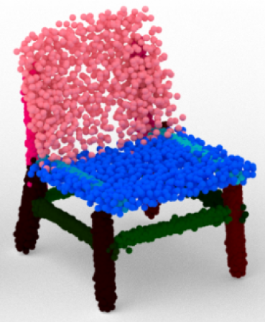

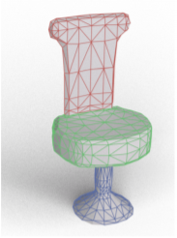

IM-Net
Point Cloud
Voxel
Mesh
SDF

Slide 3
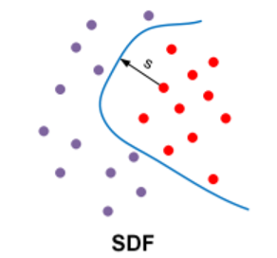


IM-Net
Signed Distance Function
F ( ) = 0 / 1 ?

Slide 4
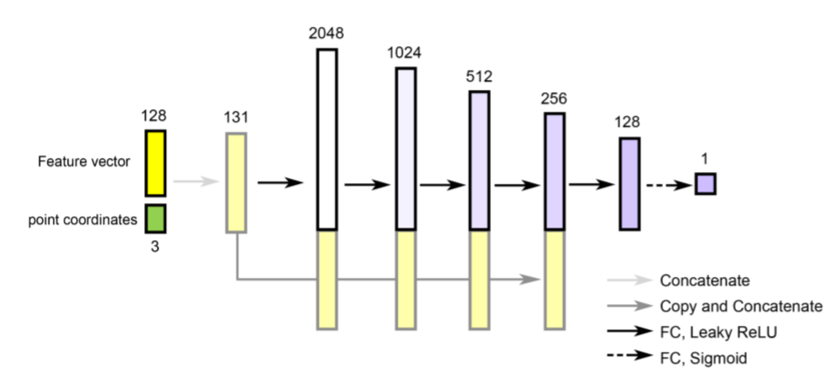
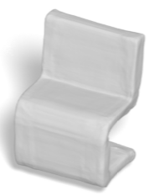
Network Structure
Encoder

Slide 5
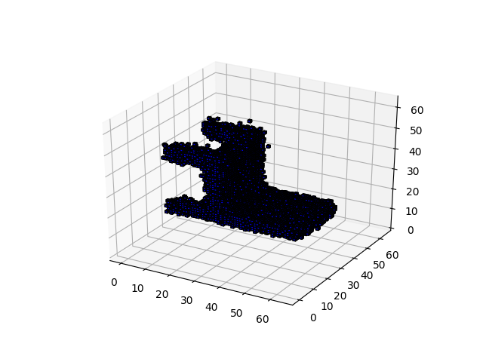
Multi-scale Sampling
Voxel : 64*64*64 ≈ 260,000
(16, 16, 16) → (32, 32, 32) → (64, 64, 64)
Point Sampling
16 → points near surface 1,000
32 → points near surface 10,000
64 → points near surface 100,000

Slide 6
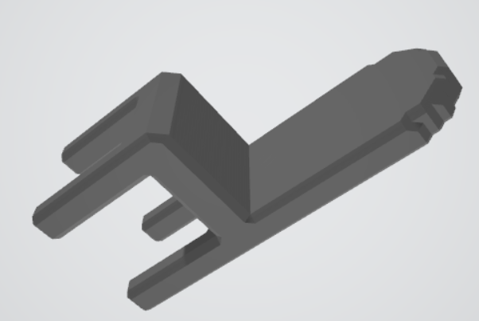
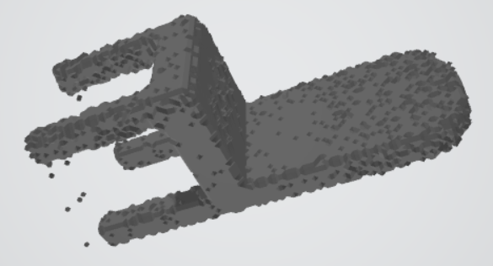
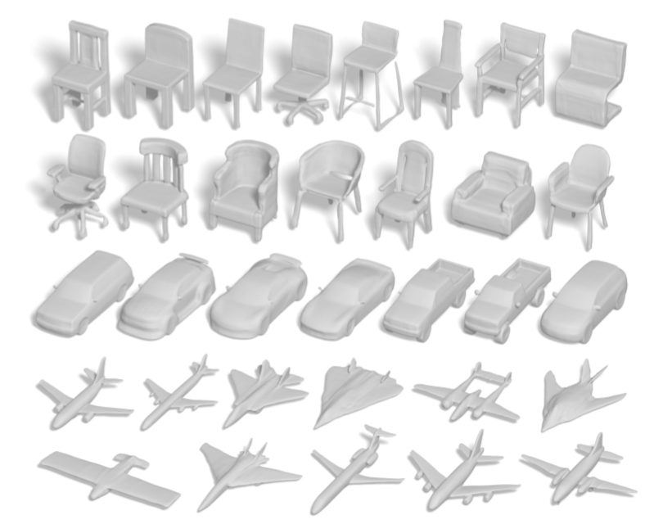
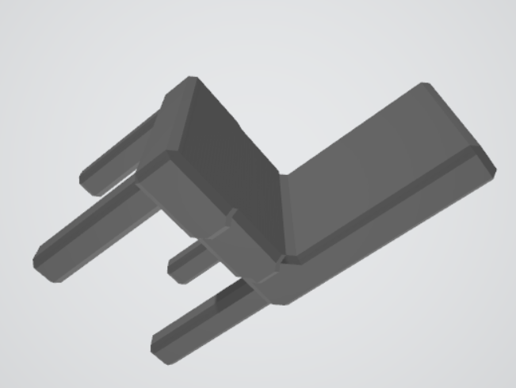
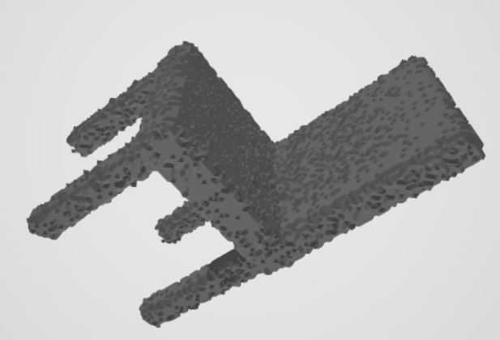
Current Result
Groundtruth
My result

Slide 7
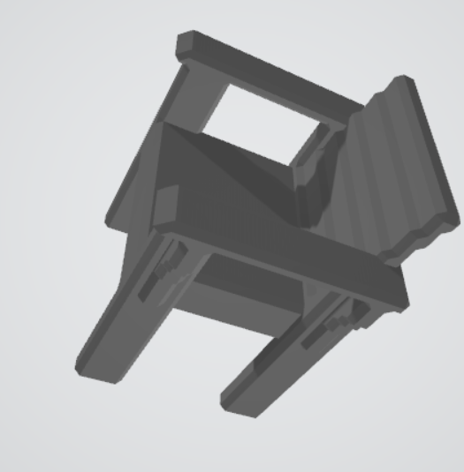
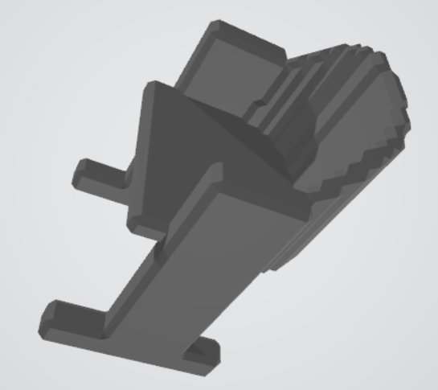
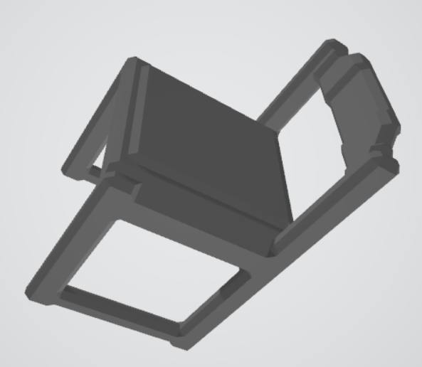
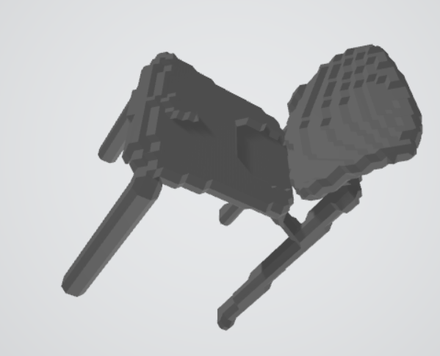
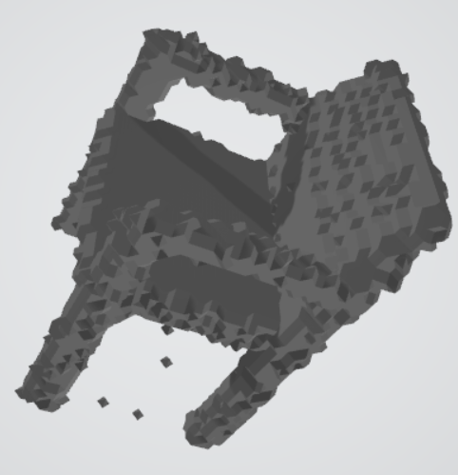
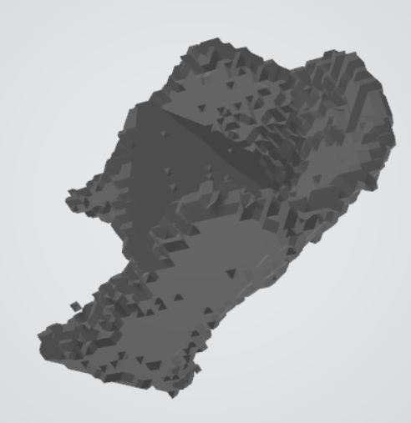
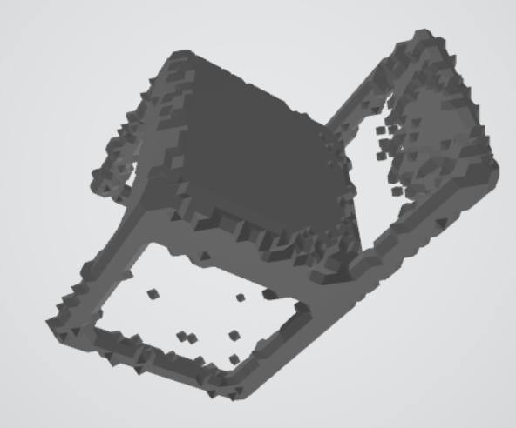
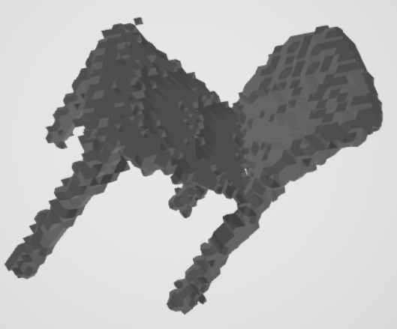
More result

Slide 8
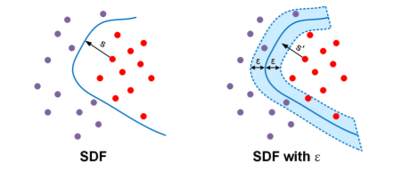
Issue Plan to do
Noise on surface -- increase sampling resolution
Optimize sampling method
Soft boundary – coarse to fine

Slide 9
Thanks for Listening

